Slide 1

Enhancing discoverability of the European Directory of Marine Environmental Data (EDMED) with schema.org
Alexandra Kokkinaki (1), Justin Buck (1), Adam Leadbetter (2), Rob Thomas (2), and Mark Hebden (1)
British Oceanographic Data Centre, National Oceanography Centre, LIVERPOOL, UK
Marine Institute (Ireland)

Slide 2
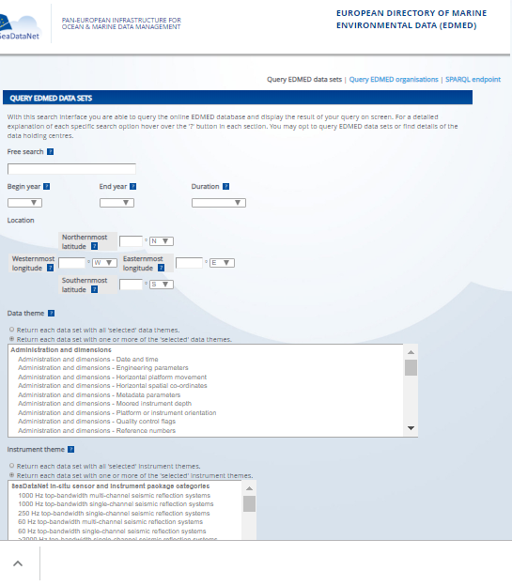
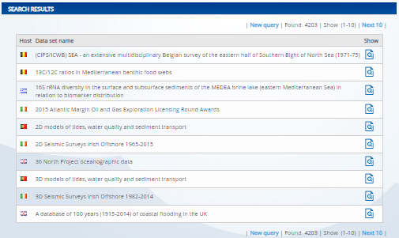
European Directory of Marine Environmental Data (EDMED)
“Is a comprehensive reference to the marine data sets and collections held within European research laboratories, so as to provide marine scientists, engineers and policy makers with a simple mechanism for their identification.”
Over 4200 data sets
Over 700 organisations
Submitted to BODC
As XML records
EDMED metadata format, based on ISO 19115
Notes:
You can search through EDMED

Slide 3
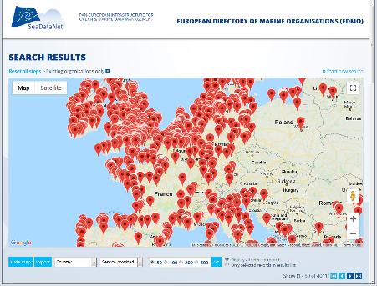
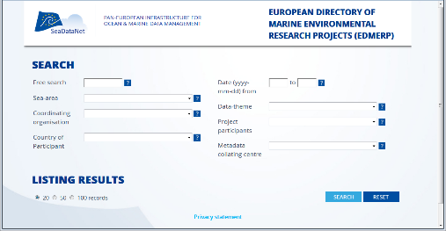
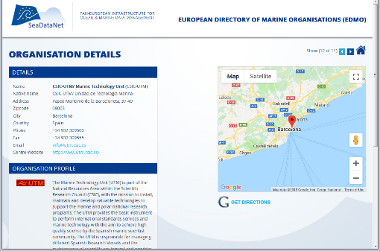
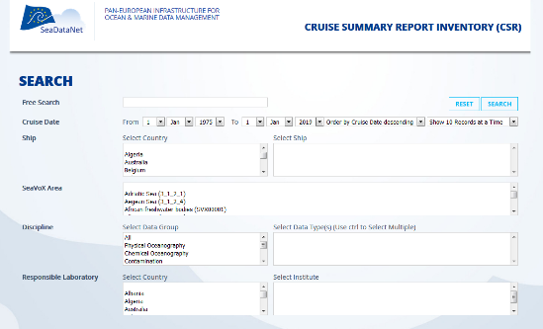
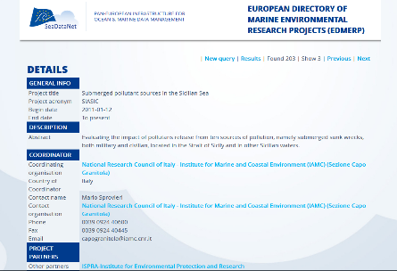
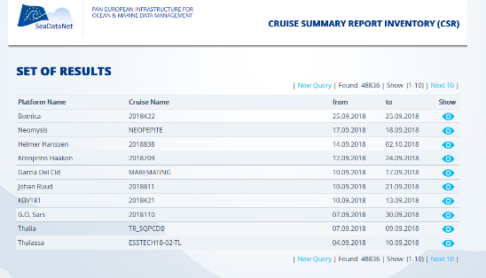
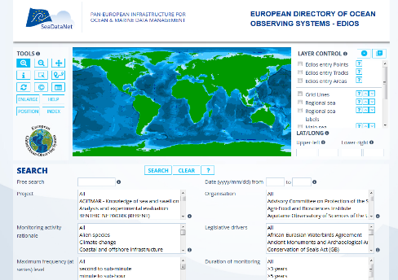
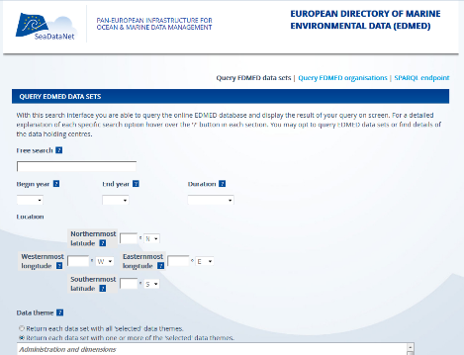
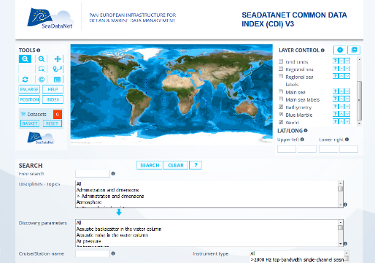
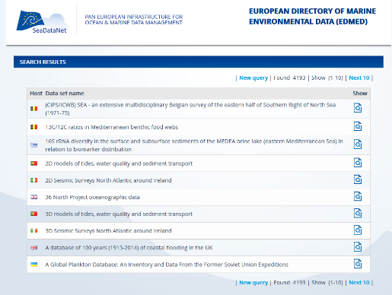
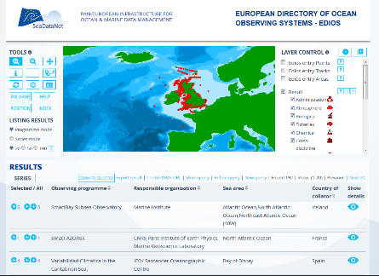
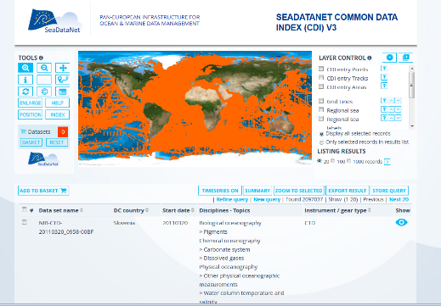
SEADATANET METADATA SERVICES
EDMO
Projects (3 079)
Organisations (4 523)
CSR
EDMERP
Research cruises (48 836)
EDIOS
EDMED
CDI
Data sets (4 193)
Observing programmes (363)
Data index (2 151 046)

Slide 4
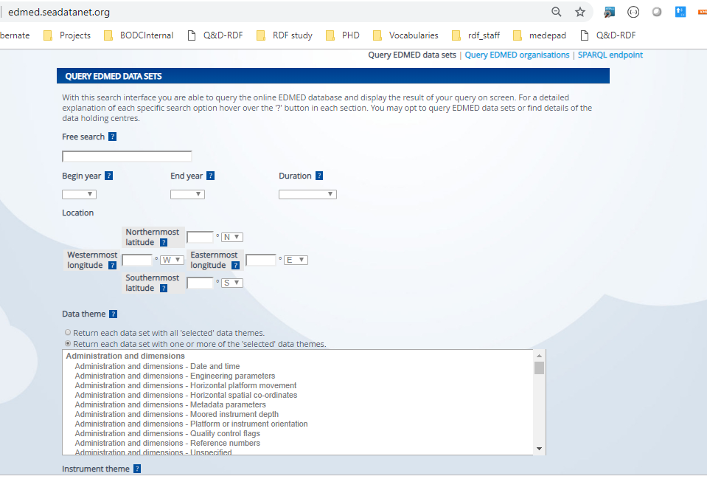
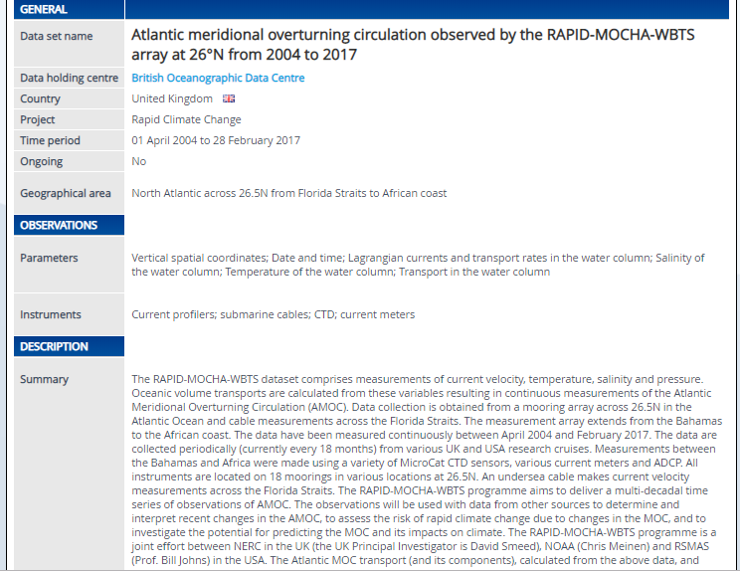

EDMED metadata format, based on ISO 19115
Annotated NERC Vocabulary Server (NVS)
HUMAN
MACHiNE
READABLE
FAIR

Slide 5
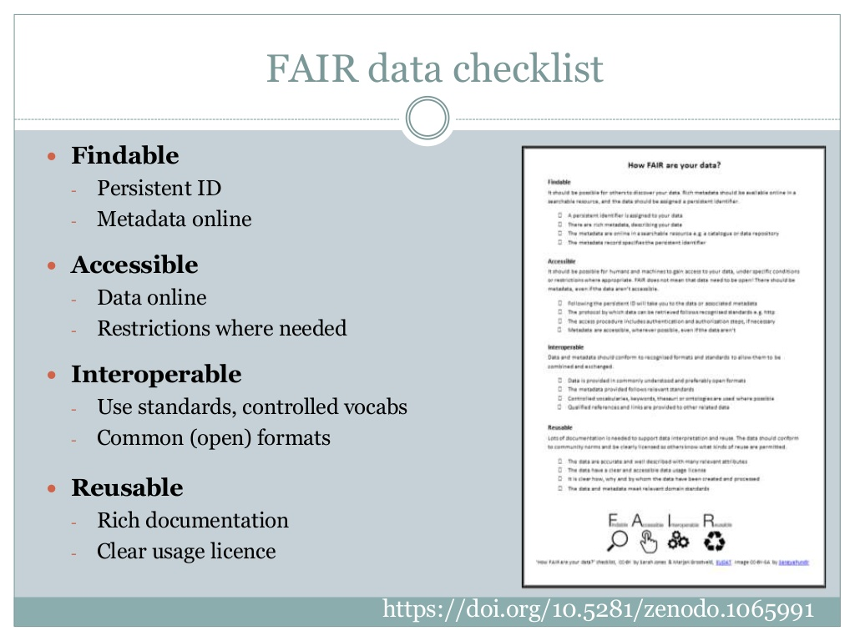
FAIR data checklist

Slide 6


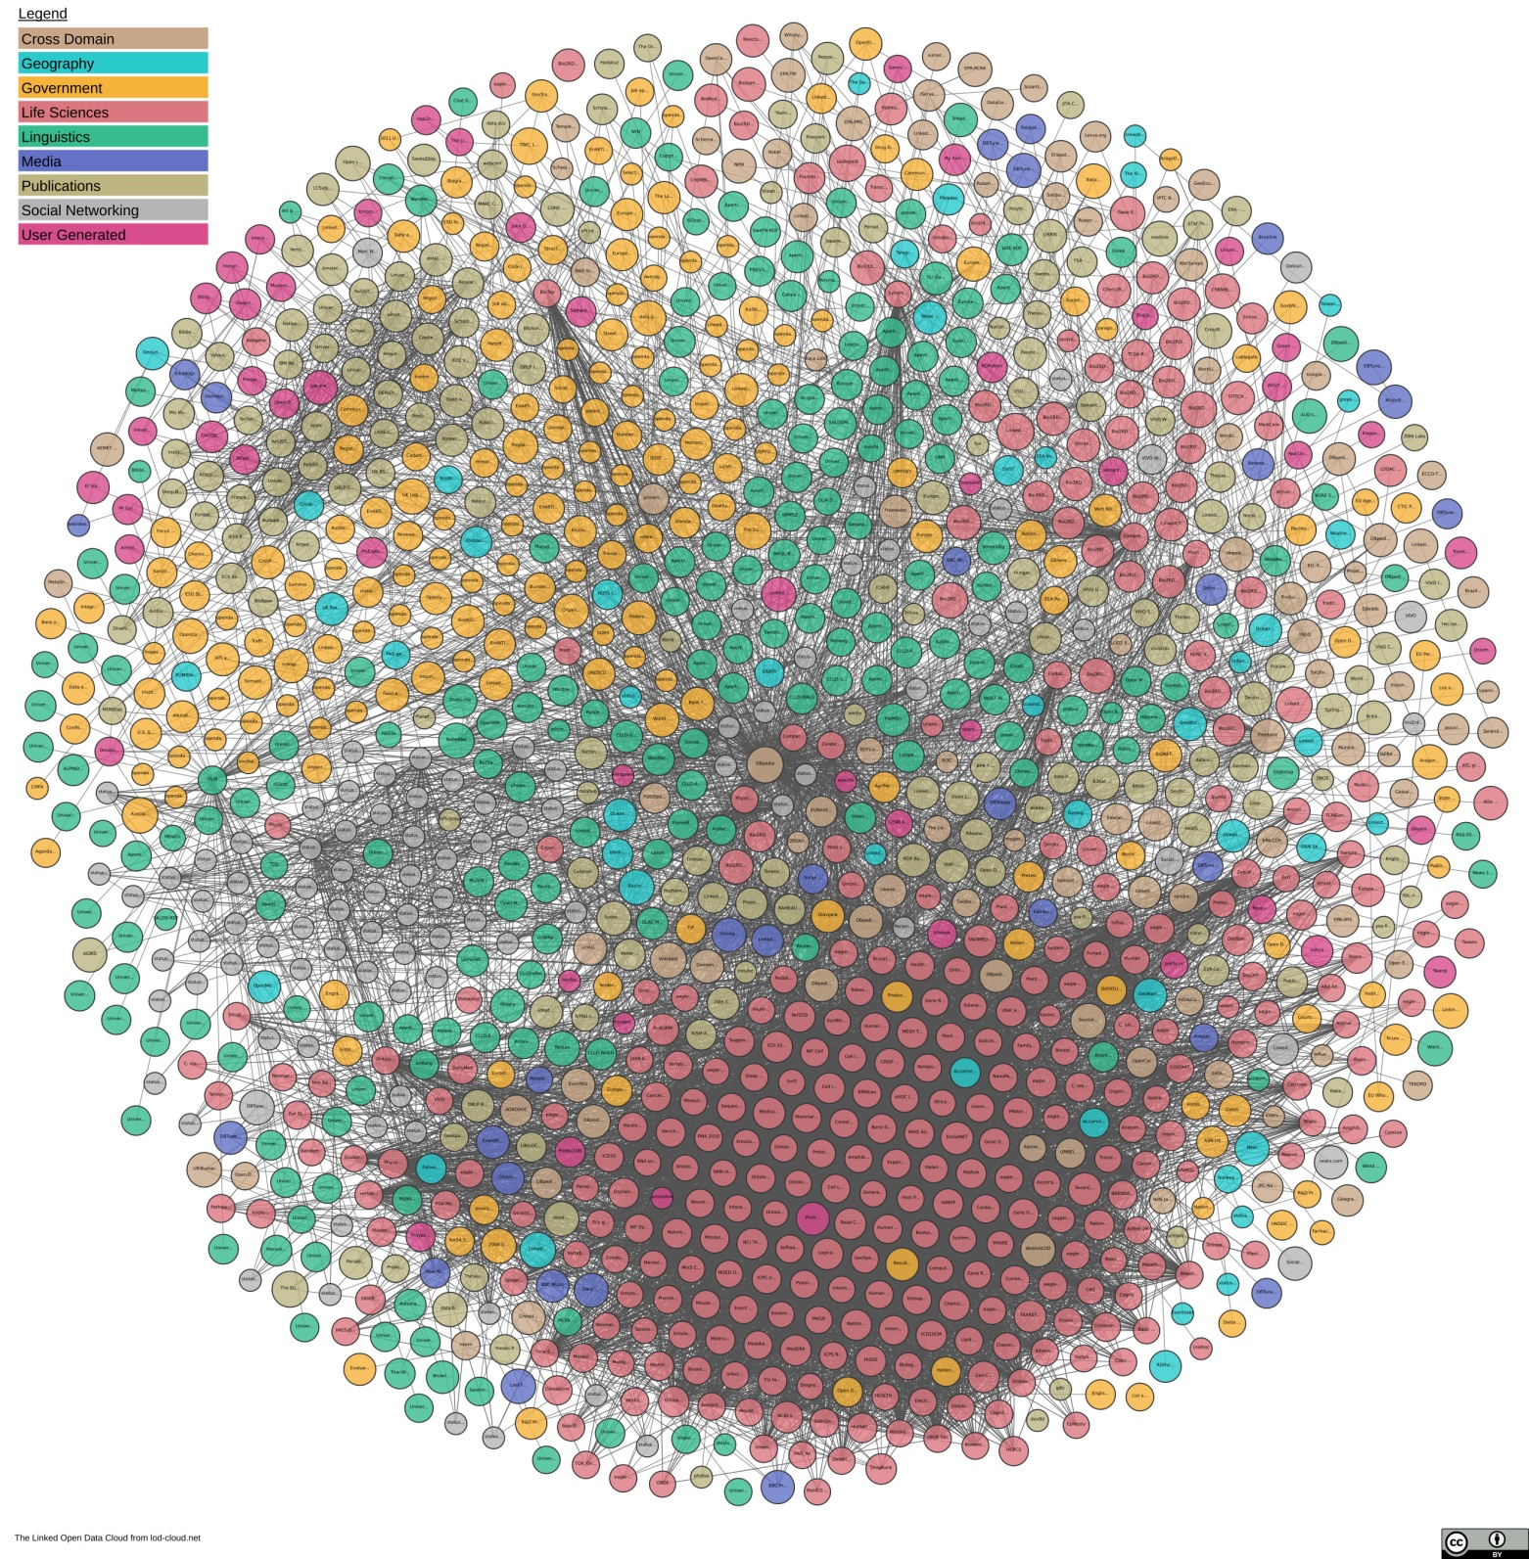
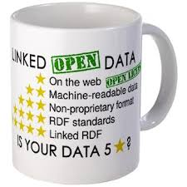
Set of best practices for publishing and interlinking structured data for access by both humans and machines

Slide 7
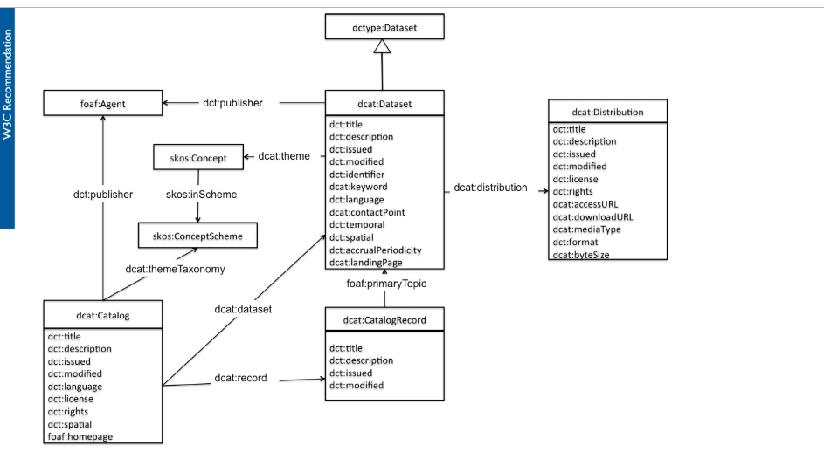
Data Catalog Vocabulary (DCAT)
Map EDMED Metadata format to standardized terms, ontologies, that humans and machines understand
Thomas and Leadbetter, 2018, Exposing the SDN metadata catalogues as Linked Data: from metadata to data on the web, EGU, Vienna
Notes:
DCAT is an RDF vocabulary well-suited to representing data catalogs

Slide 8
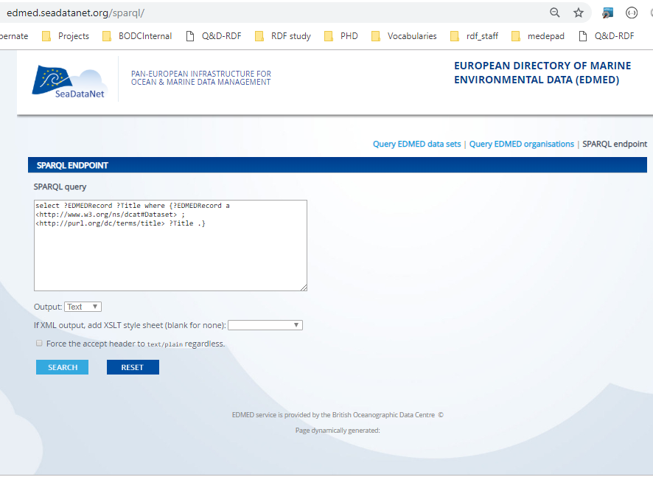
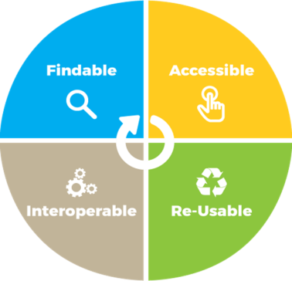
Wood et al, 2018, Exposing the SeaDataNet metadata catalogues via SPARQL endpoints, IMDIS Conf, Barcelona.

Slide 9
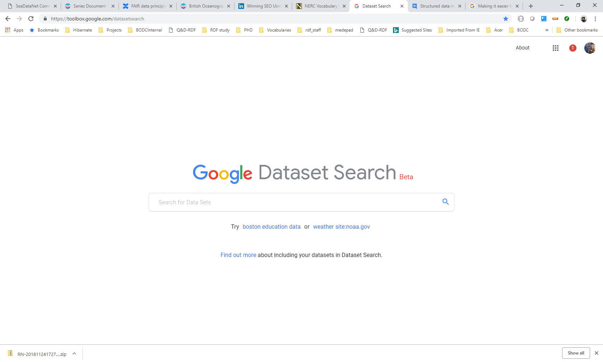
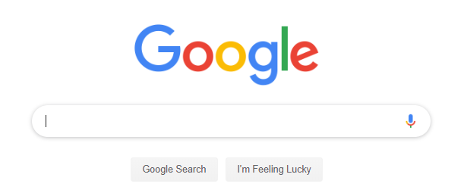
How will you discover EDMED?
Search engine
for datasets
Over metadata
provided by data providers
Search engine to tell the user where the data is
Leadbetter et al, 2018, The place of schema.org in Linked Ocean Data, IMDIS Conf, Barcelona.

Slide 10
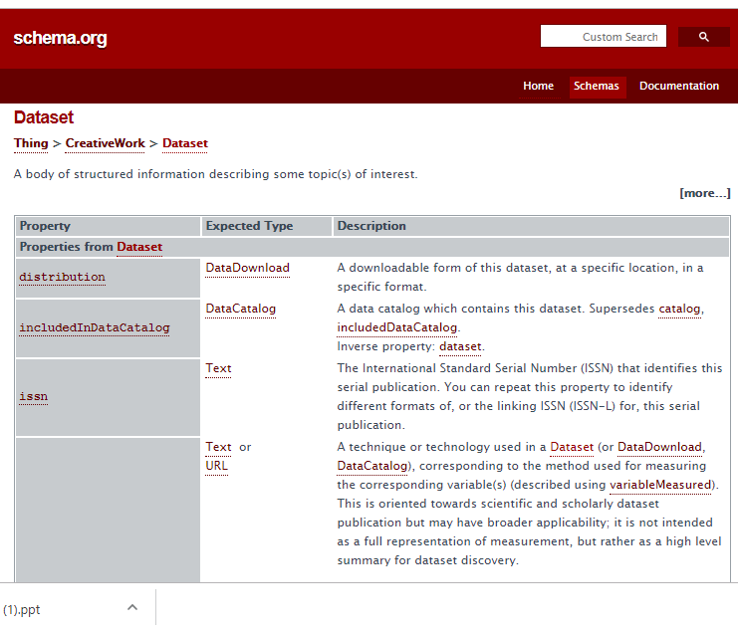
Yahoo, Microsoft, Google, Yandex
DCAT

Slide 11
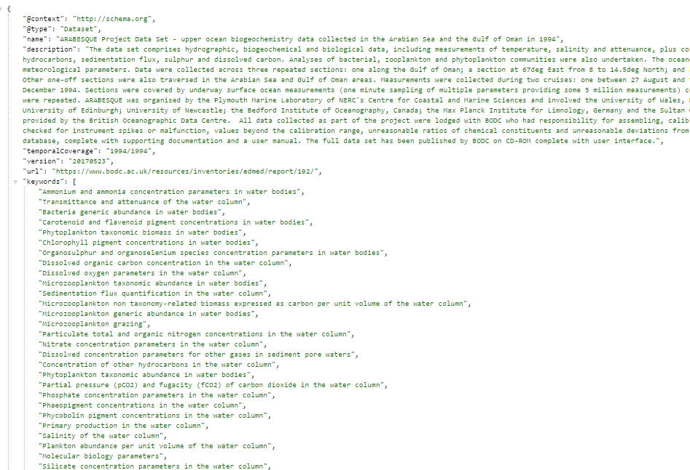


Notes:
Mapping exercise from dcat to schema.org dataset

Slide 12
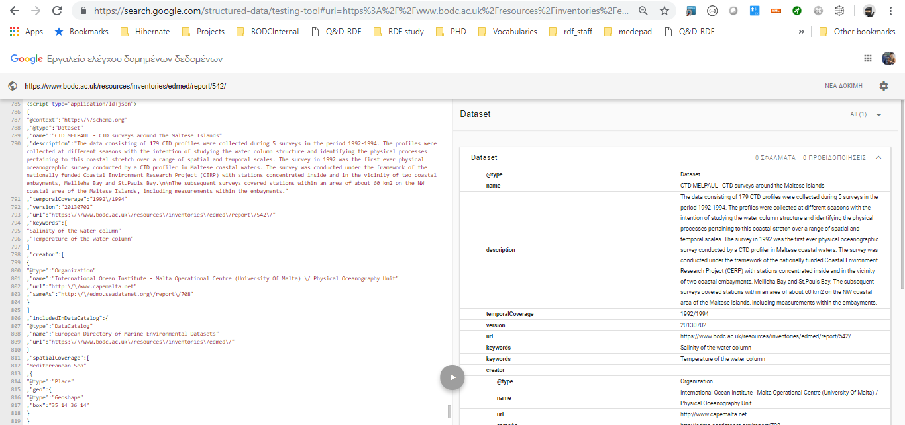
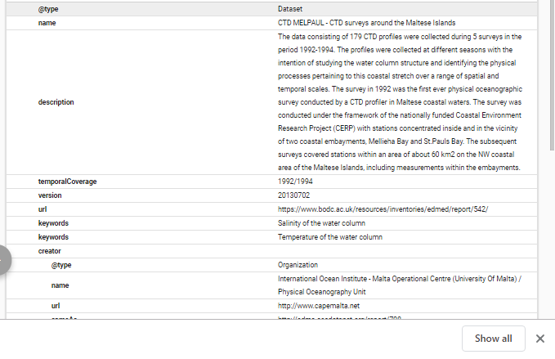
Validation
dataset name
dataset description
Temporal coverage
keywords
Provider

Slide 13
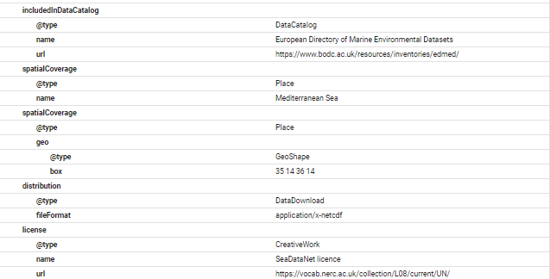
Catalog included
Spatial coverage
Distribution
License

Slide 14
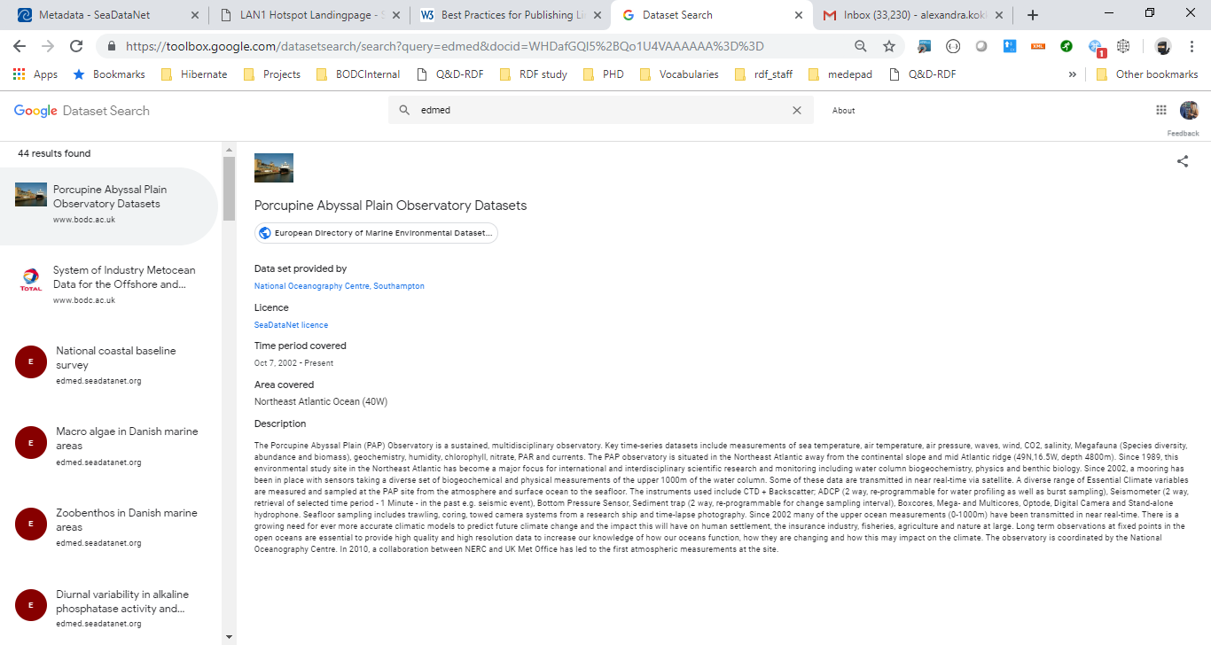
Dataset name
Provider
http://vocab.nerc.ac.uk/collection/L08/current/LS/
Made available
08/04/2019!!!
License
Temporal coverage
Spatial coverage
Dataset description

Slide 15
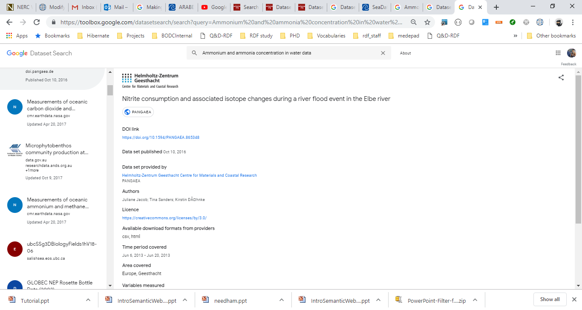

Slide 16
Where next
Structured metadata contain free text
Ideal feed NVS vocabularies in schema.org
Adding a layer of semantics in google dataset search
Notes:
Bioschemas
Vocabularies

Slide 17


Acknowledgements
 | Marine Institute, Ireland
 | SeaDataCloud, EU H2020 programme

