Slide 1
General Data Management Principles
Implementation in SeaDataNet
Sissy Iona, HCMR/HNODC

Slide 2
Morning Session
1. General Data Management Principles-Implementation in SeaDataNet
(S. Iona)
  SeaDataNet General Overview
  Metadata Directories
  Data Policy and Data Licence
  Rules for metadata submission to prevent duplication
  Data Transport Formats , Reformatting Tools, Vocabularies
  Quality Control and Flag Scale
2. Metadata Directories Management (S. Iona)
  Introduction
  Management of EDMO, EDMERP
  On line Practice (1 hr)
Afternoon Session
  On line Practice (continuation) (app.45 min)
3. Management of EDIOS Metadata (L. Rickards)

Slide 3
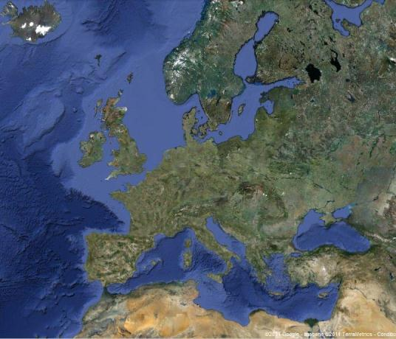
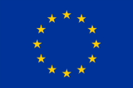
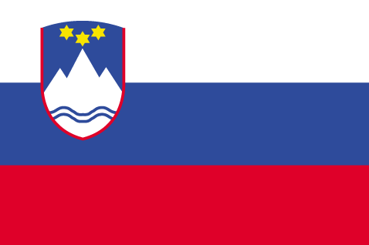

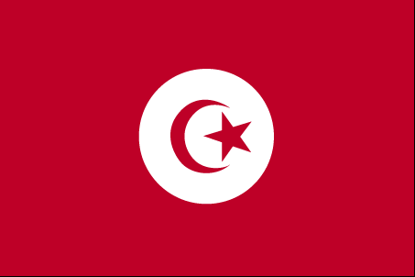
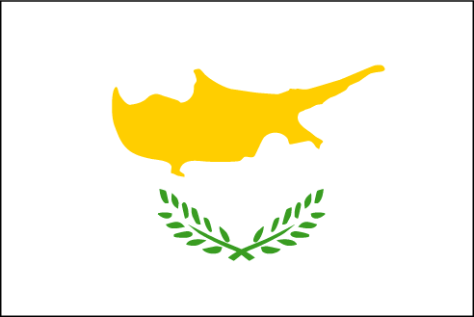

EU-FP5
EU-FP6
EU-FP7
2002-2005
Sea-Search
2006-2011
SeaDataNet
2011-2015
SeaDataNet II
SeaDataNet has set up and operates a pan-European infrastructure for managing marine and ocean data by connecting National Oceanographic Data Centres (NODCs) and oceanographic data focal points from 35 countries bordering European seas

Slide 4
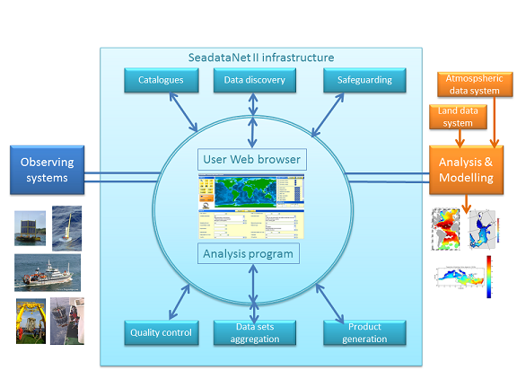
SeaDataNet infrastructure

Slide 5
SeaDataNet developments
  An infrastructure with harmonized services, products and tools:
  Development of common standards :
    Vocabularies, Transport formats
  European catalogues with standardised XML ISO-19115 descriptions
  One unique portal to access all data : virtual data centre
  Set of tools to be implemented in each data centre
    MIKADO: generator of XML descriptions of SeaDataNet catalogues
    NEMO: reformatting software to SeaDataNet formats
    Download Manager: downloading software
    ODV: Ocean data view adapted to SeaDataNet needs
    DIVA: for product generation adapted to SeaDataNet needs

Slide 6
Background
Version 0: 2006-2007
  Continuation and maintenance of past Sea-Search system :
    the data access needed several different requests to each data centre
    and the data sets were delivered in different formats
    No standardized information
Version 1: 2008-2010
  Setup of the integrated online data service to users :
    networking the distributed data centres,
    unique request to the interconnected data centres
    and the data sets are delivered with a unique format
    Interconnecting and mutually tuning the metadata directories in terms of format, syntax and semantics e.g
      ISO 19115 metadata standard for all directories
      Common vocabs, EDMERP, EDMO and CSR references in the metadata descriptions
  CSR, EDIOS still need content upgrade

Slide 7
Background
Version 2: 2010-2011
  Data product services were added to the infrastructurre
  OGC compliant viewing services
  Management of additional data types (EMODNET, Geo-Seas, etc)
  SeaDataNet II (2011-2015)
  Metadata directories (only CDI, CSR) extension with OCG-CS-W components for automatic harvesting from the SDN nodes
  ISO 19130 transport scheme and INSPIRE compliance will be implemented

Slide 8
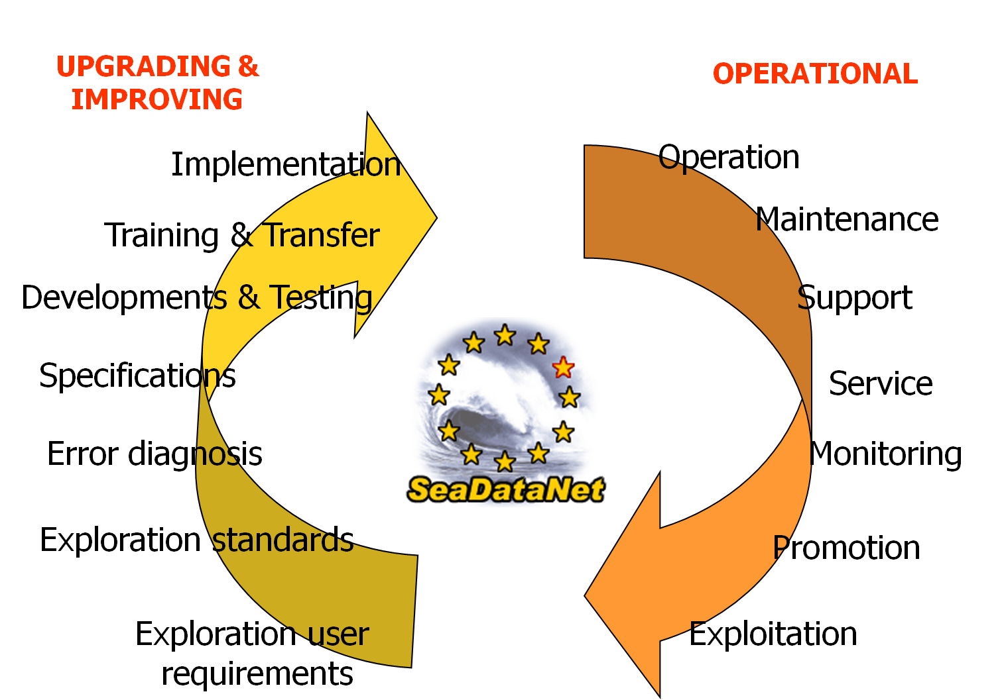
Future
Operationally robust and state of the art Pan-European infrastructure

Slide 9
Discovery and Viewing Services
SeaDataNet portal provides an overview of the Marine organisations in Europe and their involvement in scientific cruises, data collection, marine projects.
Notes:
High Level Directories – EDMED, CSR, EDIOS (for describing observational datasets collected by ships, by laboratories, by continuous observing systems)
Common References - EDMERP, EDMO and Common Vocabularies (available as Web Services) that interconnect the directories
The Common Data Index (CDI) that gives access to the data distributed by the data platforms

Slide 10
Discovery and Viewing Services
6 European catalogues maintained by NOCDs and published at Pan-European level:
EDMO : European Directory of Marine Organisations (<2200)
CSR : Cruise Summary Reports (>31500)
EDMED : European Directory of Marine Environmental Datasets (>3000)
EDMERP : European Directory of Marine Environmental Research projects (>2500)
EDIOS : European Directory of Ocean Observing Systems (>270 programmes for the UK alone and many underway for other European countries)
CDI : Common Data Index ( >1000000)

Slide 11
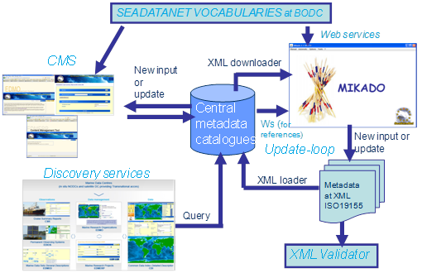
General maintenance workflow & available tools

Slide 12
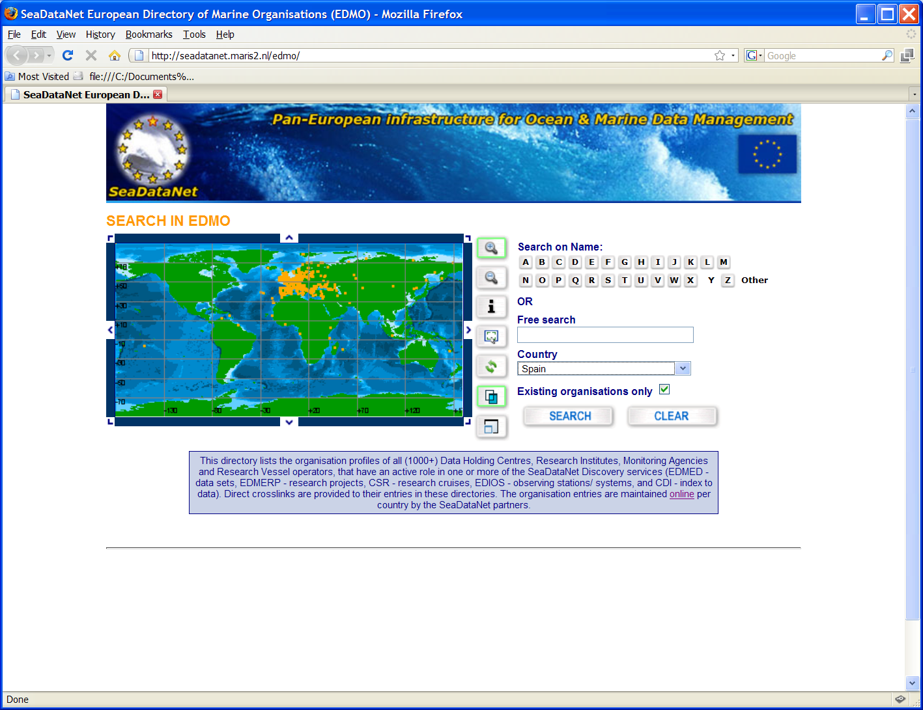
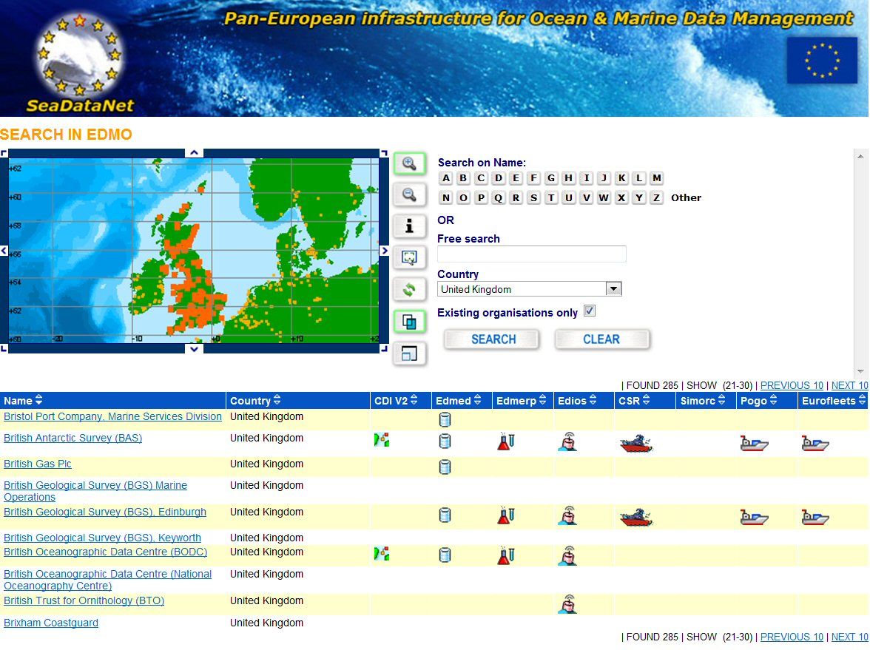
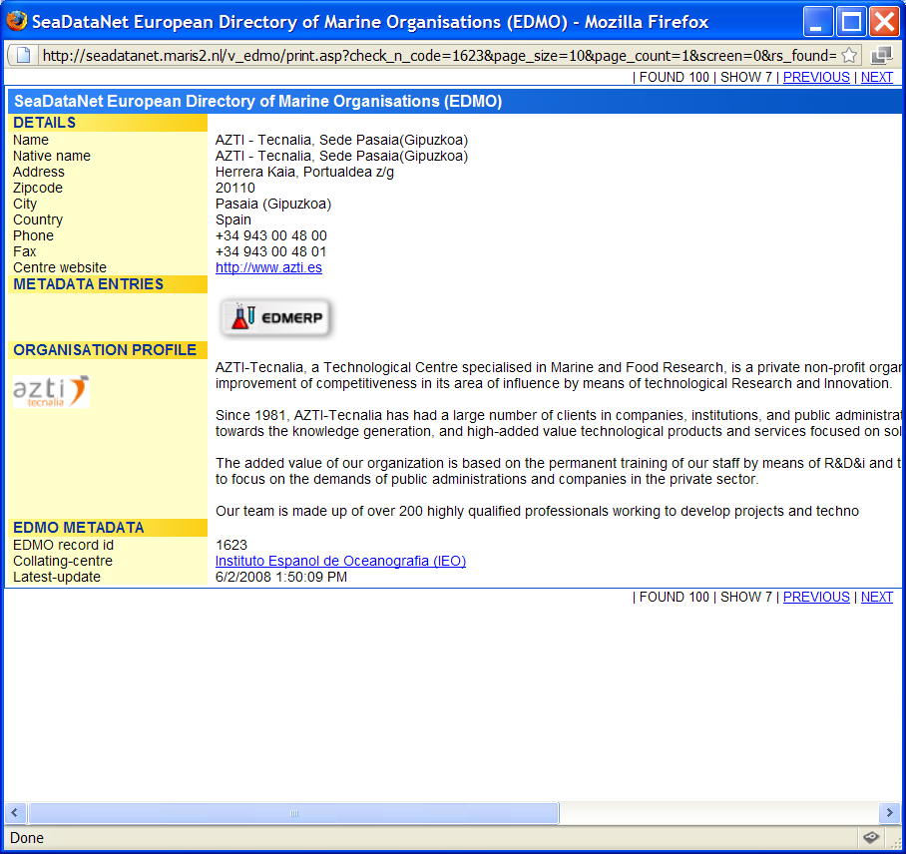
EDMO V1 search and retrieval
http://seadatanet.maris2.nl/edmo

Slide 13
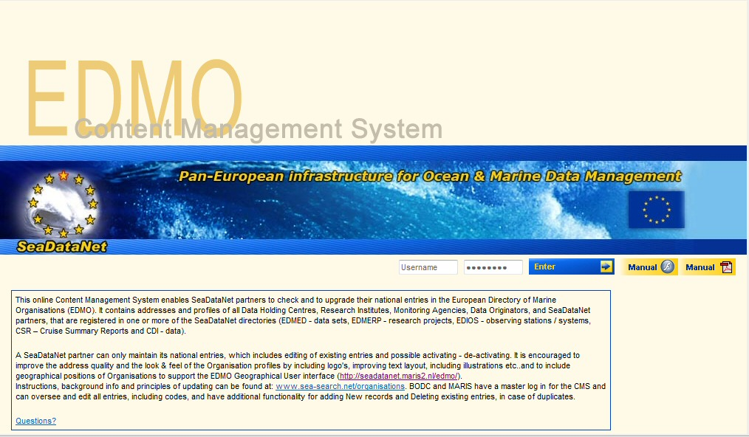
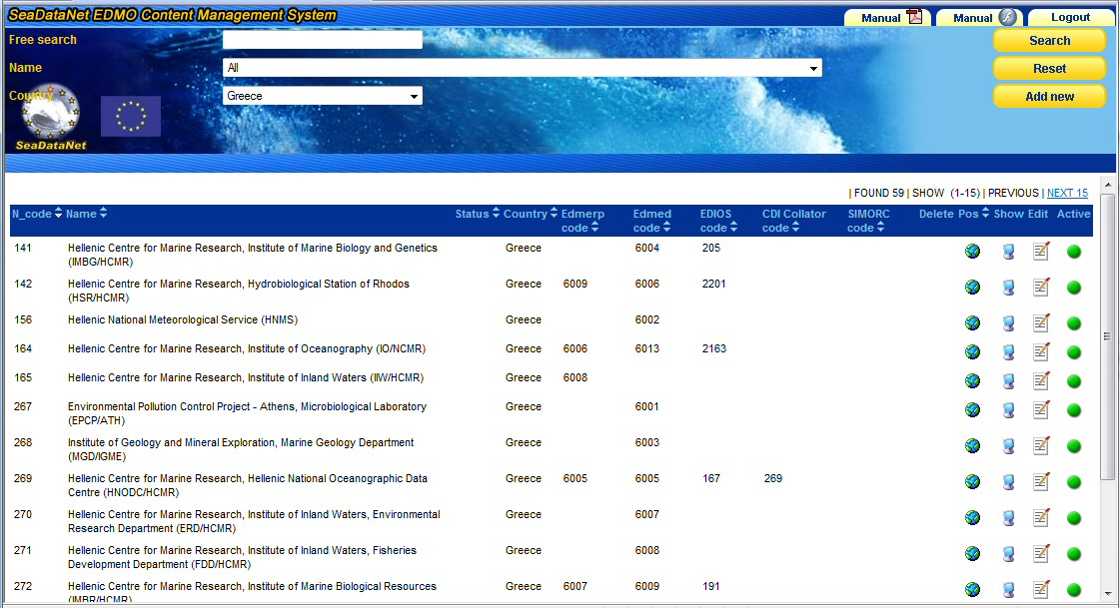
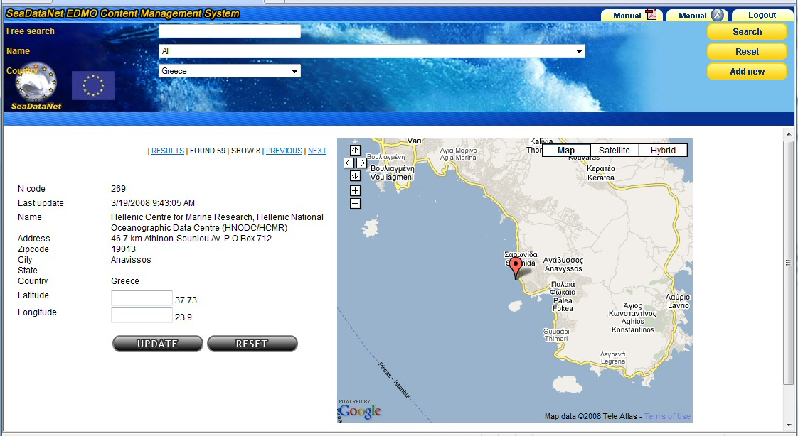
EDMO CMS
http://seadatanet.maris2.nl/vu_organisations/welcome.asp
EDMO CMS geo-locator via Google maps

Slide 14
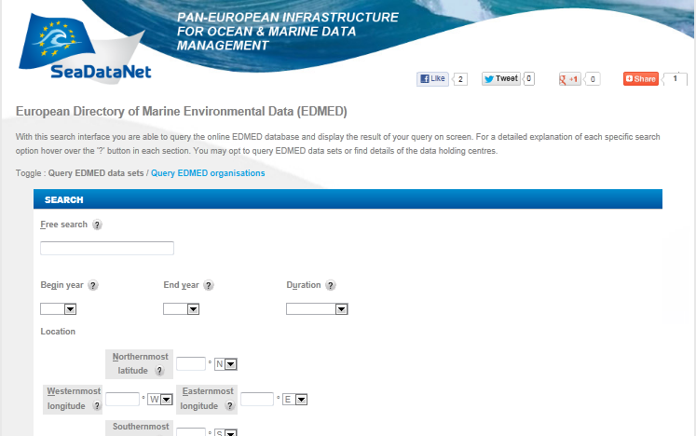
The EDMED User Interface
http://www.bodc.ac.uk/data/information_and_inventories/edmed/search/
Query by data sets (the interface includes time, geographical box search criteria)
Query by Data Holding Centre

Slide 15
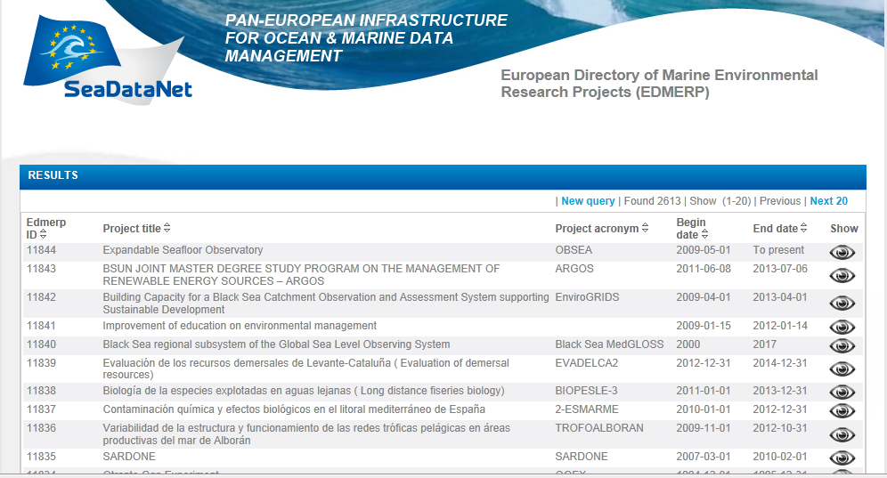
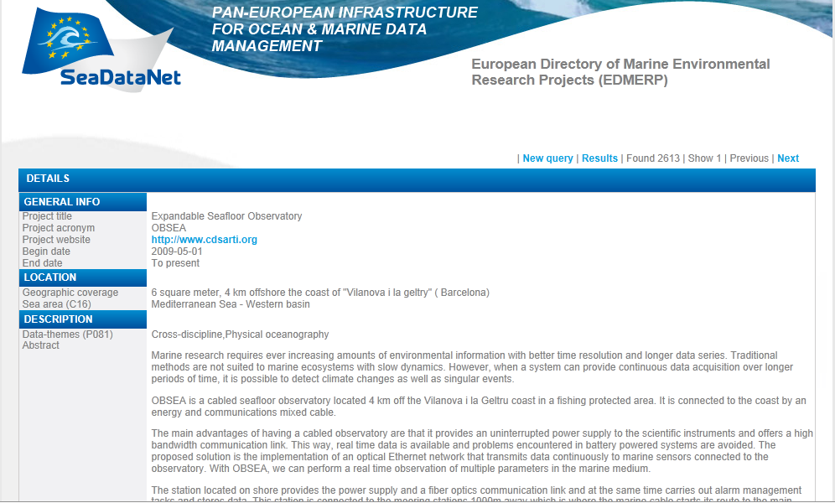
The EDMERP User Interface
http://seadatanet.maris2.nl/v_edmerp/search.asp
Additional details
Browse list

Slide 16
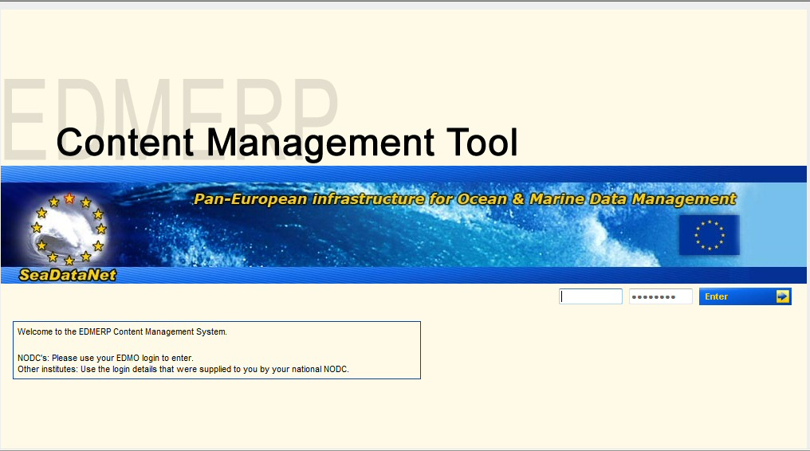
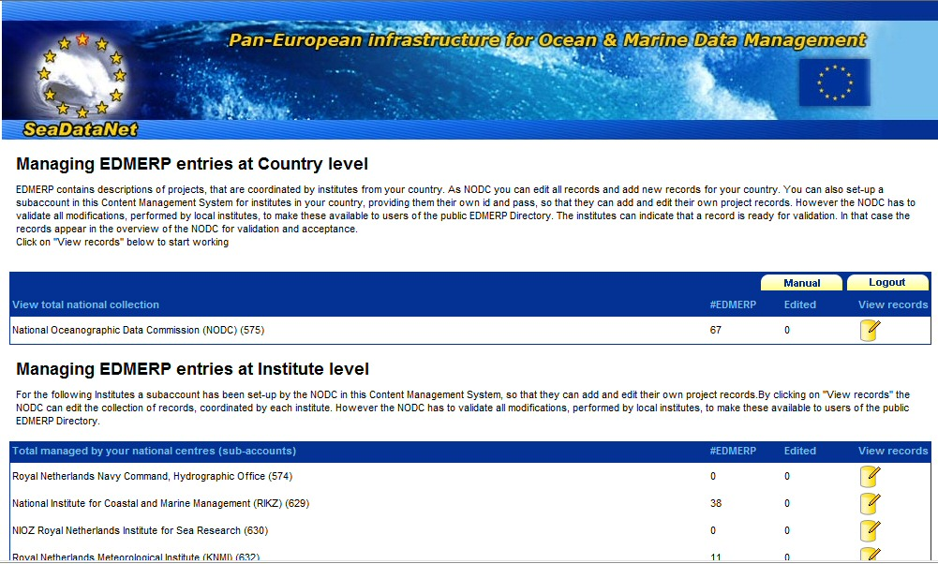
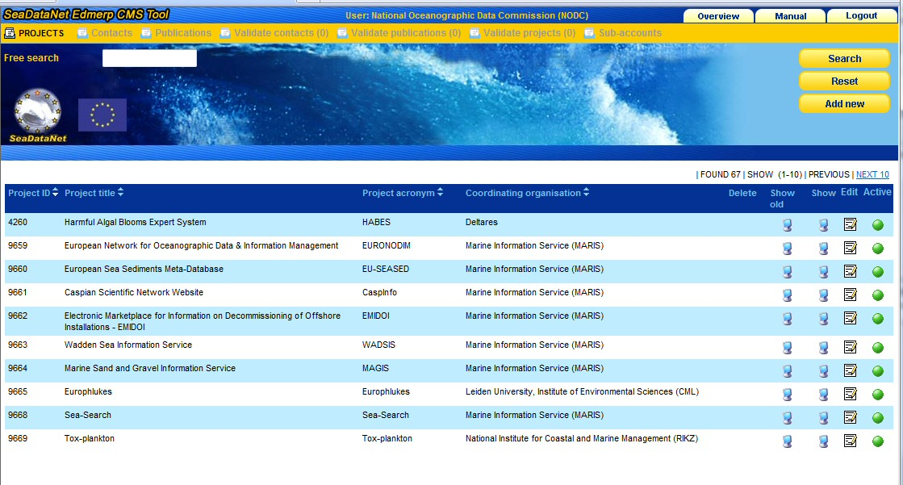
EDMERP CMS
http://seadatanet.maris2.nl/vu_edmerp/welcome.asp
capability of creation of sub-accounts for institutes in the NODC’s country, while the NODC safeguards the quality by having the chief editor role before publishing

Slide 17
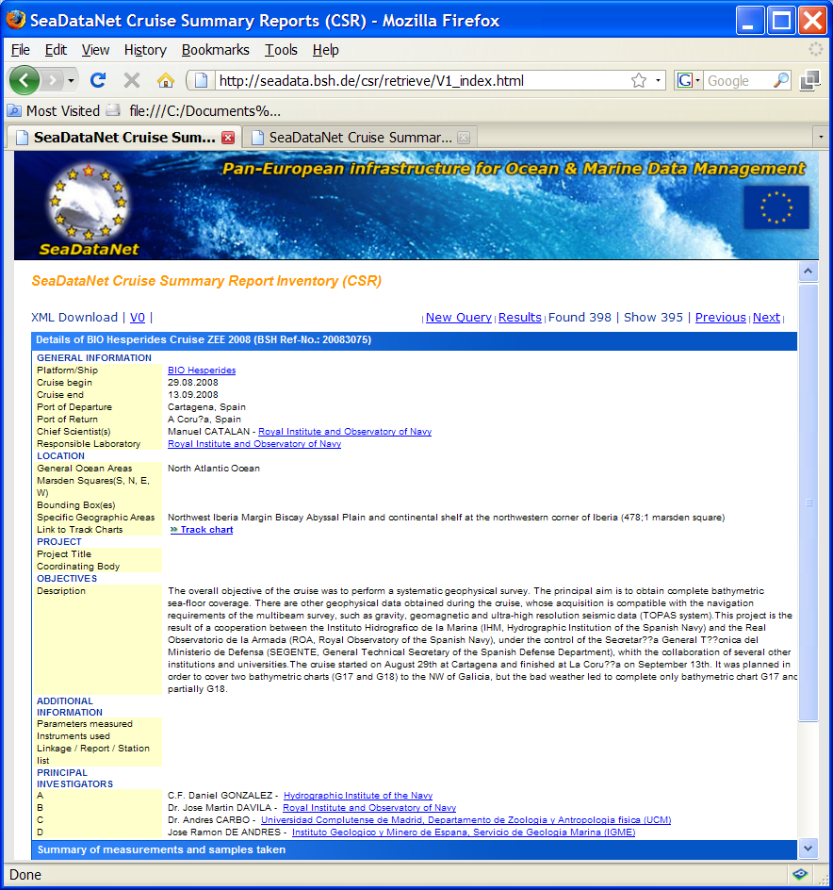
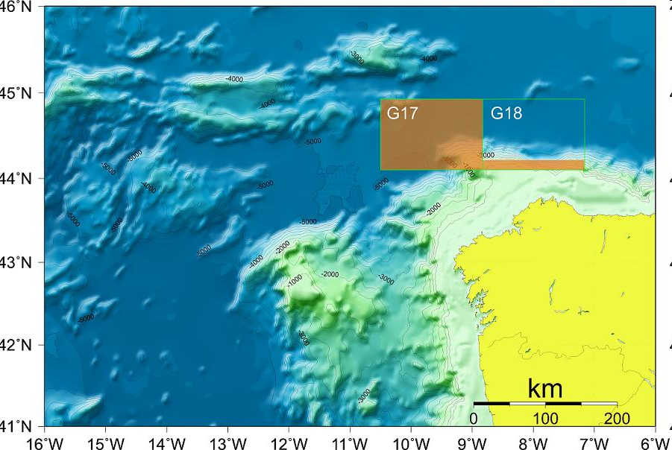
CSR V1 Query and Retrieval
http://seadata.bsh.de/csr/retrieve/V1_index.html
POGO/Ocean Going RV database link
EDMO link
Track chart

Slide 18
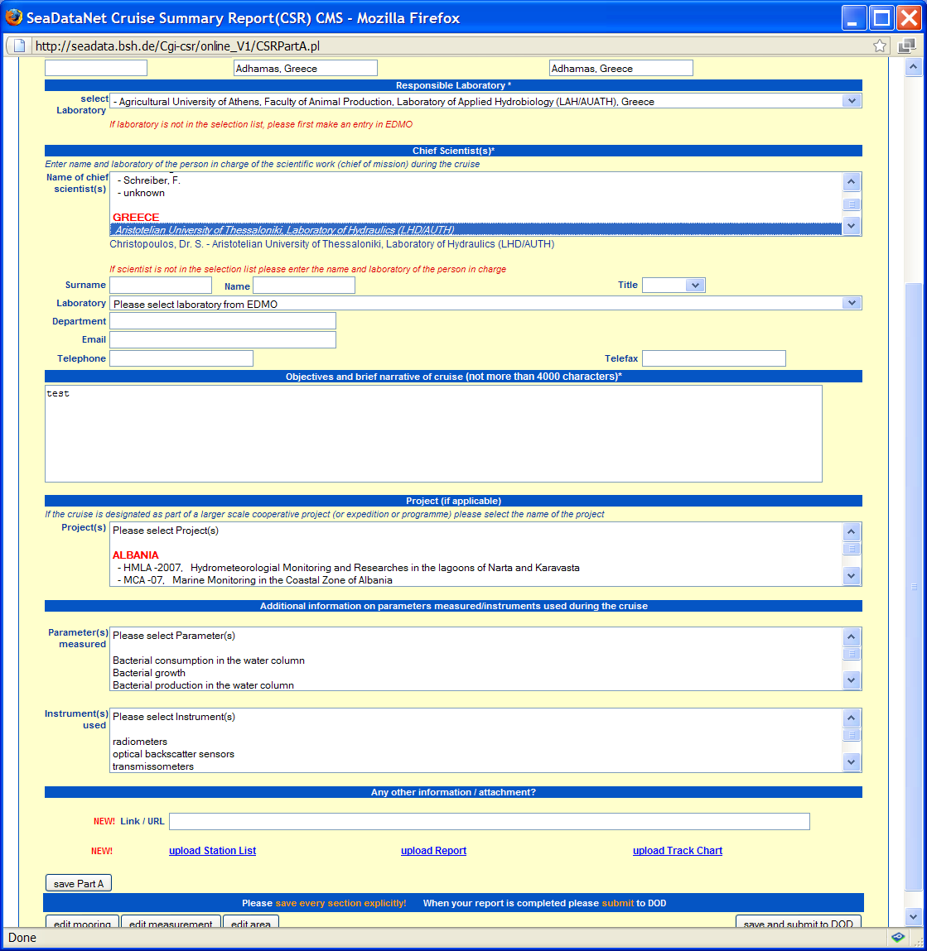
CSR V1 CMS for on-line entry
http://seadata.bsh.de/csr/online/V1_index.html
Upload station list
Upload reports
Upload track charts

Slide 19
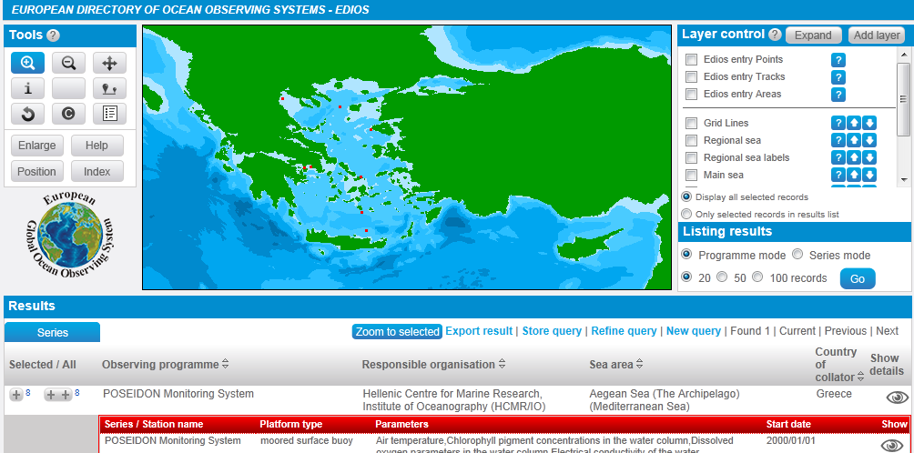
The EDIOS User Interface
http://seadatanet.maris2.nl/v_edios_v2/search.asp

Slide 20
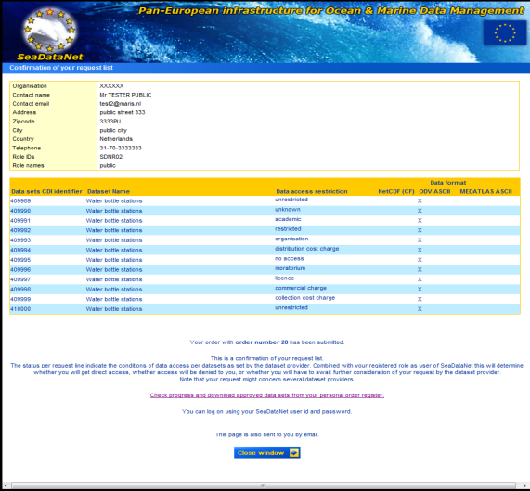
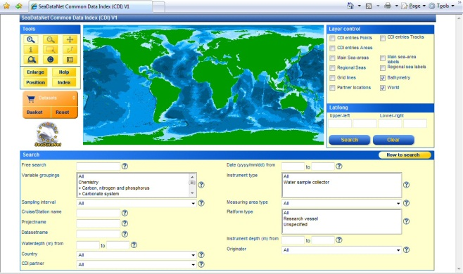
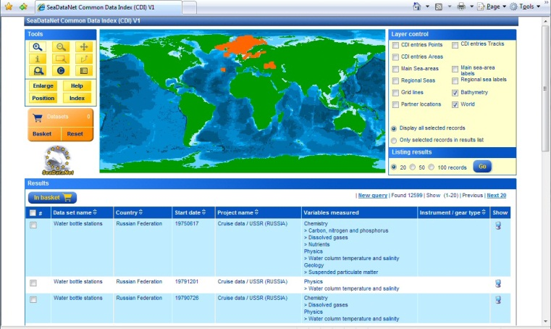
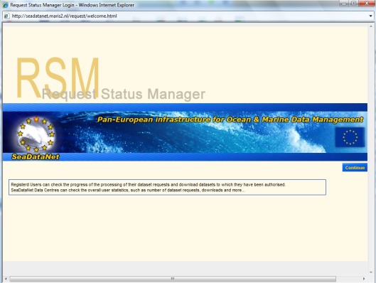
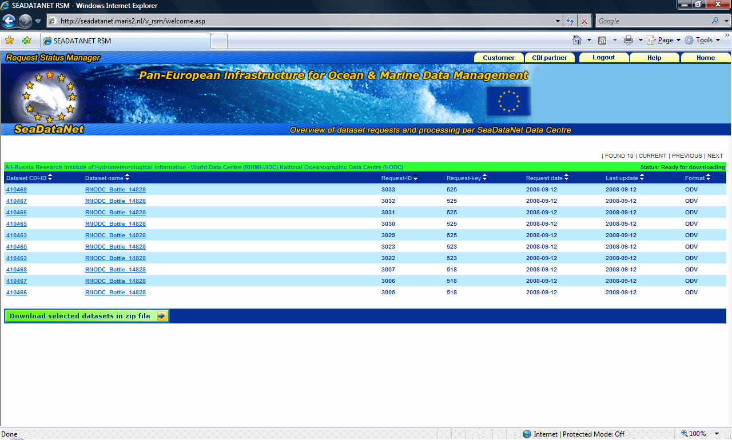
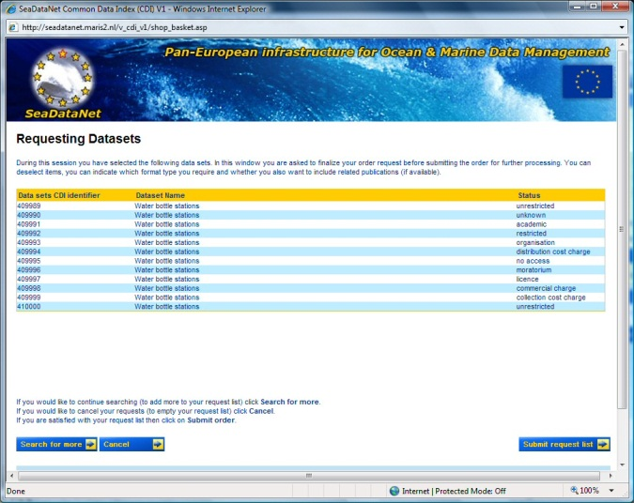
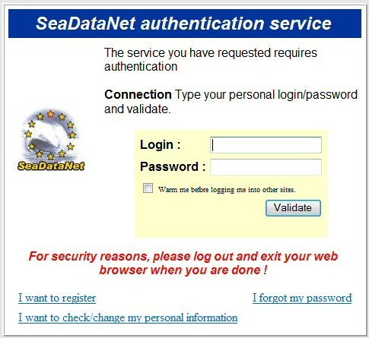
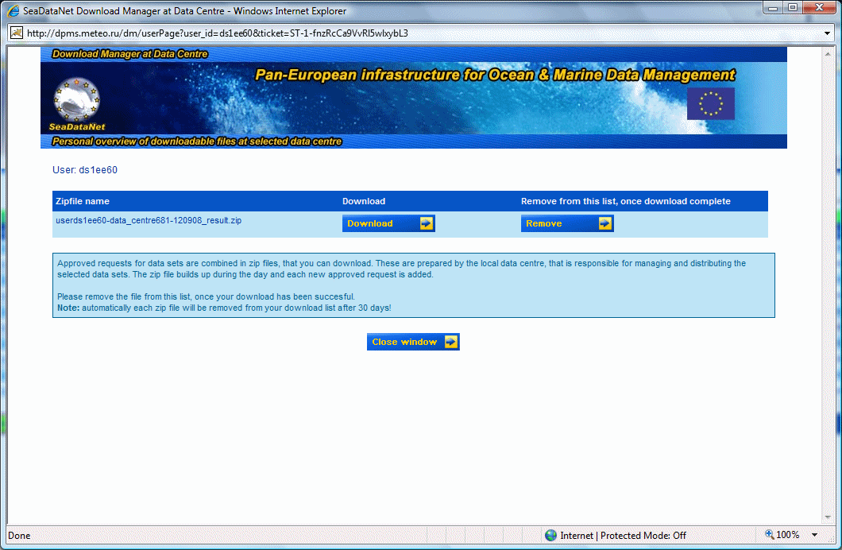
Common Data Index – Data Discovery and Access Service
Check Status
In RSM
Search
Request
Confirmed
Include in
Basket
Results
Ready at DC x
Shopping list
Download
Submit + Authentication
Data
SDN
format
Notes:
Step 1: data discovery
Step 2: shopping (request data sets, submit+authentication)
Step 3: download
Step: viewing (odv+diva)

Slide 21
SeaDataNet Data Policy History
Drafted by Project Office, 02/2007
Reviewed by the Steering Committee
Validated by the Coordination Group
Published at April 2007
Available at:
http://www.seadatanet.org/Data-Access/Data-policy

Slide 22
SeaDataNet Data Policy
It is derived from the INSPIRE directive for spatial information taking into account the national rules and the SeaDataNet users needs.
Objectives
    to serve the scientific community, public organizations, environmental agencies
    to facilitate the data flow through the Transnational Activities by stating clearly the conditions for submission, access and use of data, metadata and data-products

Slide 23
SeaDataNet Data Policy
Links and Framework
      SeaDataNet Data Policy is fully compatible with the EU Directives, International Policies, Laws and Data Principles:
  Directive 2003/4/EC of the European Parliament and of the Council of 28 January 2003 on public access to environmental information and repealing Council Directive 90/313/EEC (http://ec.europa.eu/environment/aarhus/index.htm).
  INSPIRE Directive for spatial information in the Community (http://inspire.jrc.it/home.html)
  IOC Data Policy (http://ioc3.unesco.org/iode/contents.php?id=200)
  ICES Data Policy 2006 (https://www.ices.dk/Datacentre/Data_Policy_2006.pdf)
  WMO Resolution 40 (Cg-XII; see http://www.nws.noaa.gov/im/wmor40.htm)
  Implementation plan for the Global Observing System for Climate in support of the UNFCCC, 2004; GCOS – 92, WMO/TD No.1219.
  Global Earth Observation System of Systems GEOSS 10-Year Implementation Plan Reference Document (Final Draft) 2005. GEO 204. February 2005.
  CLIVAR Initial Implementation Plan, 1998; WCRP No. 103, WMO/TS No. 869, ICPO No. 14. June 1998.

Slide 24
Policy for Data Access and Use
Metadata
  free and open access, no registration required
  each data centre is obliged to provide the meta-data in standardized format to populate the catalogue services
Data and products
  visualisation freely available
  the general case is free and without restriction (e.g. academic purposes)
  however (due to national policies) mandatory user registration is required (using Single Sign One (SSO) Service)
  a “SeaDataNet role” (partner, academic, commercial etc.) is attributed to individual user using the Authentication, Authorization and Administration (AAA) Service
    Each NODC attributes the roles to the users of its of country
    Out of the partnership, the roles are assigned by SeaDataNet user-desk
  When register, the user must accept the SDN licence agreement
  each data centre node delivers data according to the user’s role and its local regulation
  each data centre should provide freely the data sets necessary to develop the common products

Slide 25
SDN License Agreement
1. The Licensor grants to the Licensee a non-exclusive and non-transferable licence to retrieve and use data sets and products from the SeaDatanet service in accordance with this licence.
2. Retrieval, by electronic download, and the use of Data Sets is free of charge, unless otherwise stipulated.
3. Regardless of whether the data are quality controlled or not, SeaDataNet and the data source do not accept any liability for the correctness and/or appropriate interpretation of the data. Interpretation should follow scientific rules and is always the user’s responsibility. Correct and appropriate data interpretation is solely the responsibility of data users.
4. Users must acknowledge data sources. It is not ethical to publish data without proper attribution or co-authorship. Any person making substantial use of data must communicate with the data source prior to publication, and should possibly consider the data source(s) for co-authorship of published results.
5. Data Users should not give to third parties any SeaDataNet data or product without prior consent from the source Data Centre.
6. Data Users must respect any and all restrictions on the use or reproduction of data. The use or reproduction of data for commercial purpose might require prior written permission from the data source.

Slide 26
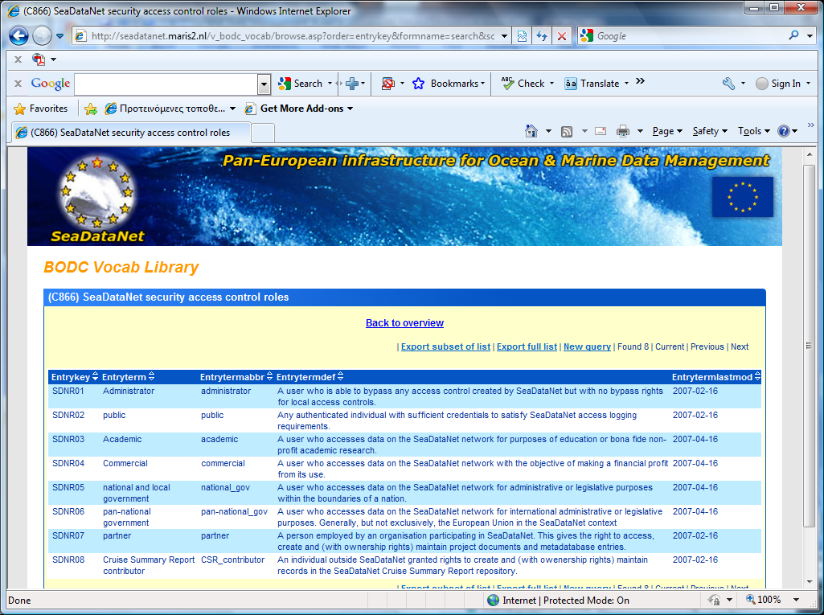
SDN Roles
on BODC Vocabulary Web Server, list C866.
http://seadatanet.maris2.nl/v_bodc_vocab/welcome.aspx

Slide 27
Causes of the duplicates
RT and DM data sets from operational oceanography
Data sets from the GTS (real time transmission) with rounded values and poorly documented profiles
International Programmes and data exchange/dissemination
Data insufficiently documented and attributed to two different sources
Water sample files including the T,S station with other parameters
Data declassified by the Navies with poor meta-data
…

Slide 28
Why to prevent duplications ?
Avoid statistical biases in data products
  One measurement could be replicated several times!
Avoid mistakenly reported and disseminated data

Slide 29
How to handle duplications ?
Duplicates checks as applied locally by partners will be described later on the QC topic
But, since there are copies of one data set in several regional databases (ICES), Black Sea databases, projects (MEDAR), global databases (WOD05), national databases, etc:
  The simplest way to prevent duplication within SeaDataNet management System is:
    partners to submit only their national data

Slide 30
Data reformatting
In general the original formats of the data files cannot be used in data management
    Include incomplete/not standardized meta-data
    There is incompatibility with the input format needed by Quality Control and other processing tools
    There is need of a unique format for safeguarding and exchanging the data sets
Data management format, archiving format and transport (exchange) format may be not necessarily the same

Slide 31
Sustainability of the archiving format
The archiving format should:
    be independent from the computer (and libraries)
    insure that includes enough meta-data to be processed (eg. Location and date)
    be compatible and include at least the mandatory fields (meta-data) requested for the internationally agreed exchange format(s)
    Include additional textual or standardized “history” or “comment” fields to prevent any loss of information
    Provide similar structure and meta-data for different data type such as vertical profiles and time series
These are normally followed also for the exchange formats.

Slide 32
SeaDataNet Data Transport Formats
      Data are available from SeaDataNet delivery services in two ASCII formats and one BINARY:
        ASCII formats for profiles, point series and trajectories
        ODV mandatory
        MEDATLAS optional
        CF-compliant NetCDF BINARY format for gridded fields and multi-dimensional data types such as ADCP

Slide 33
SeaDataNet Data Transport Formats
ASCII formats (ODV, MEDATLAS) have been modified to carry additional information required by SeaDataNet:
  provide linkage between data and metadata (CDI record)
  provide linkage to standardised SeaDataNet semantic information such as detailed parameter description

Slide 34
SeaDataNet Data Transport Formats
NetCDF inplementation in SeaDataNet is based on the CF standard which is under specification
  Upgrading NetCDF (CF) standard is planned in cooperation with UNIDATA (USA) and others expert to make it better suited for SeaDataNet, MyOcean, etc
  Integration of SDN Common Vocabs, CDI reference in the metadata header

Slide 35
SeaDataNet ODV Format
      SDN ODV (Ocean Data View) format is a spreadsheet — a collection of rows (comment, column header and data) with each data row having the same fixed number of columns
it allows for a semantic header where parameters are listed that maps to a vocabulary concept in order to avoid misspelling or misinterpretation

Slide 36
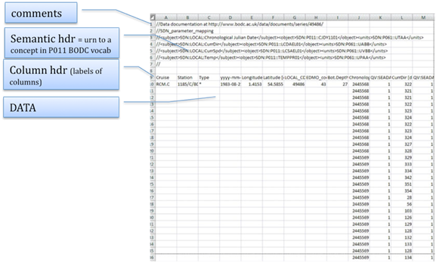
SeaDataNet ODV Format Data Model

Slide 37
SeaDataNet ODV Format Data Model
It is based on a spreadsheet model with three types of row
  Comment row
    One cell with text starting with //
    It is strongly recommended to be enriched comment rows with usage metadata
  Column header row
    contains a label for each column
  Data row

Slide 38
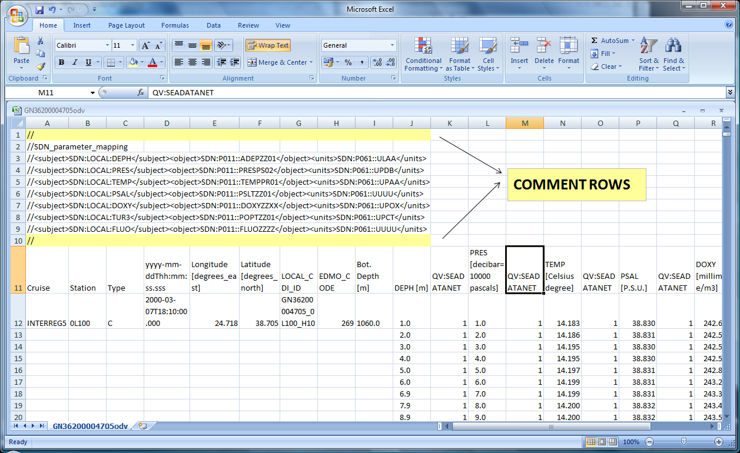
SDN ODV Profile Data Example
Primary variable is z co-ordinate and row groups (stations) made up of measurements at different depths

Slide 39
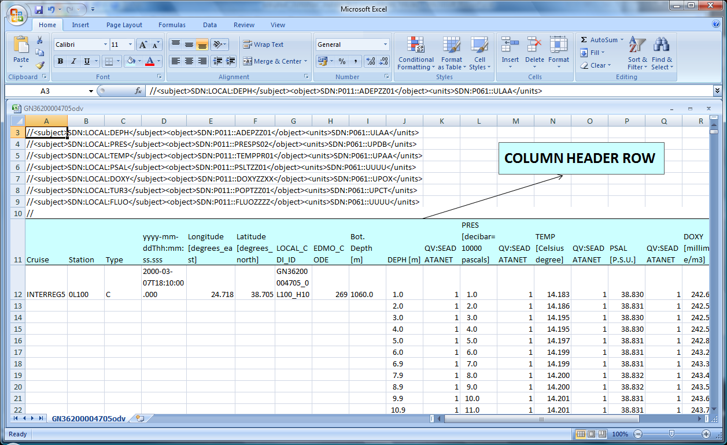
SDN ODV Profile Data Example

Slide 40
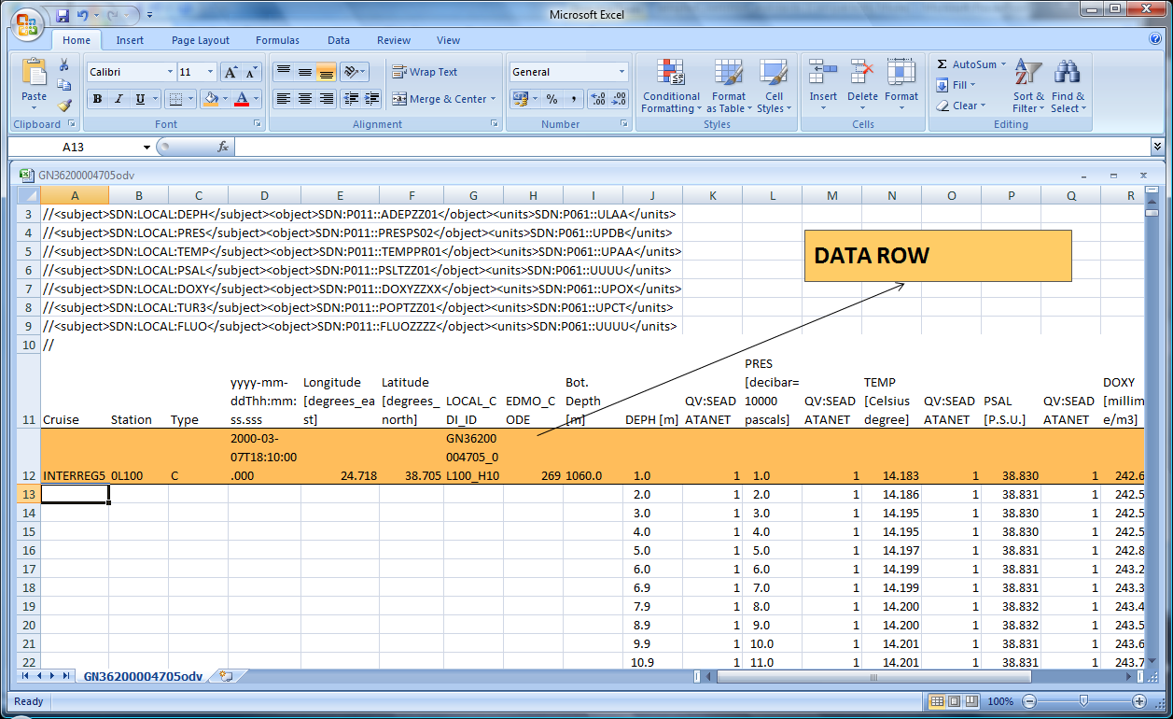
SDN ODV Profile Data Example
Date and time (UT time zone) in ISO 8601 format

Slide 41
SeaDataNet ODV Format Data Model
The Column header and the data rows have three types of column
  Metadata columns (standardized and mandatory)
  Primary variable data columns (value + flag)
  Data columns (value + flag pairs)

Slide 42
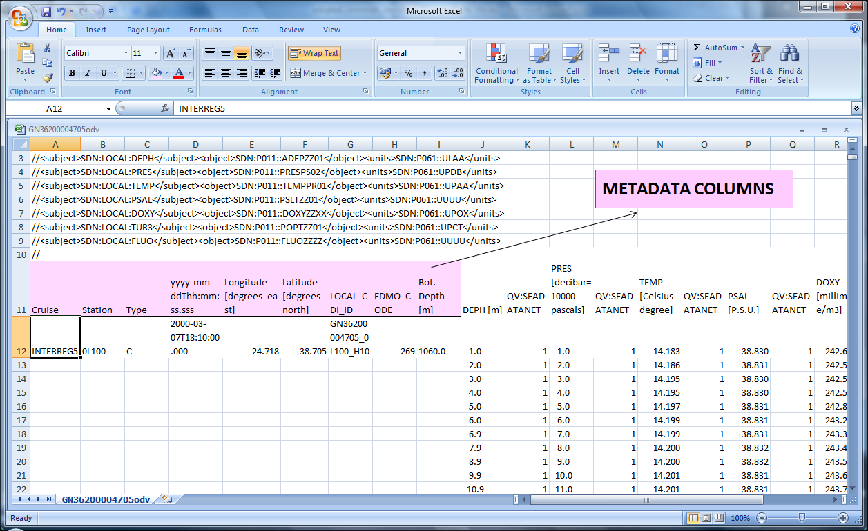
SDN ODV Profile Data Example

Slide 43
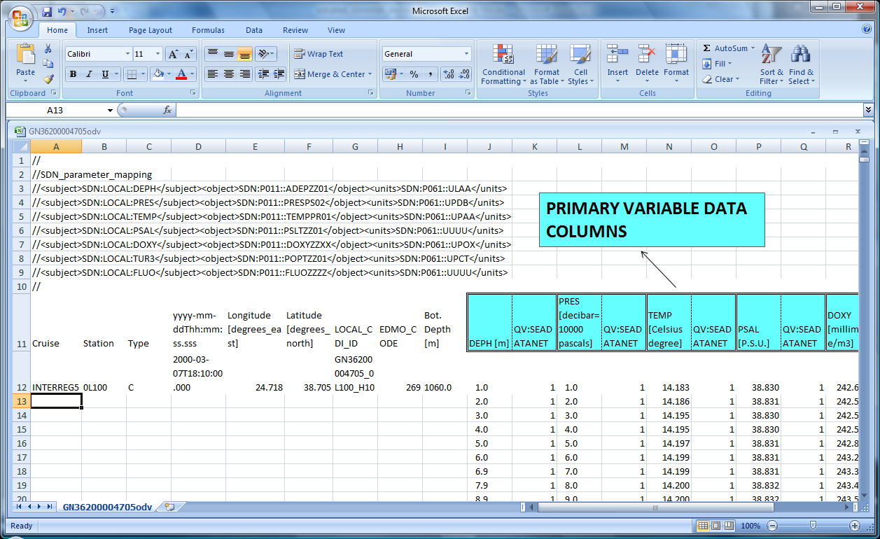
SDN ODV Profile Data Example

Slide 44
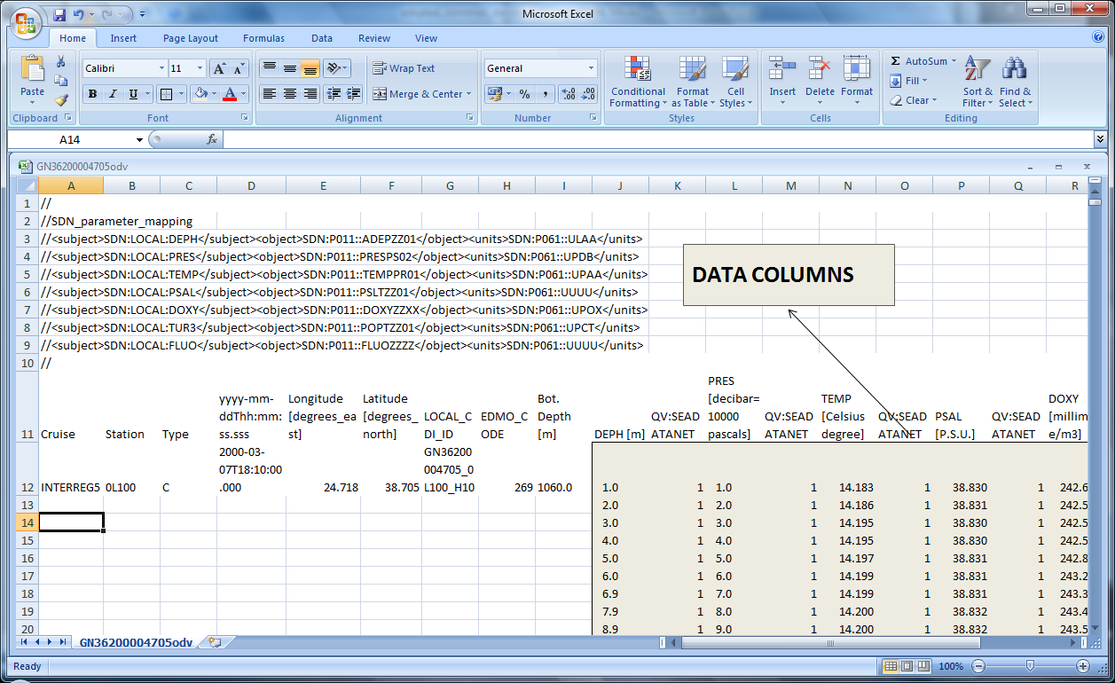
SDN ODV Profile Data Example

Slide 45
SeaDataNet ODV Format
Profile extensions
  CDI linkage
    Addition of two extra metadata columns (LOCAL_CDI_ID and EDMO_code)
  Semantic mapping
    Structured comment records immediately preceding the ODV column header record
    First record is ‘//SDN_parameter_mapping’
    Followed by one mapping record for each data column in the file

Slide 46
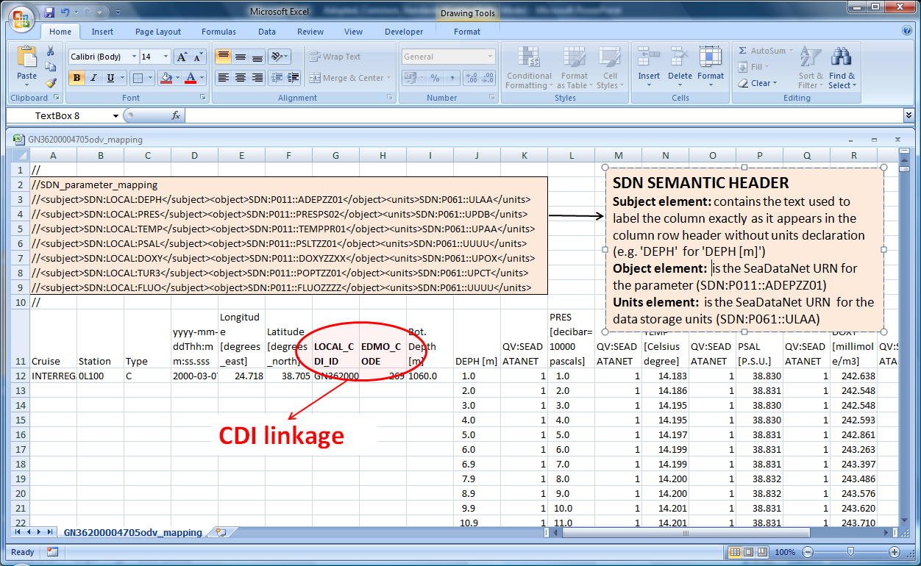
SDN ODV Profile Data Example

Slide 47
SeaDataNet ODV Format
  File extension should be .txt (it is required by the DM)
  Field separator is the tab character (not semi-colon) (DM requirement)
  Further description and other examples at the Data Transport Format manual at:
http://www.seadatanet.org/Standards-Software/Data-Transport-Formats

Slide 48
SeaDataNet MEDATLAS Format
SDN MEDATLAS which is an auto-descriptive ASCII format designed in 1994, by the MEDATLAS and MODB consortia, in the frame of the European MAST II program in conformity with international ICES/IOC GETADE recommendations.
As for ODV, the format has been upgraded to carry additional information of SeaDataNet.

Slide 49
SeaDataNet MEDATLAS Format Data Model
It includes:
  data from the same cruise
  data measured with the same instrument (CTD, Bottle, Current Meter, etc)
A MEDATLAS file consists of three parts:
  a cruise header based on the international ROSCOP information
  a station header including the cruise reference, the originator station reference within the cruise, date, location, list of observed parameters with units
  the data of the station
The sequence ‘station header + data records' is repeated for each profile

Slide 50
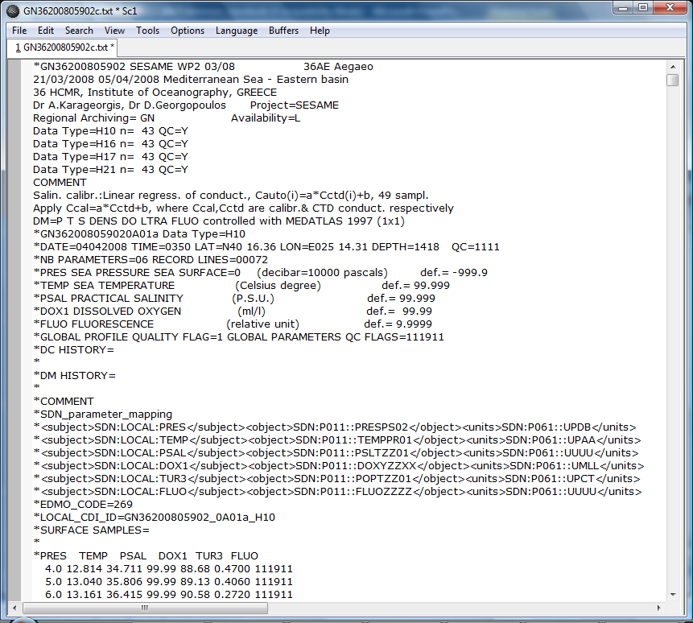
SeaDataNet MEDATLAS Profile Example
CRUISE HEADER

Slide 51
SeaDataNet MEDATLAS Profile Example
STATION HEADER

Slide 52
SeaDataNet MEDATLAS Profile Example
data

Slide 53
SeaDataNet MEDATLAS Profile Example
STATION HEADER
Semantic mapping
CDI linkage

Slide 54
SeaDataNet MEDATLAS Format
The local identifier of the station must be unique because it is the communication link between the portal and the local system
  Concatenation of MEDATLAS station code, EDMO_CODE and station data type.
MEDATLAS identifiers
Cruise code (unique):
FI35199745003 (String of 13 Characters, No blanks, ‘0’ instead)
FI data centre code
35 GF3 country code of the data source
1997 year of the beginning of the cruise
45003 assigned to the cruise by the data centre
Station code (unique):
FI3519974500300011 (String of 18 Characters, No blanks, ‘0’ instead)
FI35199745003 cruise reference
0001 station name
1 cast number

Slide 55
CDI Identifier
Examples of LOCAL_CDI_ID lines:
  LOCAL_CDI_ID = FI3519974500300011 _486_H09
  LOCAL_CDI_ID = FI3519974500300021 _486_H09
  (two different stations from the same cruise)

Slide 56
NetCDF (CF compliant) data format
NetCDF is a set of data formats, programming interfaces, and software libraries that help read and write scientific data files.
NetCDF files are self documenting. That is, they include the units of each variable and notes about what it means and how it was collected
  Principally, designed for gridded data but extended to other observational data.
  NetCDF software was developed at the Unidata Program Center in Boulder, Colorado. It is freeley available at the above UCAR’s website.

Slide 57
NetCDF data format
Like most binary formats, the structure of a netCDF file consists of header information, followed by the raw data itself.
The header information includes information about how many data values have been stored, what sorts of values they are, and where within the file the header ends.
NetCDF fits specifically to store multidimensional data arrays.

Slide 58
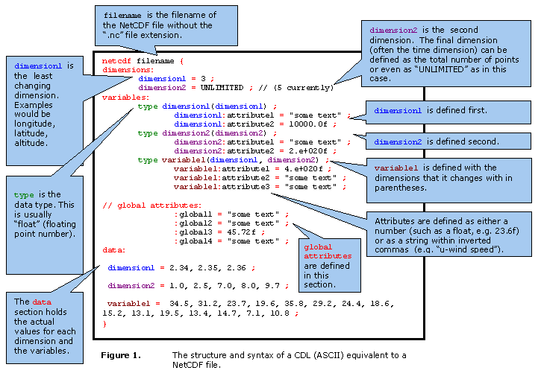
NetCDF data file structure

Slide 59
Data and metadata reformatting tools
MIKADO java tool: Editing and generating XML metadata entries
NEMO java tool: Conversion of any ASCII format to the SeaDataNet ODV4 and SeaDataNet Medatlas ASCII format
Med2MedSDN: Conversion of the Medatlas format to the SeaDataNet Medatlas format
EndsAndBends: Tool for the generation of spatial objects from vessel navigation during observations

Slide 60
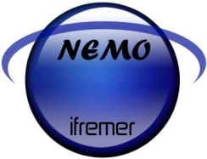
Data and metadata reformatting tools
      NEMO java tool (available under Windows)
        converts any ascii file of vertical profiles, time-series or trajectories to SDN Medatlas and SDN ODV formats
        keeps quality flags if existing in input files and map them to SDN QC flags scale
        generates of a CDI summary file directly usable by MIKADO to generate XML CDI exports
        Generation of the coupling file with the map between LOCAL_CDI_ID and the name of the file
        Latesr Version 1.4.4 and user manual available at:
        http://www.seadatanet.org/Standards-Software/Software/NEMO/Download-NEMO

Slide 61
Data and metadata reformatting tools
      Med2MedSDN java tool (available under Windows)
        reformats MEDATLAS files to MEDATLAS SeaDataNet format
        adds the SeaDataNet extensions : LOCAL_CDI_ID and EDMO_CODE and mapping for parameters
        linked to SeaDataNet vocabularies through Web services for parameters mapping and for list of EDMO codes
        generates a coupling file for the SeaDataNet download manager
        Latest Version 1.1.07 and user manual available at:
        http://www.seadatanet.org/Standards-Software/Software/Med2MedSDN

Slide 62
Data and metadata reformatting tools
      Med2MedSDN java tool (available under Windows)
        reformats MEDATLAS files to MEDATLAS SeaDataNet format
        adds the SeaDataNet extensions : LOCAL_CDI_ID and EDMO_CODE and mapping for parameters
        linked to SeaDataNet vocabularies through Web services for parameters mapping and for list of EDMO codes
        generates a coupling file for the SeaDataNet download manager
        Latest Version 1.1.07 and user manual available at:
        http://www.seadatanet.org/Standards-Software/Software/Med2MedSDN

Slide 63
SeaDataNet reformatting tools and vocabs
        Practical work on NEMO, MIKADO tool
        by
        Michele Fichaut
        tomorrow, 3 July

Slide 64
Vocabularies
At the start of SeaDataNet vocabularies were poorly managed
Metadata populated from Sea-Search libraries
  Weak content and technical governance
  Multiple local copies, each slightly different
  Interoperability compromised by this
Data out of scope at this time

Slide 65
SeaDataNet Developments
Content governance
  Management by individuals replaced by collaborative discussion groups
    SeaDataNet – the SeaDataNet Technical Task Team
    SeaVoX – SeaDataNet TTT plus international experts from IODE and academic communities
    Platforms – ICES-led group concerned with platform code management
    Geo-Seas – partner subgroup in the OGS “Colla” collaborative environment

Slide 66
SeaDataNet Developments
Technical Governance
  Through the NERC Vocabulary Server technology
    Clearly defined master copy of all vocabularies
    Formally versioned with updates published daily
    Every vocabulary and every term represented by a URI that resolves to a SKOS XML document delivering labels, definitions and mappings
    Clients developed such as the Maris Parameter Thesaurus Browser (http://seadatanet.maris2.nl/v_bodc_vocab/vocabrelations.aspx?list=P081)

Slide 67
SeaDataNet Developments
Population
  There are close to 100 vocabularies deemed of interest to SeaDataNet and Geo-Seas. Used for:
    Populating metadata fields in EDMED, CSR, EDIOS and CDI documents
    Tagging parameters in data files

Slide 68
Vocabularies
Pre-requirement for the use of the SDN reformatting tools is :
  Preparation of the mapping between the metadata and :
    SeaDataNet vocabularies : Sea areas, BODC parameters (PDV), Platform classes, SDN device categories, etc
      some automatic mapping is already available in NEMO, MIKADO, Med2MedSDN
    EDMO : Marine organisations
    EDMERP : Marine environmental projects

Slide 69
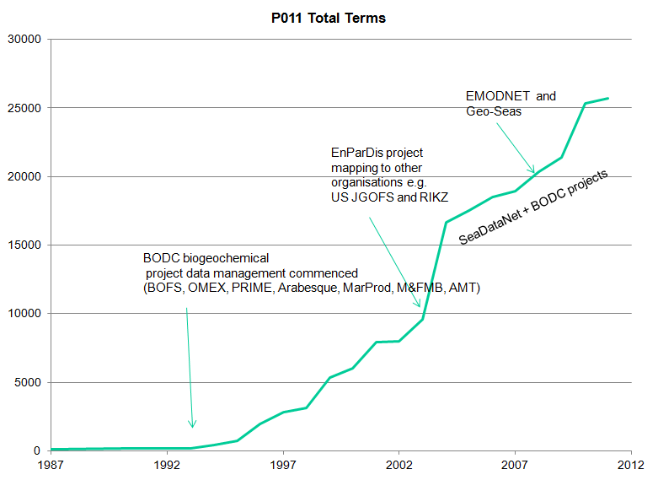
Growth of the P011 Vocabulary

Slide 70
Vocabularies for Metadata
List code | List Name
C16 | SeaDataNet Sea Areas
C77 | ICES ROSCOP data types
C174 | SeaDataNet CSR ship metadata
C180 | IOC country codes
C320 | ISO countries
C371 | Ten-degree Marsden Squares
C381 | Ports Gazetteer
L05 | SeaDataNet device categories
L021 | SeaDataNet Geospatial Feature Types
L031 | SeaDataNet Measurement Periodicity Classes
L051 | SeaDataNet sample collector categories
L061 | SeaDataNet Platform Classes
L071 | SeaDataNet data access mechanisms
L081 | SeaDataNet Data Access Restriction Policies
L101 | SeaDataNet geographic co-ordinate reference frames
L111 | Height and Depth Vertical Co-ordinate Reference Datum
L181 | ROSCOP sample quantification units
L201 | SeaDataNet measures and qualifier flags
L231 | SeaDataNet metadata entities
L241 | SeaDataNet data transport formats
L300 | MEDATLAS Data Centres
P011 | BODC Parameter Usage Vocabulary
P021 | BODC Parameter Discovery Vocabulary
P061 | BODC data storage units
P081 | SeaDataNet Parameter Disciplines
P091 | MEDATLAS Parameter Usage Vocabulary
EDMO | European Directory of Marine Organizations
EDMERP | European marine projects

Slide 71
Vocabularies for Data
The following vocabularies needed for label parameters in SeaDataNet
  ‘Ful’ Parameter Usage Vocabulary (P011)
  SeaDataNet flags (L201)
  Units Vocabulary (P061)

Slide 72
Vocabularies Mappings
Available mappings between different vocabularies lists are provided by the BODC Vocabulary Server Mappings Index (C970) at:
http://seadatanet.maris2.nl/v_bodc_vocab/search.asp?name=(C970)%20Vocabulary+Server+Mappings+Index&l=C970
These existing mappings are used by the SDN tools NEMO, MIKADO, Med2MedSDN for automatic mapping (along with links to EDMO and EDMERP entries)

Slide 73
Vocabulary Access
Interface clients
  Maris client set up for SeaDataNet at
  http://seadatanet.maris2.nl/v_bodc_vocab/welcome.aspx fulfill most needs of SeaDataNet partners
  BODC clients at http://vocab.ndg.nerc.ac.uk/ cover more vocabularies for those interested to go beyond SeaDataNet

Slide 74
Future Developments
NETMAR FP7 project
  NERC Vocabulary Server development forms the bulk of one work package
    V2 available by the end of 2011
      Thesaurus/ontology server as well as a vocabulary server
      SKOS compliant with W3C accepted version
      Mappings to external resources (e.g. GEMET)
      Fully RESTful read and secured write interface with improved API
      Multi-lingual capability
    Vocabulary/term URI addressing will be maintained
    V1 will be maintained until confirmed dead by service monitoring

Slide 75
Objectives of QC
Good quality research depends on good quality data and good quality data depends on good quality controls methods.
“to ensure the data consistency within a single dataset and within a collection of data sets and to ensure that the quality and the errors of the data are apparent to the user, who has sufficient information to assess its suitability for a task”
(IOC/CEC Manual and Guides #26)

Slide 76
QC procedures
      The QC procedures for oceanographic data according to IOC, ICES and EU recommendations include automatic and visual controls on the data and their metadata.
      Data measured from the same instrument and coming from the same “cruise” are organized at the same file, transformed to the same exchange format and then are subject to a series of quality tests:
  Check of the Format
  Check of the location and date
  Check of the measurements
      The results of the automatic control are added as QC flags to each data value.
      Validation or correction is made manually to the QC flags and NOT to the data.
      In case of uncertainties, the data originator is contacted.
      All QC procedures applied to the data are fully documented by DCs

Slide 77
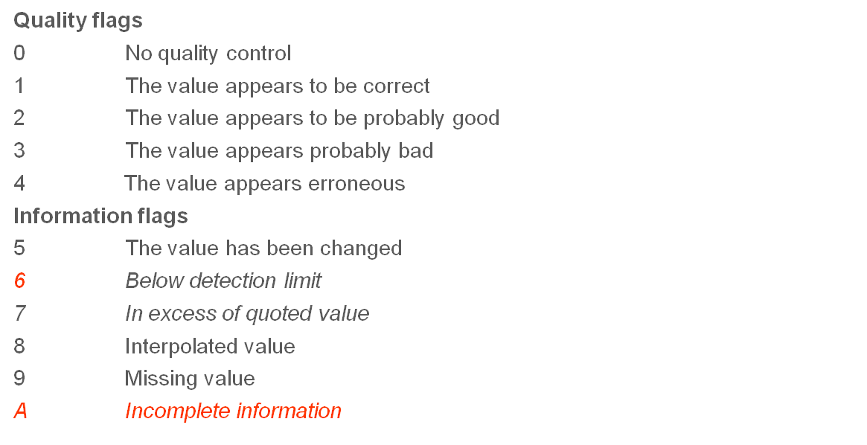
SEADATANET Quality Flags values (L021)
(Based on IGOSS/UOT/GTSPP & Argo QC flags)

Slide 78
Format Check
      Detects anomalies like wrong platform codes or names, parameters name or units, missing mandatory information like reference to a cruise or observation system, source laboratory, sensor type
      No further control should be made before the correction and validation of the archive format

Slide 79
Automatic Checks of location and date
      For vertical profiles
      (CTD, XBT, MBT, Bottle Data, etc)
        duplicate entries within a space-time radius
        date: reasonable date, station date within the begin and end date of the cruise
        ship velocity between two consecutive stations.
        (e.g., speed > 15 knots (threshold value) means wrong station date or wrong station location )
        location/shoreline: on land position
        bottom sounding: out of the regional scale, compared with the reference surroundings

Slide 80
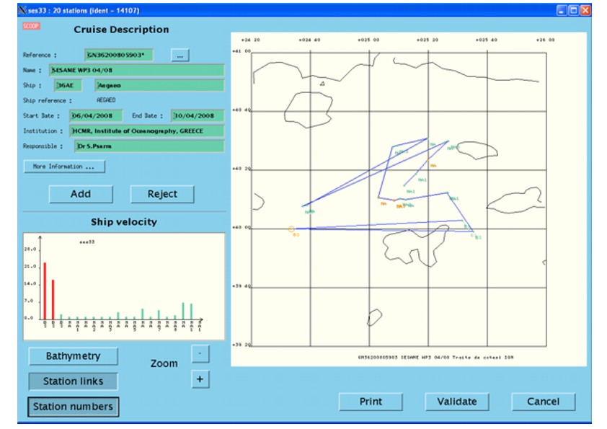
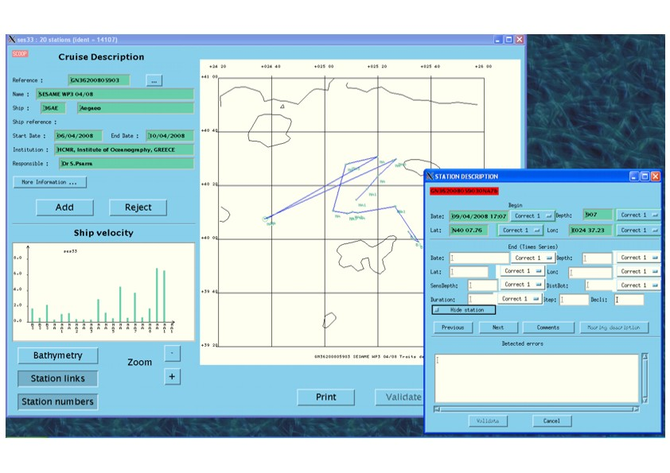
Visual Checks of location and date of cruises

Slide 81
Automatic Checks of location and date
      For time series from fixed moorings (Current Meters, ADCP, Sediment Traps, etc)
  depth checks: less than the bottom depth
  series duration checks: consistence with the start and end date of the dataset
  duplicate moorings checks
  land position checks

Slide 82
Dublicates Checks
  Conventional techniques
    Algorithms
      comparison of the location, time of the measurements
      (5 miles, 15 mins in GTSPP)
      comparison of the measurements
      comparison of extra metadata (platform codes- floats id, … )
    Visualization of ships tracks, transects, …
  Advanced techniques:
    Computation of an electronic signal/Unique data identifier -CRC Tag (GTSPP report 2002)
    With a more experimental approach giving more weight on some metadata like platform code, position, time, …
      Need of reliable metadata
    Keep the most complete data set

Slide 83
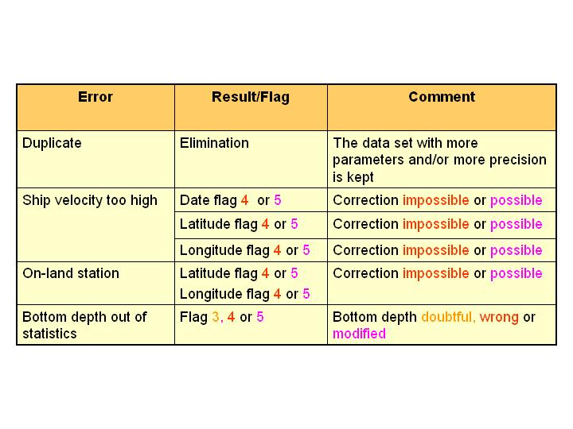
Metadata QC results
  According to MEDATLASII QC flag scale

Slide 84
Automatic Checks of measurements
For vertical profiles and time series
  presence of at least two parameters: vertical/time reference + measurement
  pressure/time must be monotonous increasing
  the profile/time series must not be constant: sensor jammed
  broad range checks: check for extreme regional values compared with the min. and max. values for the region. The broad range check is performed before the narrow range check.
  data points below the bottom depth
  spikes detection: usually requires visual inspection. For time series a filter is applied first to remove the effect of tides and internal waves.
  narrow range check: comparison with pre-existing climatological statistics. Time series are compared with internal statistics.
  density inversion test: (potential density anomaly, FOFONOF and MILLARD, 1983, MILLERO and POISSON, 1981)
  Redfield ratio for nutrients: ratio of the oxygen, nitrate and alkalinity (carbonates) concentration over the phosphate (172, 16 and 122 in Atlantic and Indian ocean, Takahashi & al)

Slide 85
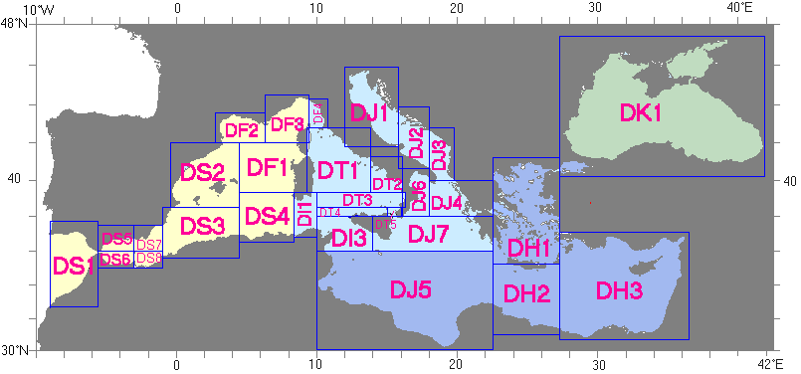


Broad Range Check
Regional and depth parameterization in MEDAR/MEDATLASII
http://www.ifremer.fr/sismer/program/medar/htql/liste_region.htql

Slide 86

Narrow Range Check
    qc flag=2, probably good data, (result of auto control)
    qc=1 (manually)
    The automatic comparison with reference climatologies is made by linearly interpolating the references at the level of the observation
    Outliers are detected if the data points differ from the references more than:
      5 x standard deviation over the shelf (depth <200m)
      4 x standard deviation at the slop and straits region (200 m< depth < 400m)
      3 x standard deviation at the deep sea (depth >400m)

Slide 87
Density inversion test, the importance of visual check
example of density inversion due to temperature increase with depth
z1
Wrong Temp value
detected
automatically
z1
Wrong Temp value detected
automatically,
but it is correct value,
the previous value flag is
Manually changed to “good”
z2
z2
threshold value in HNODC=0.03 for high resolution data, 0.05 for near surface and low resolution data

Slide 88
Spikes Check
  The test is sensitive to the vertical/time resolution.
  It requires at least 3 consecutive good/acceptable values.
  It requires 2 consecutive at the surface and the bottom.
  The IOC Algorithm to detect the spikes taking into account the difference in values (for regularly spaced data like CTD):
    |V2-(V3+V1)/2 | - |V1-V3|/2 ) > THRESHOLD VALUE
  For irregularly spaced values (like bottle data) a better algorithm to detect the spikes, taking into account the difference in gradients instead the difference in values, is:
    ||(V2-V1)/(P2-P1)-(V3-V1)/(P3-P1)|-|(V3-V1)/(P3-P1)||>THRESHOLD VALUE

Slide 89
Large temperature inversion and gradient tests
  World Ocean Data Centre, NODC Ocean Climate Laboratory.
    Relying solely to temperature data to quantify the maximum allowable temperature increase with depth (inversion) and decrease (excessive gradient) with depth (0.3 C per m, 0.7 C per m)

Slide 90

Measurements QC results
  According to MEDATLASII qc flag scale

Slide 91
Real Time QC in Operational Oceanography
(such as Argo, GTSPP and GOSUD Programmes of IOC/IODE)
Managed data sets are mainly T-S profiles and time series (point time series or trajectories) from:
  CTD
  XBT
  Profiling floats
  Thermosalinographs
  Drifting and moored buoys
  Gliders

Slide 92
ARGO Real-Time QC on vertical profiles
Based on the Global Temperature and Salinity Profile Project–GTSPP of IOC/IODE, the automatic QC tests are:
Platform identification: checks whether the floats ID corresponds to the correct WMO number.
Impossible date test: checks whether the observation date and time from the float is sensible.
Impossible location test: checks whether the observation latitude and longitude from the float is sensible.
Position on land test: observation latitude and longitude from the float be located in an ocean.
Impossible speed test: checks the position and time of the floats.
Global range test: applies a gross filter on observed values for temperature and salinity.
Regional range test: checks for extreme regional values
Pressure increasing test: checks for monotonically increasing pressure
Spike test: checks for large differences between adjacent values.
Gradient test: is failed when the difference between vertically adjacent measurements is too steep.
Digit rollover test: checks whether the temperature and salinity values exceed the floats storage capacity.
Stuck value test: checks for all measurements of temperature or salinity in a profile being identical.
Density inversion: Densities are compared at consecutive levels in a profile, in both directions, i.e. from top to bottom profile and from bottom to top.
Grey list (7 items): stop the real-time dissemination of measurements from a sensor that is not working correctly.
Gross salinity or temperature sensor drift: to detect a sudden and important sensor drift.
Frozen profile test: detect a float that reproduces the same profile (with very small deviations) over and over again.
Deepest pressure test: the profile has pressures not higher than DEEPEST_PRESSURE plus 10%.

Slide 93
CORIOLIS QC on time series
Real Time Automatic quality controls
test 1: Platform Identification
test 2: Impossible Date Test
test 3: Impossible Location Test
test 4: Position on Land Test
test 5: Impossible Speed Test
test 6: Global Range Test
test 7: Regional Global Parameter Test for Red Sea and Mediterranean Sea
test 8: Spike Test
test 10: comparison with climatology
The Delayed-Mode QC in Coriolis Data centre for profiles and time series consists of Visual QC, objective analysis and residual analysis (to correct sensor drift and offsets).

Slide 94
Sea Level Data QC
(Based on EASEAS-RI Project)
Near Real Time QC (L1)
Detection of strange characters
Wrong assignment of date and hour
Spike test
Outliers
Gaps
Constant values detection (stability test)
Filtering to hourly values
Computation of residuals
Delayed Mode QC (L2)
Detection of strange characters
Wrong assignment of date and hour
Spike test
Gaps
Constant values detection (stability test)
Interpolation of short gaps and filtering to hourly values
Delayed Mode-Higher Level QC
Tidal analysis
Computation and inspection of residuals
extremes
Statistics means
Comparison with neighbouring tide gauges (correlations)
Standard Normal Homogeneity Test
EOF Analysis

Slide 95
Real Time QC limitations
The real time qc tests are limited and automatic due to the requirement of minimal delay to their distribution.
After real time QC, visual QC and calibrations (delayed mode qc) are necessary before data distribution.

Slide 96
World Ocean Data Centre
The QC procedures in the WDC, Ocean Climate Laboratory are summarized in three major parts:
1. Check of the observed level data
For the construction of the climatology – processing
2. Interpolation to standard levels
    3. Standard level data checks

Slide 97
World Ocean Data Centre
1. Checks of the observed level data
  Format conversion
  Position/date/time check
  Assignment of cruise and cast numbers
  Speed check
  Duplicate profile/cruise checks
  Range checks
  Depth inversion and depth duplication checks
  Large temperature inversion and gradient tests: to quantify the maximum allowable temperature increase with depth (inversion) and decrease (excessive gradient) with depth (0.3 C per m, 0.7 C per m)
  Observed level density inversion checks

Slide 98
World Ocean Data Centre
Regional parameterization of the world ocean in WOD09.
(plus vertical parameterization)

Slide 99
World Ocean Data Centre
2. Interpolation to standard levels
  Modified Reiniger – Ross scheme (Reiniger and Ross, 1968): less spurious features in regions with large vertical gradients than a 3-point Lagrangian interpolation.
3. Standard level data checks
  Density inversion checks (Fofonoff et al., 1983)
  Standard deviation checks: a series of statistical analysis tests based on the mean, std and number of observations in a 5 degrees square box for coastal, near-coastal and open ocean data.
  Objective analysis
  Post objective analysis subjective checks: to detect unrealistic -“bullseyes” features mostly in data sparse areas

Slide 100
SeaDataNet QC Protocol
A guideline (V1) of recommended QC procedures has been compiled, reviewing NODC schemes and other known schemes (e.g. WGMDM guidelines, World Ocean Database, GTSPP, Argo, WOCE, QARTOD, ESEAS,SIMORC, etc.)
The guideline at present contains QC methods for CTD (temperature and salinity), current meter data (including ADCP), wave data and sea level data
The guideline (V1) has been compiled in discussion with IOC, ICES and JCOMM, to ensure an international acceptance and tuning

Slide 101


SeaDataNet QC tools
Ocean Data View (ODV)
  QC, analysis and visualization of data sets
DIVA software package
QC= compare the data-analysis misfit to a theoretically derived distribution of these misfits (residuals).
  Interpolation and variational analysis of data sets
  DIVA has been integrated into ODV
    better interpolation scheme
    proper treatment of domain separation due to land masses
Available at:
http://www.seadatanet.org/Standards-Software/Software

Slide 102
SeaDataNet QC tools
        Practical work with ODV and Diva tools
        by
        Reiner Schlitzer , Mohamed Ouberdous
        on Wednesday, 4 July

