Slide 1
Introduction to biological data management
Leen Vandepitte – Flanders Marine Institute

Slide 2
SDN and biological data
Marine biological data system in Europe
International data flow
Types of biological data
Data formats
Taxonomy
Definition
Spelling and other errors or variations
Synonyms & homonyms
World Register of Marine Species
What?
Users
How to use it
Exercises

Slide 3
SeaDataNet & biological data
Marine observing systems highly fragmented; measurement of physical, geophysical, geological, biological and chemical parameters, biological species, …
SDN: standardized system to manage these kind of data
Now: mostly oceanographic data
Near future: also biological data from SDN partners available
According to standard data format
Public data will become part of international data flow
Now: short introduction to biological data; more elaborate training in future

Slide 4
Marine biological data system in Europe
EurOBIS – European Ocean Biogeographic Information System
Biogeographic data on European marine species: taxon name – position (lat-long) – time
Freely available online, quality controlled data
Developed within MarBEF (FP6) (2004-2009)
Further maintenance by VLIZ
1 of the 14 regional nodes (RoNs) of OBIS
Backbone of EMODnet
Standards: Darwin Core & World Register of Marine Species (WoRMS)
Currently available in EurOBIS (July 2012)
386 datasets
15,2 million distribution records
International data flow: EurOBIS <=> OBIS <=> GBIF

Slide 5
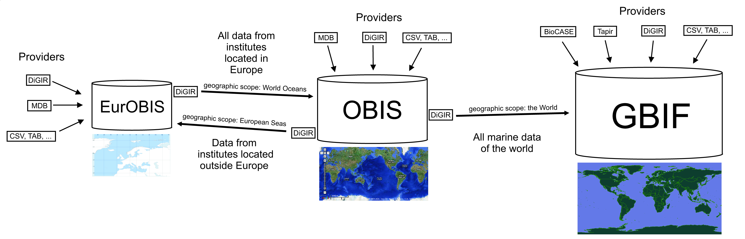
Data flow for public data
Marine data from
Europe
outside Europe, by European institutes
Data delivery:
Through email: excell, access, CSV, …
Through servers: DIGIR, IPT toolkit
EurOBIS: one of the 14 regional nodes of the Ocean Biogeographic Information System (OBIS)
OBIS: marine thematic sub-network of the Global Biodiversity Information Facility (GBIF)

Slide 6
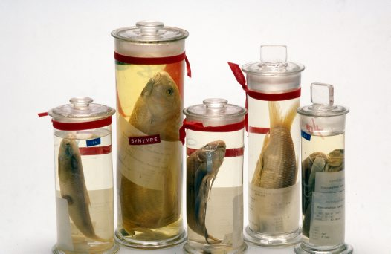
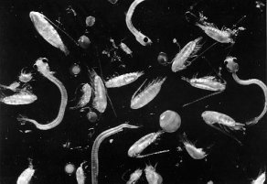
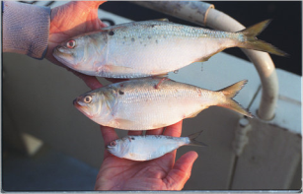
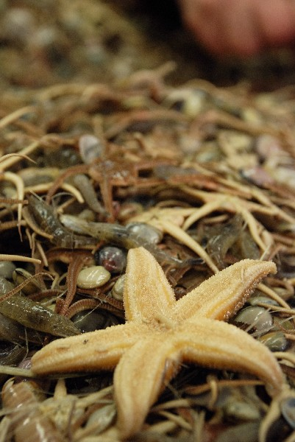
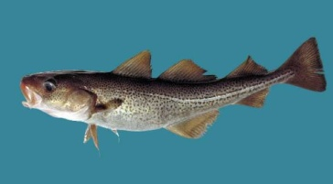
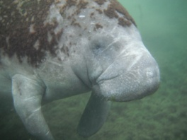
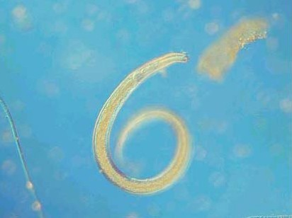
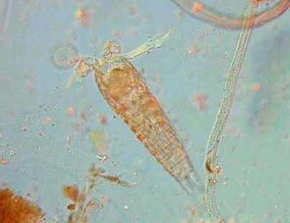
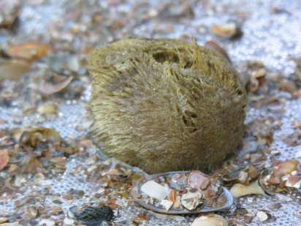
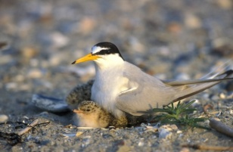
Types of biological data
Observation and results
Occurence
Density
Biomass
Body morphology
Condition
Substance concentrations or ratios
Sequencing material
Biological components (=non-taxonomic groups)
benthos, plankton, fish, birds, mammals, ...
Notes:
manatee

Slide 7
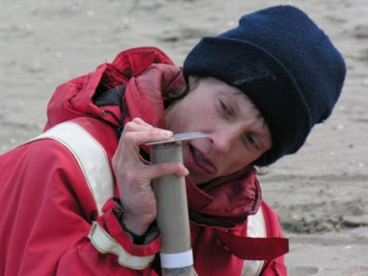
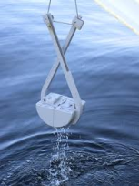
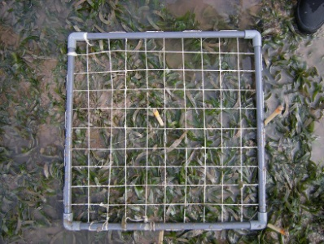
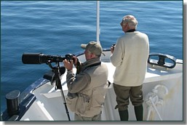
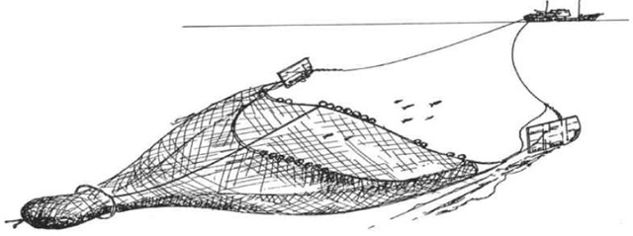
Geometry and sampling protocol
Point
soft-bottom grabs & cores (depth layer separation possible)
vertical net and water samples (multiple depths possible)
static net samples
hard-bottom sampling (scraping or visual)
static observations/underwater photography
Curve
net trawl, dredge or sledge
transect observations/underwater video
Surface
surface observations

Slide 8
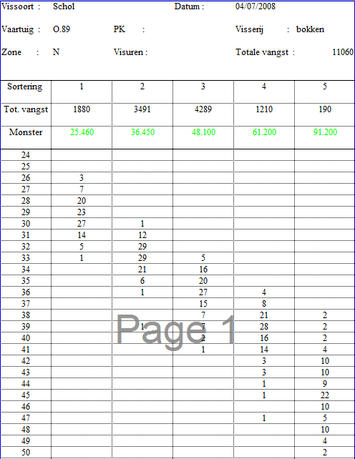
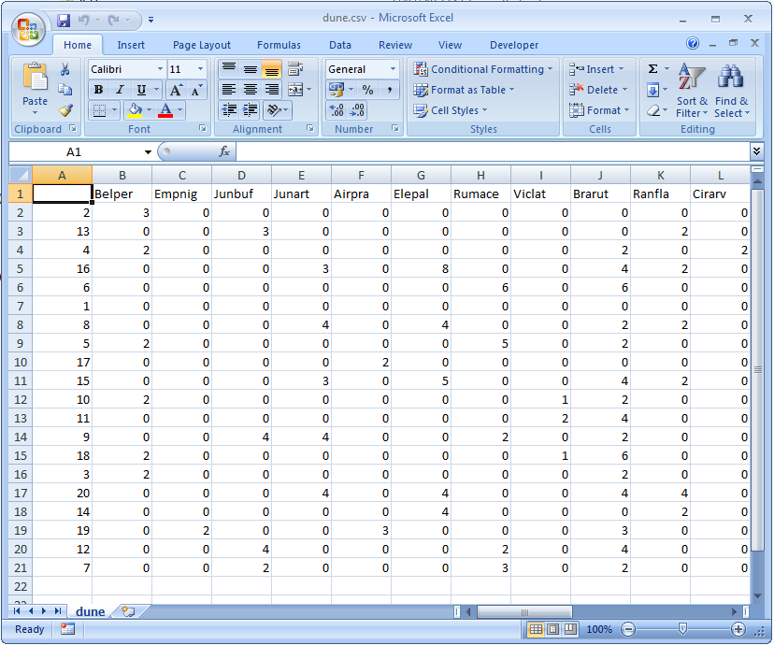
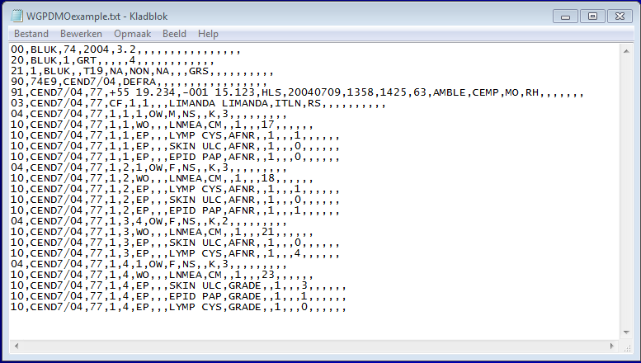
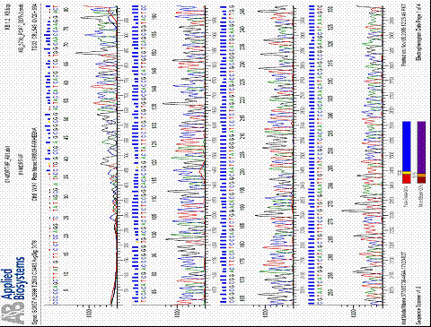
Data formats

Slide 9
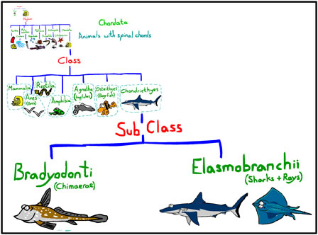
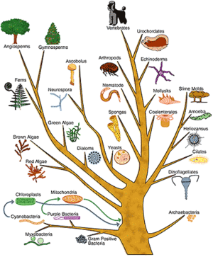
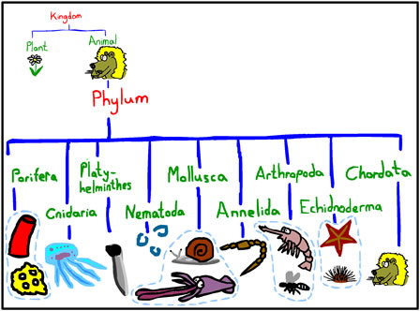
“Common denominator” = taxonomy
Taxonomy
from Ancient Greek: τάξις taxis "arrangement" and Ancient Greek: νομία nomia "method"
= the academic discipline of defining groups of biological organisms on the basis of shared characteristics and giving names to those groups.
To bring order into the “chaos” of species, to help scientists in how to deal with species, so they know they are talking about the same creature and to classify them in larger groups.
International Code on Zoological Nomenclature (ICZN)
International Code of Nomenclature for algae, fungi, and plants
Kingdom > Phylum > Class > Order > Family > Genus > Species
Notes:
http://www.sharky-jones.com/Sharkyjones/Slow/what%20page/whatmain1bii.html

Slide 10
Taxonomy: spelling errors
… some names are harder to spell than others …
Actinobacillus actimomycetemcomitans
Actinobacillus actimycetemcomitans
Actinobacillus actinmycetemcomitans
Actinobacillus actinomicetemcomitans
Actinobacillus actinomy
Actinobacillus actinomyce
Actinobacillus actinomycemcomitans
Actinobacillus actinomyceremcomitans
Actinobacillus actinomycetam
Actinobacillus actinomycetamcomitans
Actinobacillus actinomycetecomitans
Actinobacillus actinomycetemcmitans
Actinobacillus actinomycetemcomintans
Actinobacillus actinomycetemcomitance
Actinobacillus actinomycetemcomitans
Actinobacillus actinomycetemcomitants
Actinobacillus actinomycetemcommitans
Actinobacillus actinomycetemocimitans
Actinobacillus actinomycetencomitans
Actinobacillus actinomycetum
Actinobacillus actinomyctemcomitans
Actinobacillus actinomyectomcomitans
Actinobacillus actinomyetemcomitans
Actinobacillus actinonmycetemcomitans
Actinobacillus actionomycetemcomitans
Actinobacillus actynomicetemcomitans
Actinobacillus antinomycetemcomitans
Difficulties with Latinized Names
Transcription errors
Which one is correct? Controlled taxonomic vocabulary necessary!

Slide 11
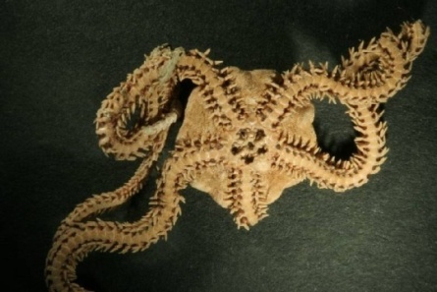
Dataset | Before tax. check |  | After tax. check
1 | Amphiura sunderali
2 | Amphiura sundevali |  | Amphiura sundevalli
3 | Amphiura sundvali
4 | Amphiura sundevalli

Slide 12
Taxonomy: computer errors
… automatic ‘series filling’ is not always recommended …
Clupea harengus Linnaeus, 1758
Clupea harengus Linnaeus, 1759
Clupea harengus Linnaeus, 1760
Clupea harengus Linnaeus, 1761
Clupea harengus Linnaeus, 1762
…
Clupea harengus Linnaeus, 2254
Clupea harengus Linnaeus, 2255
…

Slide 13
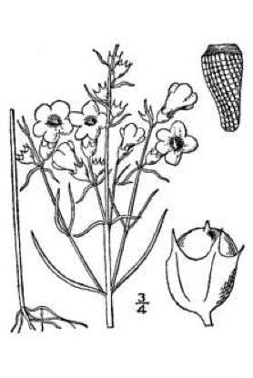
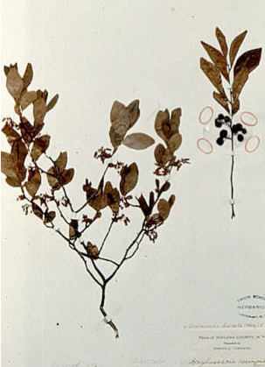
Taxonomy: many ways to (correctly) spell a name
Agalinus paupercula borealis
Agalinus pauperculum borealis
Agalinis paupercula var. Borealis
Agalinus pauperculum var. borealis
Agalinus paupercula var. borealis
Agalinus paupercula var. borealis Pennell
Agalinus paupercula Britton var. borealis Pennell
Agalinus paupercula (Gray) Britt. var. borealis Pennell
Agalinis paupercula (A.Gray) Britton var. borealis Pennell
Agalinus paupercula (Gray) Britton var. borealis (Pennell) Zenkert 1934
Gerardia paupercula borealis
Gerardia paupercula var. borealis
Gerardia paupercula var. borealis (Pennell) Deam
Gerardia paupercula (Gray) Britt. var. borealis (Pennell) Deam
Gerardia paupercula (Gray) Britt. var. borealis (Pennell) Deam
Gerardia paupercula (A. Gray) Britton var. borealis (Pennell) Deam
Gerardia paupercula (A. Gray) Britton subsp. borealis (Pennell) Pennell
Gerardia paupercula (Gray) Britt. ssp. borealis (Pennell) Pennell
Gerardia paupercula Britton ssp. borealis Pennell

Slide 14
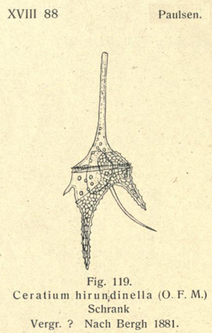
Taxonomy: variation in author name
Ceratium hirudinella
Ceratium hirudinella (Muller 1773)
Ceratium hirundienella
Ceratium hirundinella
Ceratium hirundinella (Mull )
Ceratium hirundinella (Mull)
Ceratium hirundinella (Muller )
Ceratium hirundinella (Muller 1773)
Ceratium hirundinella (Muller)
Ceratium hirundinella (O. F. Müller) Bergh
Ceratium hirundinella (O.F. MÃ¼ller) Bergh
Ceratium hirundinella (O.F. Müller) Bergh
Ceratium hirundinella (O.F. Müller, 1773) Dujardin, 1841
Ceratium hirundinella (O.F. M�ller) Bergh
Ceratium hirundinella Dujardin
Ceratium hirundinella O. F. M.
Ceratium hirundinella O. F. Muller
(Example from the Global Names Index - GNI)

Slide 15
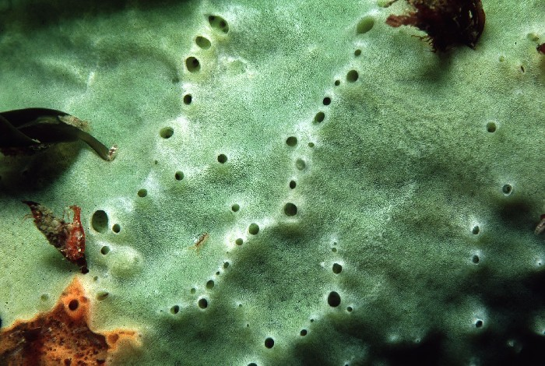
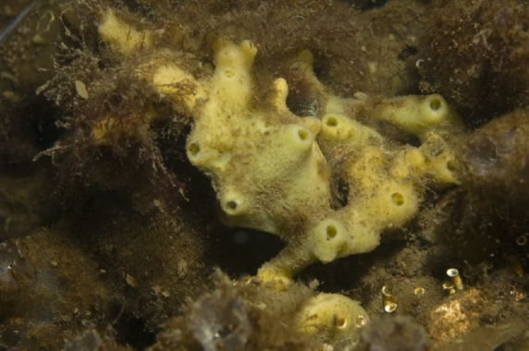
Taxonomy: synonymy
Halichondria (Halichondria) panicea (Pallas, 1766)
Bread-crumb sponge
(> 60 synonyms)

Slide 16
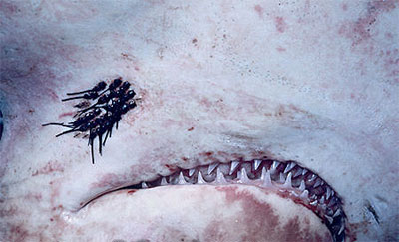
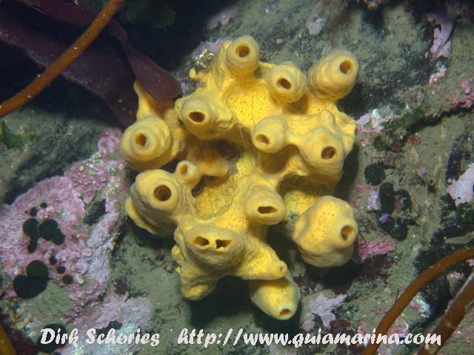
Taxonomy: homonymy
Homonym
A name for a taxon that is identical in spelling to another such name,
that belongs to a different taxon.
Only one of the two names can stay “valid”, the other becomes “invalid”.
Scientific name: Alebion
Alebion Krøyer, 1863
=> Animalia, Crustacea, parasitic copepods
Alebion Gray, 1867
=> Animalia, Porifera
=> Accepted as Iophon Gray, 1867

Slide 17
How to deal with all this variation?
Link taxon names with World Register of Marine Species (WoRMS)
WoRMS:
Standard list of marine taxon names
First authoritative list of names of all marine & brackish water taxa worldwide
Managed by VLIZ, directed by taxonomic experts
Open access
Follow international standards & serve permanent Global Unique IDs (LSIDs) http://www.tdwg.org/standards/150/download/
Up-to-date and (near) complete (incl. synonyms &commonly used spelling mistakes)
If no link possible:
Consult with data provider(s)
Consult with taxonomic expert(s) at info@marinespecies.org
Originally delivered name is always safeguarded!
www.marinespecies.org

Slide 18
WoRMS content
455 642 taxa
213 997 accepted species of which 91% is checked by a taxonomic editor
20 573 images
47 275 vernacular names
155 076 key literature references (=sources)
45 000 specimen details
345 914 published distributions
> 500 000 web links
Notes, feeding type & habitat information, host-parasite relationships …

Slide 19
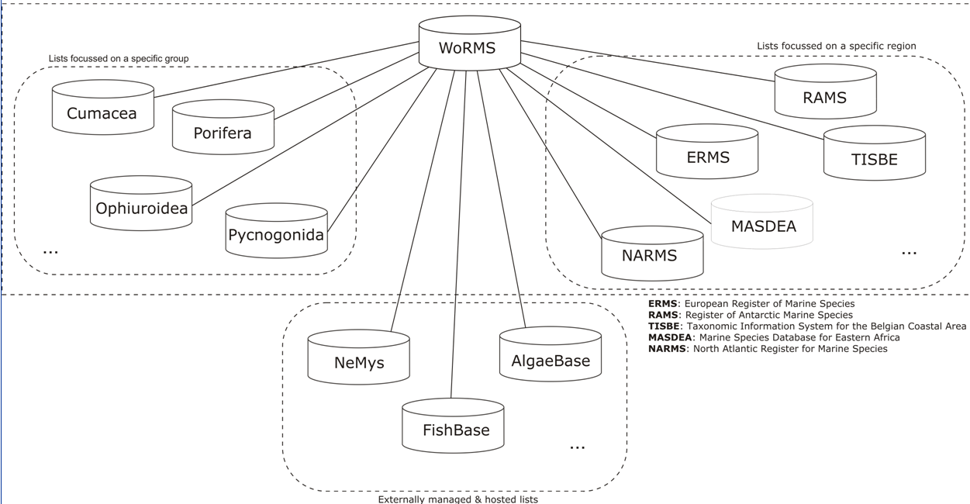
integrates over 100 global, regional and thematic species databases into a common IT platform, which means every species occurs in the system only once
9 RSDs
71 GSDs
4 TSDs
9 ext. GSDs

Slide 20
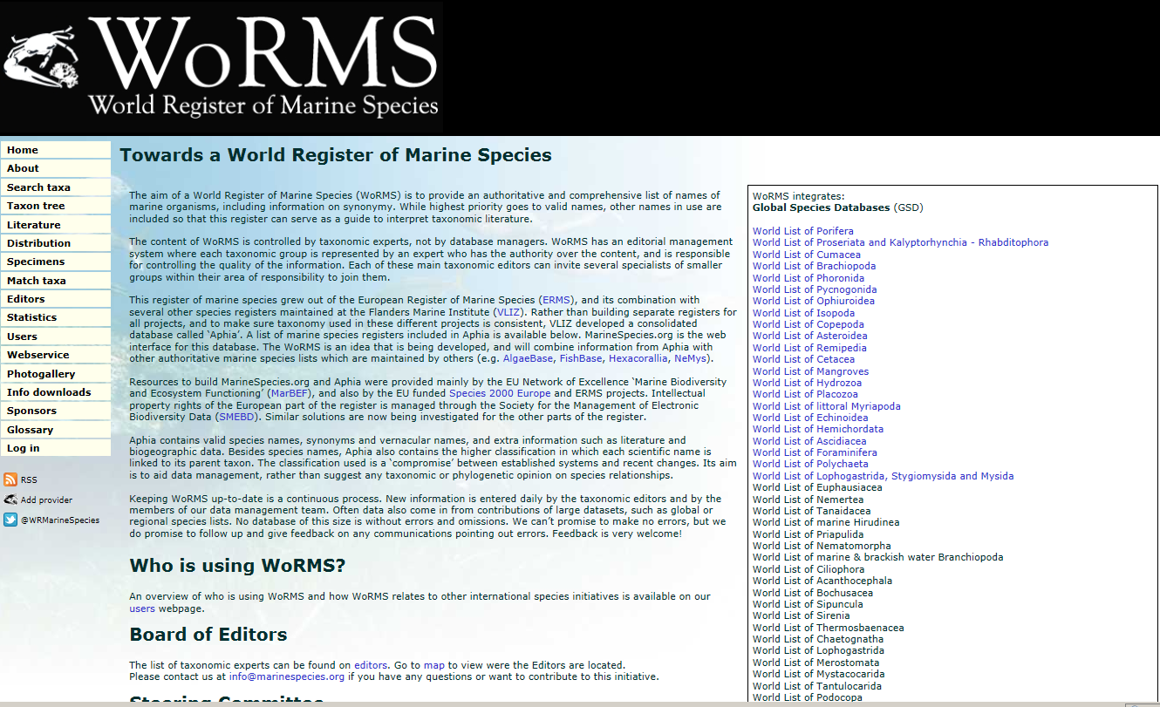

Slide 21
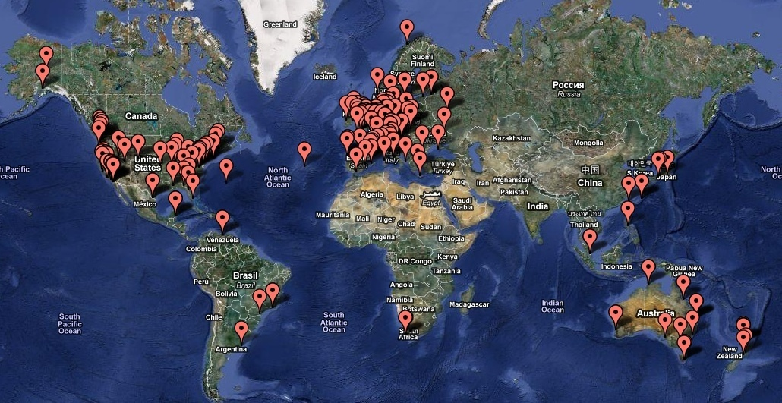
WoRMS users
As standard taxonomic reference for organizations and programmes
=> e.g. GBIF, OBIS, CoL, EoL, ICES, NODCs, …
Quality control purposes
=> through webservices & taxon match tool
Website:
4 000 visitors per day
3 million hits per month
> 600 citations of “World Register of Marine Species” through Google Scholar

Slide 22
How to use WoRMS?
For single name: ‘search taxa’
www.marinespecies.org

Slide 23
For a batch of names: ‘match taxa’ (online ‘taxon match’ tool)
This tool uses the following components:
TAXAMATCH fuzzy matching algorithm by Tony Rees
PHP/MySql port of TAXAMATCH by Michael Giddens
Scientific Names Parser by Dmitry Mozzherin

Slide 24
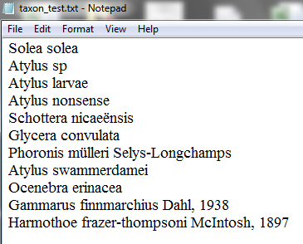
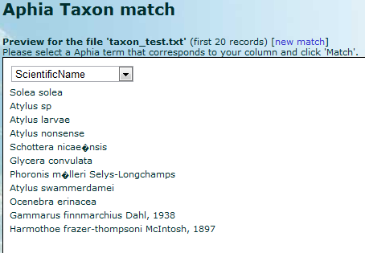
Prepare your own file (Plain text [TXT], Comma Separated [CSV] & Excel Sheet [XLS, XLSX]
Upload onto website

Slide 25
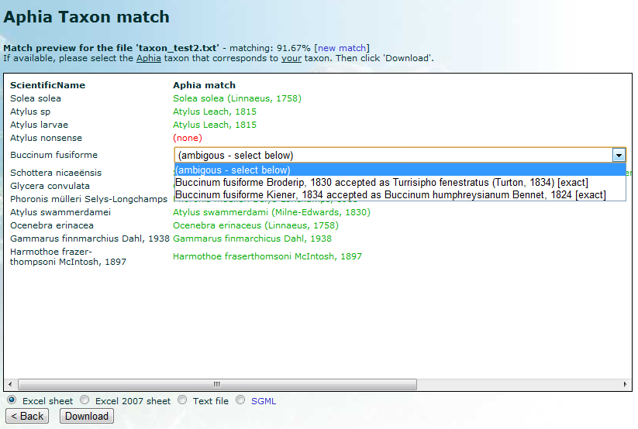

Slide 27
Some exercises
Online taxon match
Check providers page of EurOBIS (www.eurobis.org => providers)
Datasets from your country/institute already present?
Additional (large monitoring) datasets missing?

Slide 28
Online taxon match
Download exercise files from training server (3 excel files)
Go to www.marinespecies.org => match taxa
(check online manual)
Match files with online taxon match tool (! Data format)
Double check possible doubtful (dubious) entries
Any questions? Just ask ☺

Slide 30
SOAP web services
Allows to dynamically link own applications to the register
Allows to match a locally stored species list to the register
Allows to extract taxonomic and other information from this register
A few examples of possible applications:
get the AphiaID for your taxon
check the spelling of your taxa
get the authority for your taxa
get the full classification for your taxa
resolve your unaccepted names to accepted ones
get all synonyms for a taxon
match your species list
resolve a common name/vernacular to a scientific name
get the sources/references for a taxon
get the WoRMS citation for a taxon
Notes:
As a user or developer you can use this service to feed your own application with standard taxonomy. We currently use the platform-independent SOAP/WSDL standard.
SOAP (Simple Object Access Protocol) is a way for a program running in one kind of operating system (such as Windows 2000) to communicate with a progam in the same or another kind of an operating system (such as Linux) by using the World Wide Web's Hypertext Transfer Protocol (HTTP) and its Extensible Markup Language (XML) defined by the Web Service Definition Language (WSDL), as a mechanisms for information exchange

