Slide 1
Further developing the SeaDataNet pan-European infrastructure for marine and ocean data management
Michèle Fichaut and the SeaDataNet Consortium

Slide 2
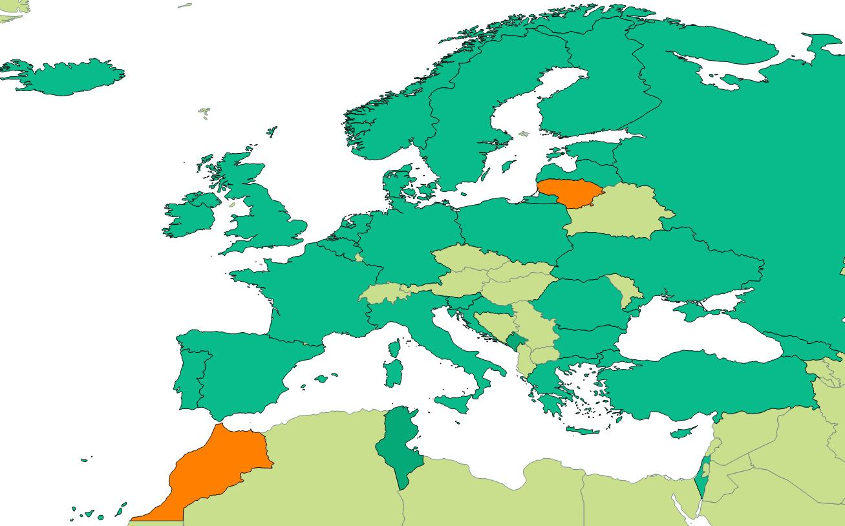
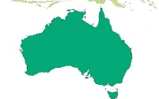
What is SeaDataNet?
A pan-European infrastructure set up and operated for managing marine and ocean data in cooperation with the NODCs and data focal points of 34 countries bordering the European seas
A legal entity : SeaDataNet AISBL for sustainability of the Consortium
(same structure than EuroGoos)
90s | Metadata directories Medar/MedAtlas
2002-2005 | Sea-Search (FP5)
2006-2011 | SeaDataNet (FP6)
2011-2015 | SeaDataNet II (FP7)
2016-2020 | SeaDataCloud (H2020)

Slide 3
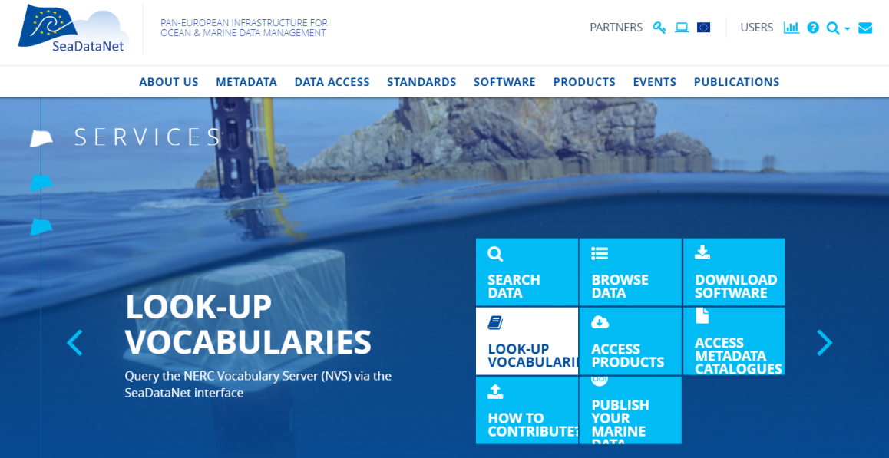
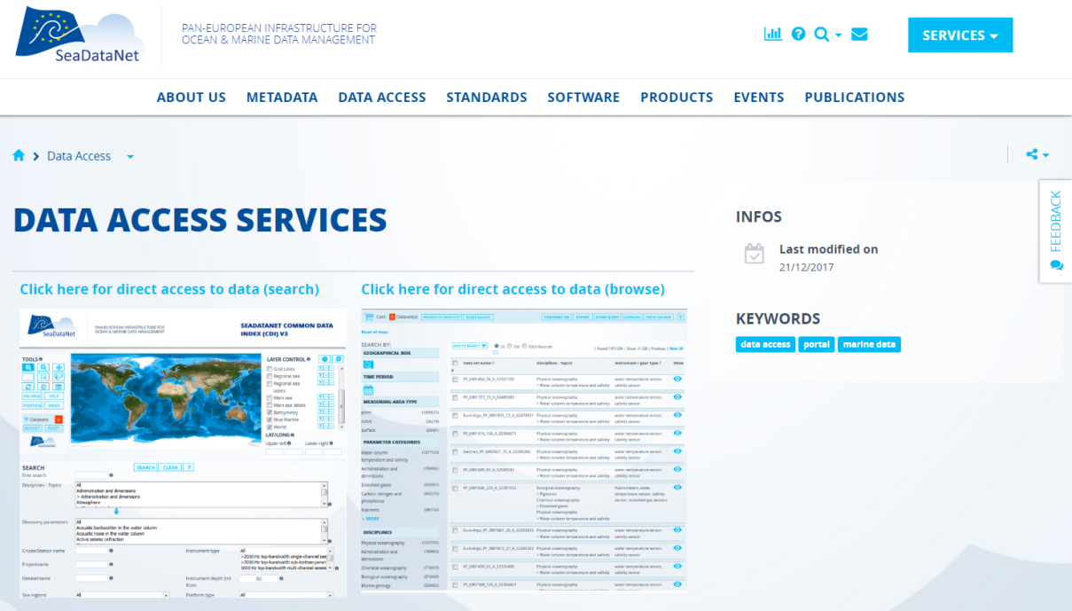
SeaDataNet portal
With access to
Standards
& common vocabularies
Software tools both for data centres and users
Data
Products
http://www.seadatanet.org

Slide 4
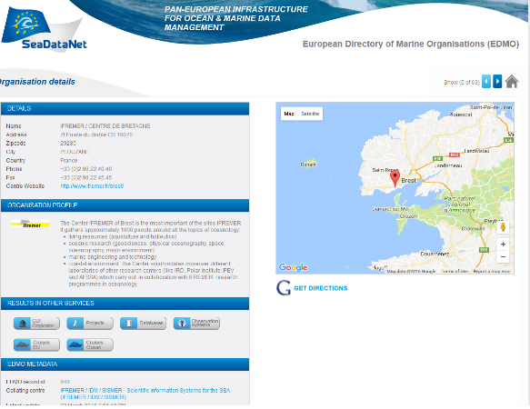
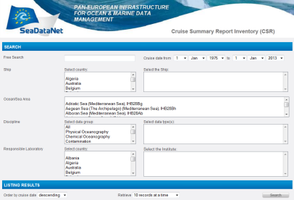
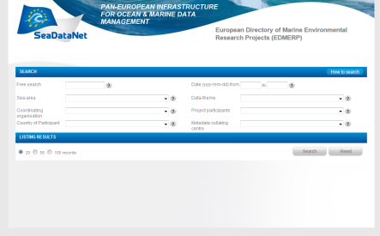
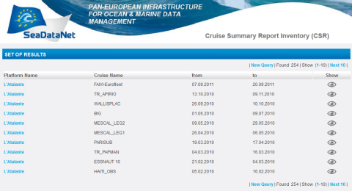
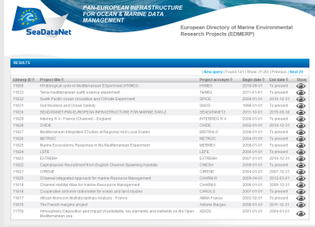
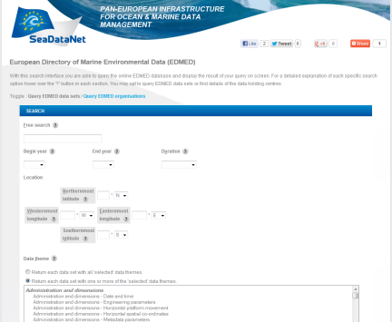
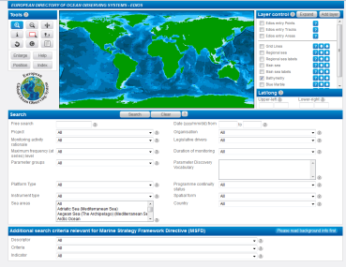
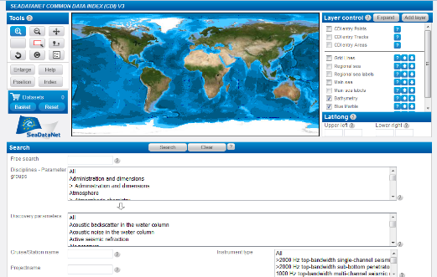
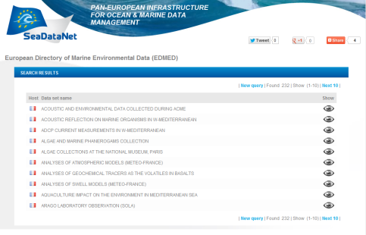
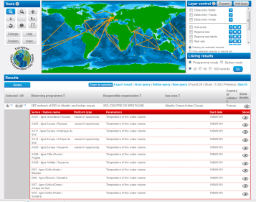
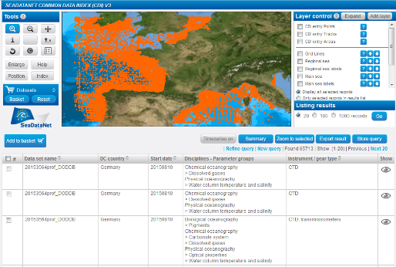
SeaDataNet metadata directories
EDMO
Organisations
CSR
EDMERP
Research cruises
Projects
EDIOS
EDMED
Observing programmes
CDI
Data sets
Data index

Slide 5
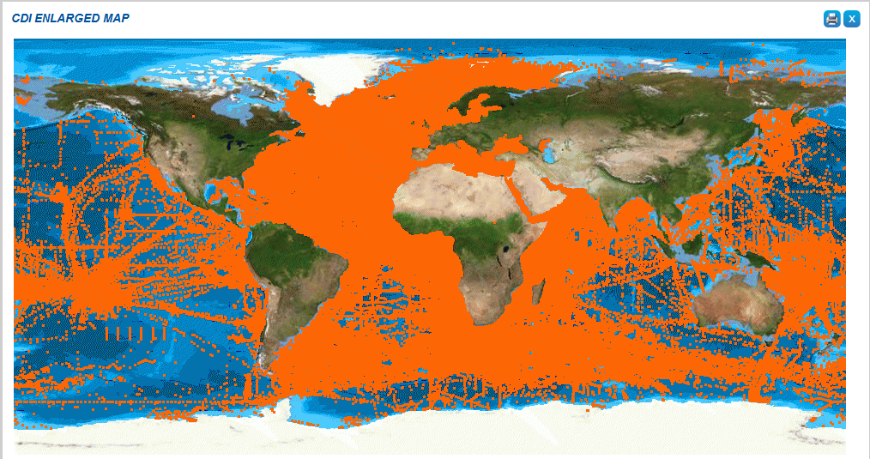
Service for discovery and unified data access
+2.2 million data entries from 34 countries, ≈115 data centres and 597 originators for physics, chemistry, geology, geophysics, bathymetry and biology; from 1805 to 2016; 86% unrestricted or under SDN License

Slide 6
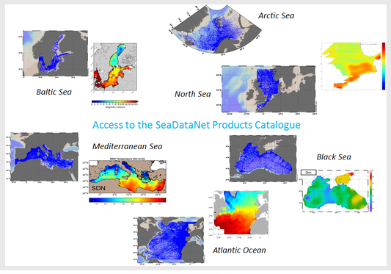

SeaDataNet products
CENTRAL CDI
File and parameter aggregation
Analysis of data anomalies
QC analysis
Data harvesting
SeaDataNet Quality Checks Strategy (QCS)
Aggregated datasets and climatologies
Improvement of the data quality

Slide 7

Known issues and ongoing work (SeaDataCloud project)
Usage of the discovery and access services lags behind expectation; major obstacle ➔ multiple download transactions with data from multiple data centres.
Performance issues because data centres are not always online, operational and have different machine capacities ➔ extra delays
Quality issues concerning of data files and their consistency with metadata
Connecting new data centres can be challenging due to different configurations, firewalls.. ➔ different versions installed, because upgrading can add issues
Cooperation with EUDAT
  To speed up data access
  (“Technical cache” :
  the reference version of datasets remains at distributed data centres)
  To facilitate an overall quality check on provided data (harmonization)
  To propose a Virtual Research Environment
    Data sets
    Software tools
    Developments facilities

Slide 8
European Open Science Cloud (EOSC)
6 May 2015 the EU adopted the Digital Single Markets strategy and announced the launch of a cloud for research data
A High Level Expert Group was established to advise on scientific services to be provided on the cloud and its governance structure
16 April 2016 the EU published a package of measures for digitising European industry, including a communication on the European Cloud Initiative
12 June 2017 the European Open Science Cloud Summit took place bringing together key players from across Europe, to make the ‘EOSC a reality by 2020’
14 March 2018 the EU adopted the Implementation Roadmap for the European Science Cloud
EOSC should to give the EU a global lead in research data management and ensure that European scientists reap the full benefits of data-driven science. It also foresees setting up a European Data Infrastructure, with high-capacity cloud solutions with super-computing capacity.

Slide 9

SeaDataNet anticipating EOSC
In anticipation of these EOSC planning activities, SeaDataNet submitted in March 2016 the SeaDataCloud proposal with the following aims:
  Further developing skills, standards, tools and services for dealing with marine data, such as handling data from new instruments, INSPIRE compliance, interoperability with other data infrastructures, vocabularies governance, and adopting new technical approaches such as ‘Linked Data’, and ‘Sensor Web Enablement’,
  Exploring the trend towards cloud storage and cloud computing, also taking into account ‘big data’ challenges, for instance by analysing an architecture for a Virtual Research Environment (VRE) and developing a VRE pilot
  Improving and expanding services and tools for data providers for connecting and ingesting data AND for users to make it easier and more performing to find, access, and use datasets
  Better joining in an early stage and
  riding the EOSC wave than losing ourselves
  in the undertow

Slide 10
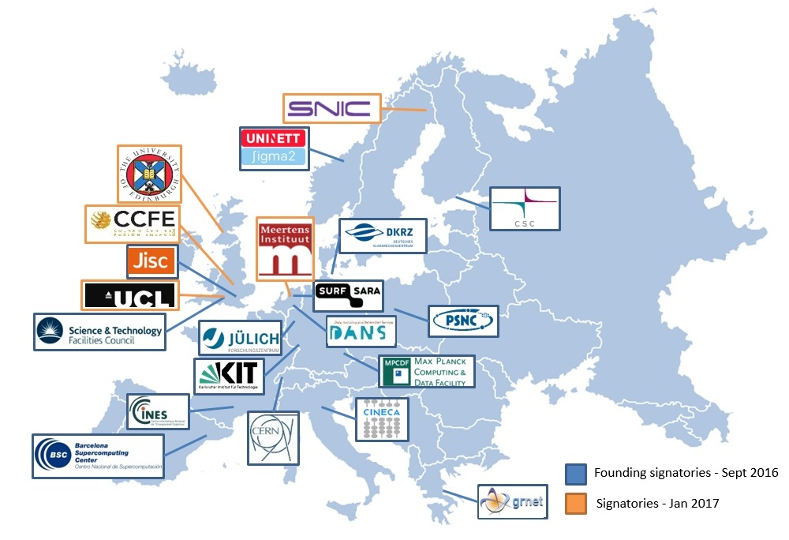
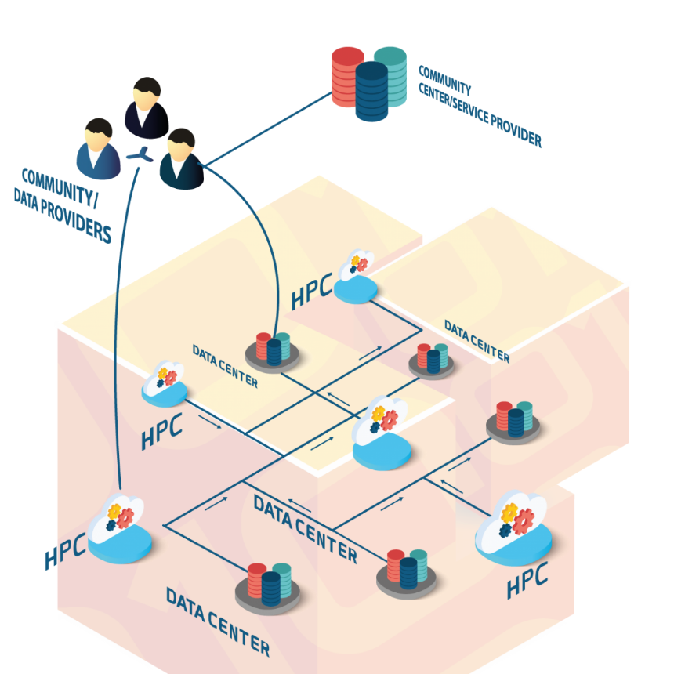
Cooperation with EUDAT
A consortium of 20 High Performance Computing (HPC) centres offering also storage resources
5 EUDAT members are partners of SeaDataCloud

Slide 11
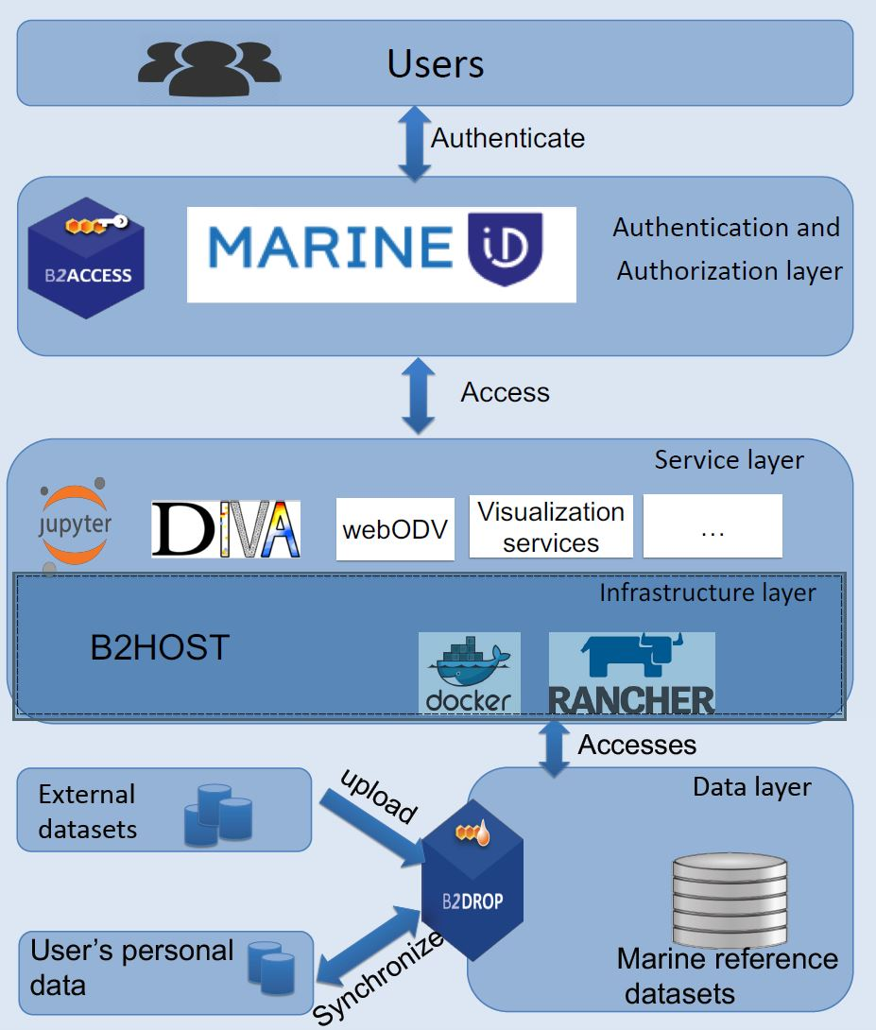
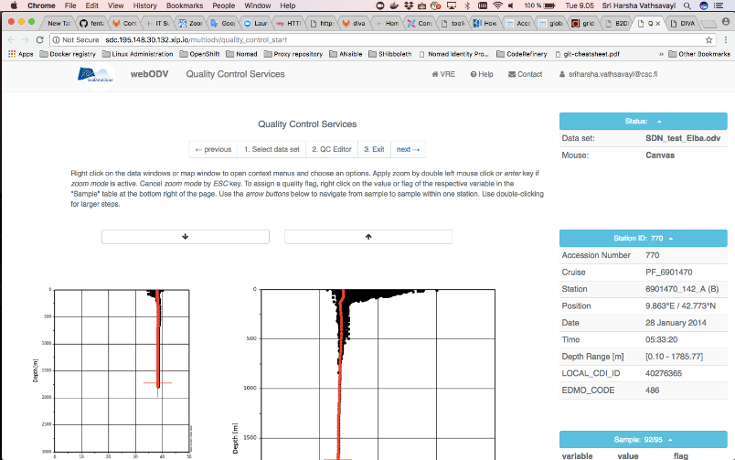
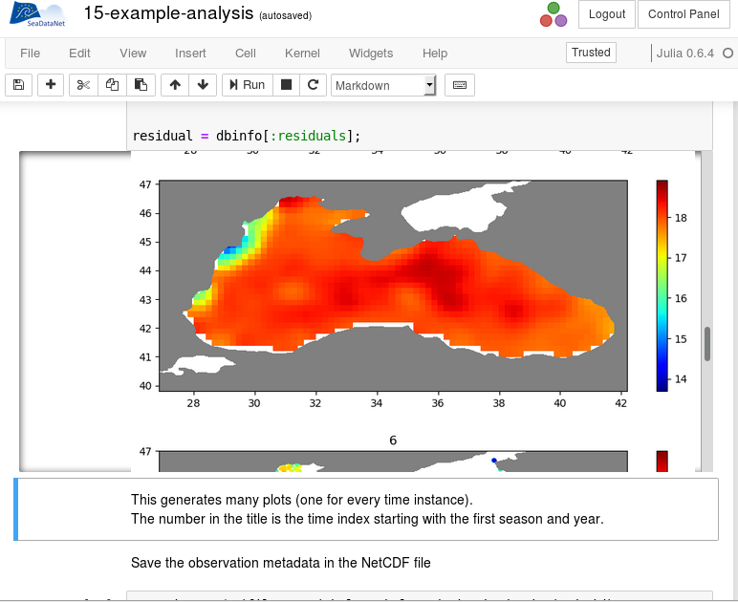
Overall architecture for the SDC VRE

Slide 12
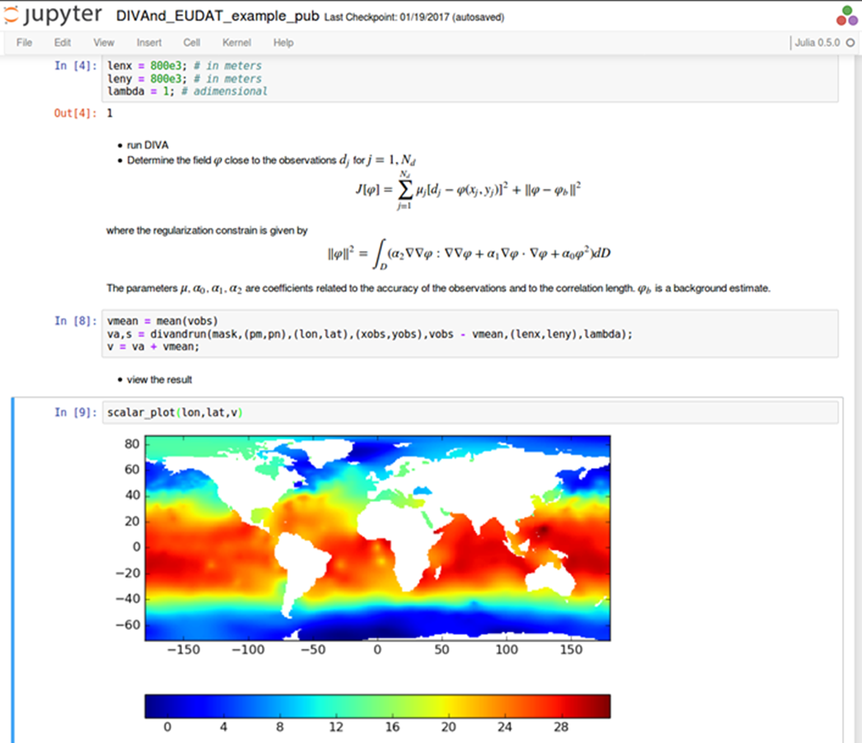

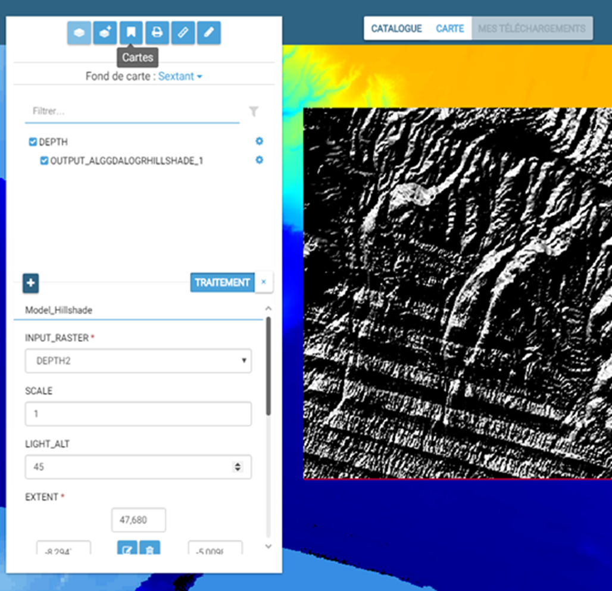
Processing shared processing, dev & publication
(University of Liege, DIVA in Jupyter)
(Sextant, Ifremer)

Slide 13
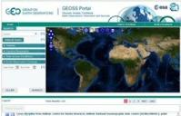
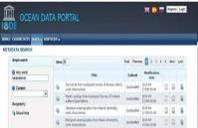
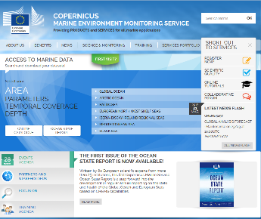

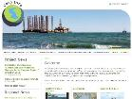
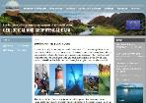



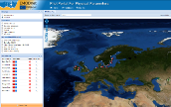
Total collection
GEOSS portal
IODE ODP portal
Copernicus MEMS
Aggregated collection
Data discovery
and access
Black Sea portal
Caspian portal
Geo-Seas portal
Regional subsets
> 100 data centres
Bathymetry
Thematic portals
NODCs; HOs; GEOs; BIOs; ICES
Physics
Chemistry
≈ 600 European data originators
General context
Geology
Biology

Slide 14
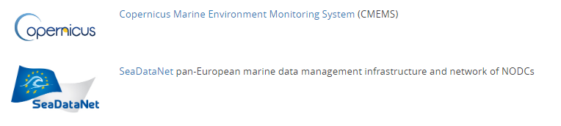

Links with other European initiatives
European Marine Observation and Data Network
Different funding schemes : Copernicus, DG-Research, DG-MARE
Different objectives : Earth Environment Monitoring, Development of Knowledge (studies of processus, R&D), support to public policies and marine economic sector.
Different time frames : Operational / longer term
But, a shared environment : the Ocean!!!
➔ Collaboration required!

Slide 15
Memorandum of Understanding between CMEMS and SeaDataNet
Signed in June 2018, “to cooperate in strategy, research, and operation, where mutually beneficial and desirable.”
Seven cooperation areas have been identified:
  Development, maintenance, adoption and promotion of standards
  Development, adoption and promotion of QA-QC methodologies
  Metadata and data exchange from SeaDataNet to CMEMS INSTAC
  Metadata and data exchange from CMEMS to SeaDataNet
  Development of products
  Distribution of products
  Teaming up in relevant projects

Slide 16
And in practice…
Cooperation is just starting practically.
Data sets are complementary
  More data from CMEMS, for a limited number of variables
  Much more variables for SDN
  Offshore data from CMEMS
  Coastal data from SDN
Both experiences are valuable
  Comprehensive metadata management in SDC
  Efficient (automatic and real time) QC/QA in CMEMS
  Larger spectrum of QA/QC in SDC
But, there are still issues for a real cooperation
  Data exchanges must be technically optimized
  Some necessary metadata are missing
  Some discrepancies in data models, formats, data organization, common vocabularies …

Slide 17
Towards a reinforced cooperation
Improvements included in the SeaDataCloud 2 proposal just submitted yesterday.
From the technical side
  Links between Wekeo DIAS and EOSC (EUDAT)
  Streamlining of data flows (… regular synchronization)
For Metadata and QA/QC
  Management by SDN of all metadata requested by CMEMS (when available)
  Harmonization of procedures
  E.g. Min/Max developed by OceanScope in CMEMS
  To be adopted by SDC and refined for regional basins
Development of common or complementary products
(with EMODNET as well esp. Physics and Chemistry lots)
  Aggregated datasets of reference
  Work in common to establish the list of products (and who will process what!)

