Slide 1
Delivering marine data from the cloud
Peter Thijsse (MARIS, NL)
Michele Fichaut (IFREMER, FR - Coordinator),
Dick M.A. Schaap (MARIS, NL, Techical coordinator)

Slide 2
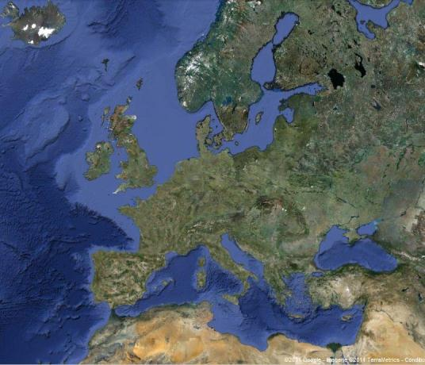
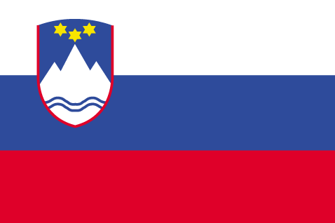

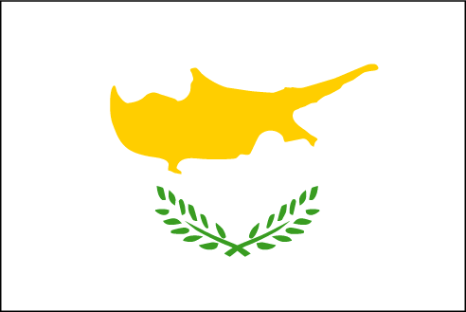

What is SeaDataNet?
A pan-European infrastructure set up and operated for managing marine and ocean data in cooperation with the NODCs and data focal points of 34 countries bordering the European seas
90s | Metadata directories Medar/MedAtlas
2002-2005 | Sea-Search (FP5)
2006-2011 | SeaDataNet (FP6)
2011-2015 | SeaDataNet II (FP7)
2016-2020 | SeaDataCloud (H2020)

Slide 3
European Open Science Cloud (EOSC)
6 May 2015 the EU adopted the Digital Single Markets strategy and announced the launch of a cloud for research data
A High Level Expert Group was established to advise on scientific services to be provided on the cloud and its governance structure
16 April 2016 the EU published a package of measures for digitising European industry, including a communication on the European Cloud Initiative
12 June 2017 the European Open Science Cloud Summit took place bringing together key players from across Europe, to make the ‘EOSC a reality by 2020’
14 March 2018 the EU adopted the Implementation Roadmap for the European Science Cloud
EOSC should to give the EU a global lead in research data management and ensure that European scientists reap the full benefits of data-driven science. It also foresees setting up a European Data Infrastructure, with high-capacity cloud solutions with super-computing capacity.

Slide 4

SeaDataNet anticipating EOSC
In anticipation of these EOSC planning activities, SeaDataNet Started in December 2016 the SeaDataCloud project with the following aims:
  Further developing skills, standards, tools and services for dealing with marine data, such as handling data from new instruments, INSPIRE compliance, interoperability with other data infrastructures, vocabularies governance, and adopting new technical approaches such as ‘Linked Data’, and ‘Sensor Web Enablement’,
  Exploring the trend towards cloud storage and cloud computing, also taking into account ‘big data’ challenges, for instance by analysing an architecture for a Virtual Research Environment (VRE) and developing a VRE pilot
  Improving and expanding services and tools for data providers for connecting and ingesting data AND for users to make it easier and more performing to find, access, and use datasets
  Better joining in an early stage and
  riding the EOSC wave than losing ourselves
  in the undertow

Slide 5
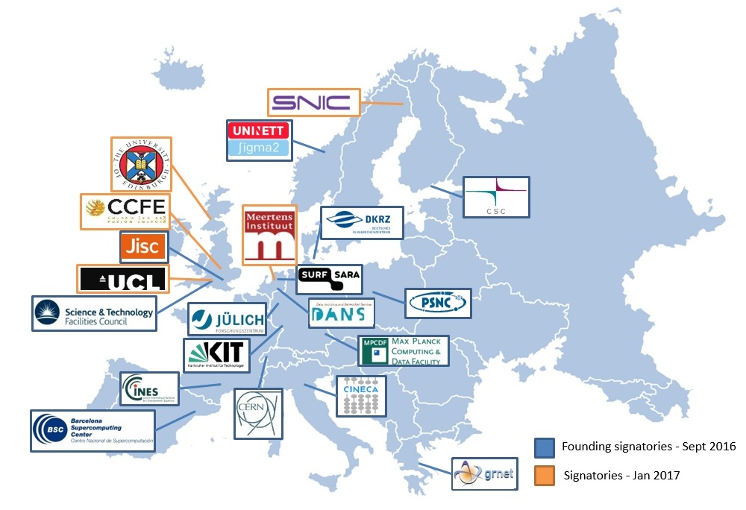
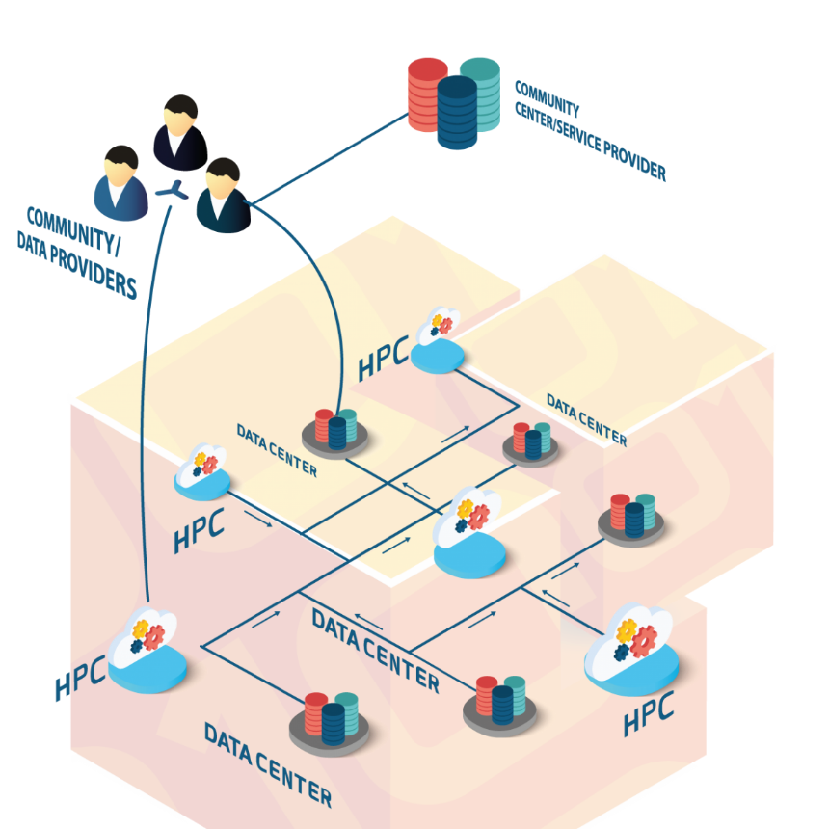
Cooperation with the EUDAT network of e-infrastructure providers
5 EUDAT members are partners of SeaDataCloud :
CINECA, CSC, DKRZ, GRNET and STFC

Slide 6
Leading concept for SeaDataCloud
Providing a cloud platform with common services for data pre-processing, subsetting, analyses, visualizations, publishing, DOIs…
Applying common standards and interoperability solutions for providing harmonised data and metadata
Providing harmonised discovery and access to data output from multiple sources, such as European research and monitoring data gathering, but also from other European and international data infrastructures
Added-value services and applications – Cloud
Platform
Downstream
Services
Standards
OGC, ISO, W3C &
Vocabularies
Upstream
Services
Discovery and access
to datasets from many sources

Slide 7
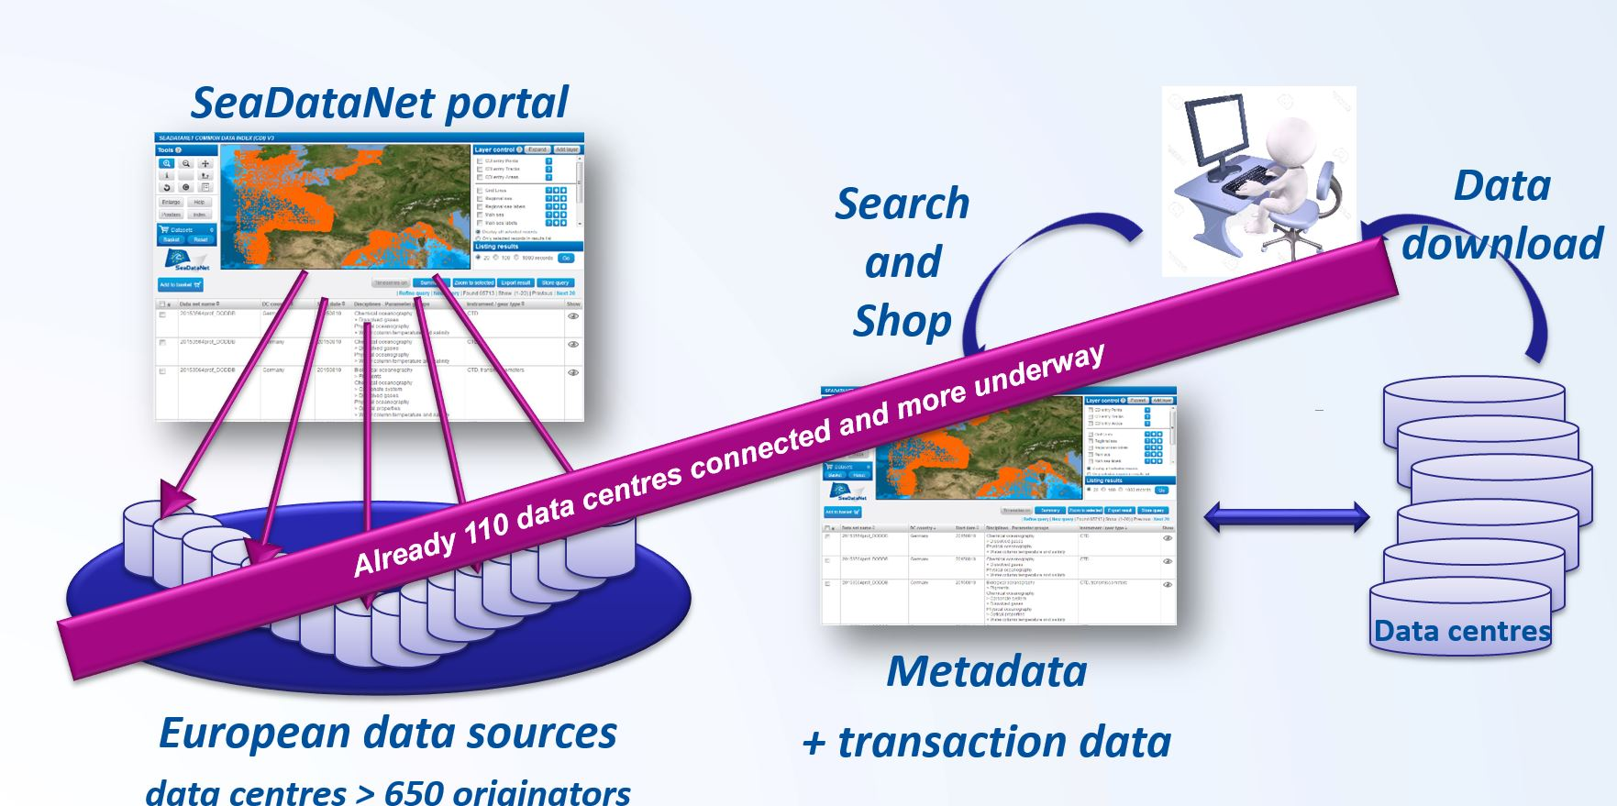
CDI Data Discovery and Access service
It is one of the core services of the SeaDataNet infrastructure
It provides a highly detailed insight and unified access to the large volumes of marine and oceanographic data sets managed by the distributed data centres
It is a fine-grained index (ISO 19115 – ISO 19139) to individual data measurements (such as a CTD cast or moored instrument record)

Slide 8
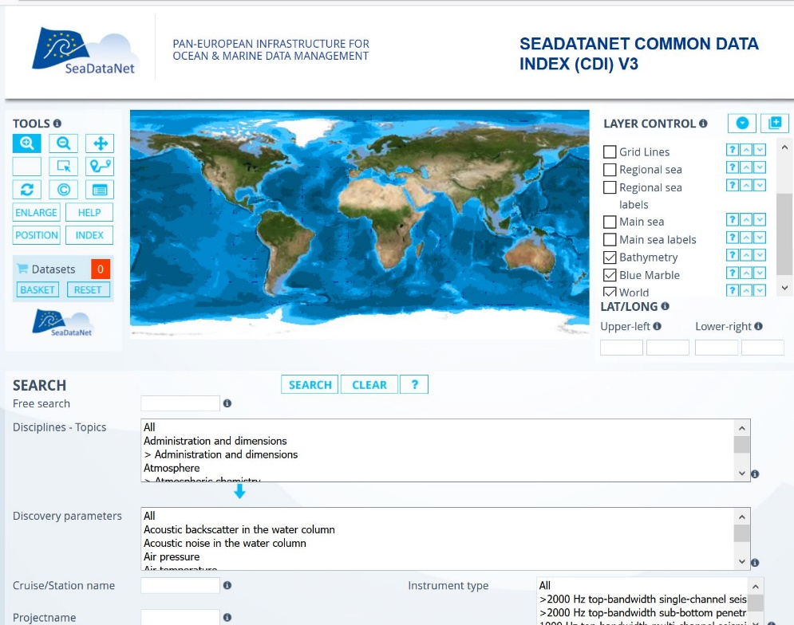
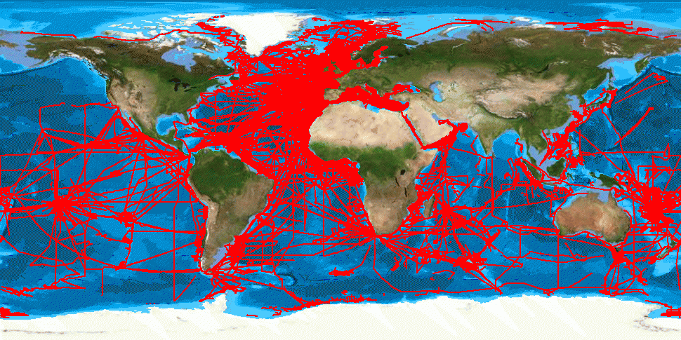
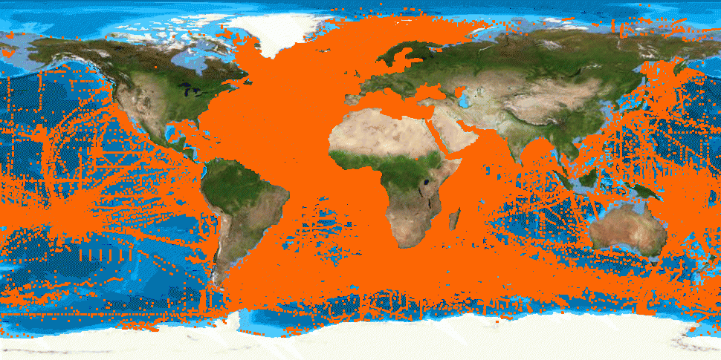
CDI service with global coverage
> 2.2 Million CDI entries for physics, chemistry, biology, geology and geophysics

Slide 9
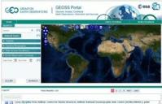
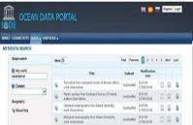
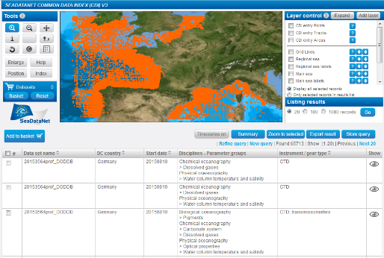

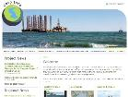
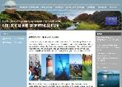



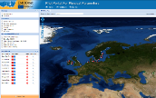
CDI service contributes to many portals
Total collection
GEOSS portal
IODE ODP portal
Aggregated collection
Data discovery
and access
Black Sea portal
Caspian portal
Geo-Seas portal
Regional subsets
> 110 data centres
Bathymetry
Thematic portals
NODCs; HOs; GEOs; BIOs; ICES; PANGAEA
Physics
Chemistry
≈ 650 European data originators
CDI Data Discovery and Access service
Geology
Biology

Slide 10
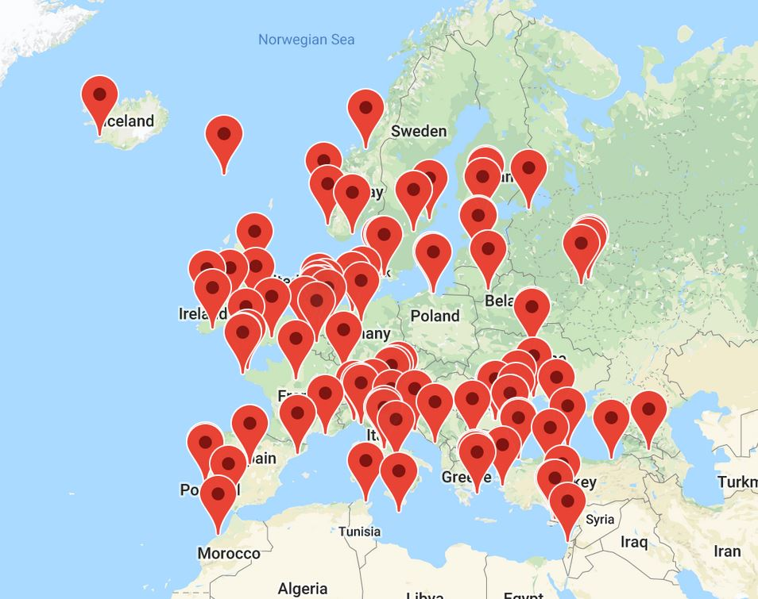
Installed base of CDI nodes (> 110)

Slide 11
Issues with current CDI service
Performance for users:
  CDI works via a shopping basket, user can submit a shopping basket with requests for data from multiple data centres.
  user must await the automatic data preparation by each of these data centres
  user must download resulting data sets through the RSM as packages directly from each data centre, which implicates multiple download transactions
Performance for users: data centres are not always online, operational and have different machine capacities which might give extra delays
Quality issues: concerning formats of data files (ODV + NetCDF) and their consistency with CDI metadata.
Installation and configuration of the Download Manager software can be challenging due to different configurations, firewalls etc., which in practice results in having different versions installed

Slide 12
Upgrading the CDI service using the cloud
To configure and maintain a CLOUD buffer to host copies of unrestricted data resources
Exchange by dynamic replication from the individual data centres, following their updating of the CDI catalogue service
In the cloud buffer:
  checking overall quality of metadata and data, as extra check on top of local QA-QC by data centres
  checking integrity of data files and metadata relations.
  results of checks to be reported back to data centres for corrections
Include transformation services for converting data sets to SeaDataNet ODV and NetCDF formats and relevant INSPIRE data models.
Introduce PID and versioning of metadata and data as part of provenance

Slide 13
New CDI service architecture

Slide 14
Where are we now in back-end?
SeaDataCloud project just past mid-term, almost ready to go and roll-out.
Cloud:
  Cloud system set up (mostly CSC and Cineca) using B2Stage (API), B2Handle (PIDs), B2Access (secure), B2Safe (storage)
  Development environment (Cineca), test environment, production environments (both at CSC)
  Some last issues with performance and reliability
  Ready to be preloaded with data once system is frozen (1 May 2019)
Import manager:
  Fully working, connected to cloud and Replication Managers
  Preloaded with all metadata
Replication Manager:
  Communicates to IM and cloud
  Tested, last action: Pre-loading with restricted data

Slide 15
Front-end – All new GUI
Faster, using Elastic Search for search and indexing, and GeoServer for latest mapping technology
Easier, including full text search next to controlled terms
Modern design with large map and sliding windows
MySeaDataNet integrated in GUI for customized services, such as SSO, RSM access, search profiles, prepared for VRE data pooling
Developed and refined as prototype (http://sdc.maris.nl) interacting with users and data managers, following the SeaDataCloud Training Workshops in June 2018

Slide 16
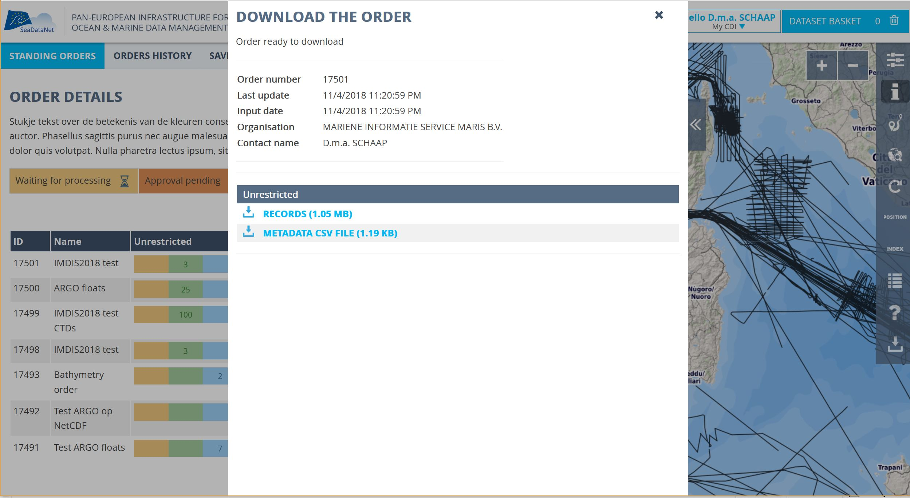
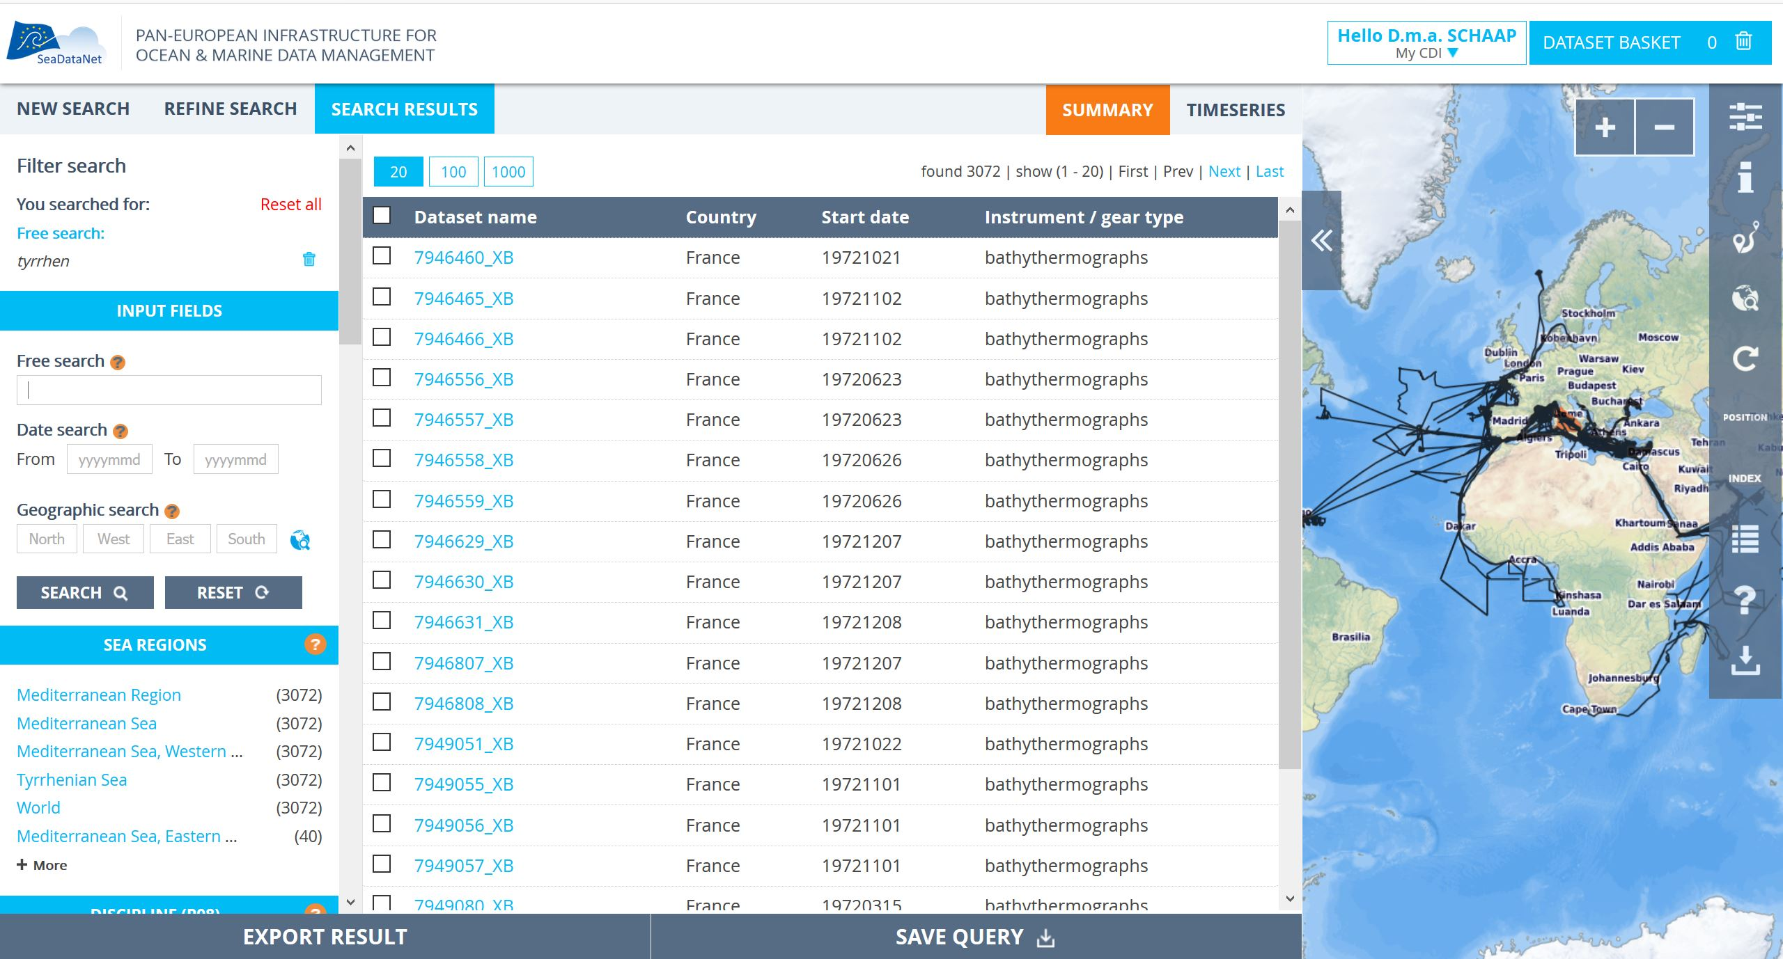
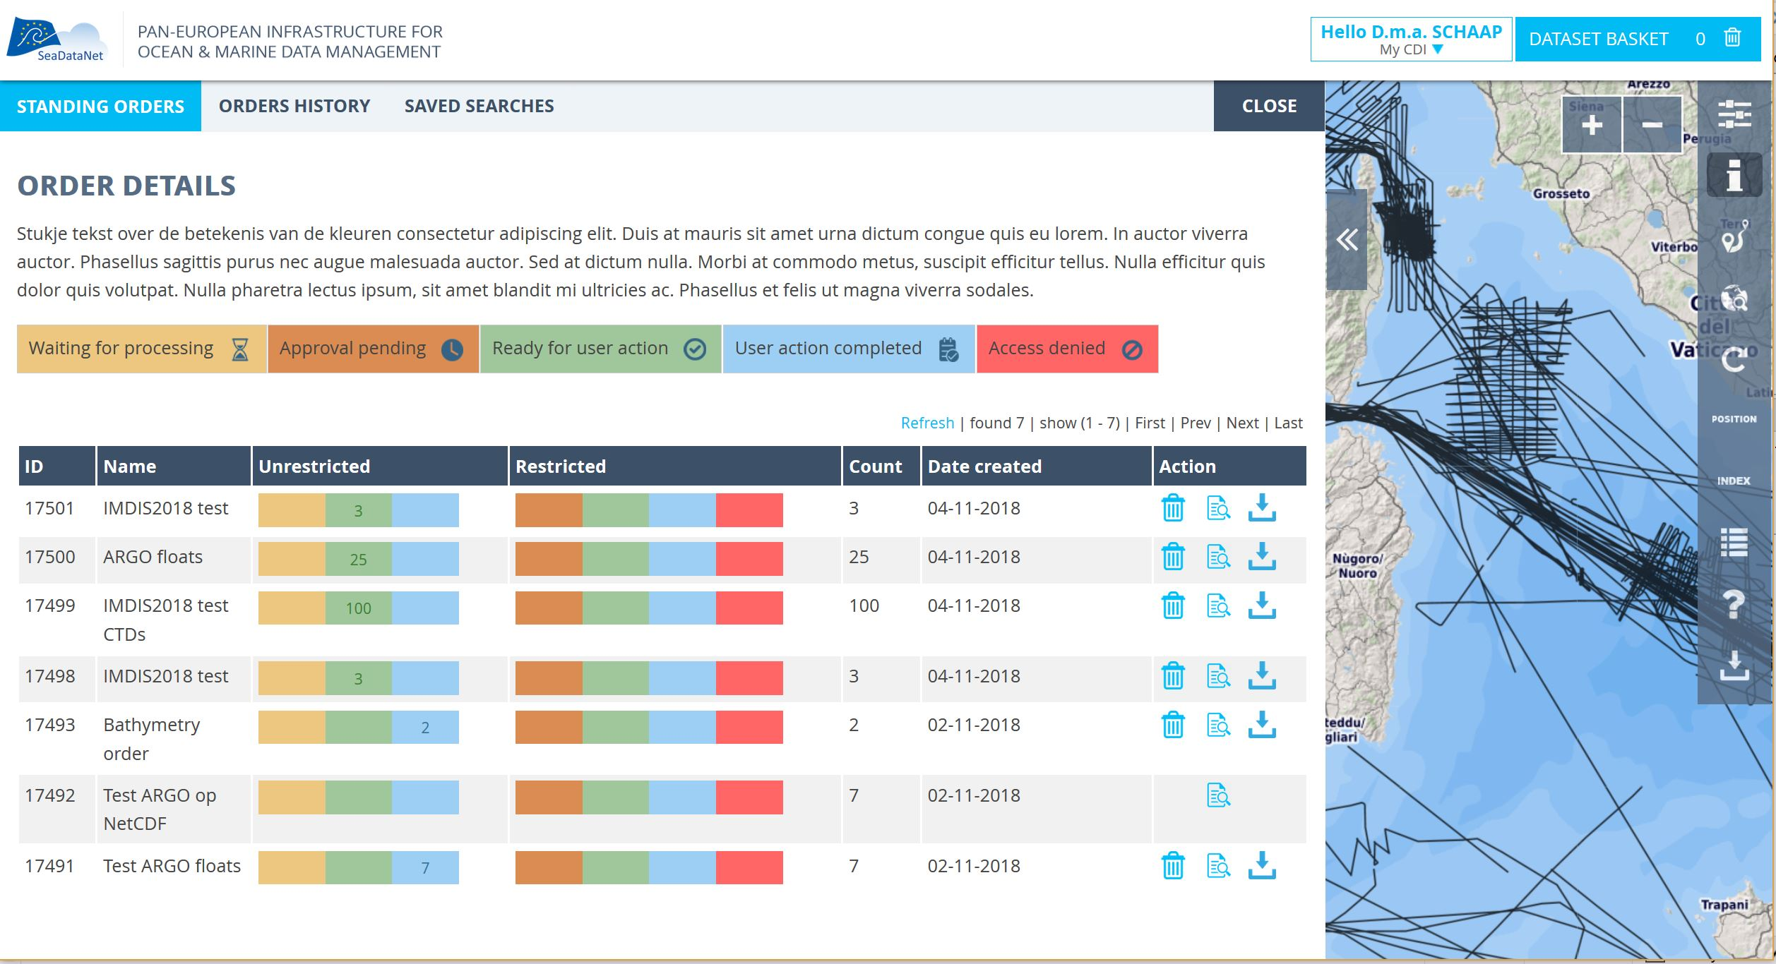
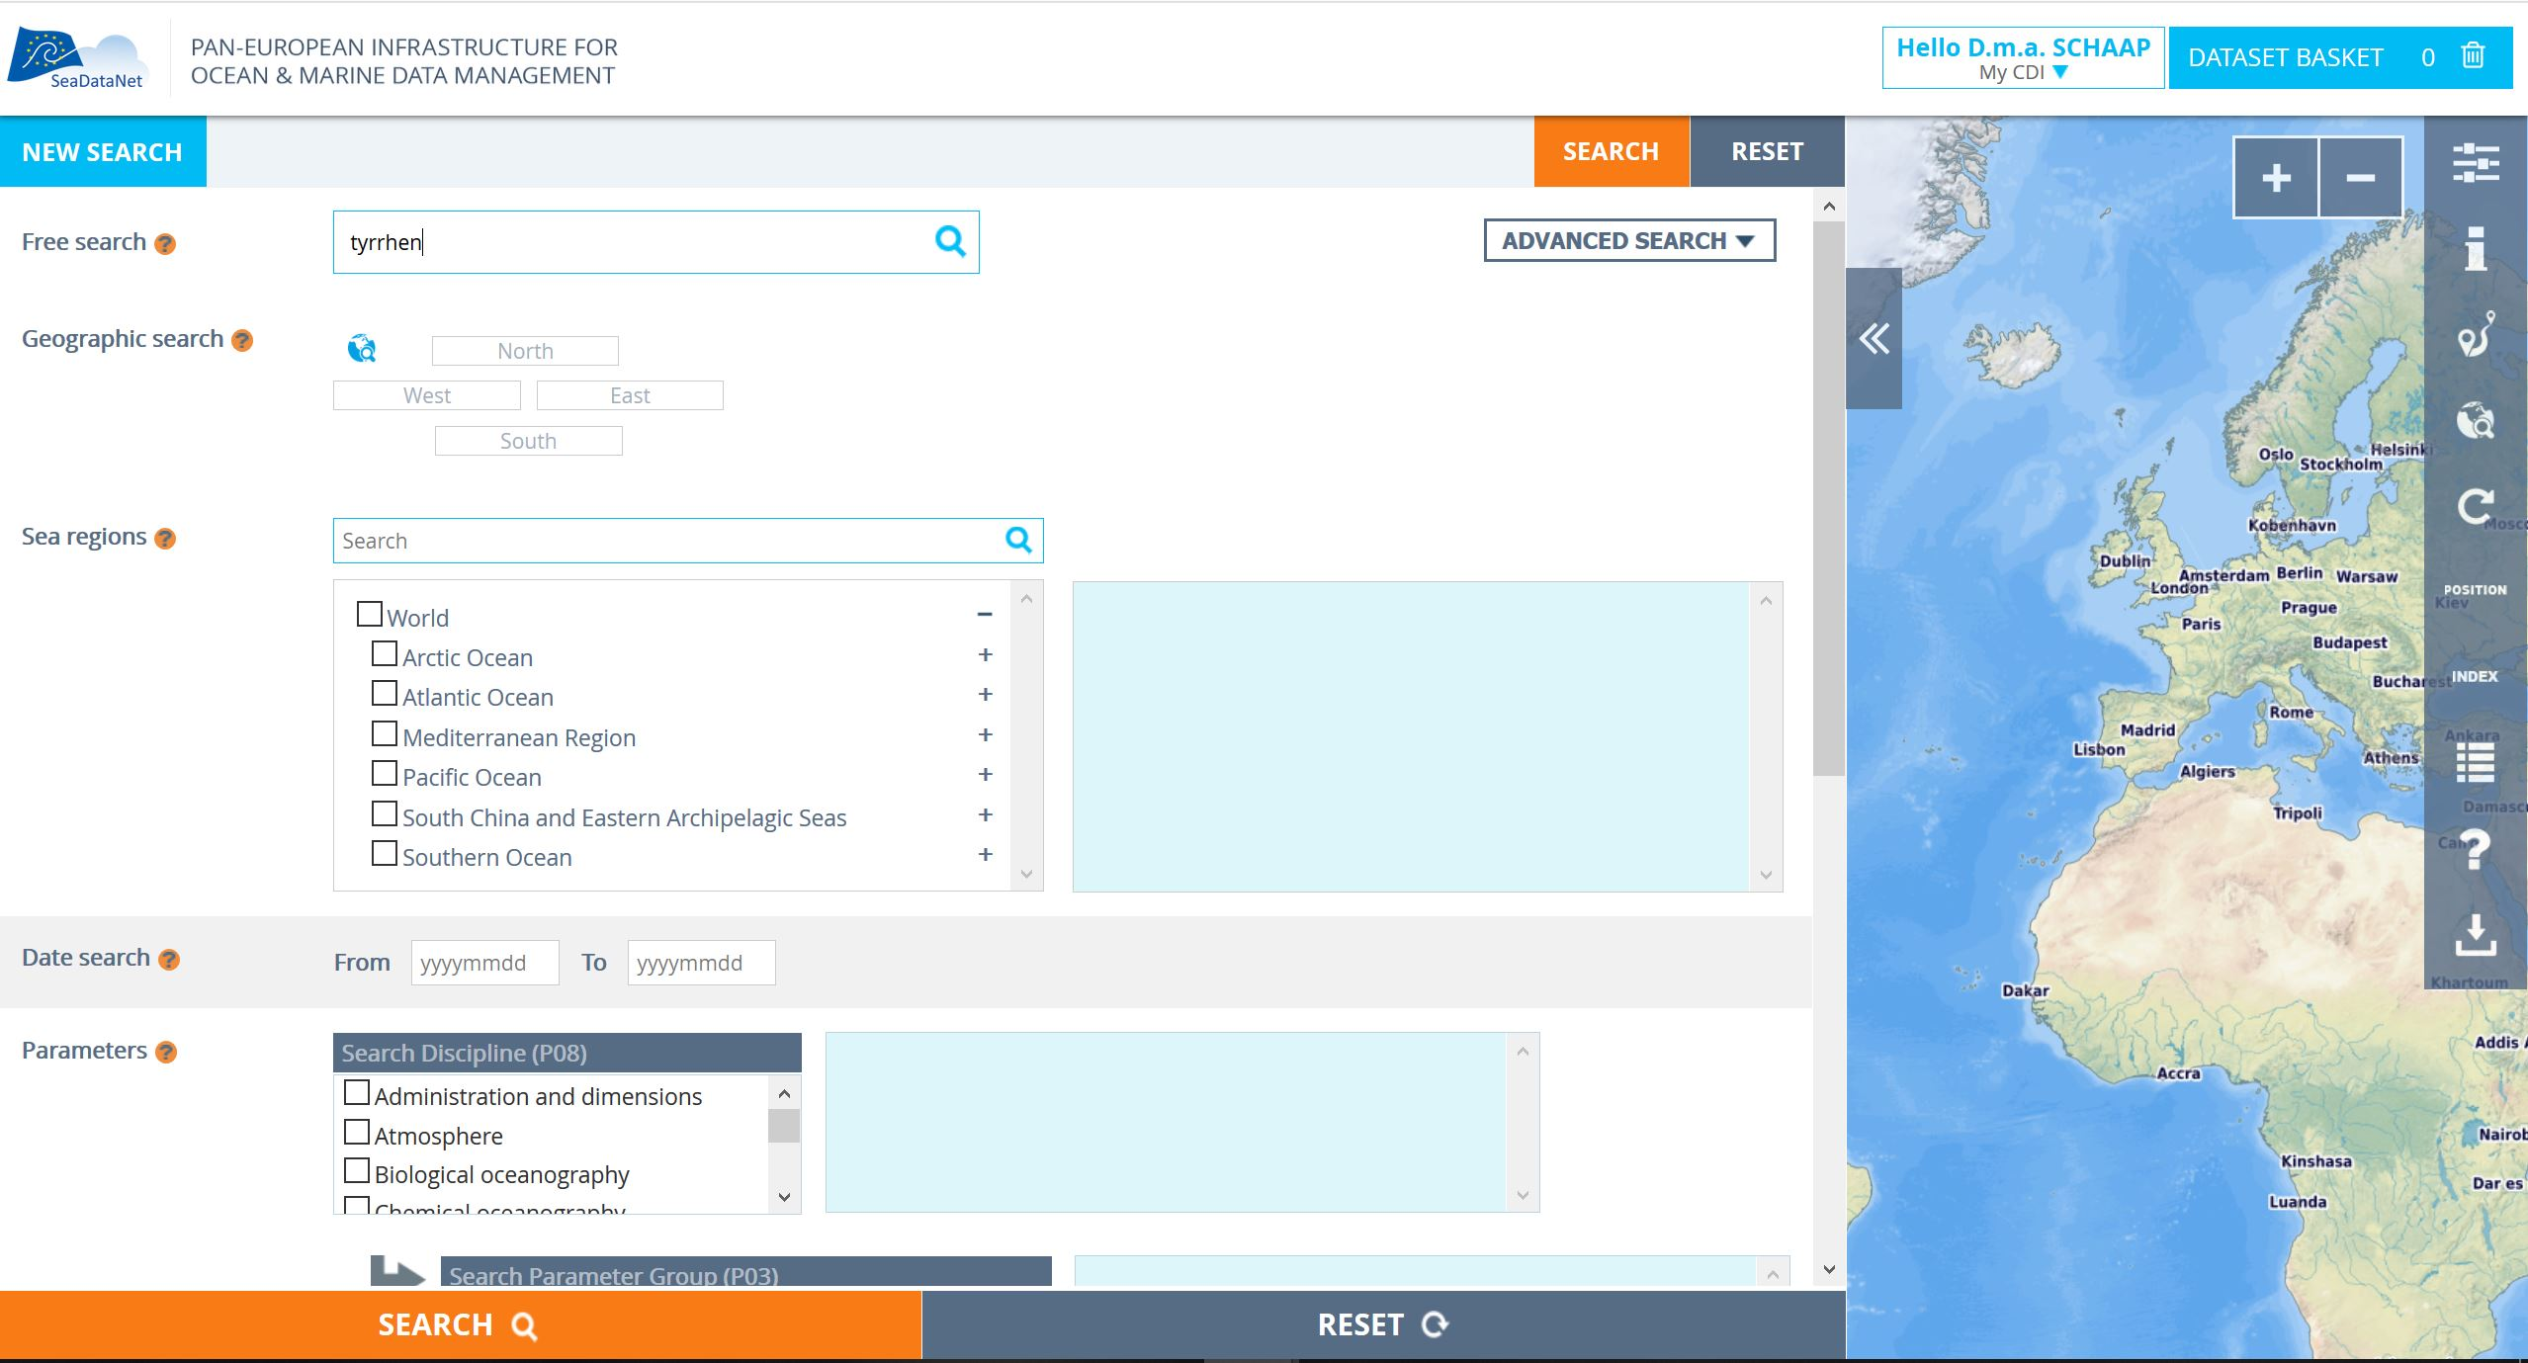
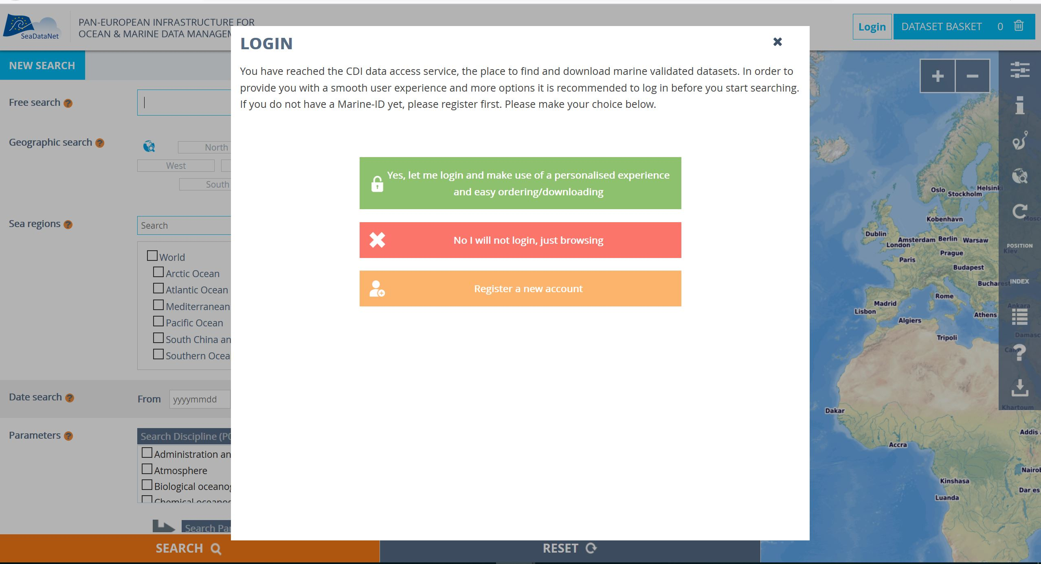
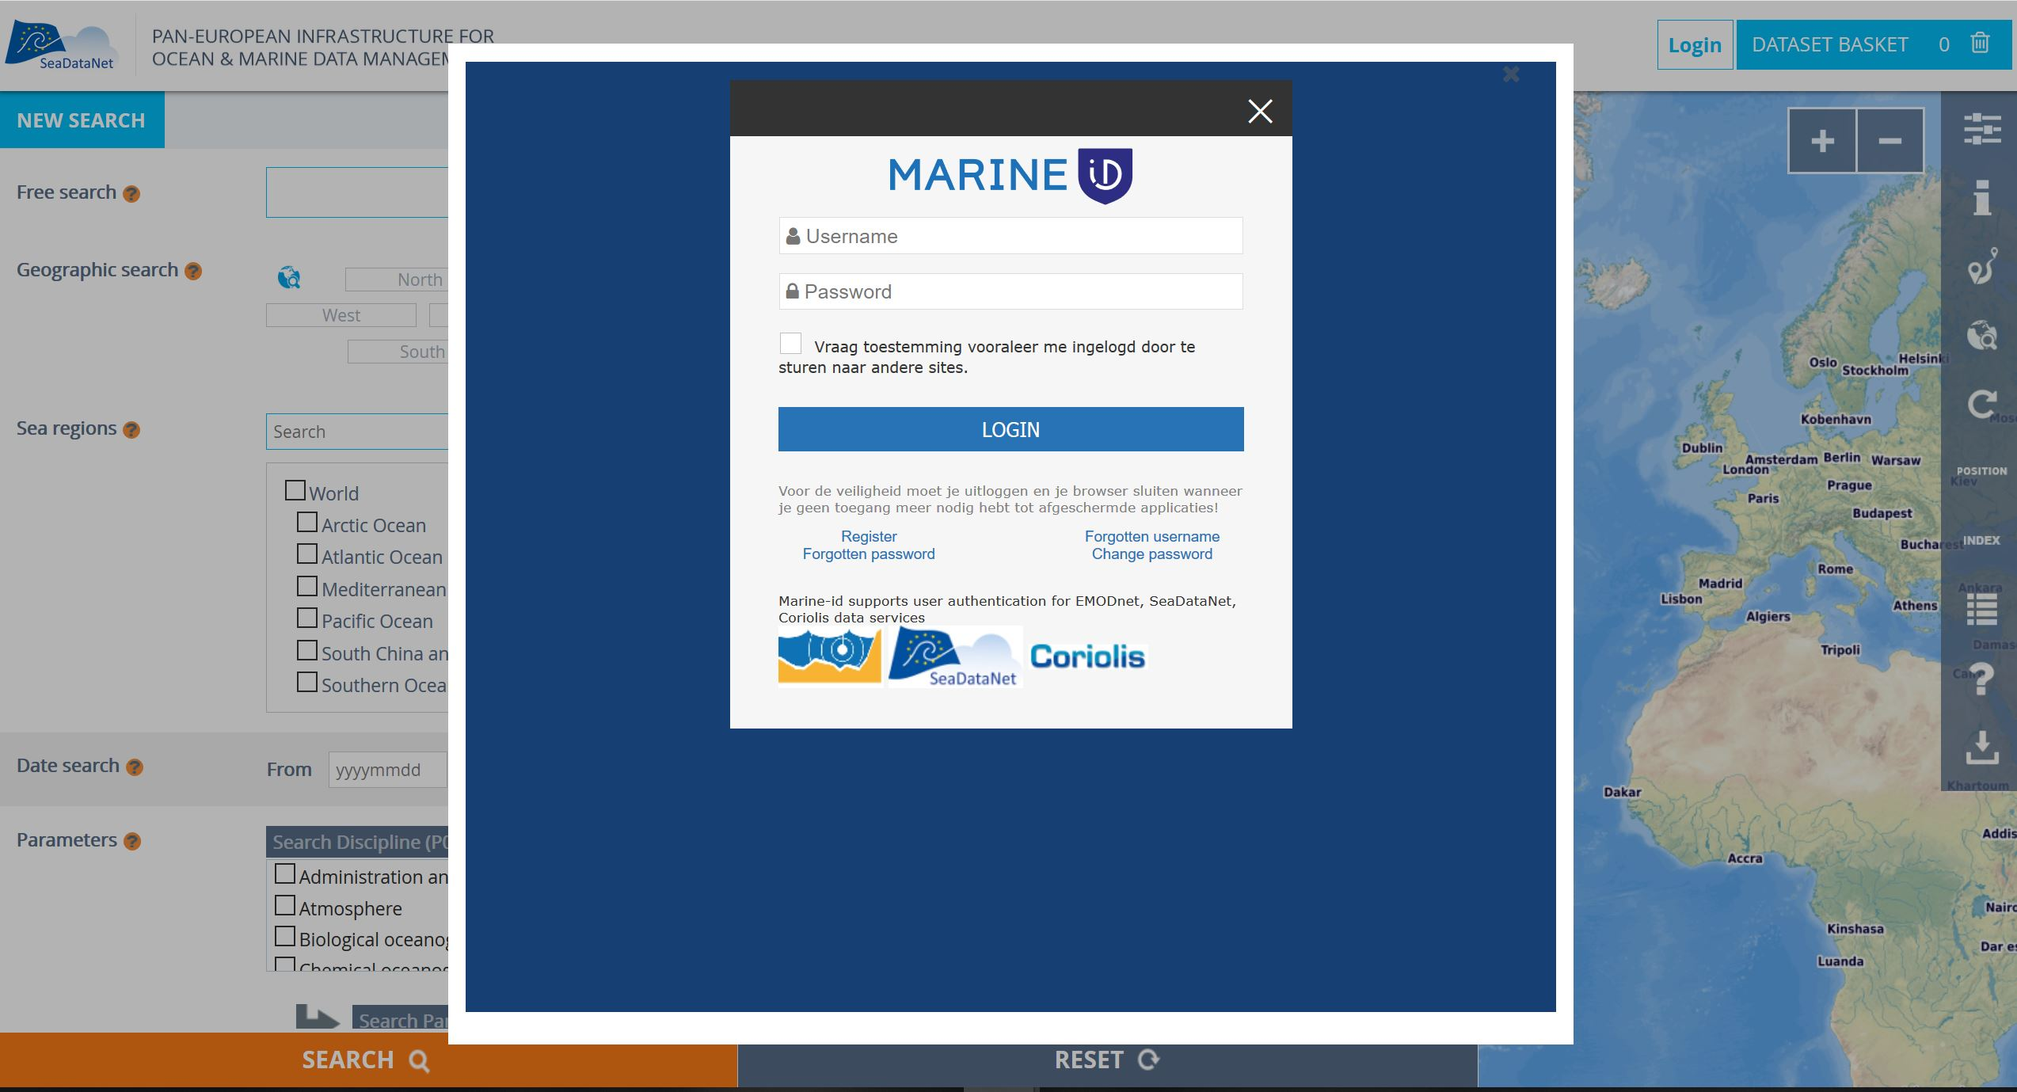
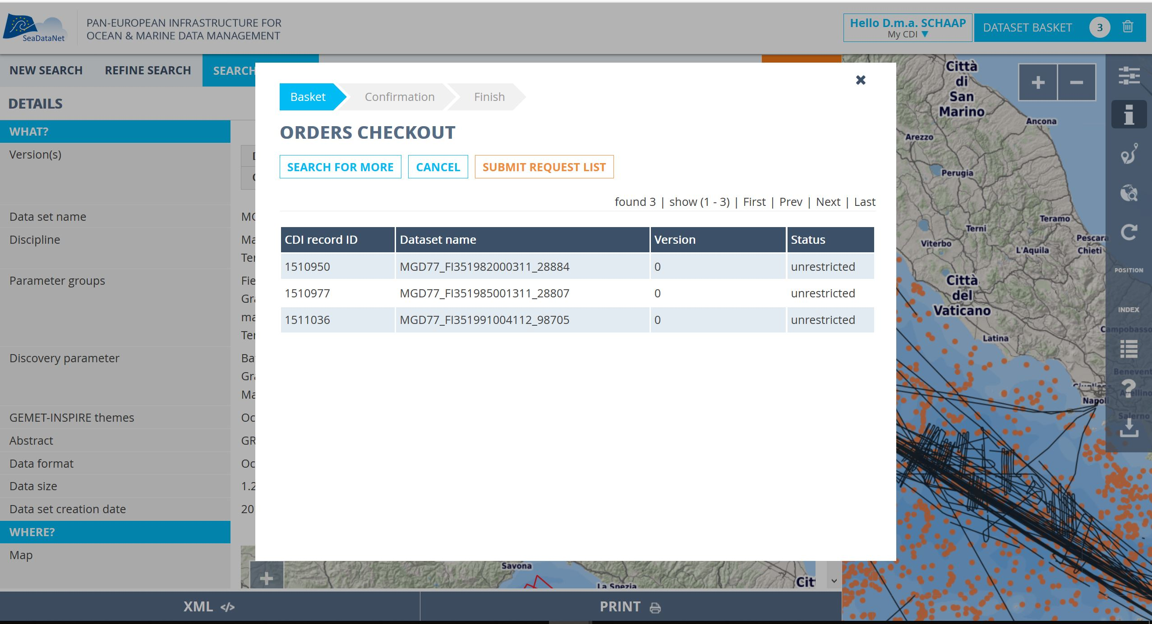
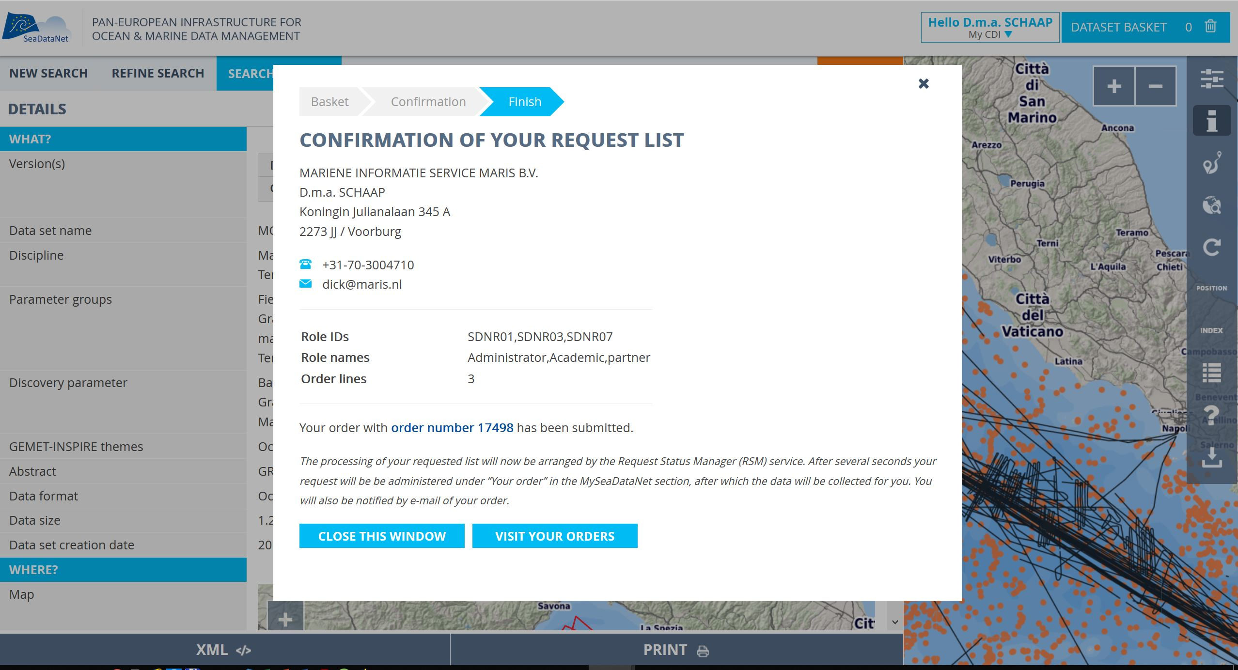
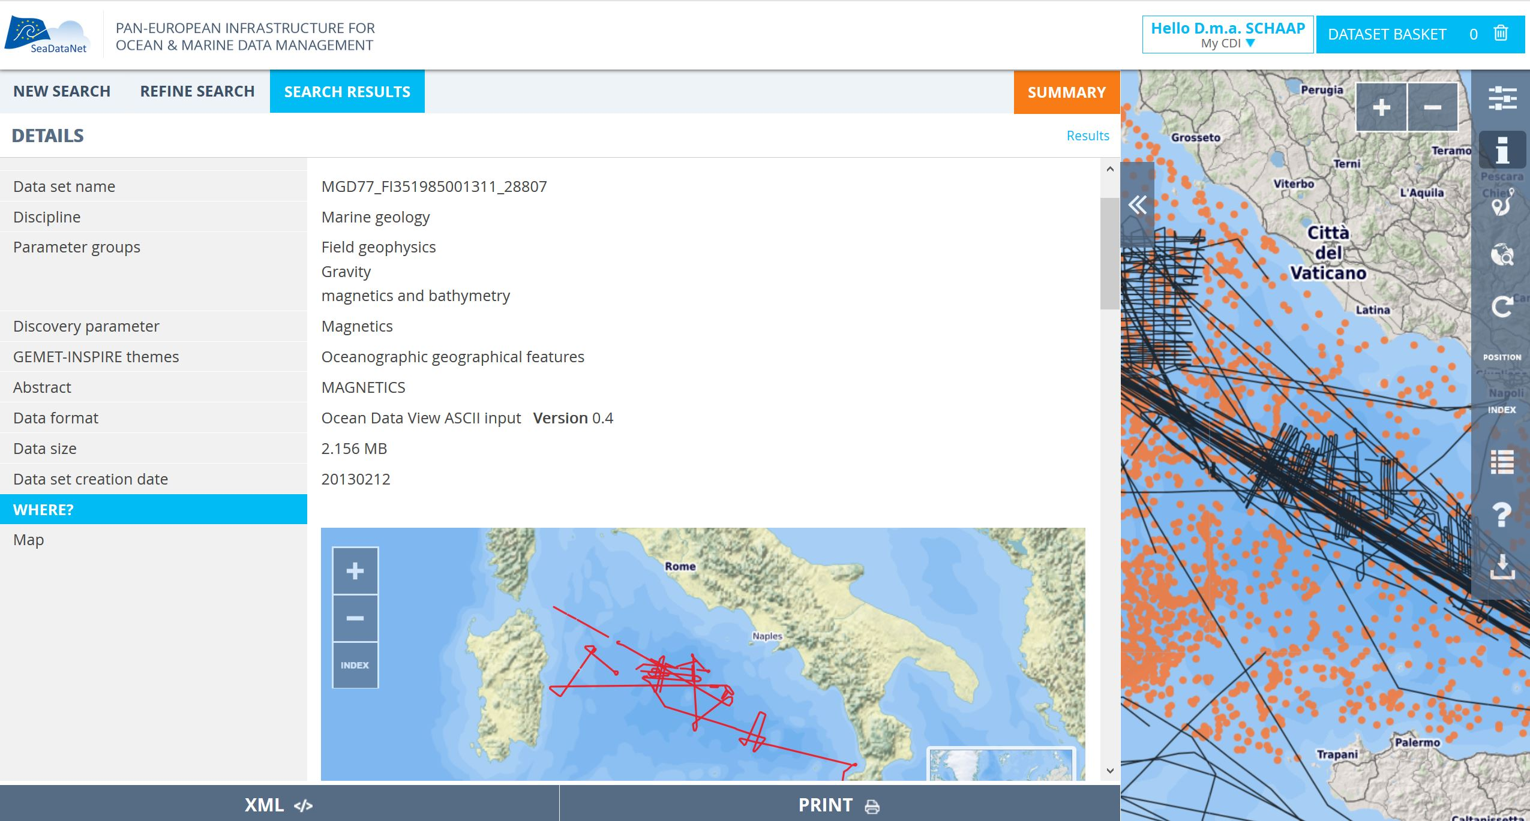
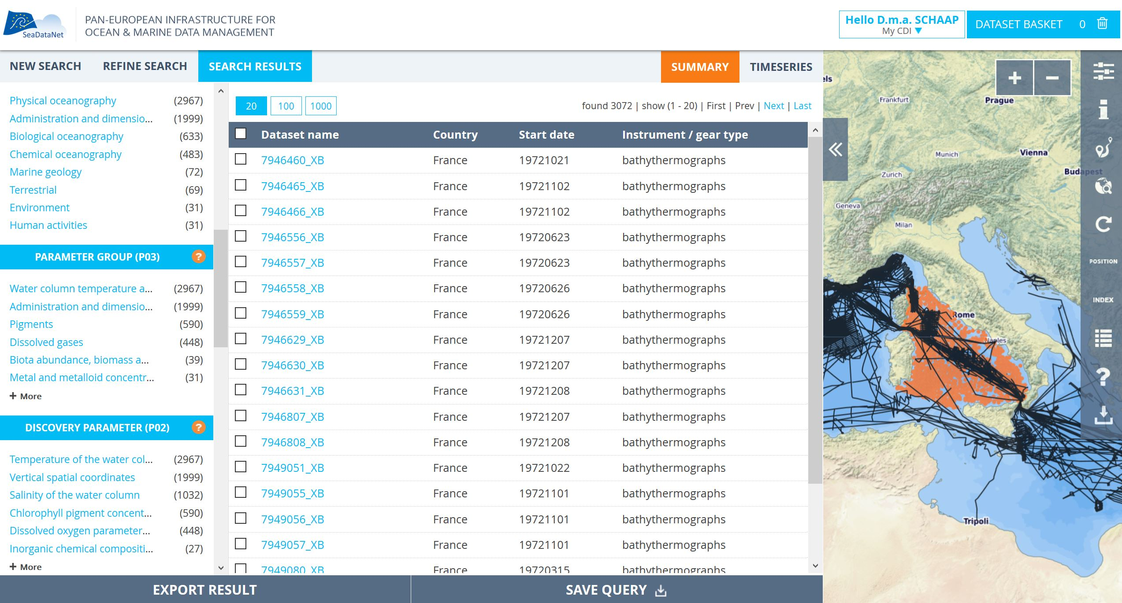
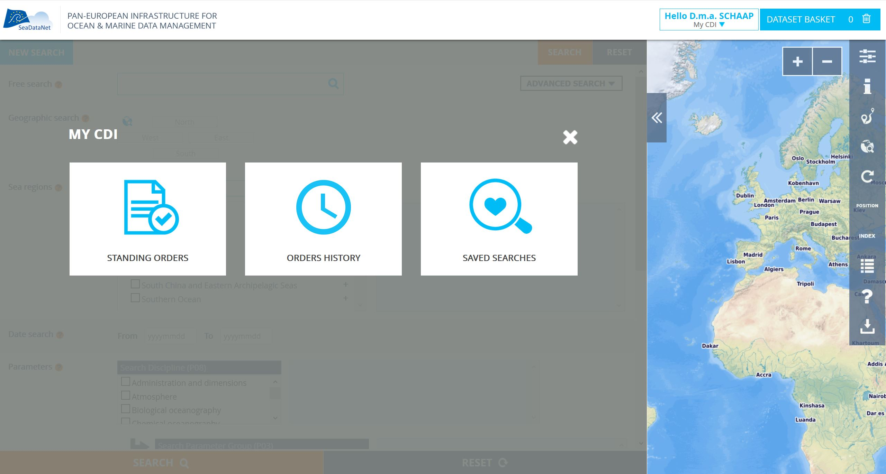
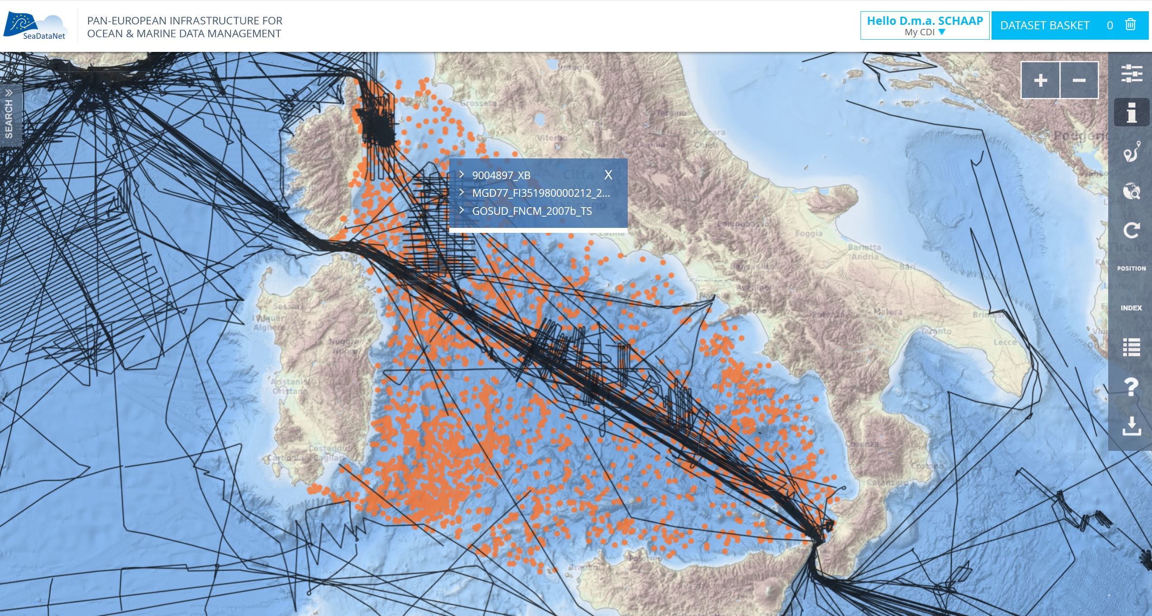
New GUI impressions

Slide 17
What’s expected?
May 2019: Current system frozen (no more new and updates)
May-June 2019:
  System loaded with all data
  Last QC check on unrestricted data (V0)
  All RM’s rolled out to data centers (should be quite simple and fast!)
  Monitoring of cloud services finalised
Early July 2019: SDC CDI - Version 1 release
Next:
  Improved buffer services
  More QC steps in cloud
  Connection to the Virtual Research Environment in development
  ..

Slide 18
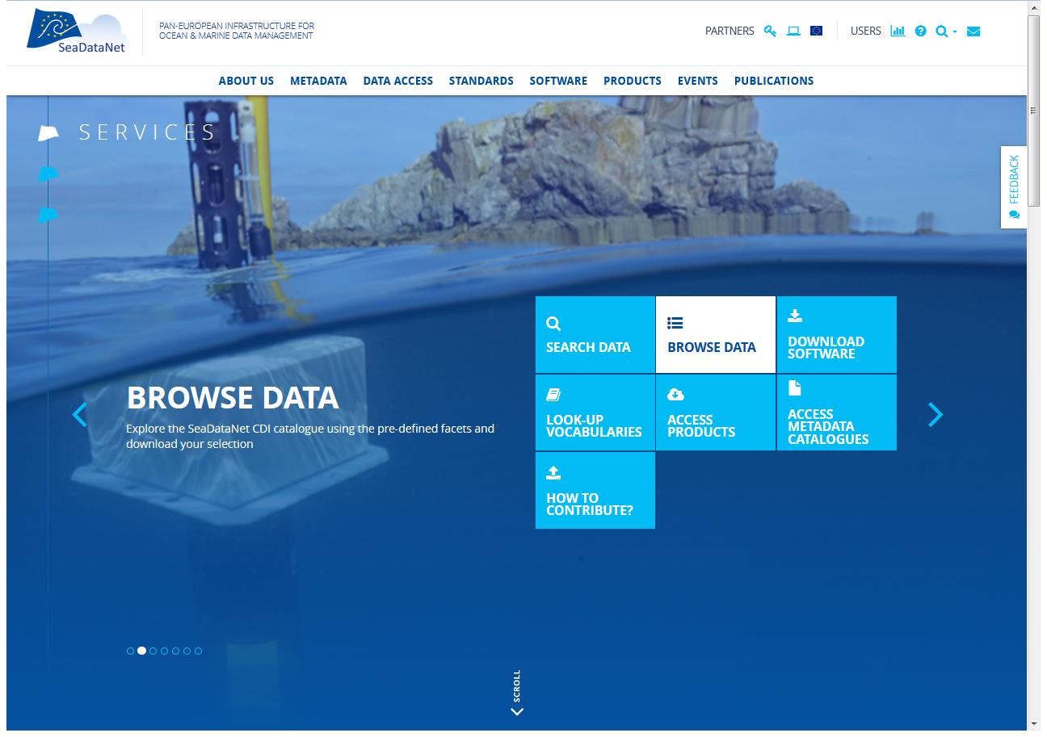
Keep following us via: www.seadatanet.org

