Slide 1
Access and work with marine data in the cloud
Peter Thijsse (MARIS, NL)

Slide 2
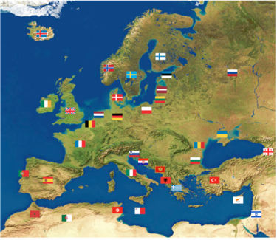
What is SeaDataNet?
A pan-European infrastructure set up and operated for managing marine and ocean data in cooperation with the NODCs and data focal points of 34 countries bordering the European seas
90s | Metadata directories Medar/MedAtlas
2002-2005 | Sea-Search (FP5)
2006-2011 | SeaDataNet (FP6)
2011-2015 | SeaDataNet II (FP7)
2016-2020 | SeaDataCloud (H2020)

Slide 3
European Open Science Cloud (EOSC)
6 May 2015 the EU adopted the Digital Single Markets strategy and announced the launch of a cloud for research data
A High Level Expert Group was established to advise on scientific services to be provided on the cloud and its governance structure
16 April 2016 the EU published a package of measures for digitising European industry, including a communication on the European Cloud Initiative
12 June 2017 the European Open Science Cloud Summit took place bringing together key players from across Europe, to make the ‘EOSC a reality by 2020’
14 March 2018 the EU adopted the Implementation Roadmap for the European Science Cloud
EOSC should to give the EU a global lead in research data management and ensure that European scientists reap the full benefits of data-driven science. It also foresees setting up a European Data Infrastructure, with high-capacity cloud solutions with super-computing capacity.

Slide 4

SeaDataNet anticipating EOSC
In anticipation of these EOSC planning activities, SeaDataNet Started in December 2016 the SeaDataCloud project with the following aims:
  Further developing skills, standards, tools and services for dealing with marine data, such as handling data from new instruments, INSPIRE compliance, interoperability with other data infrastructures, vocabularies governance, and adopting new technical approaches such as ‘Linked Data’, and ‘Sensor Web Enablement’,
  Exploring the trend towards cloud storage and cloud computing, also taking into account ‘big data’ challenges, for instance by analysing an architecture for a Virtual Research Environment (VRE) and developing a VRE pilot
  Improving and expanding services and tools for data providers for connecting and ingesting data AND for users to make it easier and more performing to find, access, and use datasets
  Better joining in an early stage and
  riding the EOSC wave than losing ourselves
  in the undertow

Slide 5
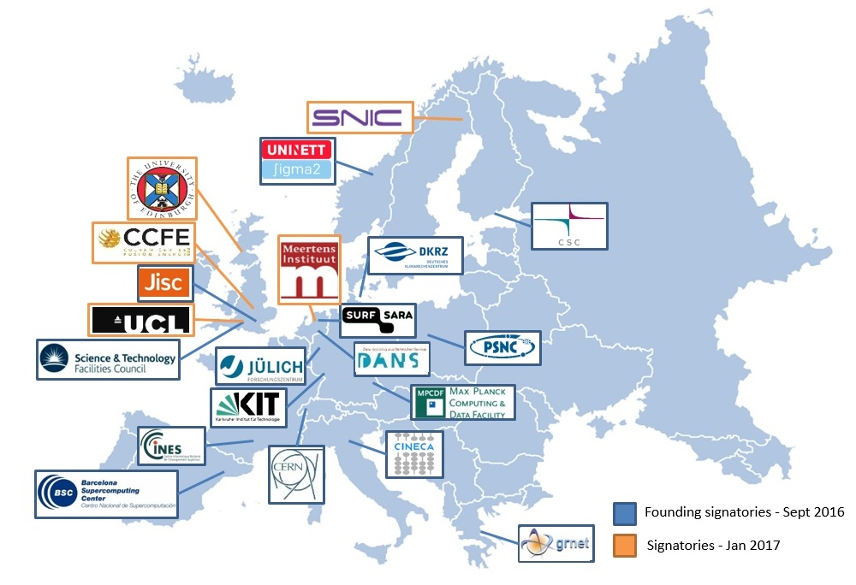
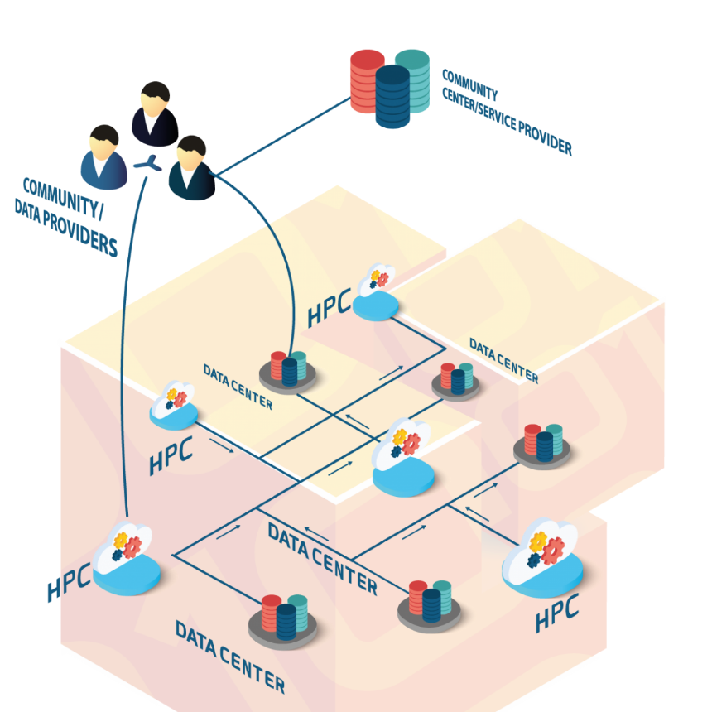
Cooperation with the EUDAT network of e-infrastructure providers
5 EUDAT members are partners of SeaDataCloud :
CINECA, CSC, DKRZ, GRNET and STFC

Slide 6
Leading concept for SeaDataCloud
Providing a cloud platform with common services for data pre-processing, subsetting, analyses, visualizations, publishing, DOIs…
Applying common standards and interoperability solutions for providing harmonised data and metadata
Providing harmonised discovery and access to data output from multiple sources, such as European research and monitoring data gathering, but also from other European and international data infrastructures
Added-value services and applications – Cloud
Platform
Downstream
Services
Standards
OGC, ISO, W3C &
Vocabularies
Upstream
Services
Discovery and access
to datasets from many sources

Slide 7
Data discovery and Access

Slide 8
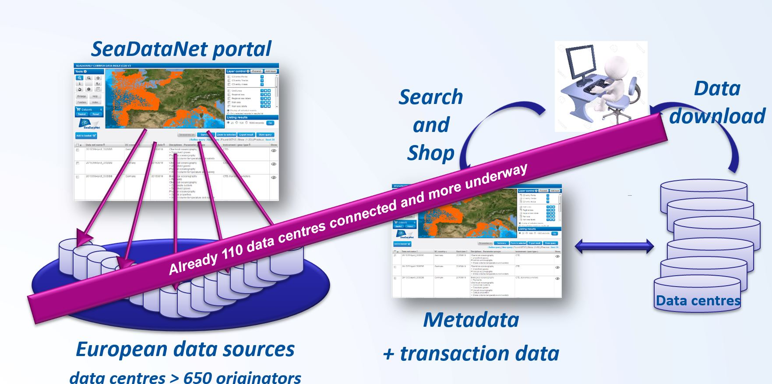
CDI Data Discovery and Access service
It is one of the core services of the SeaDataNet infrastructure
It provides a highly detailed insight and unified access to the large volumes of marine and oceanographic data sets managed by the distributed data centres
It is a fine-grained index (ISO 19115 – ISO 19139) to individual data measurements (such as a CTD cast or moored instrument record)

Slide 9
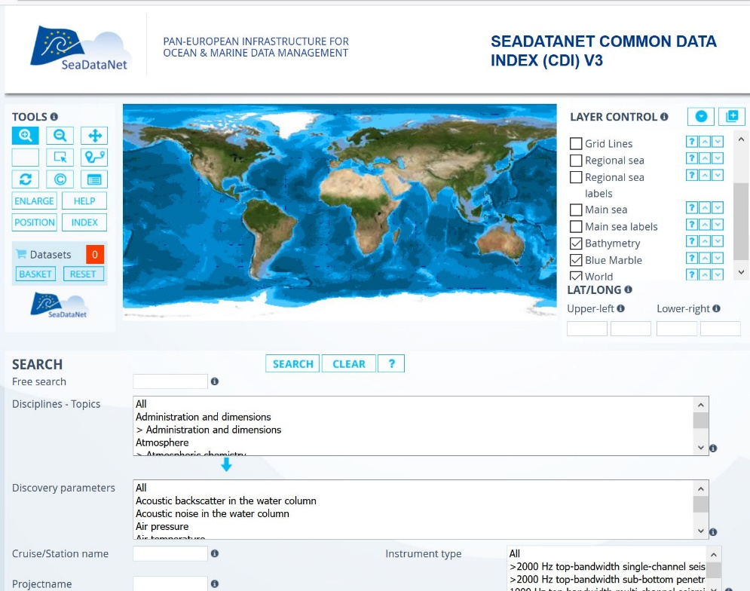
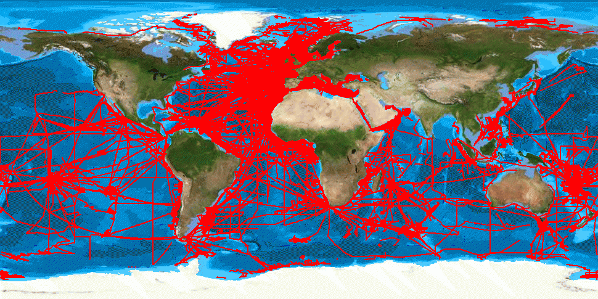
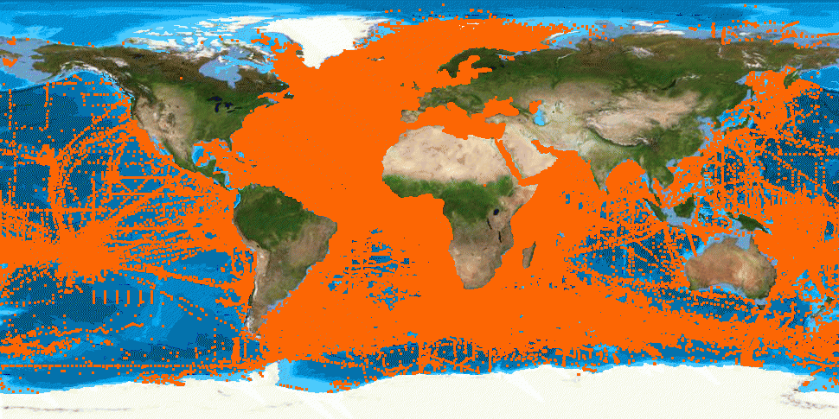
CDI service with global coverage
> 2.2 Million CDI entries for physics, chemistry, biology, geology and geophysics

Slide 10
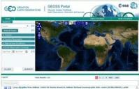
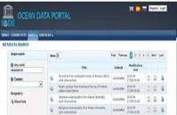
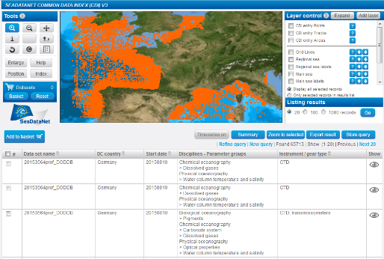

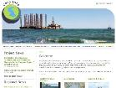
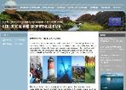



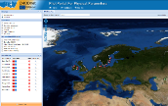
CDI service contributes to many portals
Total collection
GEOSS portal
IODE ODP portal
Aggregated collection
Data discovery
and access
Black Sea portal
Caspian portal
Geo-Seas portal
Regional subsets
> 110 data centres
Bathymetry
Thematic portals
NODCs; HOs; GEOs; BIOs; ICES; PANGAEA
Physics
Chemistry
≈ 650 European data originators
CDI Data Discovery and Access service
Geology
Biology

Slide 11
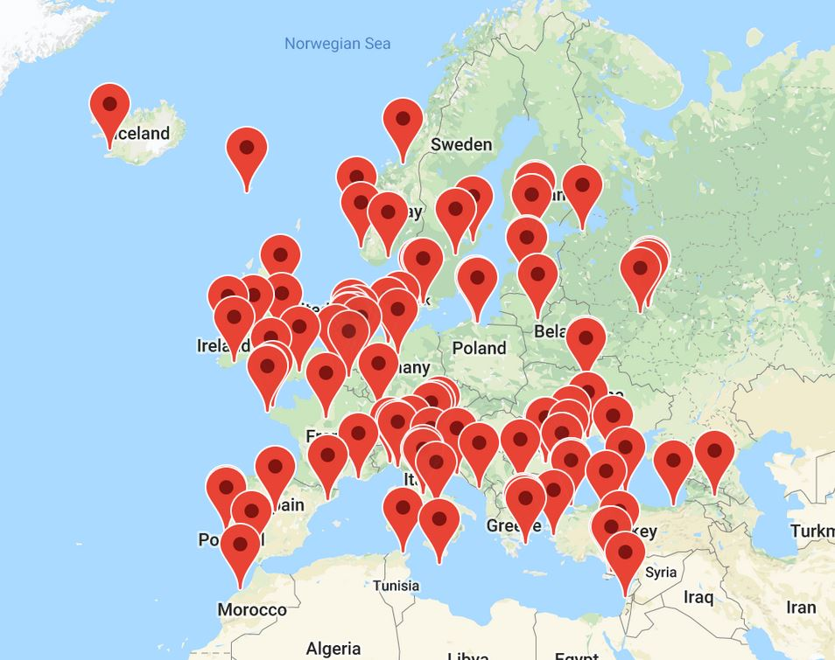
Installed base of CDI nodes (> 110)

Slide 12
Upgrading the CDI service using the cloud
To configure and maintain a CLOUD buffer to host copies of unrestricted data resources
Exchange by dynamic replication from the individual data centres, following their updating of the CDI catalogue service
In the cloud buffer:
  checking overall quality of metadata and data, as extra check on top of local QA-QC by data centres
  checking integrity of data files and metadata relations.
  results of checks to be reported back to data centres for corrections
Include transformation services for converting data sets to SeaDataNet ODV and NetCDF formats and relevant INSPIRE data models.
Introduce PID and versioning of metadata and data as part of provenance

Slide 13
New CDI service architecture

Slide 14
Front-end – All new GUI
Faster, using Elastic Search for search and indexing, and GeoServer for latest mapping technology
Easier, including full text search next to controlled terms
Modern design with large map and sliding windows
MySeaDataNet integrated in GUI for customized services, such as SSO, RSM access, search profiles, prepared for VRE data pooling
Developed and refined as prototype (http://sdc.maris.nl) interacting with users and data managers, following the SeaDataCloud Training Workshops in June 2018

Slide 15
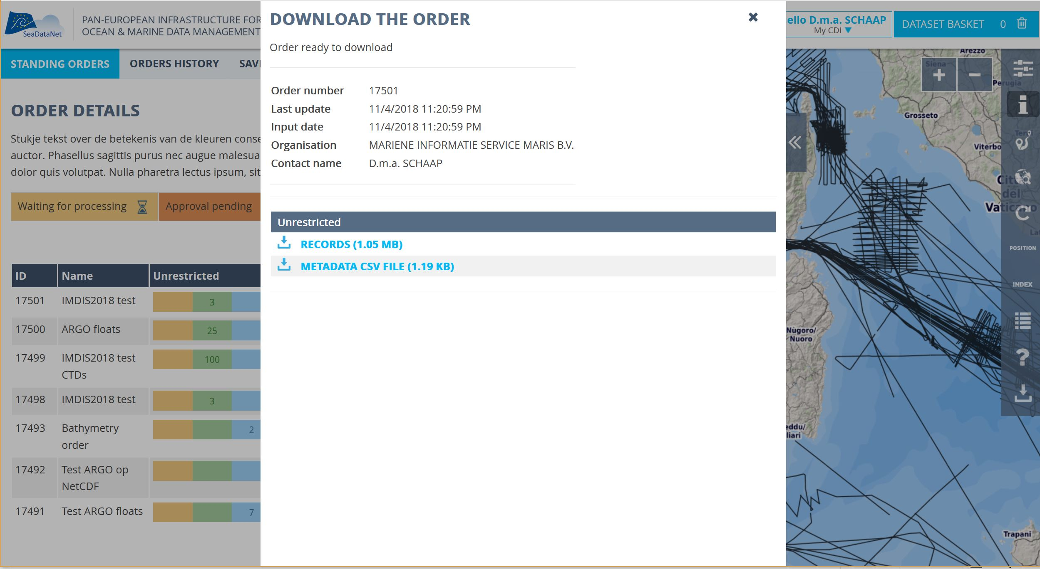
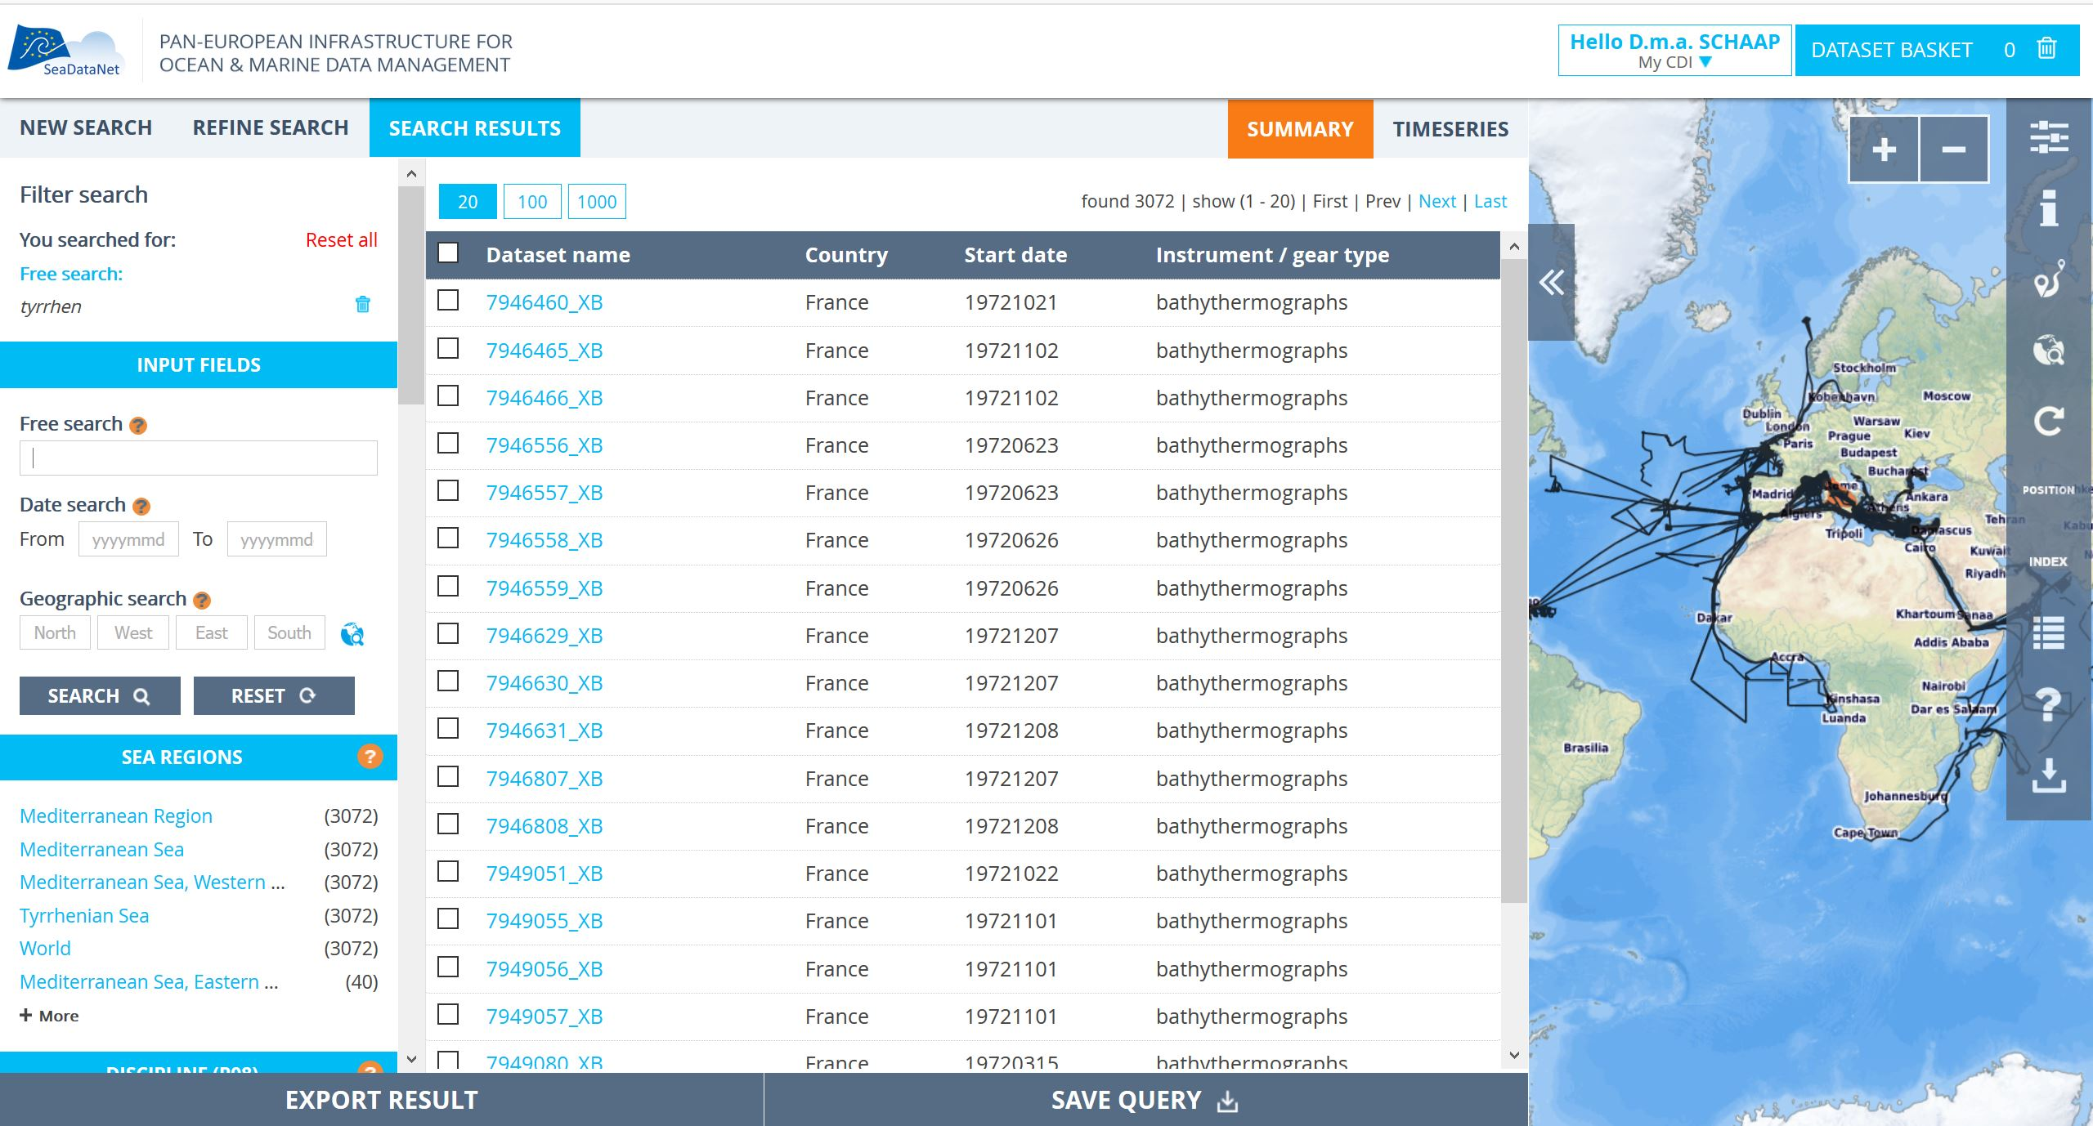
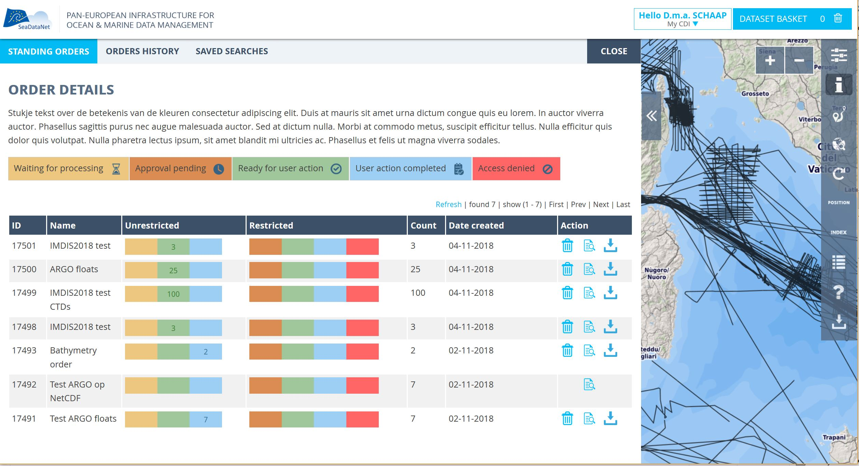
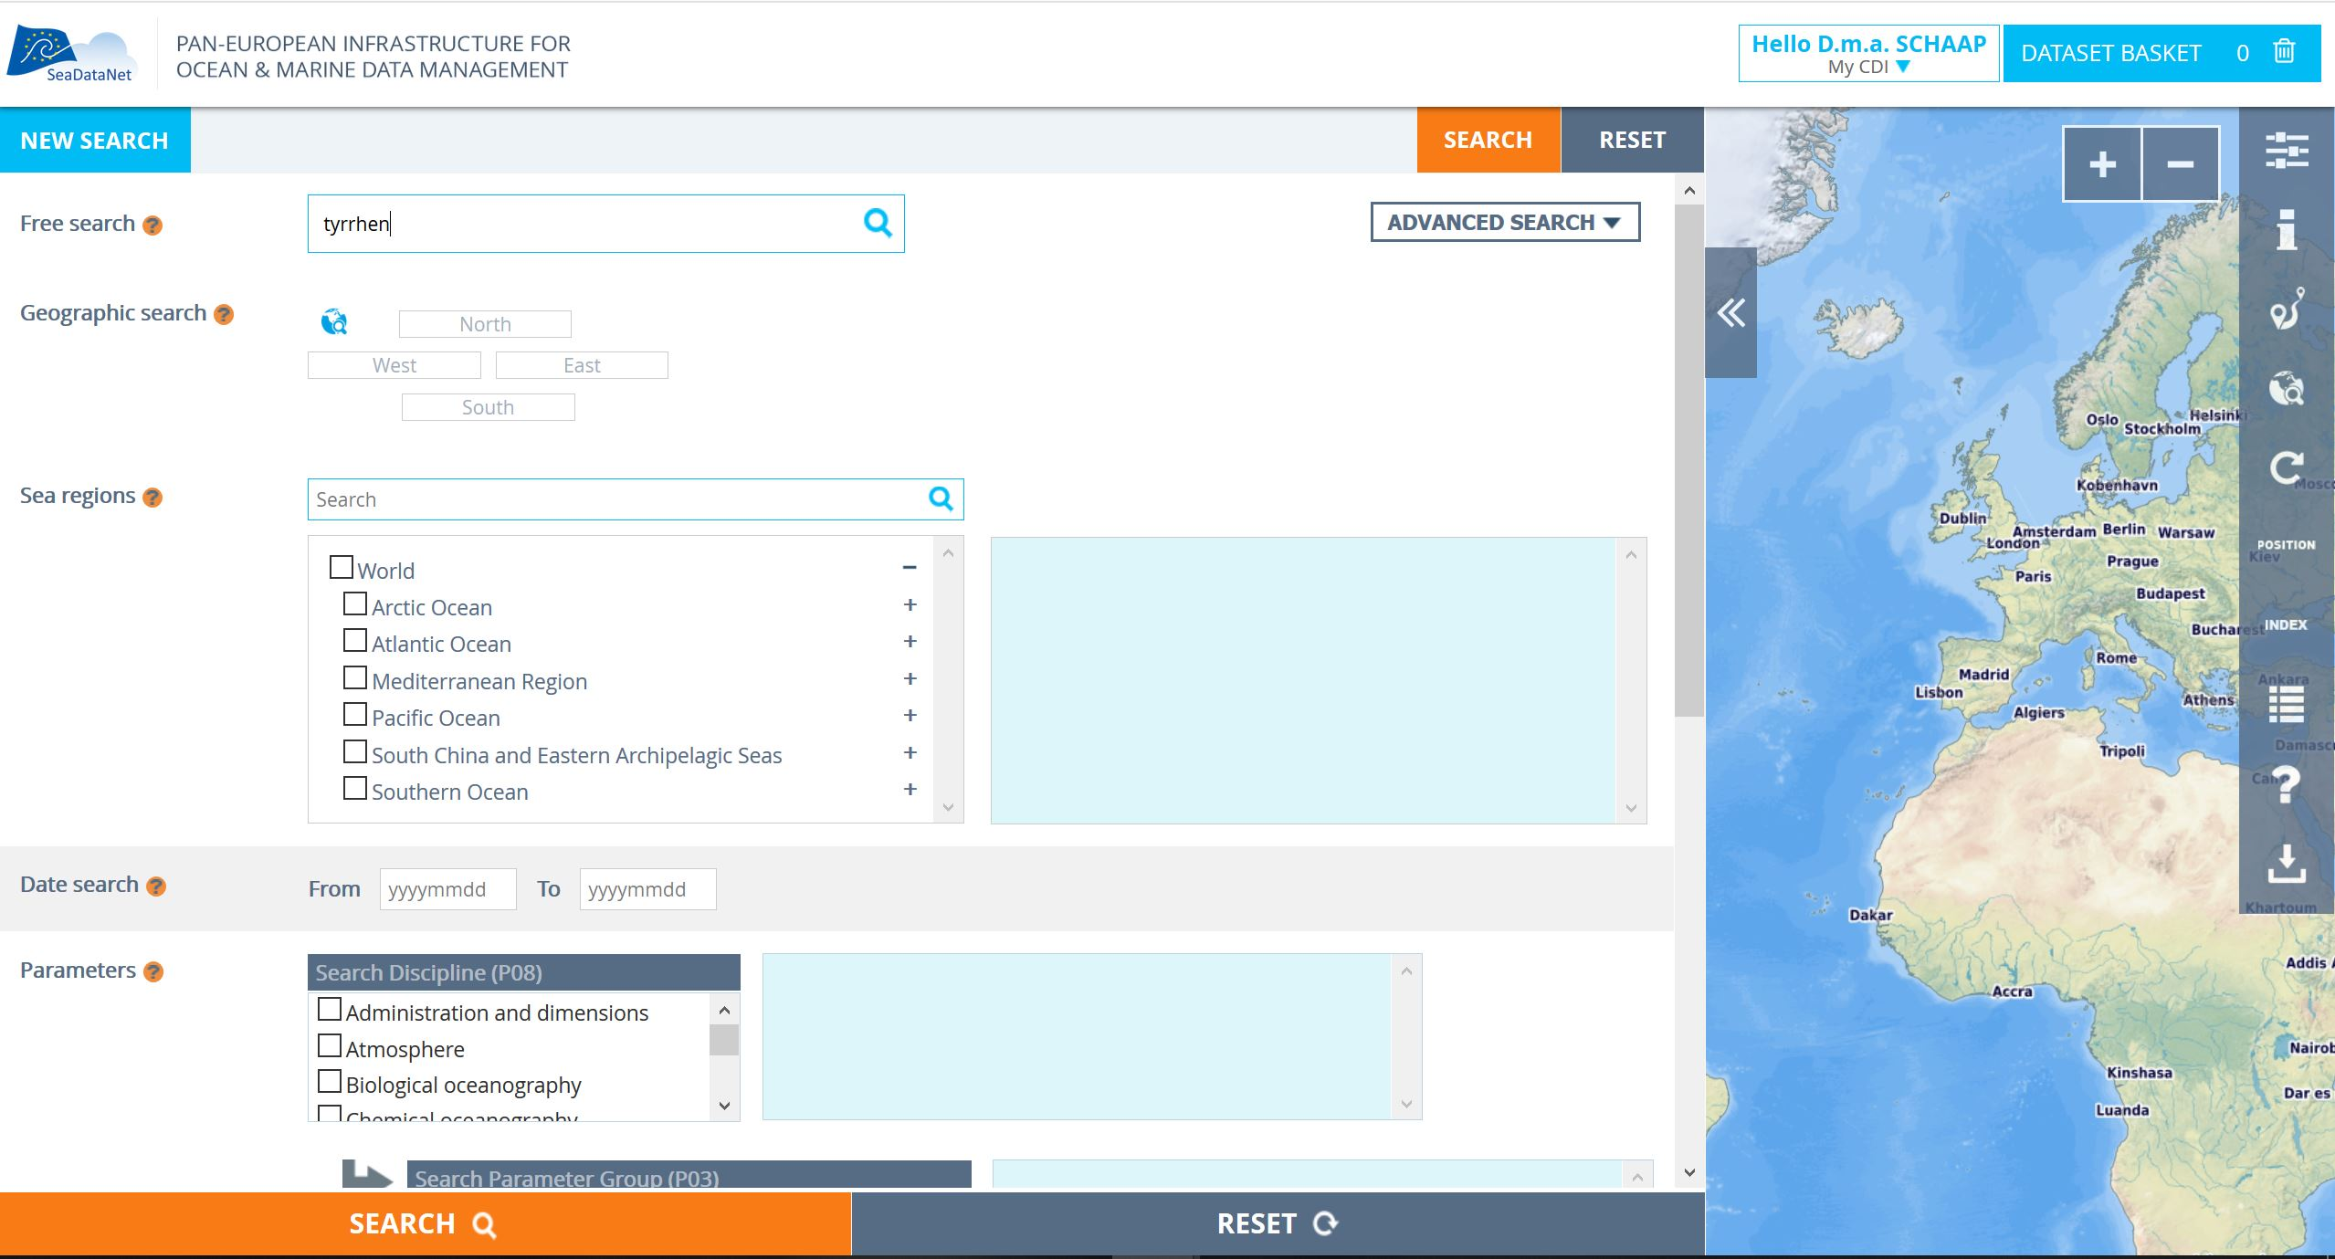
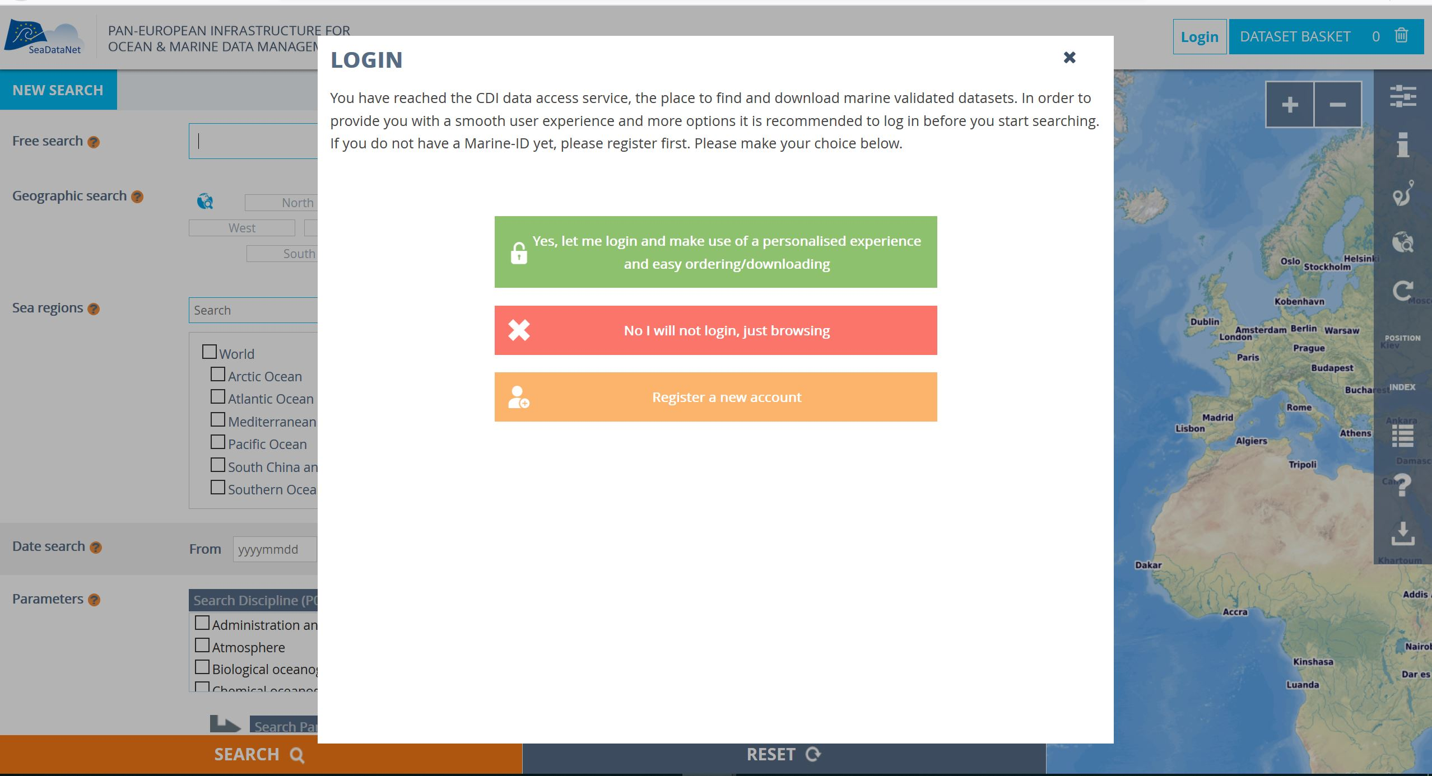
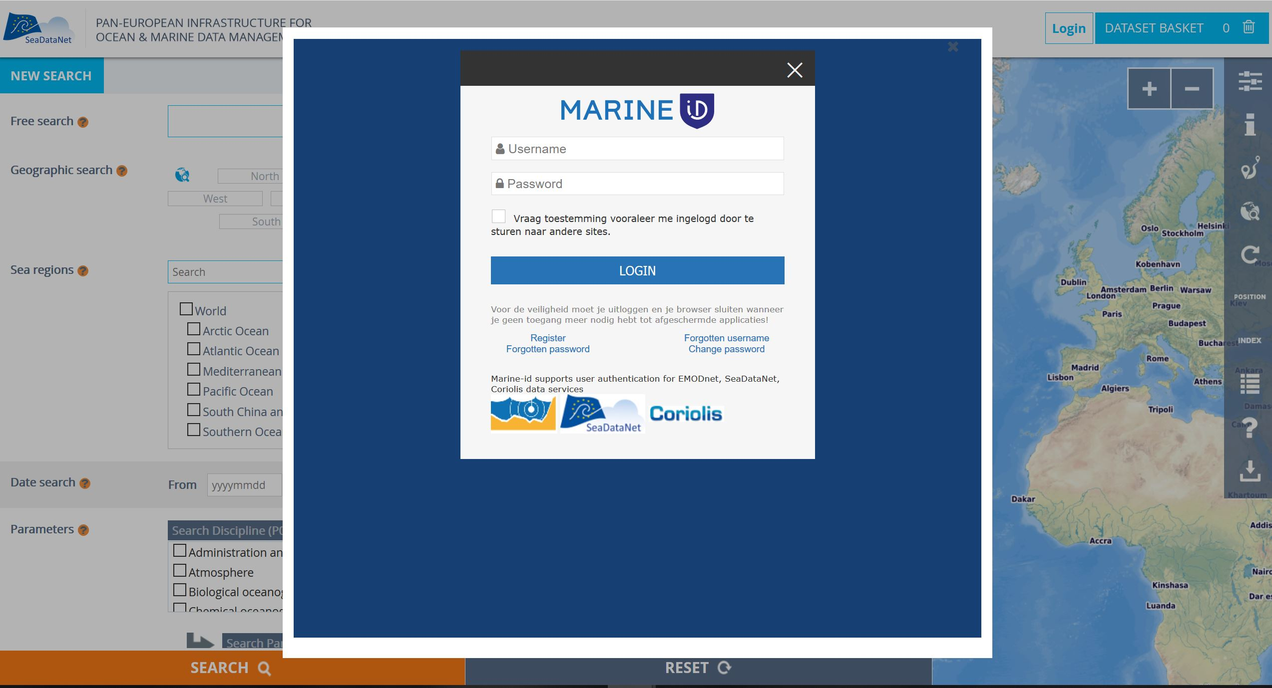
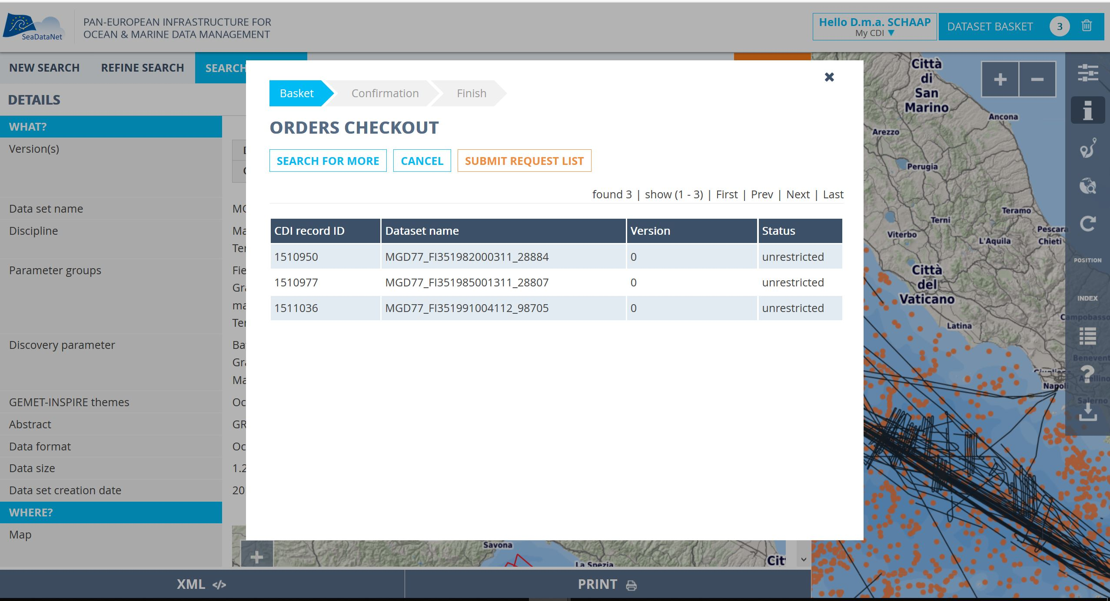
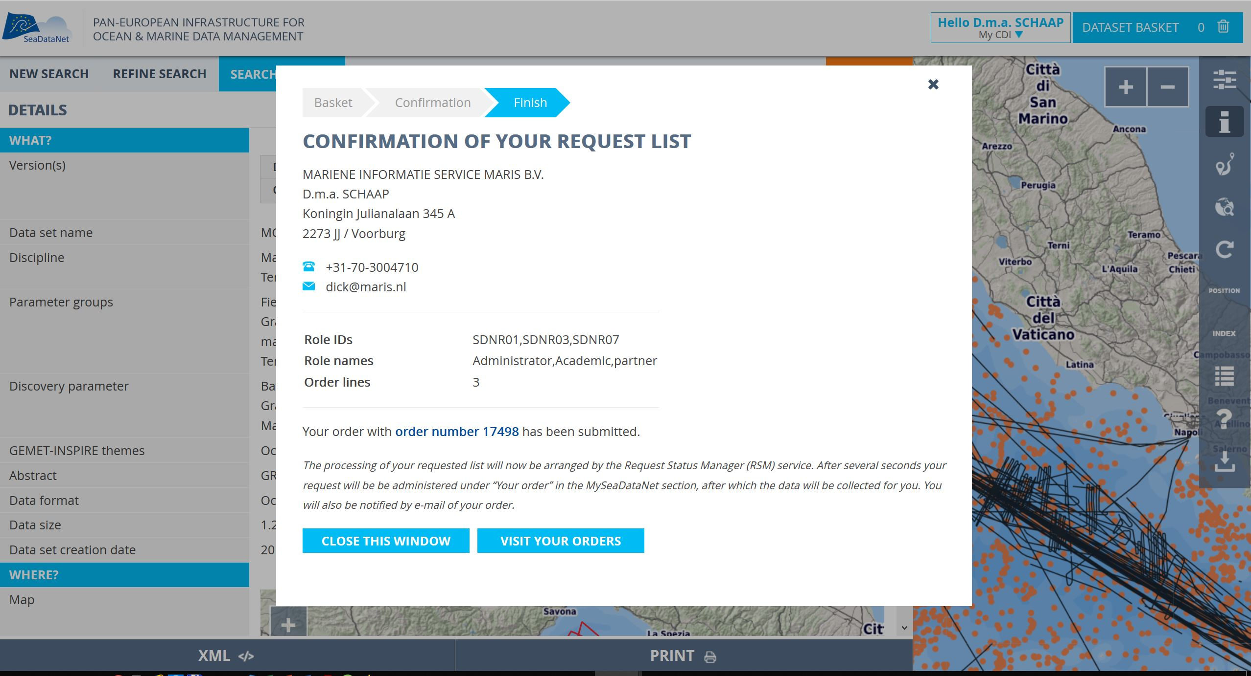
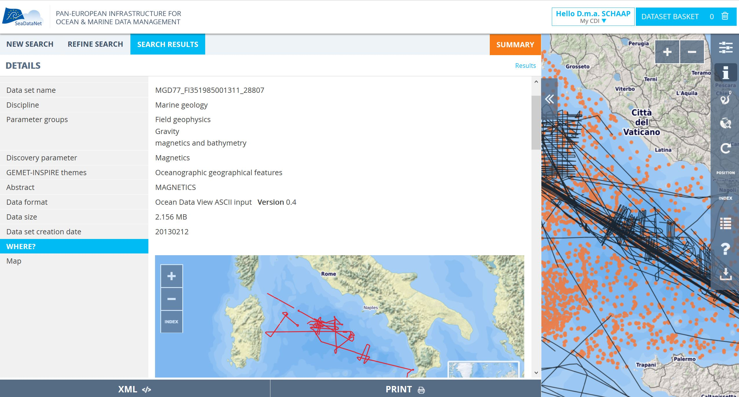
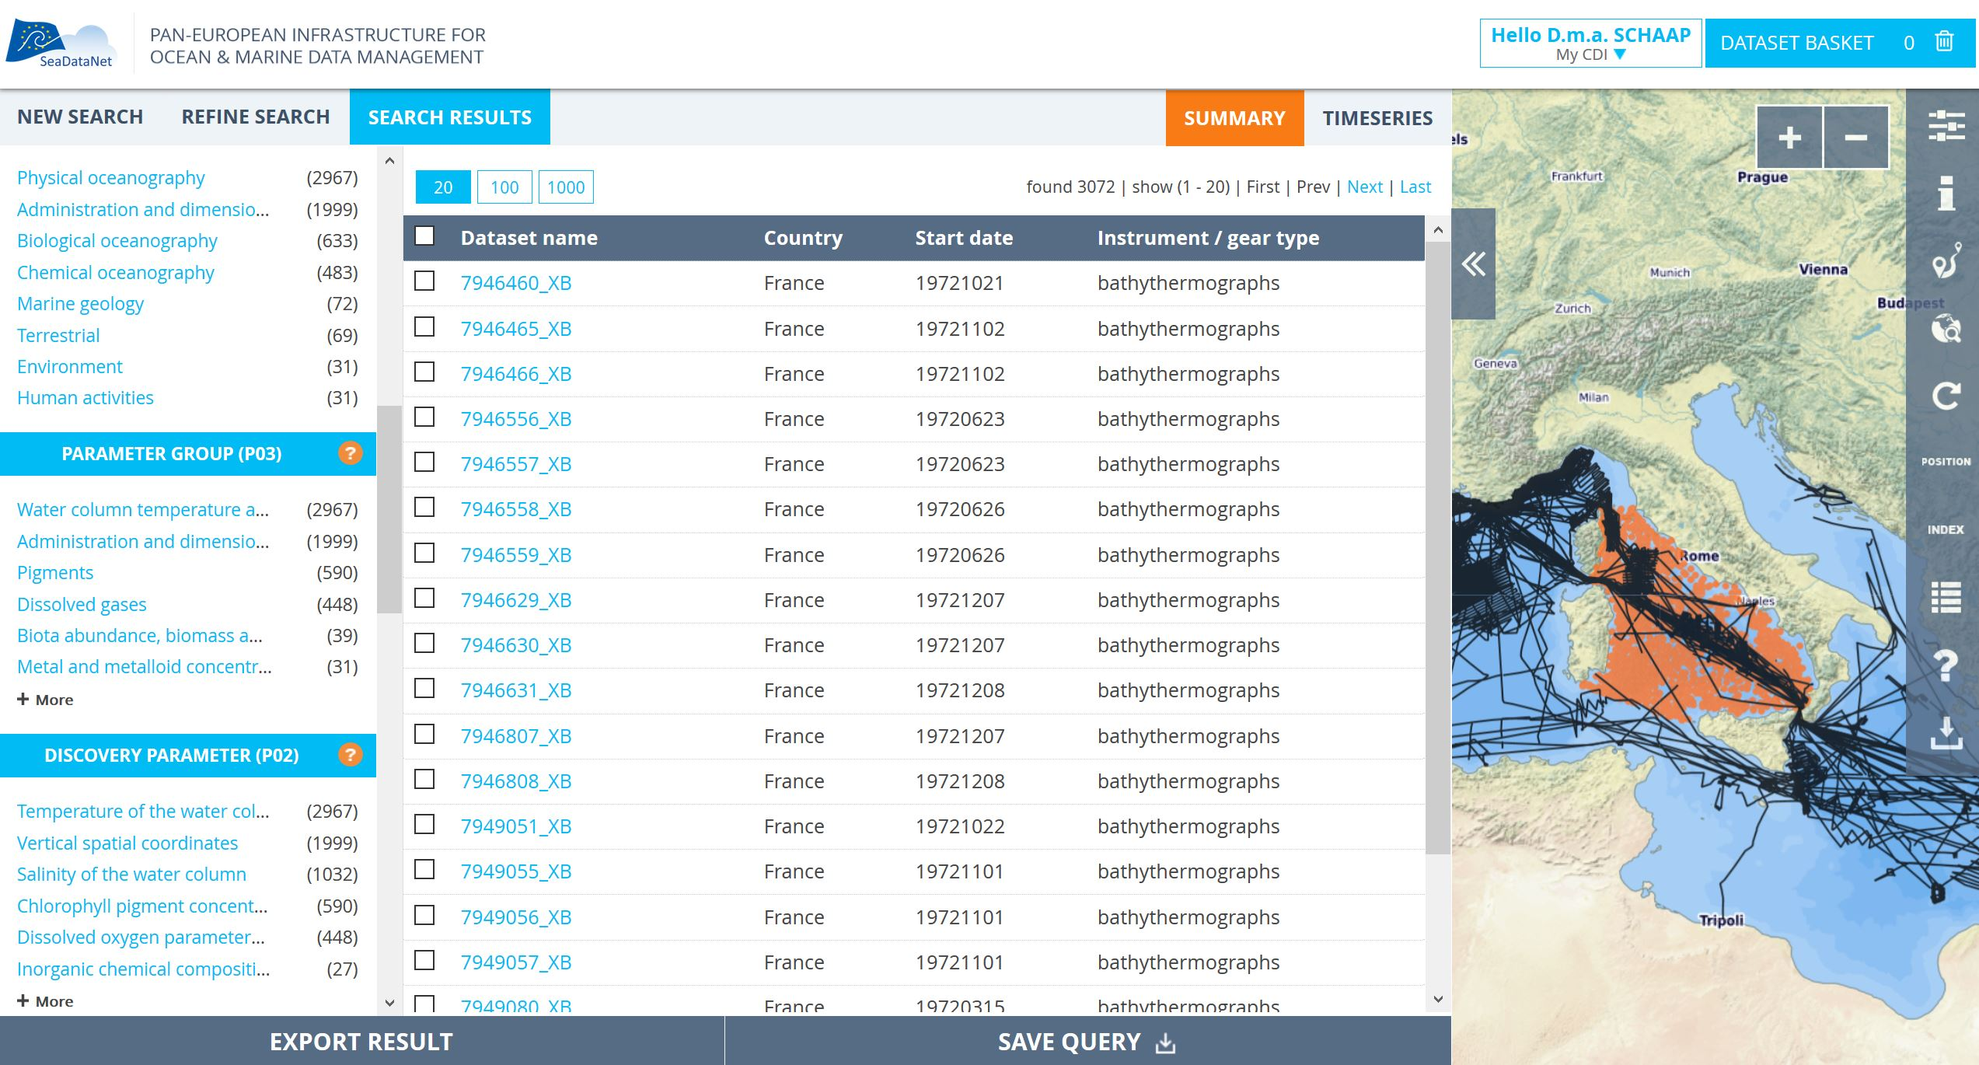
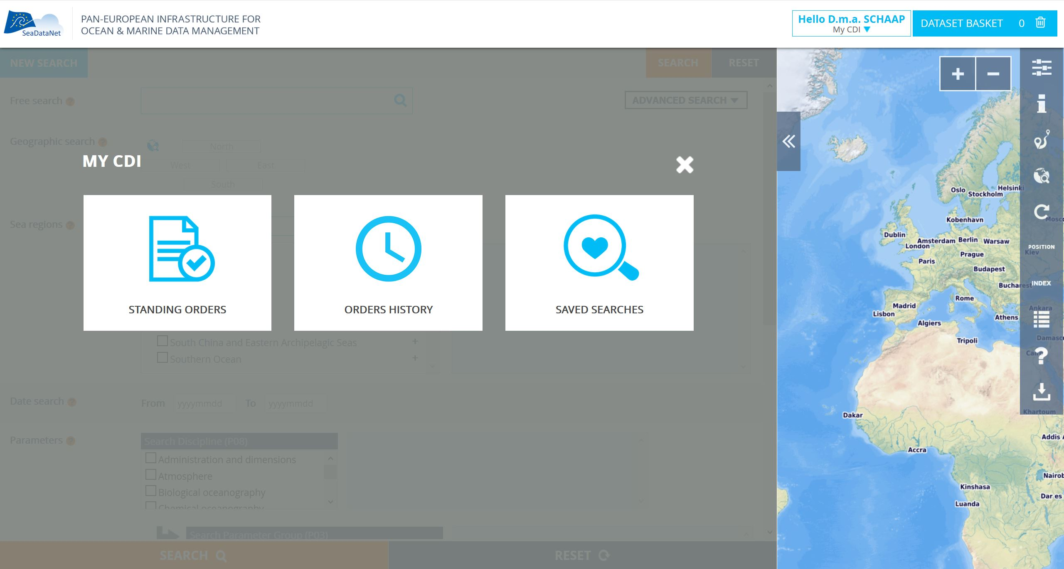
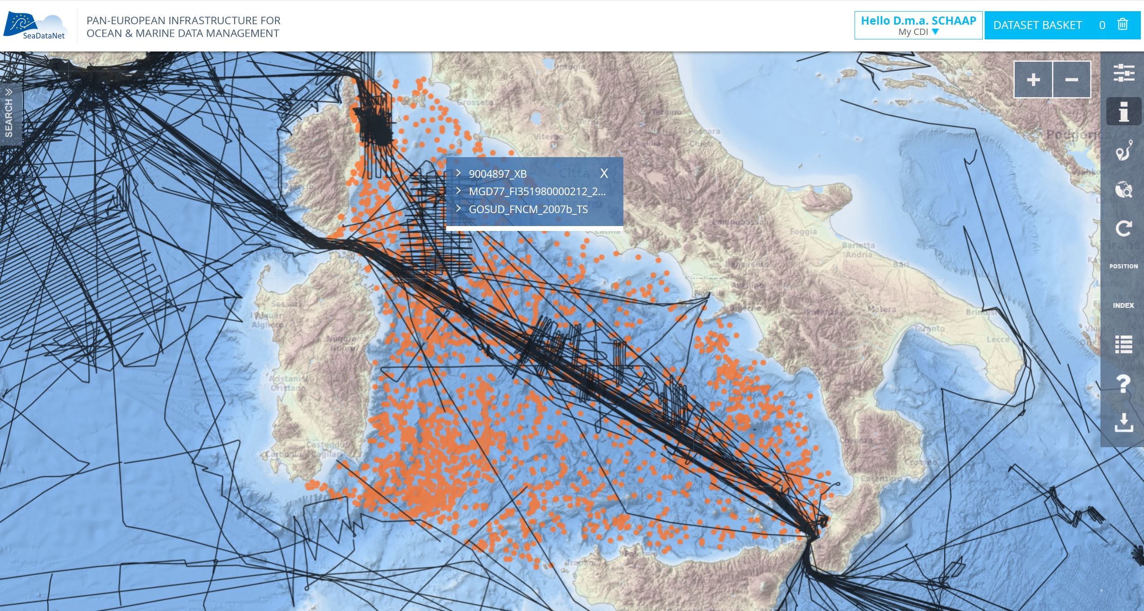
New GUI impressions

Slide 16
Virtual research environment

Slide 17
Virtual Research Environment (VRE)
  Reviewing of existing VRE developments in Australia, USA and Europe, also as part of the Ocean Data Interoperability Platform (ODIP) activities
  Formulating a ToR for the VRE overall specifications
  Analysing and defining an overall architecture for the SDC VRE, considering EUDAT’s generic services and embedding dedicated SDN services, custom and generic
  Analysing the workflow and specific functions required for supporting the SDC pilot: generating a SeaDataNet Temperature & Salinity climatology
  Developing VRE components and integrating these into the SDC VRE pilot

Slide 18
SeaDataClouds VRE main requirements
  Facilitate collaborative and individual research
  Combine data with subsets from other data resources
  Have a high capacity and performance for big data processing and web visualisation services
  Differentiated users, different access to data and data products
  Configure virtual work spaces for individuals or groups, including setting up of dedicated pools of data
  Sharing options, if user decides
  Based and hosted on EUDAT’s infrastructure and its B2-… service platforms

Slide 19
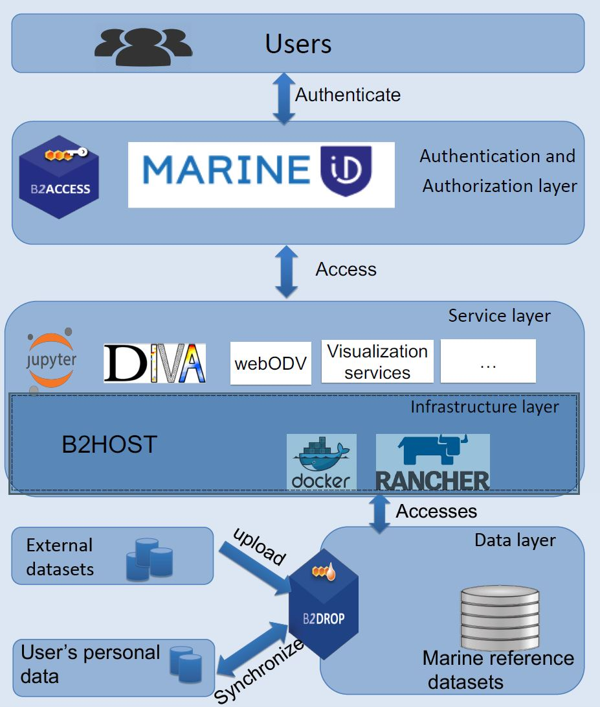
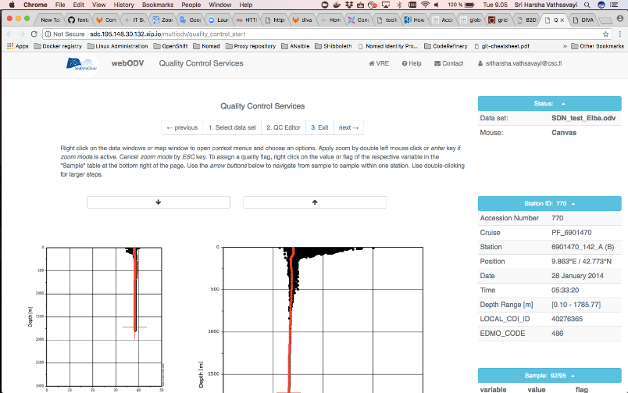
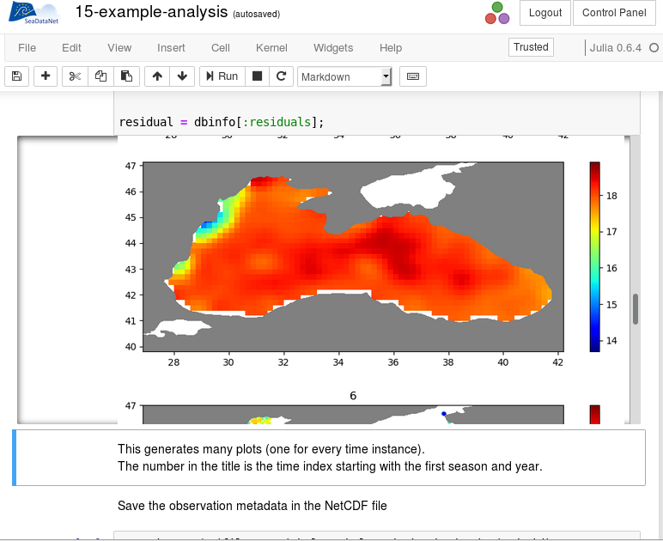
Overall architecture for the SDC VRE

Slide 20


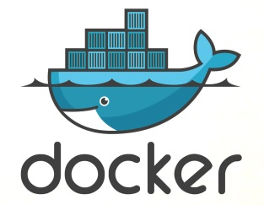
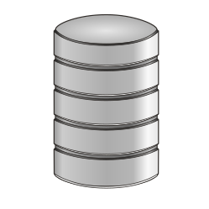
© Merret Buurman - DKRZ
VL1
VL2
Frontend
B2ACCESS & Marine-ID
(+Single Sign On)
Frontend
Client
B2HOST
GUI
Notebook
API
API
GUI
Processing layer
B2SAFE
Data access
B2DROP
B2DROP
Data layer
CDI data
Reference
datasets
Custom data Alice
Custom data Bob

Slide 21

Outlook
We are here!
© Merret Buurman - DKRZ

Slide 22
Next steps until end 2019:
Integration
Internal user test
Beautiful design
Customization for different groups
Push CDI data from portal to VRE
Enable usage of SDN products
etc.
After Dec 2019: Advanced features
(workflows, group management, communications, data publications, etc.)

Slide 23
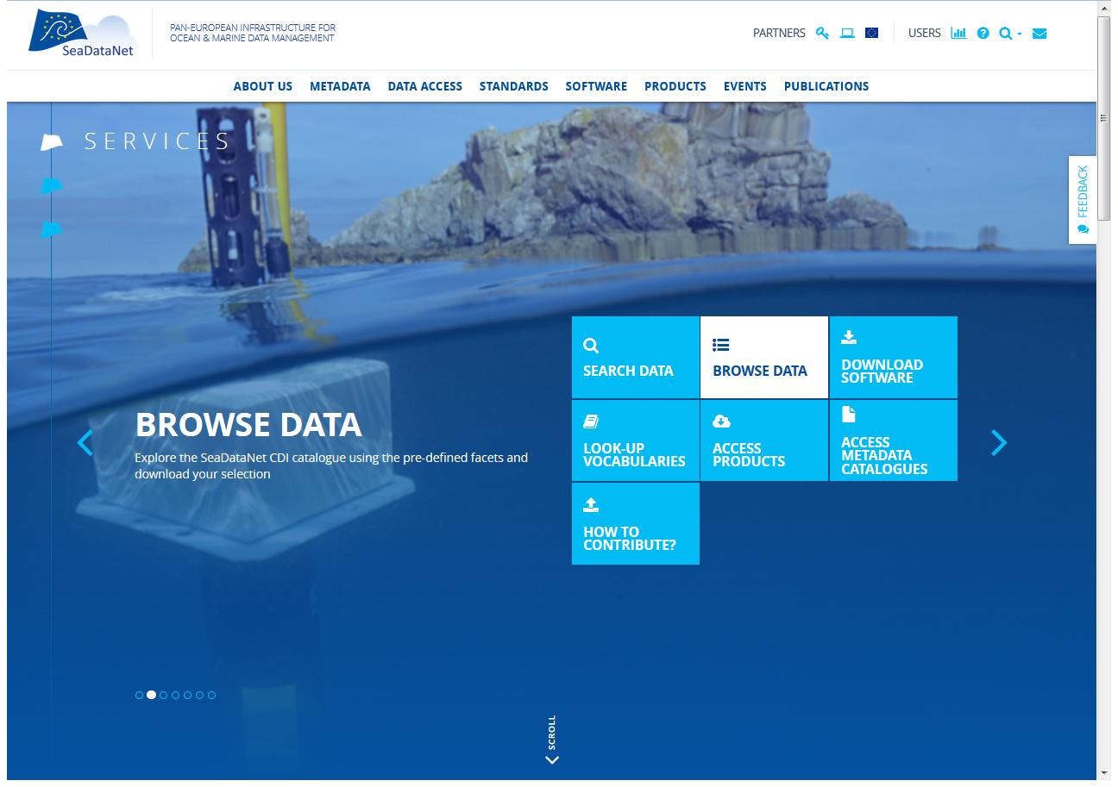
Keep following us via: www.seadatanet.org

