Slide 1
Working in Partnership with SeaDataNet
Michèle Fichaut, IFREMER, SeaDataCloud project coordinator

Slide 2
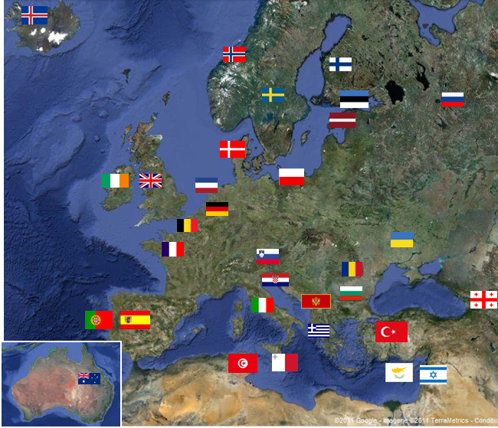
What is SeaDataNet ?
A pan-European infrastructure set up and operated for managing marine and ocean data in cooperation with the NODCs and data focal points of 34 countries bordering the European seas
90s | Metadata directories Medar/MedAtlas
2002-2005 | Sea-Search (FP5)
2006-2011 | SeaDataNet (FP6)
2011-2015 | SeaDataNet 2 (FP7)
2016-2020 | SeaDataCloud (H2020)
2019-2023? | SeaDataCloud 2 ?

Slide 3
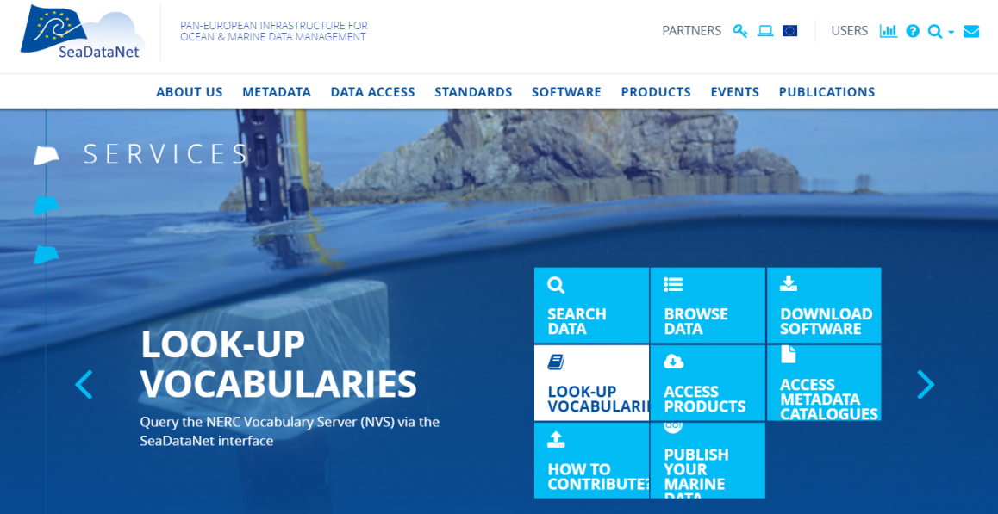
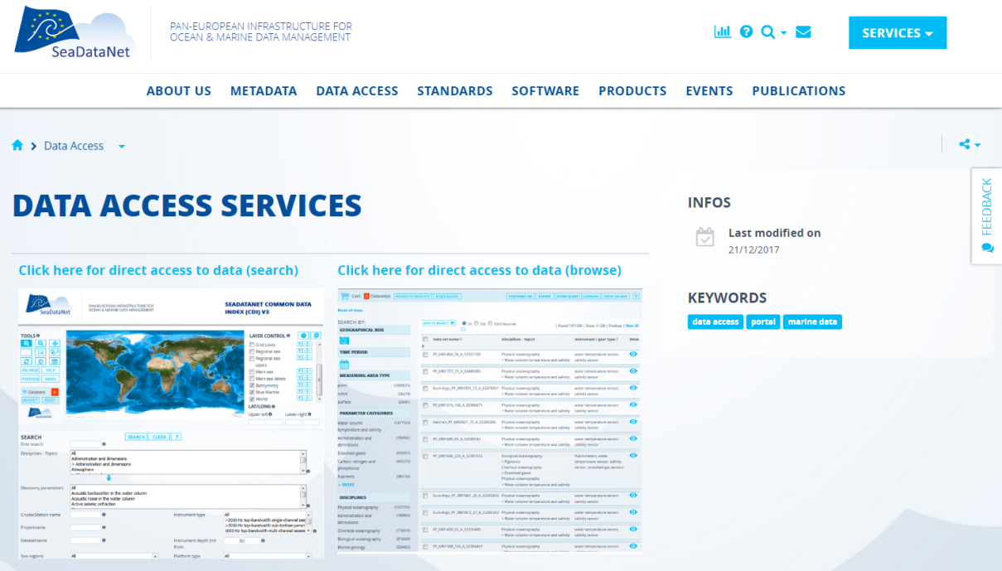
SeaDataNet portal
With access to
Standards & vocabularies
Software tools both for data centres and users
Data
Products

Slide 4
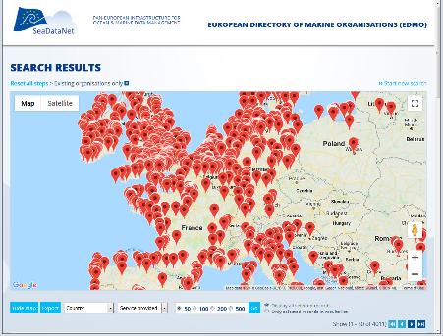
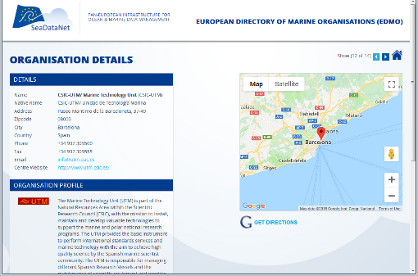
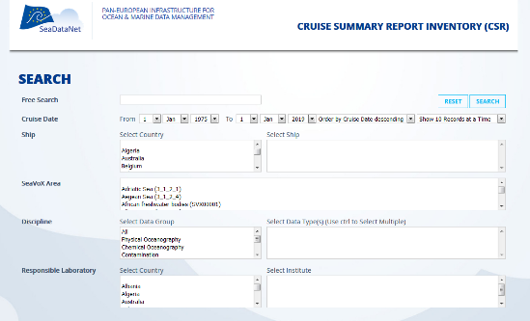
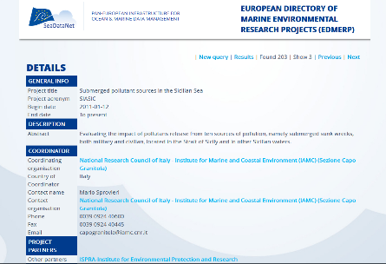
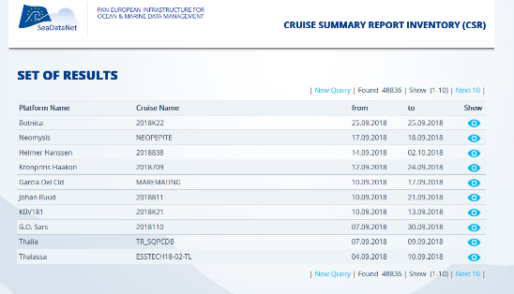
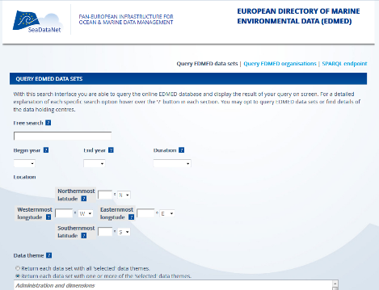
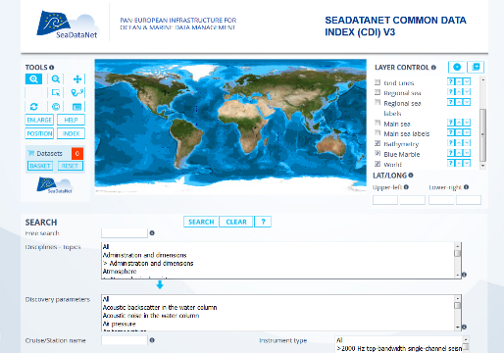
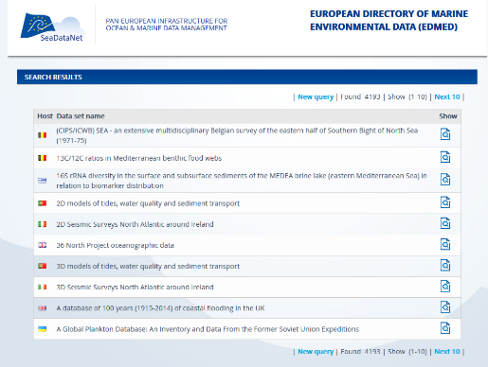
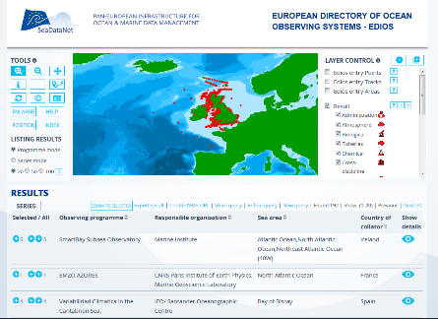
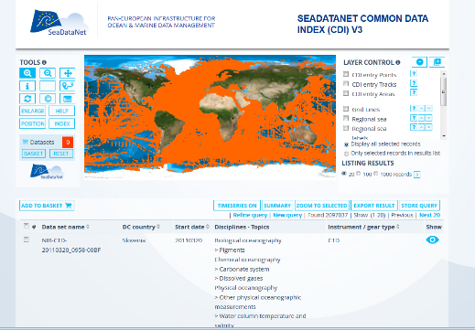
Metadata catalogues
EDMO
Organisations
EDMERP
CSR
Projects
Cruises
EDIOS
EDMED
CDI
Data sets
Observatories
Data

Slide 5
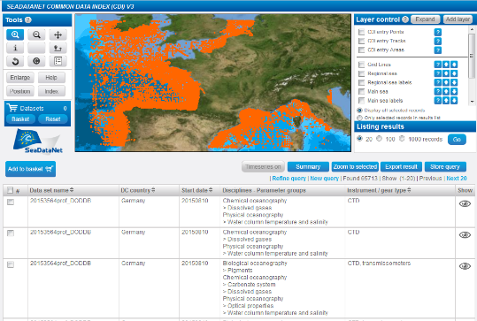

CDI catalogue: discovery and access to data
Dearch and selection
Data download
More than 110 data centres connected
Data centres
European data sources
Data centres⬅ ≈ 650 source laboratories

Slide 6
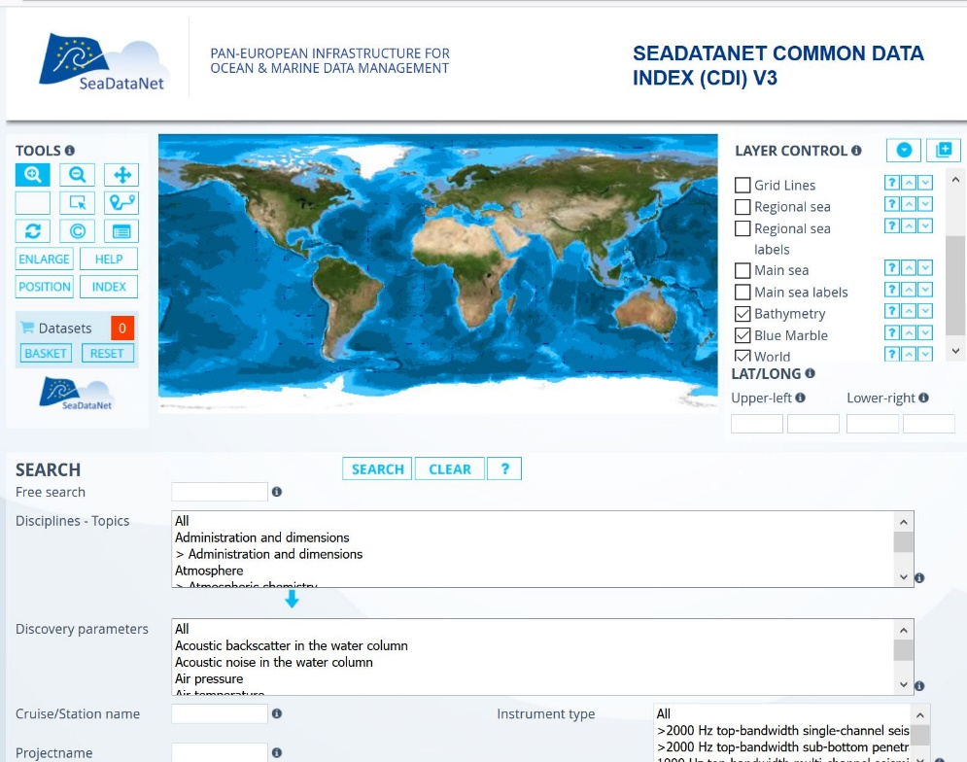
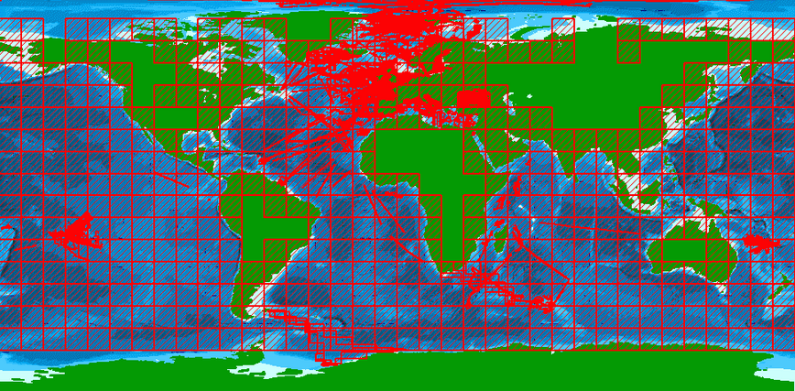
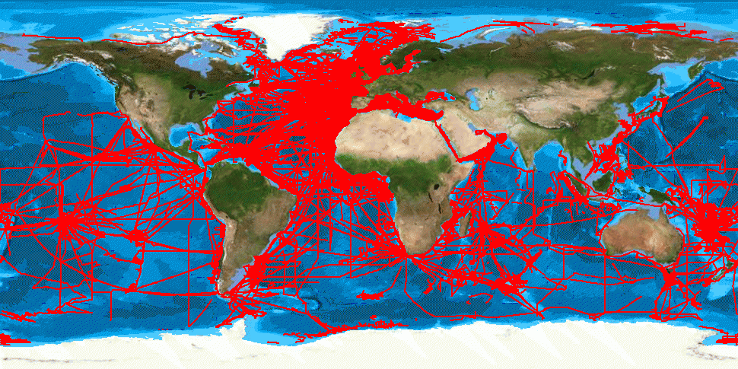
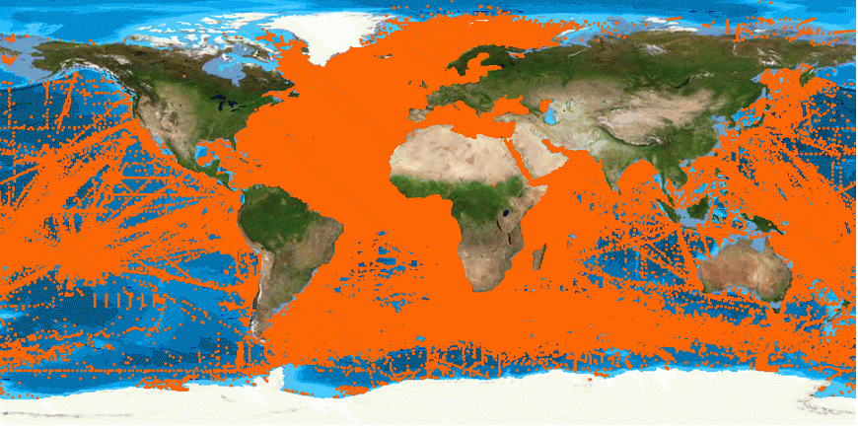
visite IRISA - 26/03/2019
CDI user interface
Areas
Trajectories
Vertical profiles
since 1800 ➔ 2019
2.3 M of CDIs for physical, chemical, biological, geosciences data
89 % unrestricted data

Slide 7
BODC and SDN
Involved since the beginning (and before…)
Core partner of the project
  WP leader for the Governance of standards and development of common services
  Management of the vocabularies
  Definition of the common data transport formats
  Management of 2 of the metadata catalogues of SeaDataNet : observatories (EDIOS) and datasets (EDMED)

Slide 8
BODC and SDN
Member of the Steering Group and of the Technical task team of all the SDN projects
Involved as trainer in all SDN training workshop sessions since 2007
Member of the scientific committee of IMDIS conferences, in the review committee, and as chairs in IMDIS sessions

Slide 9
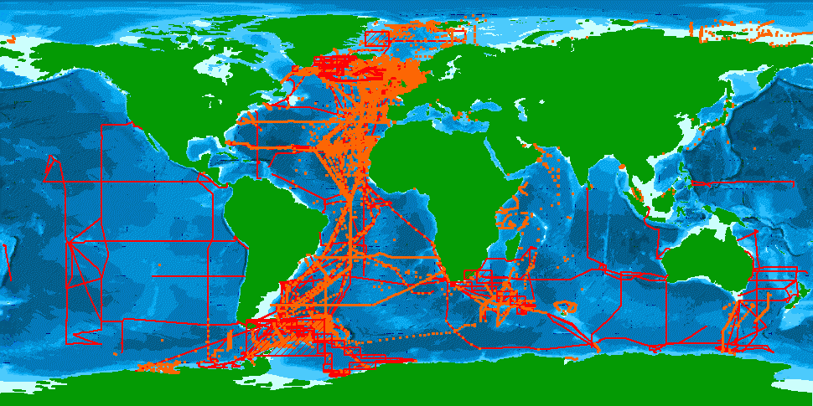
More than 125 000 CDIs issued by BODC in SDN

Slide 10
SeaDataNet vocabulary lists
BODC develops and maintains
  111 SeaDataNet vocabulary lists leading to more than 86 000 terms
  Web Services on top of the vocabularies
    Vocabulary builder and browser: to search entries in the vocabulary and/or ask for the creation of new terms
    Vocabulary editor: for advanced users to insert new or update existing entries
The vocabulary is a KEY COMPONENT of SeaDataNet infrastructure and is essential for interoperability

Slide 11
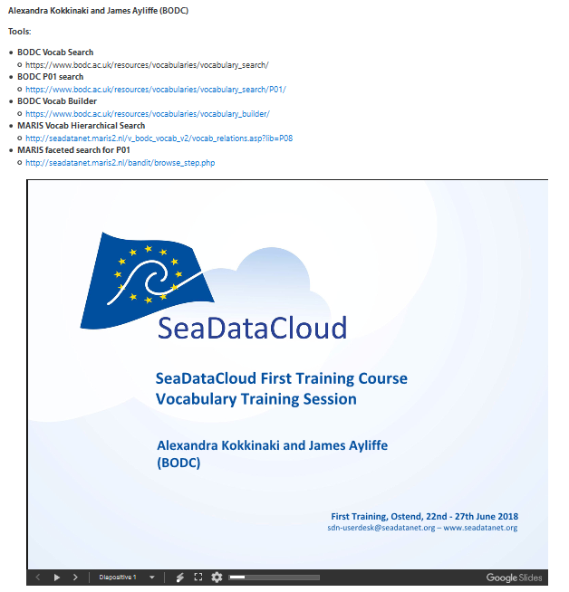
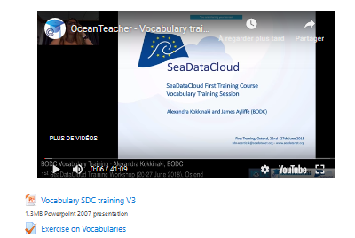
SeaDataNet vocabulary lists
At each SeaDataNet training course, detailed presentation on the vocabulary and related tools has been done by BODC team. Data centres are trained, by BODC, to search terms in the vocabulary and to use the vocabulary tools. Video and training material are available online (Oceanteacher)

Slide 12
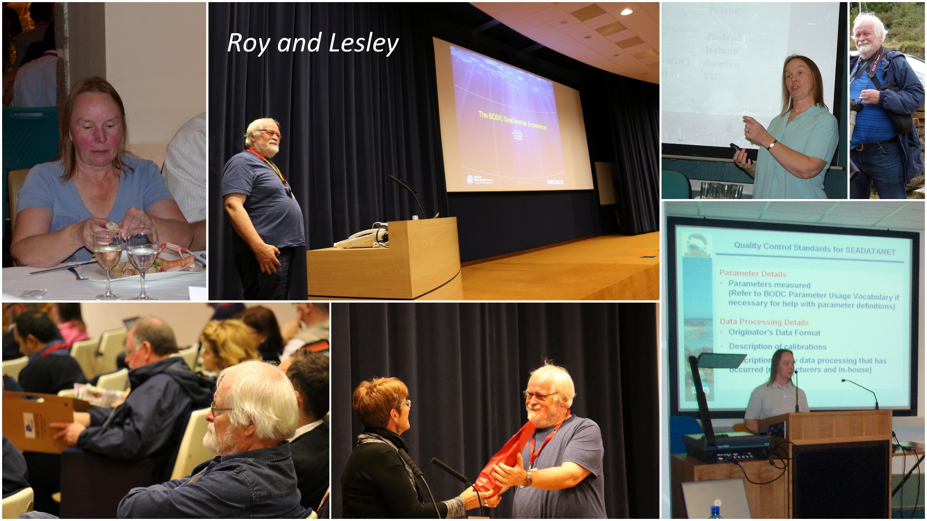
At the beginning of SDN

Slide 13
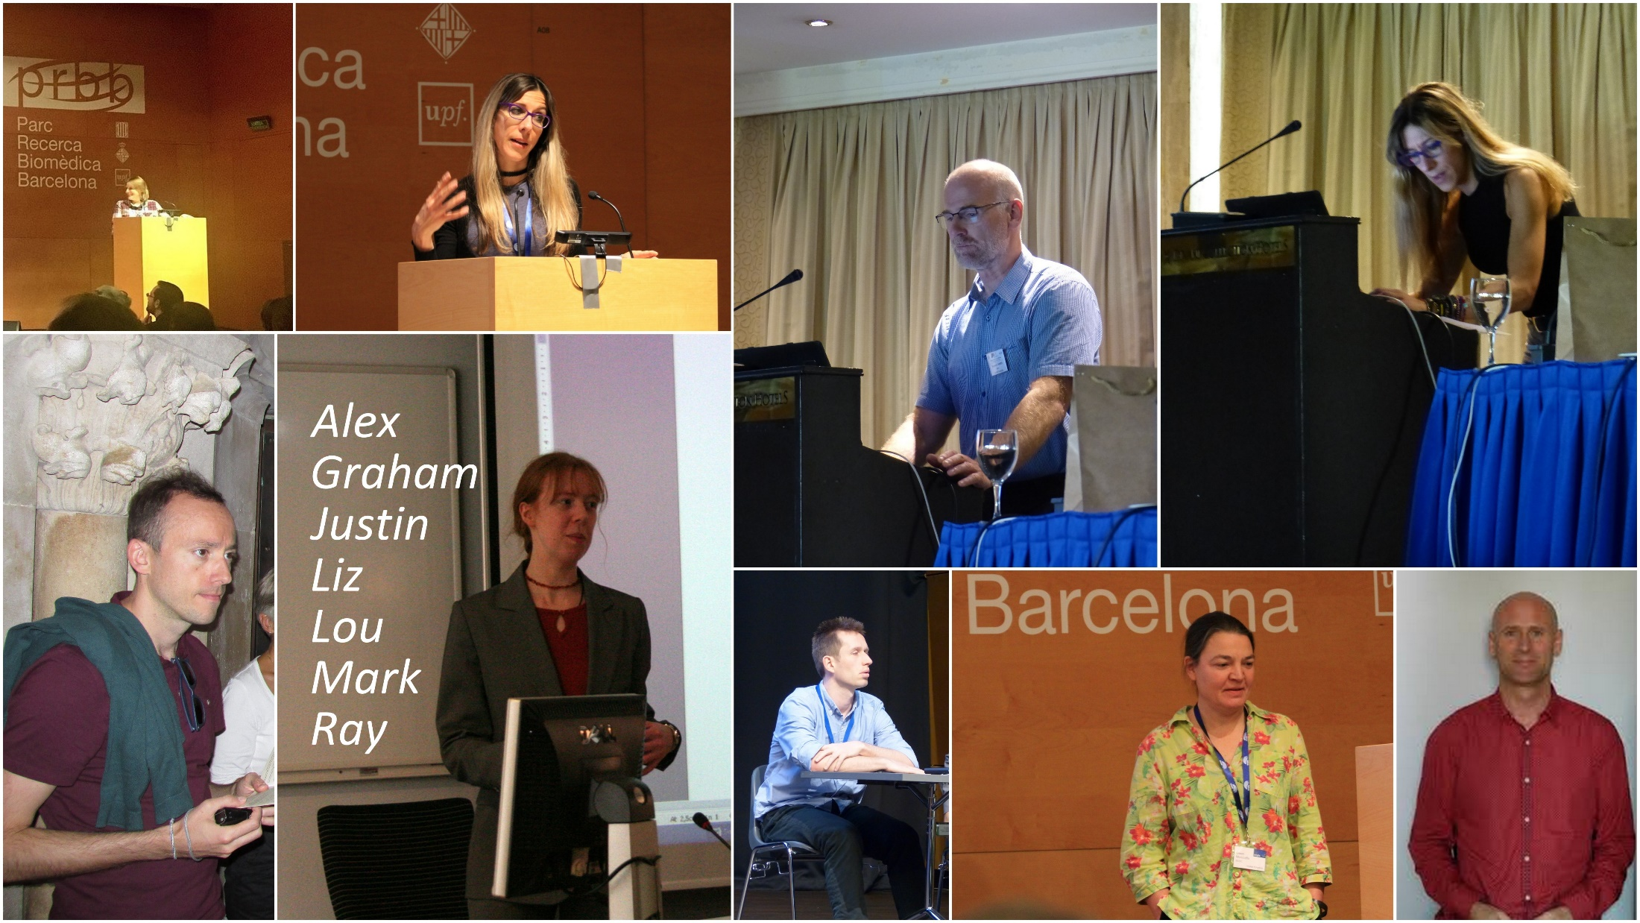
And then ….
…

Slide 14
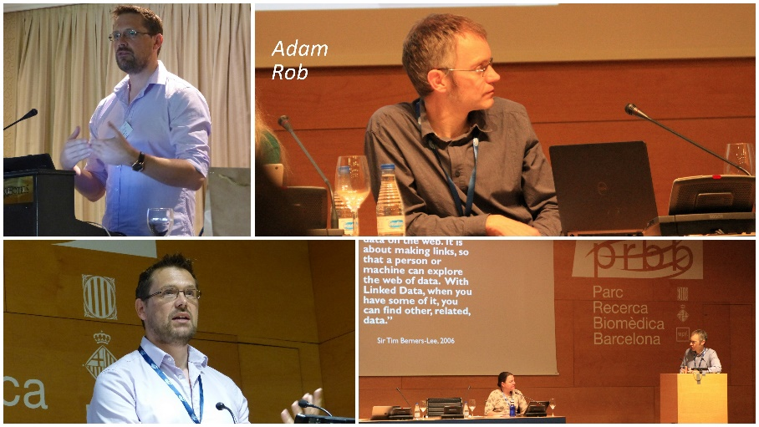

Not to mention the ones who left ….

Slide 15
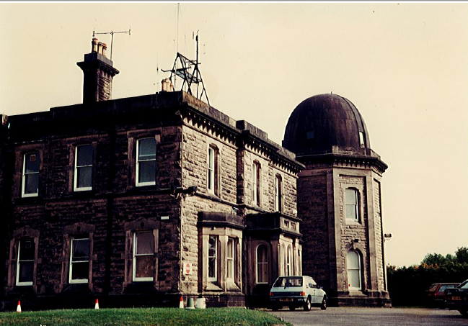
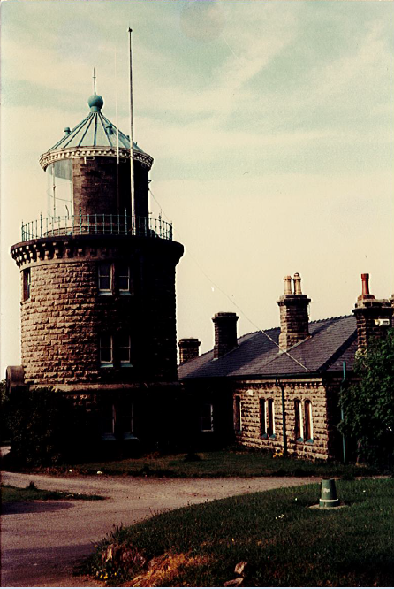
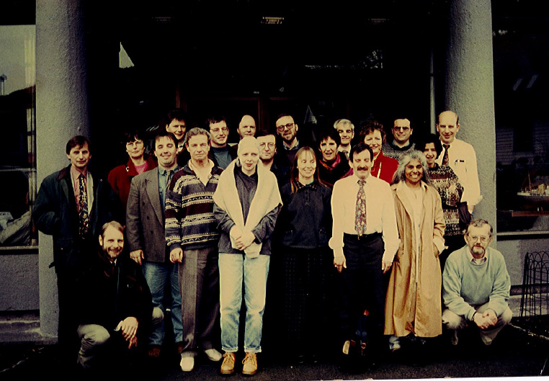
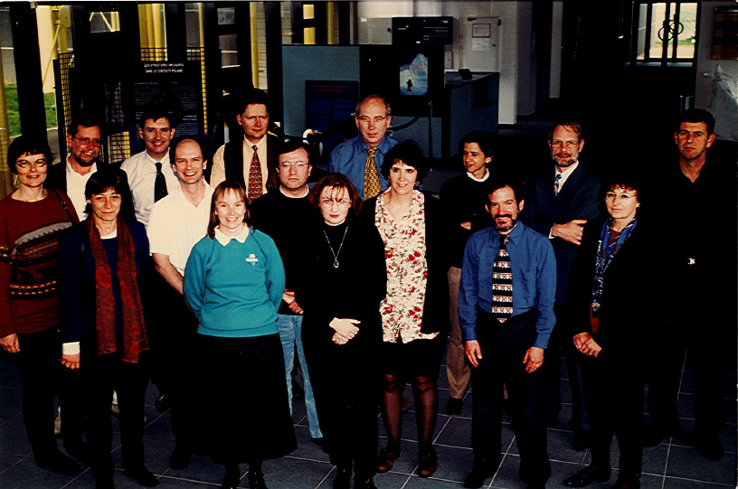
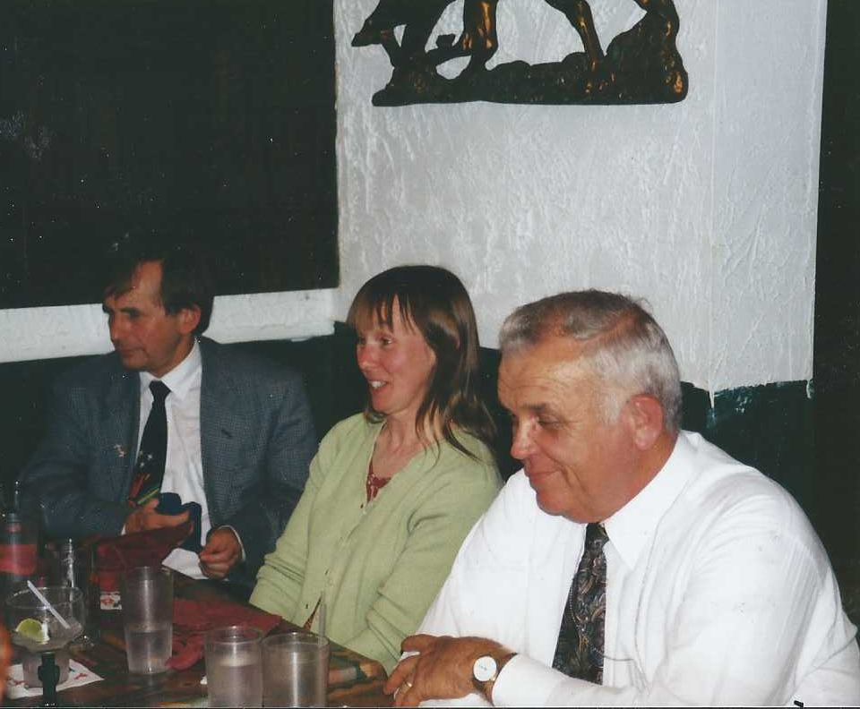
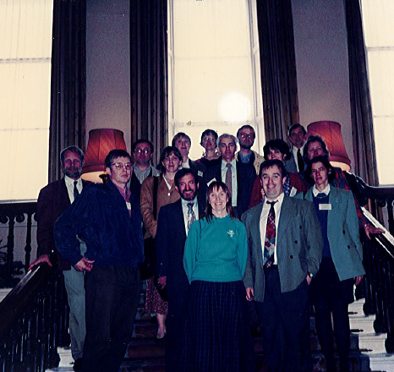
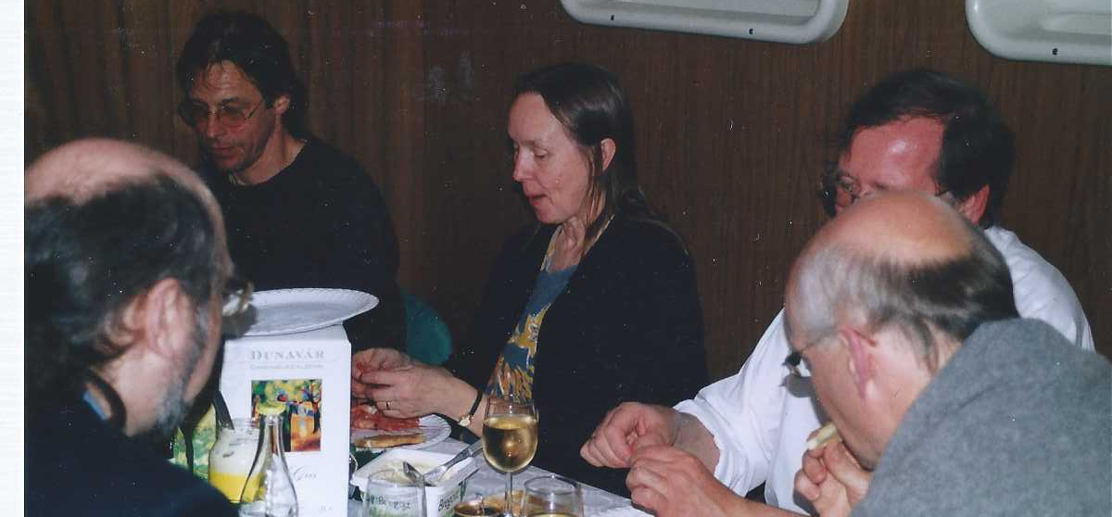
But, this story started well ahead of SeaDataNet
1994, ICES MDM, IMR, Bergen
1996, ICES MDM, MI, DUBLIN
1997, GODAR, Washington DC
1998, ICES MDM, IFREMER, Brest
2003, ICES MDM, SMHI, Sweden

Slide 16
EMODnet – Special contributions by BODC
Dick Schaap (MARIS)

Slide 17


SeaDataNet and EMODnet
EU initiative for an overarching European Marine Observation and Data Network (EMODNet) driven by Marine Knowledge 2020 and Blue Growth
SeaDataNet qualified as a leading infrastructure for the EMODnet data management component and is driving several thematic portals from the start in 2008
This synergy has resulted in many more data centres adopting SeaDataNet standards and connecting to the CDI Data Discovery and Access service while it gave a flying start to EMODnet

Slide 18
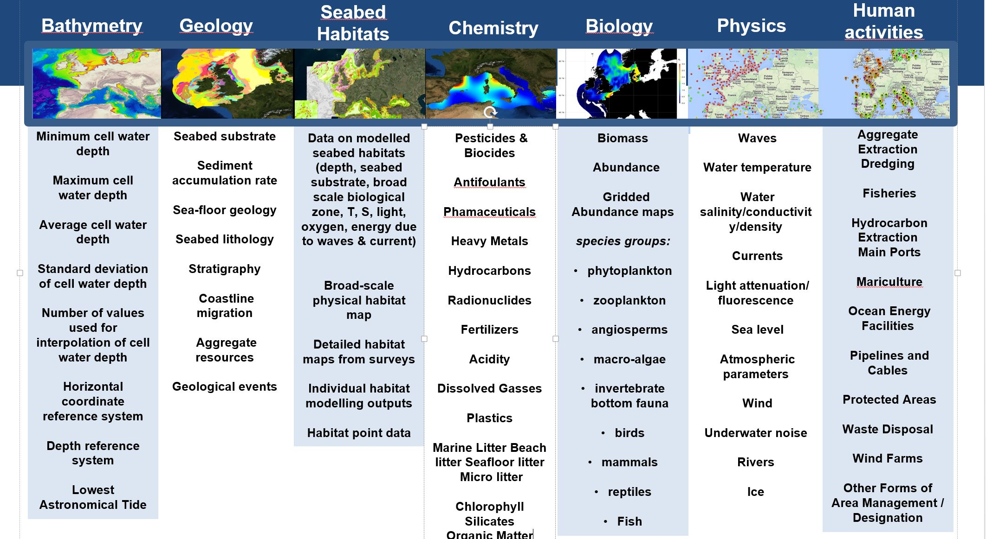
EMODnet thematic portals

Slide 19
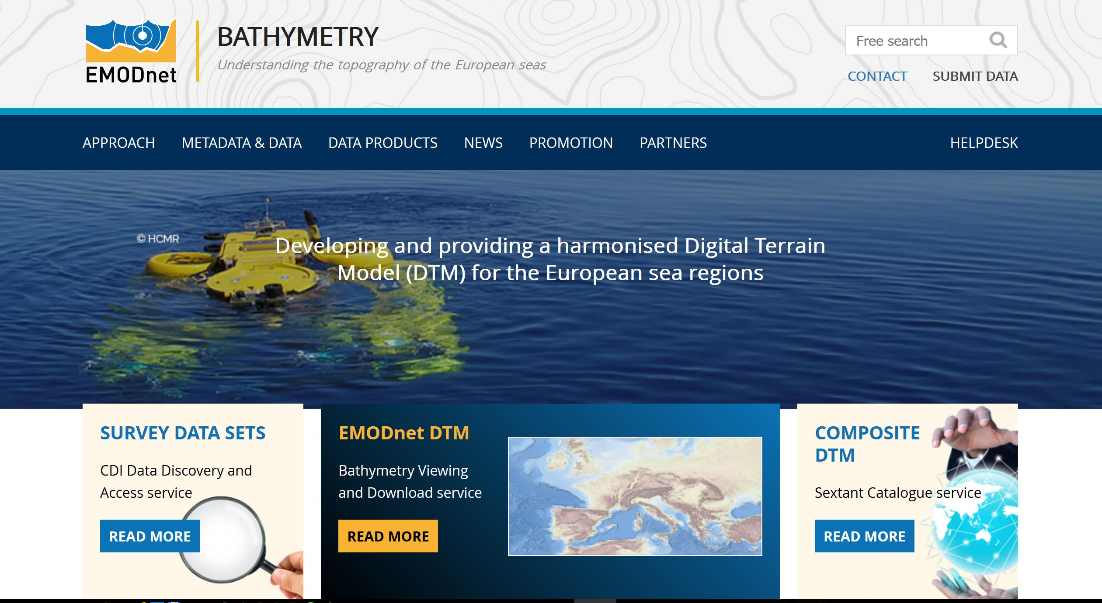
EMODnet Bathymetry portal
www.emodnet-bathymetry.eu

Slide 20
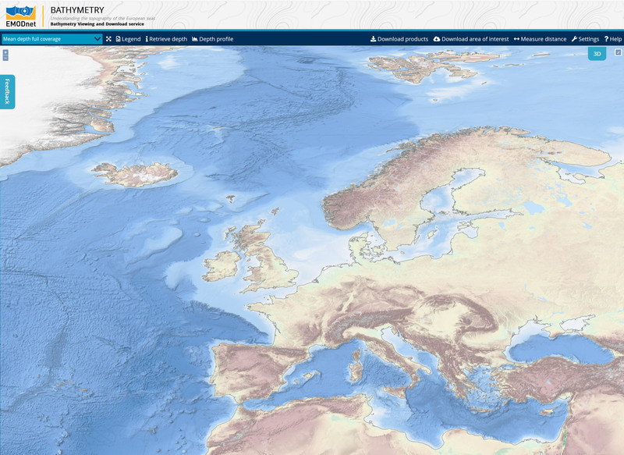
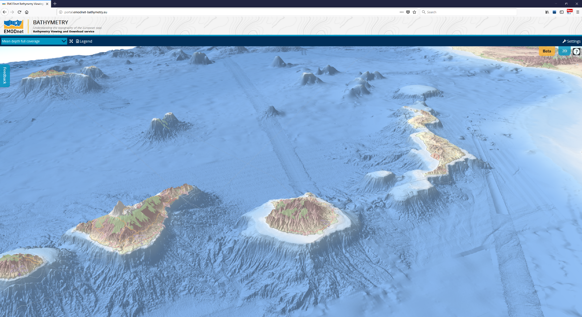
The best Digital Terrain Model (DTM) for the European seas with a resolution of 115 * 115 m (incl 3D viewer)

Slide 21
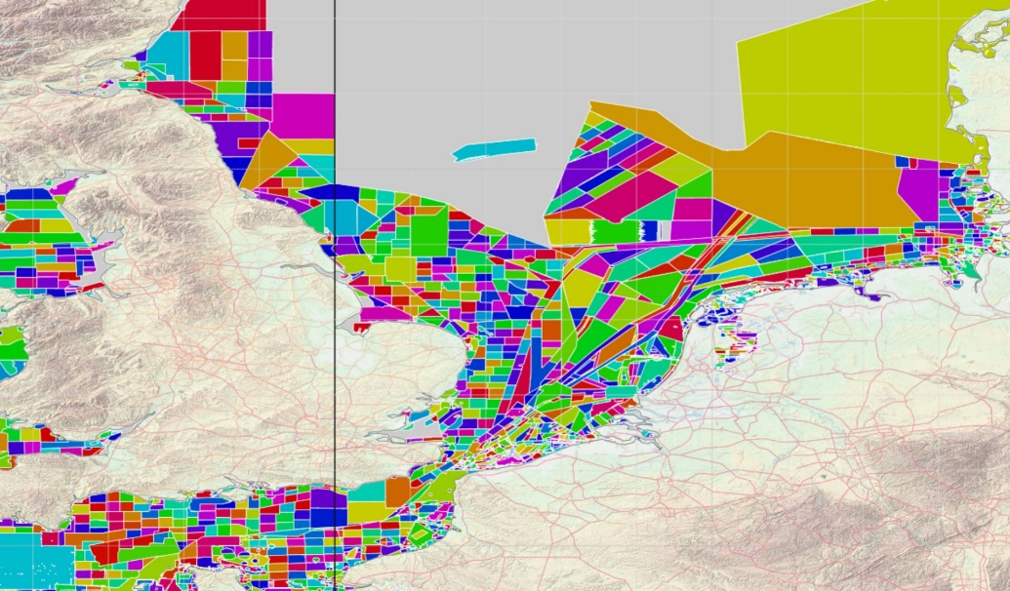
Bathymetry: input by BODC
The EMODnet DTM is built upon > 9.400 bathymetric survey data sets which have been gathered and fully described in the SeaDataNet CDI service
However there is no full coverage of the European seas with surveys. For example see the source references map below which shows no data (=grey) in the central North Sea.
This is solved by using GEBCO data in those uncovered areas.
BODC is editor of GEBCO and with the EMODnet Bathymetry team have arranged a merging process.
While EMODnet DTM is used to improve GEBCO => win-win situation

Slide 22
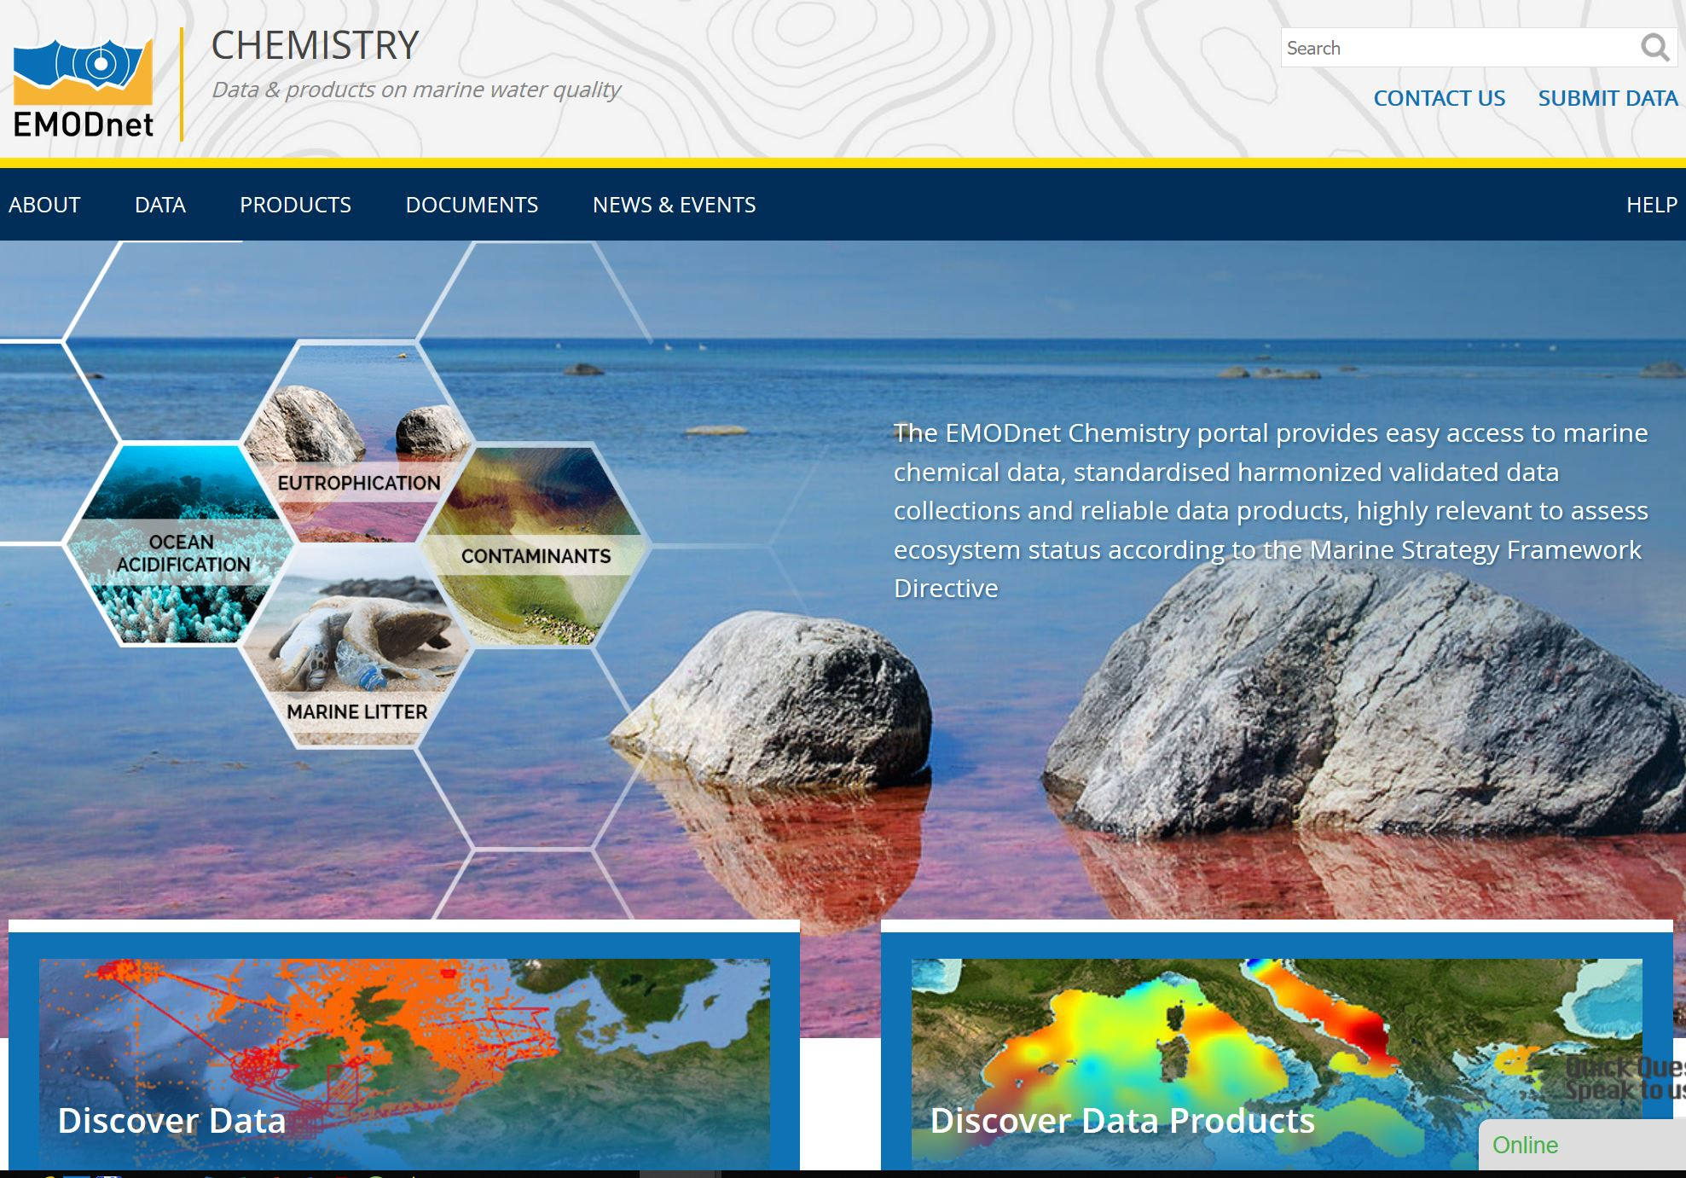
EMODnet Chemistry
Portal with data and products for eutrophication, contaminants and
marine litter

Slide 23
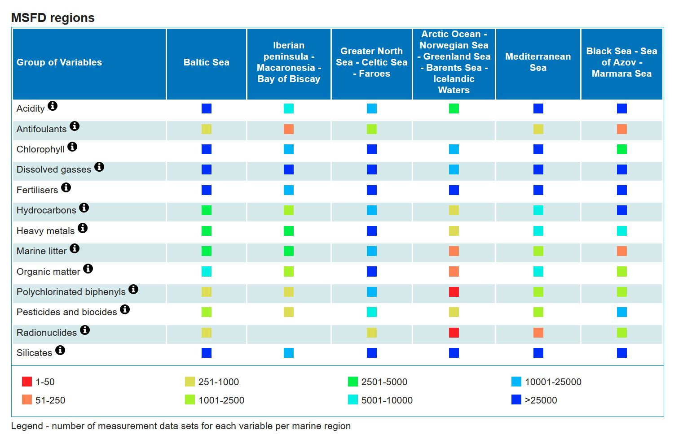
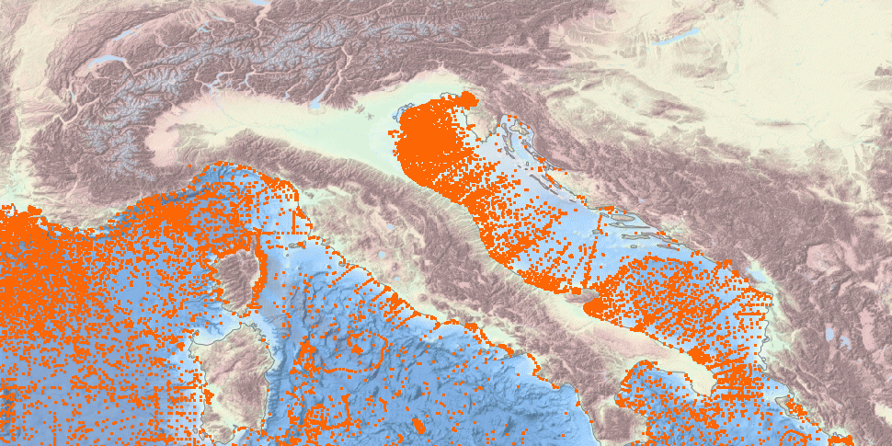
EMODnet Chemistry
Almost 1 Million data sets (CDIs) divided over 13 chemistry groups
In water, biota and sediment

Slide 24
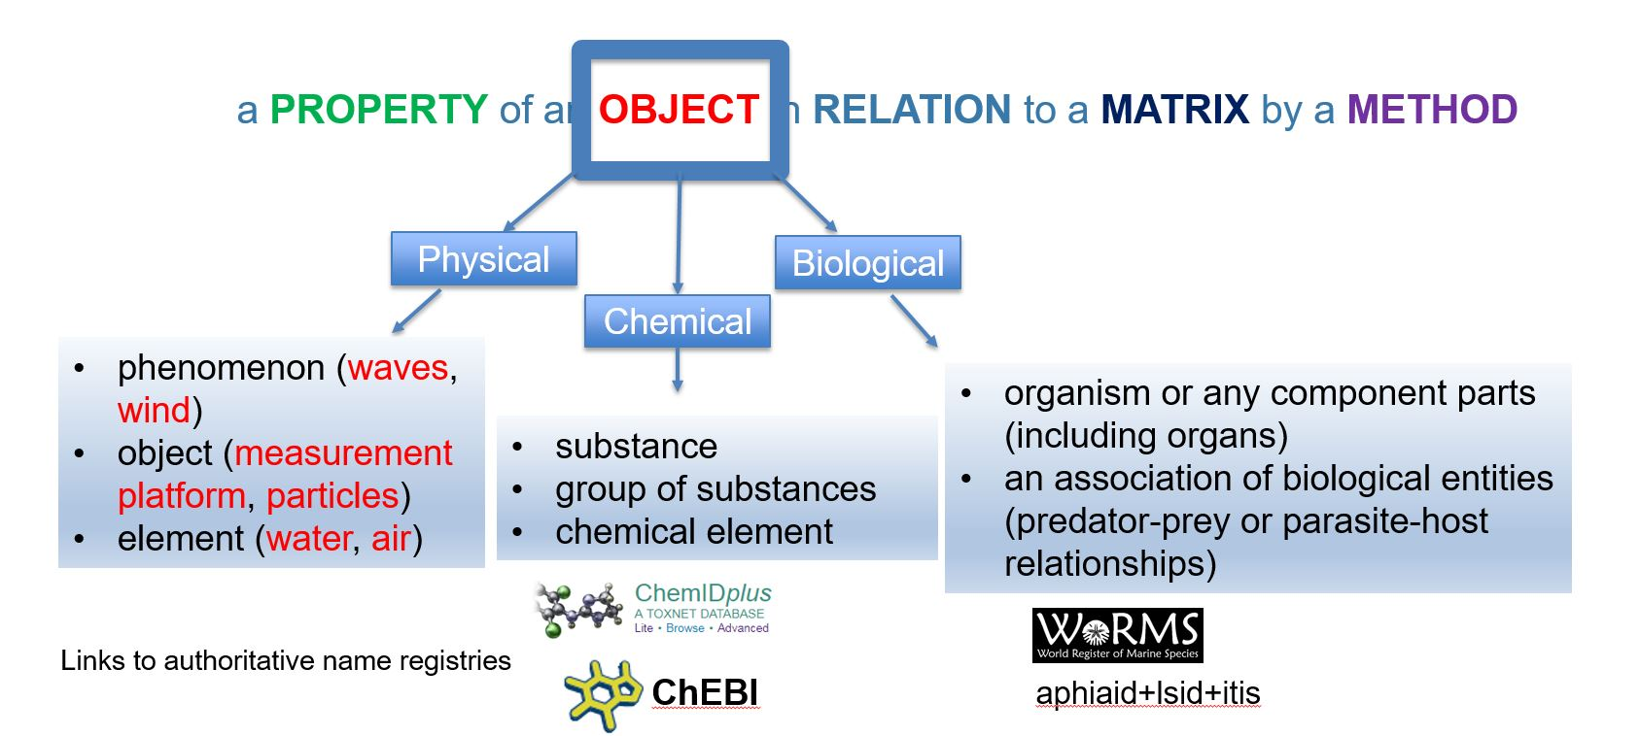
Chemistry: input by BODC
The data are gathered from more than 70 data centres from 32 countries and many different methods were used for gathering and analyzing parameters => this implicates a highly heterogeneous situation.
BODC build a model for the P01 parameter vocabulary. Together with a Vocabulary Builder and Browser we were able to describe and use all necessary parameters in a systematic way
Moreover BODC set up the P35 vocabulary which allows to aggregate several P01 entries in one P35 which facilitates generating harmonized European data collections for eg eutrophication

Slide 25
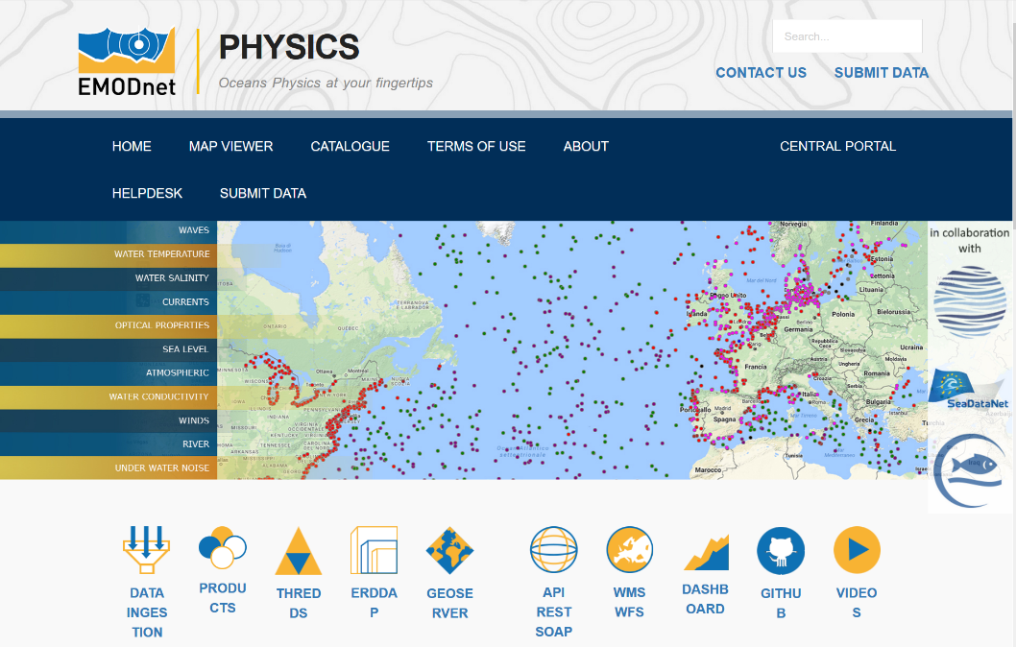
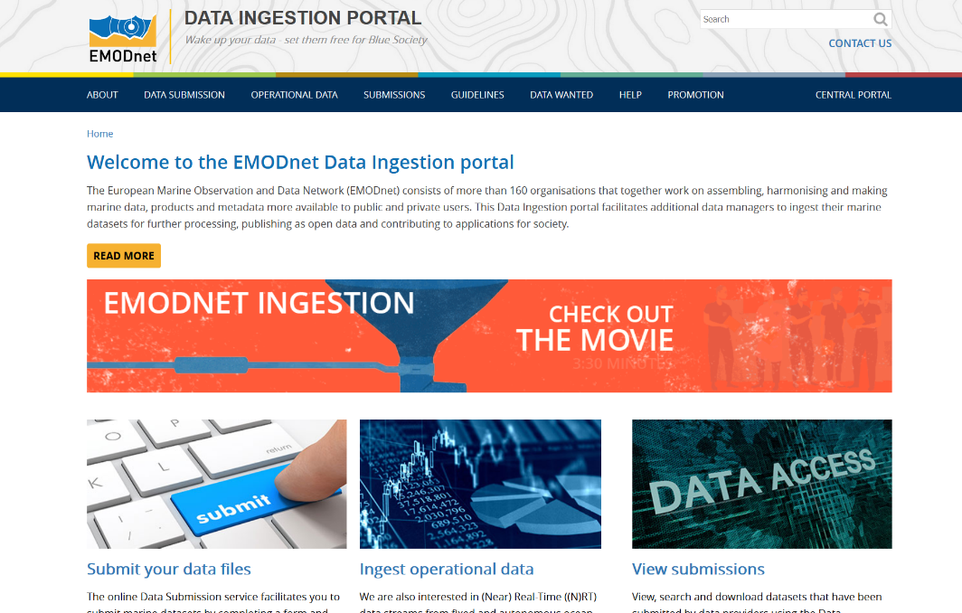
BODC also involved in other EMODnet lots
EMODnet Physics which provides a shop window for platforms and time series of physics parameters
EMODnet Ingestion which identifies, encourages and gives guidance to data owners that are not yet organized, to make their data part of the European data exchange, using the Ingestion portal

Slide 26


