Slide 1
Virtual Research Environments (VRE) – further plans
Dick MA Schaap – SeaDataCloud Technical Coordinator

Slide 2
Leading concept for SeaDataCloud
Providing a cloud platform with common services for data pre-processing, subsetting, analyses, visualizations, publishing, DOIs…
Applying common standards and interoperability solutions for providing harmonised data and metadata
Providing harmonised discovery and access to data output from multiple sources, such as European research and monitoring data gathering, but also from other European and international data infrastructures
Added-value services and applications – Cloud
Platform
Downstream
Services
Standards
OGC, ISO, W3C &
Vocabularies
Upstream
Services
Discovery and access
to datasets from many sources

Slide 3
Virtual Research Environment (VRE)
Cloud based analytical framework
Components for:
  calculations
  visualisations
  conversions
  subsetting
  QA-QC
  .….
Integrated workflows
Account management
Menu shell

Slide 4
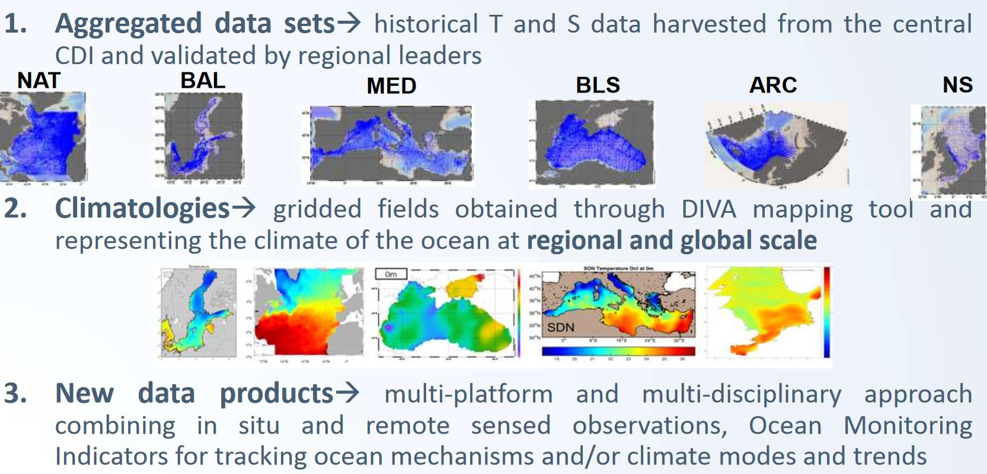
SDC data products development

Slide 5
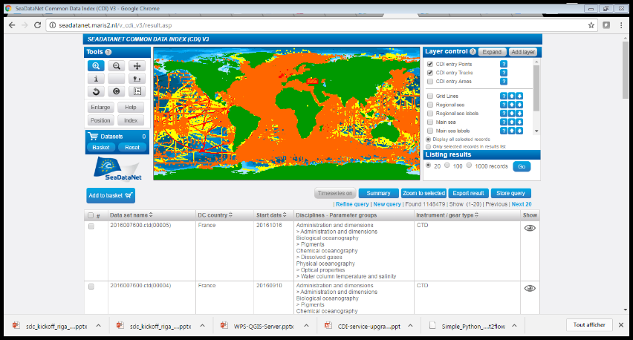
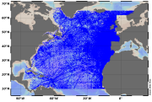
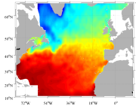
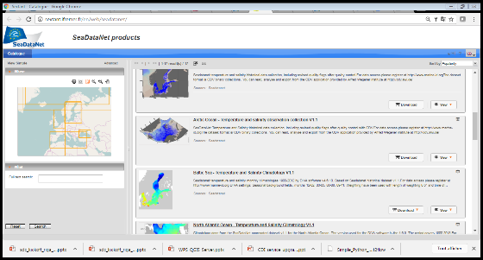
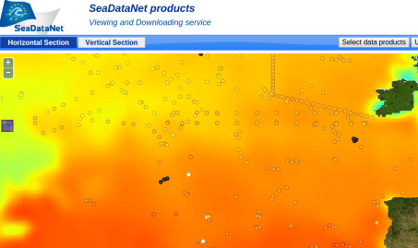
SDC VRE application – use case
CDI
Qualified buffer
Geospatial interpolation
Publication (catalogue, doi, visualization)
Generating a Temperature & Salinity Climatology, including interpolated basin maps in time

Slide 6
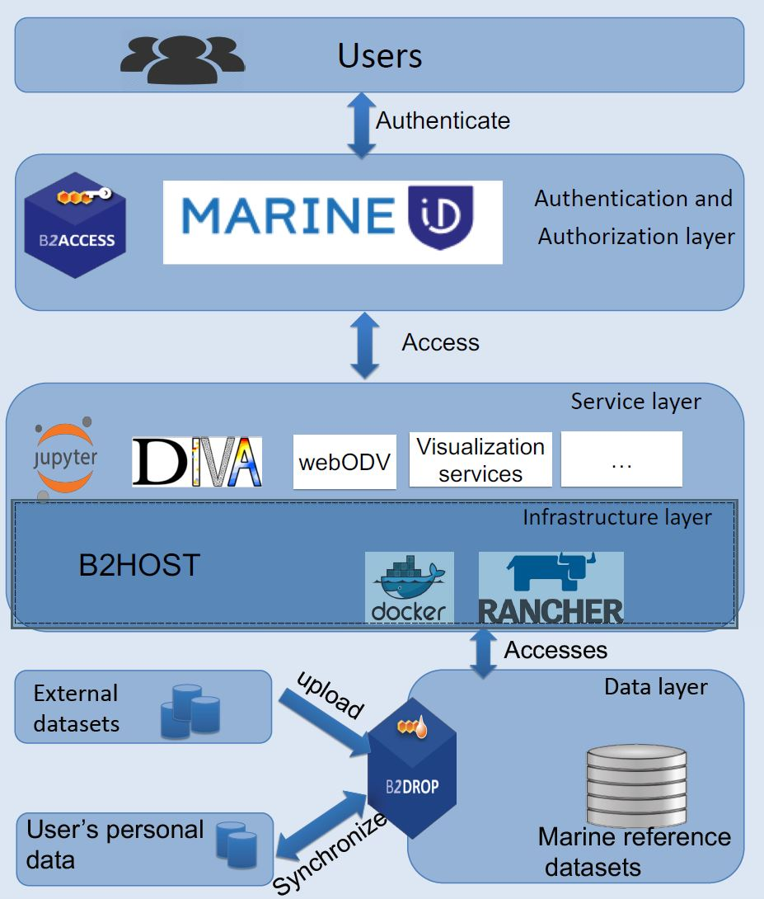
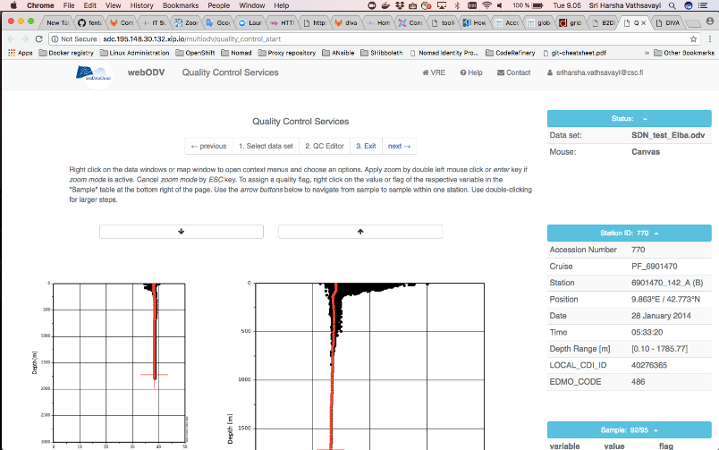
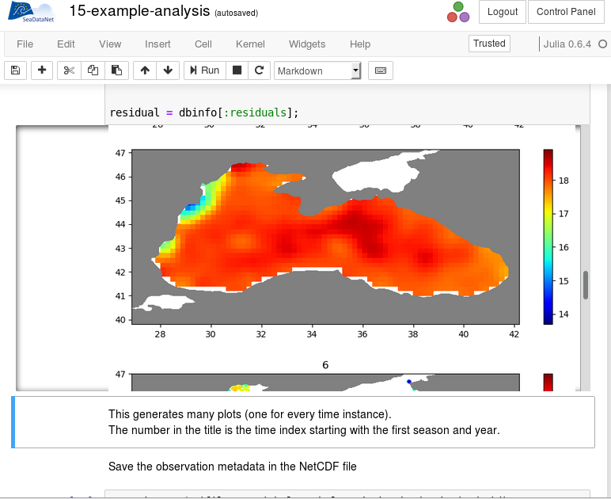
Overall architecture for the SDC VRE
Workshop planned with SDC Product group
for refining SDC VRE and try-out

Slide 7
VRE promises
Collaborative and individual research
Using, handling, analysing and processing ocean and marine data into value-added data products
High capacity and performance for big data processing and visualisations
Combining multidisciplinary data and data products
Machine Learning, e.g. for QA-QC processes
More VRE use cases

Slide 8

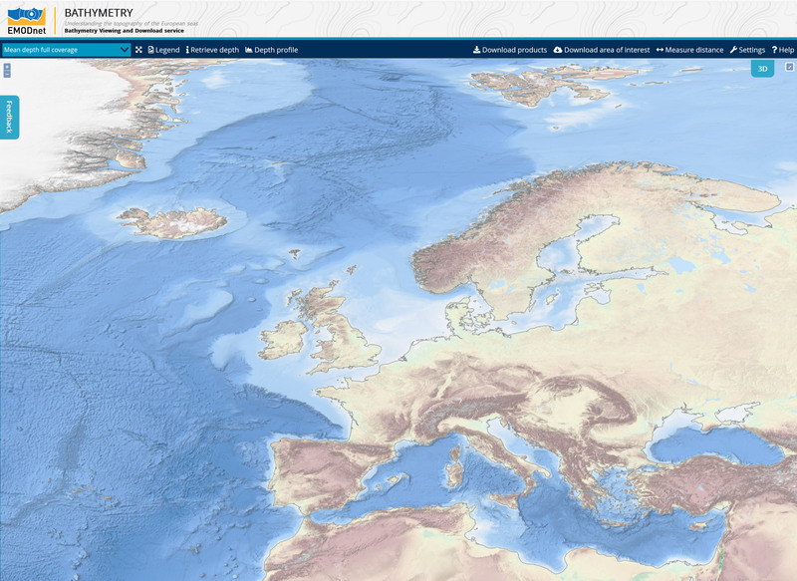
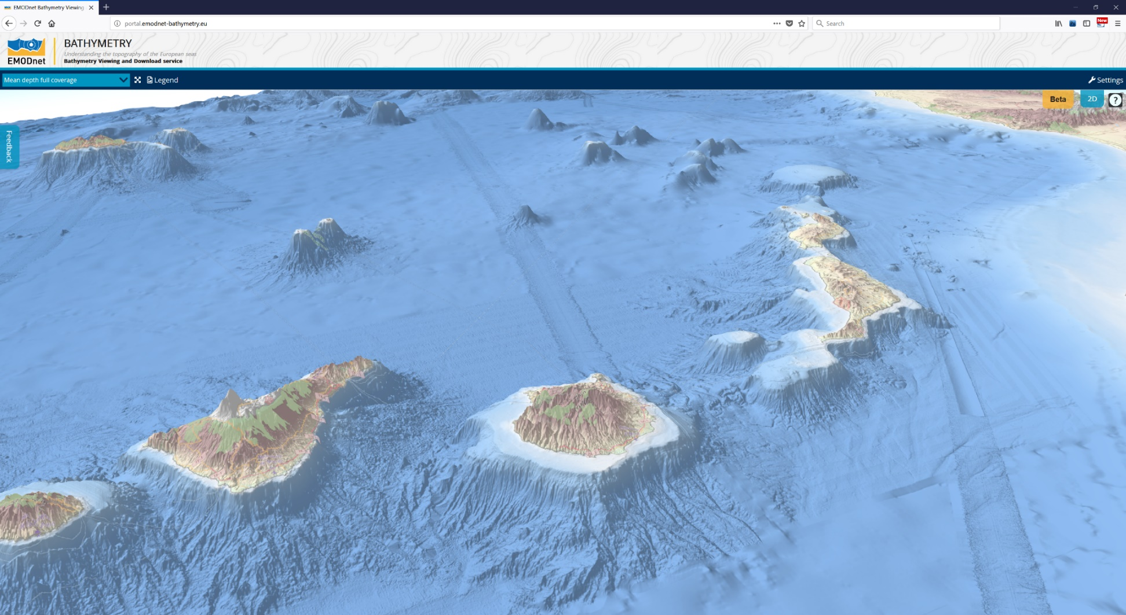
EMODnet Bathymetry
The best and market leading Digital Terrain Model for all European seas (grid circa 125 * 125 meters)

Slide 9
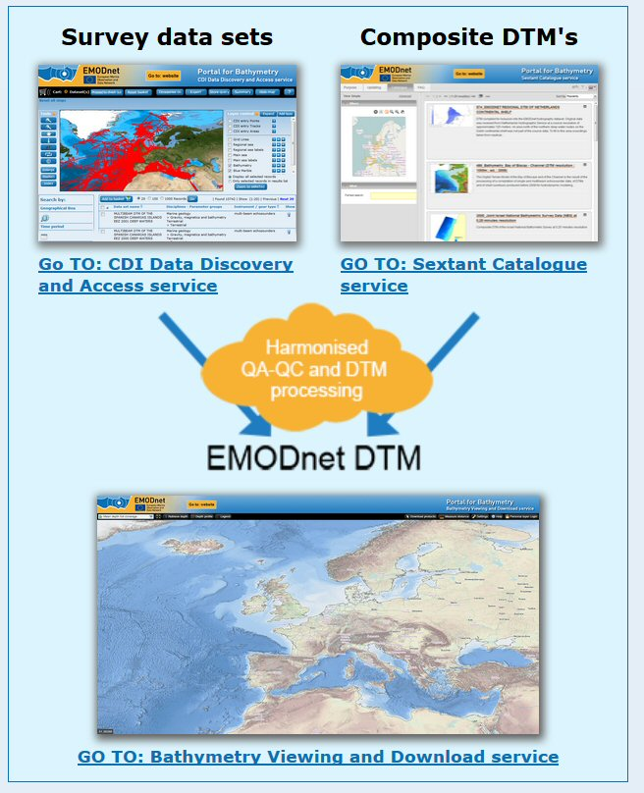
EMODnet Bathymetry process
Population of SeaDataNet CDI and Sextant services
Common method and GLOBE software used by all involved
  Data pre-gridded by data providers
  Regional Basin Coordinators select datasets and generate Regional DTMs
  DTM Integrator compiles the resulting EMODnet DTM

Slide 10
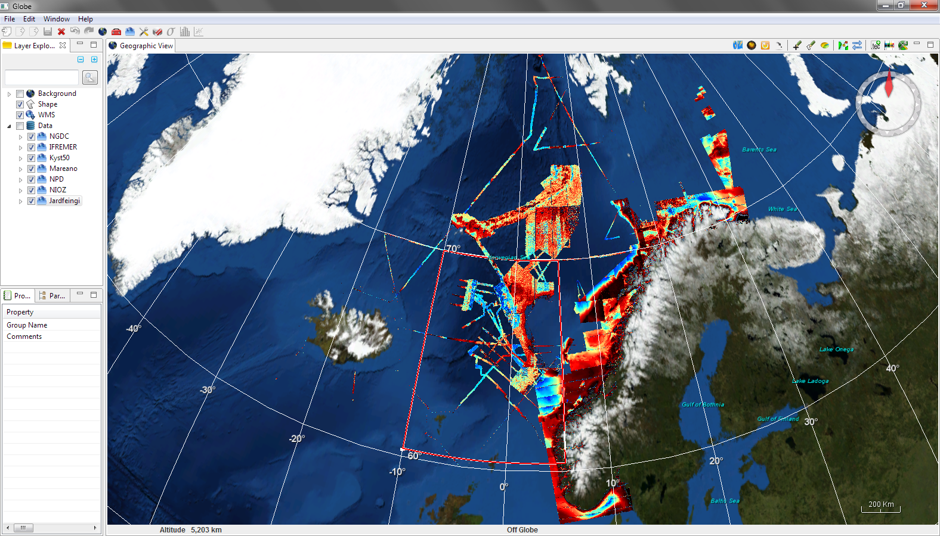
EMODnet Bathymetry – GLOBE software

Slide 11
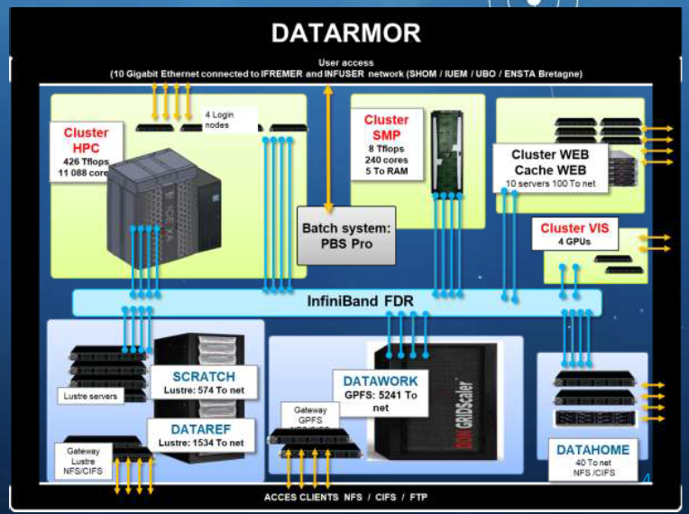
EMODnet Bathymetry VRE
Collaborative environment :
  a data infrastructure has been set up for sharing the input data and the merged DTMs on a unique space
  Online GLOBE has been configured
  Environment is available for Regional Coordinators
Alternatively also Web Processing Service (WPS) are being set up for specific GLOBE functions

Slide 12
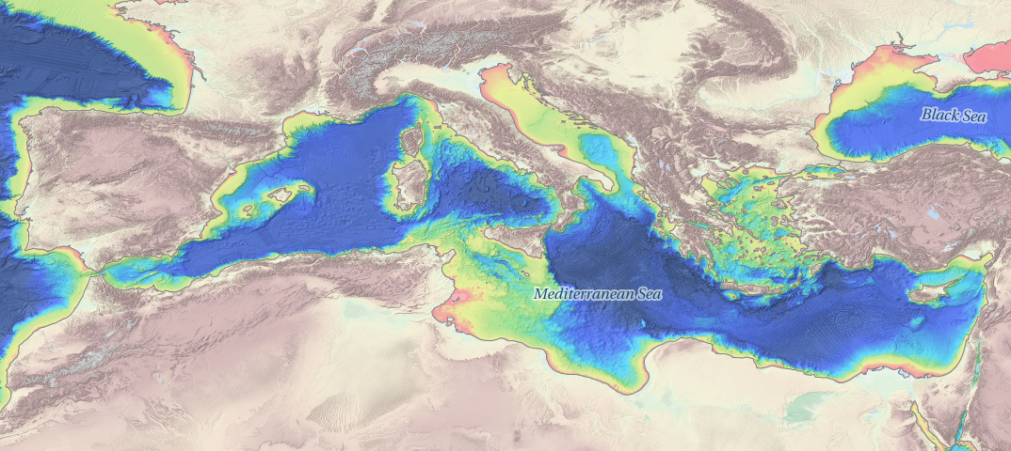
EMODnet Bathymetry VRE use case
Use GLOBE online for generating the 3 Regional DTMs that together cover the Mediterranean (2020)

Slide 13
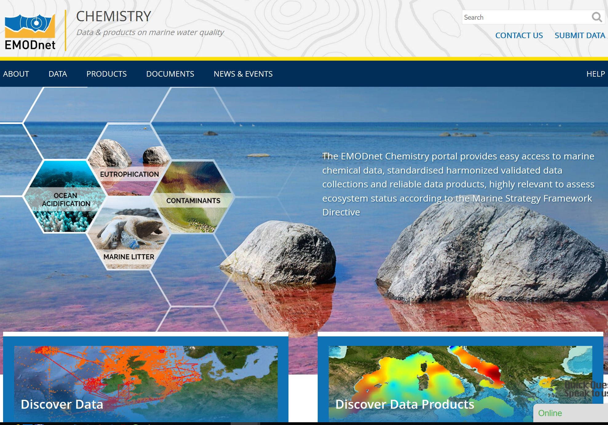
EMODnet Chemistry

Slide 14
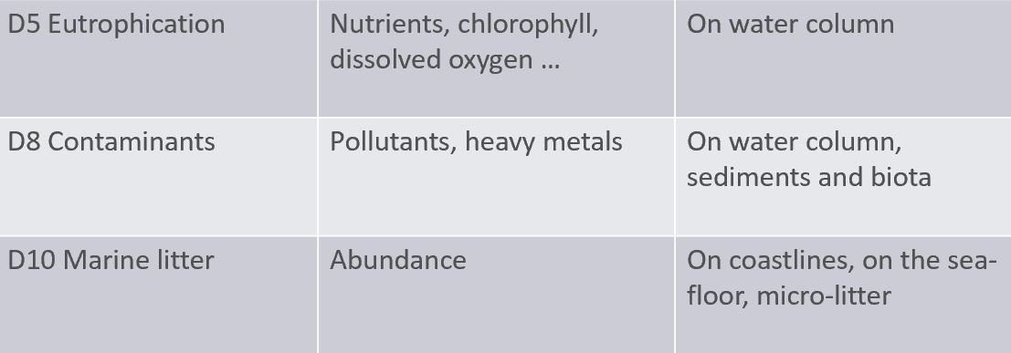
EMODnet Chemistry
Aims at collecting, aggregating, validating and giving access to data collections related to

Slide 15
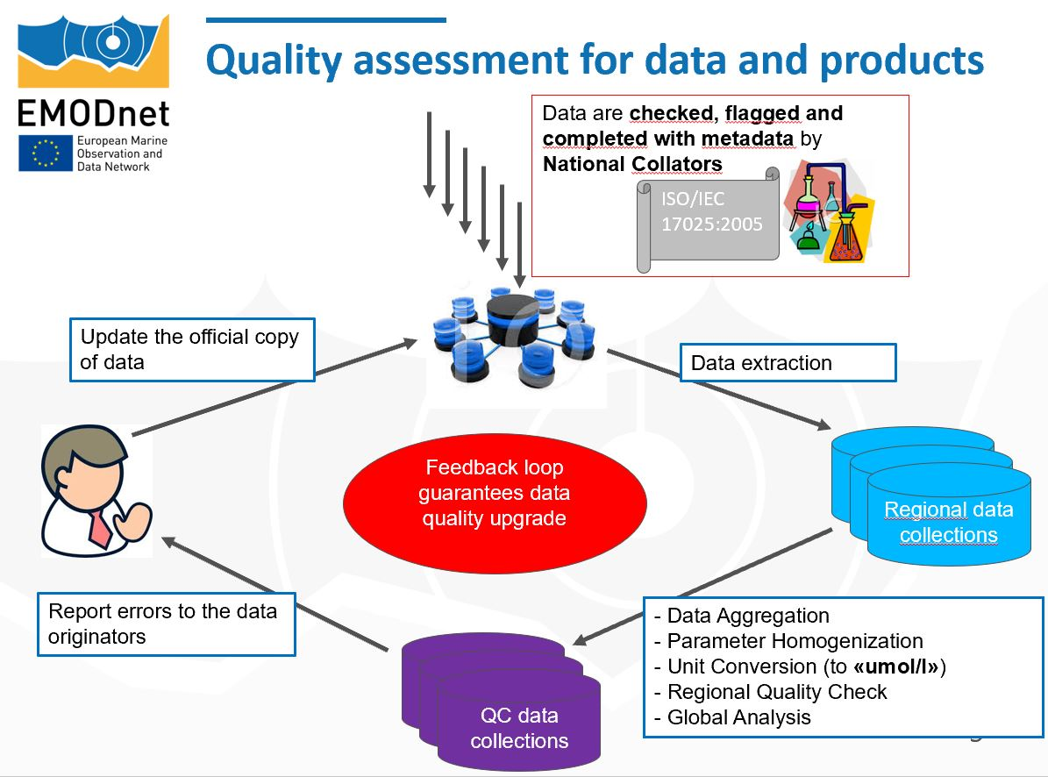
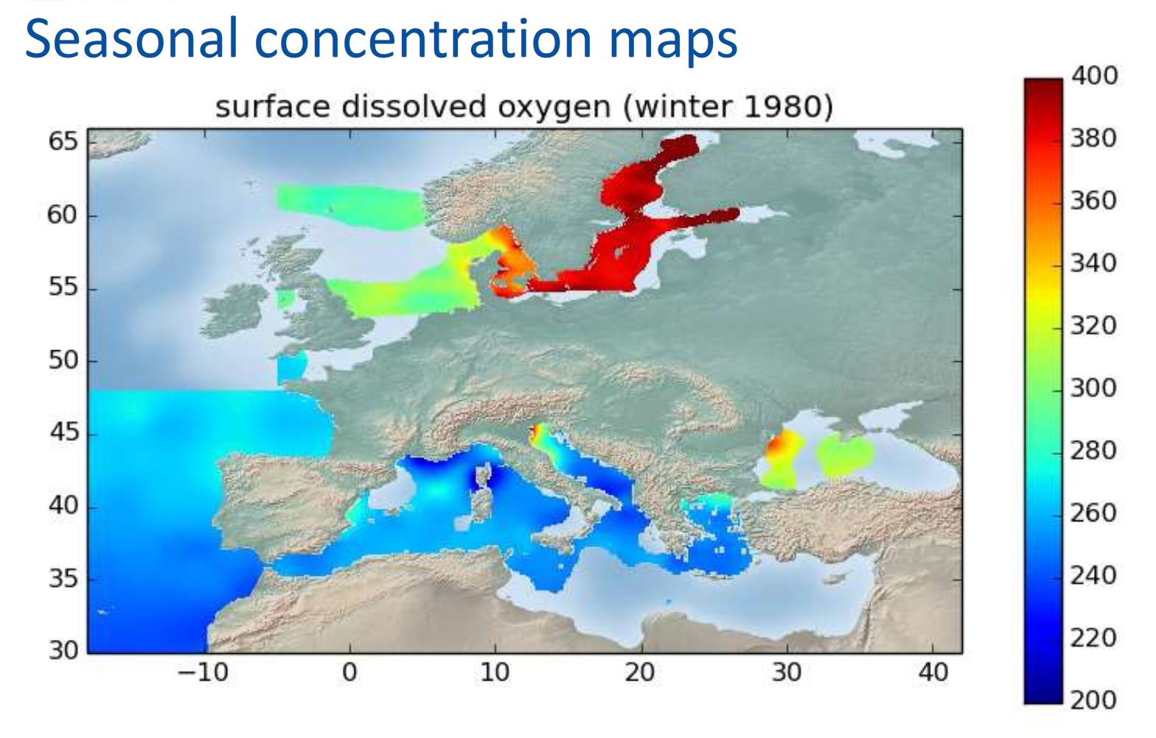
EMODnet Chemistry process

Slide 16
EMODnet Chemistry VRE use case
Product generation process is quite similar to the SeaDataCloud use case for Temperature & Salinity
Also both processes make use of ODV and DIVA as main analytical tools
EMODnet Chemistry will learn from SDC experiences and set up a VRE pilot in the next phase (2019 – 2021)

Slide 17
The Blue Cloud – new project
Successful application to the H2020 call: ‘The Future of Seas and Oceans Flagship Initiative’.
Aims:
  To explore and demonstrate the potential of cloud based open science
  To build and demonstrate a Pilot Blue Cloud by combining distributed marine data resources, computing platforms, and analytical services
  To develop services for supporting research to better understand & manage the many aspects of ocean sustainability
  To formulate a roadmap for a longer term expansion of the Blue Cloud infrastructure and services, e.g. as a thematic EOSC cloud

Slide 18
The Blue Cloud components
Consortium:
  Leading European marine data management infrastructures: SeaDataNet, EurOBIS, Euro-ARGO, Argo GDAC, EMODnet, ELIXIR-ENA, EuroBioImaging, COPERNICUS CMEMS, COPERNICUS C3S, and ICOS-Marine
  Leading e-infrastructures: EUDAT, COPERNICUS DIAS, and Blue Bridge
  Excellent marine researchers.

Slide 19
The Blue Cloud components
A BlueCloud service to provide discovery and access to multi-disciplinary data sets from multiple blue data management infrastructures
A BlueCloud VRE to access a federation of blue services
Five dedicated Demonstrators, each with a Virtual Lab on the VRE, and each led by high level researchers:
  Zoo- and Phytoplankton EOV products (led by VLIZ)
  Plankton Genomics (led by EMBL)
  Marine Environmental Indicators (led by CMCC)
  Fish, a matter of scales (led by FAO)
  Aquaculture Monitor (led by FAO).

