Slide 1
Upgrading the CDI Data Discovery and Access service
Dick MA Schaap – SeaDataCloud Technical Coordinator

Slide 2
SeaDataNet output
Standards for metadata and data formats
European directories for data (CDI), data collections (EDMED), research projects (EDMERP), cruise summary reports (CSR), organisations (EDMO), monitoring programs and networks (EDIOS)
European Marine Data Discovery and Access service (CDI)
Software tools and services for populating SeaDataNet directories
Software tools and services for analysing and validating marine data sets
SeaDataNet data products
Capacity building

Slide 3
SeaDataNet cooperation
Copernicus Marine Environmental Monitoring Services (CMEMS): providing long-term archives and standards
Marine Strategy Framework Directive (MSFD): providing infrastructure, standards and data collections for several indicators
Large ocean monitoring systems and their projects (EuroGOOS, AtlantOS, Euro-ARGO, JERICO-Next, ..): providing standards and validation + long-term archiving services
EU projects, such as Upgrade BlackSeaScene, CaspInfo, Geo-Seas, Eurofleets …: adopting and adapting SeaDataNet standards and services for developing marine data management capabilities
Ocean Data Interoperability Platform (ODIP): exploring and demonstrating common standards and interoperability with leading data management infrastructures in USA and Australia
GEOSS - EuroGEOSS: Maintaining the GEOSS portal with SeaDataNet in-situ data collections from large community of European data holders (> 100 data centres; >600 data originators)
European Open Science Cloud (EOSC): shaping the Blue Cloud

Slide 4
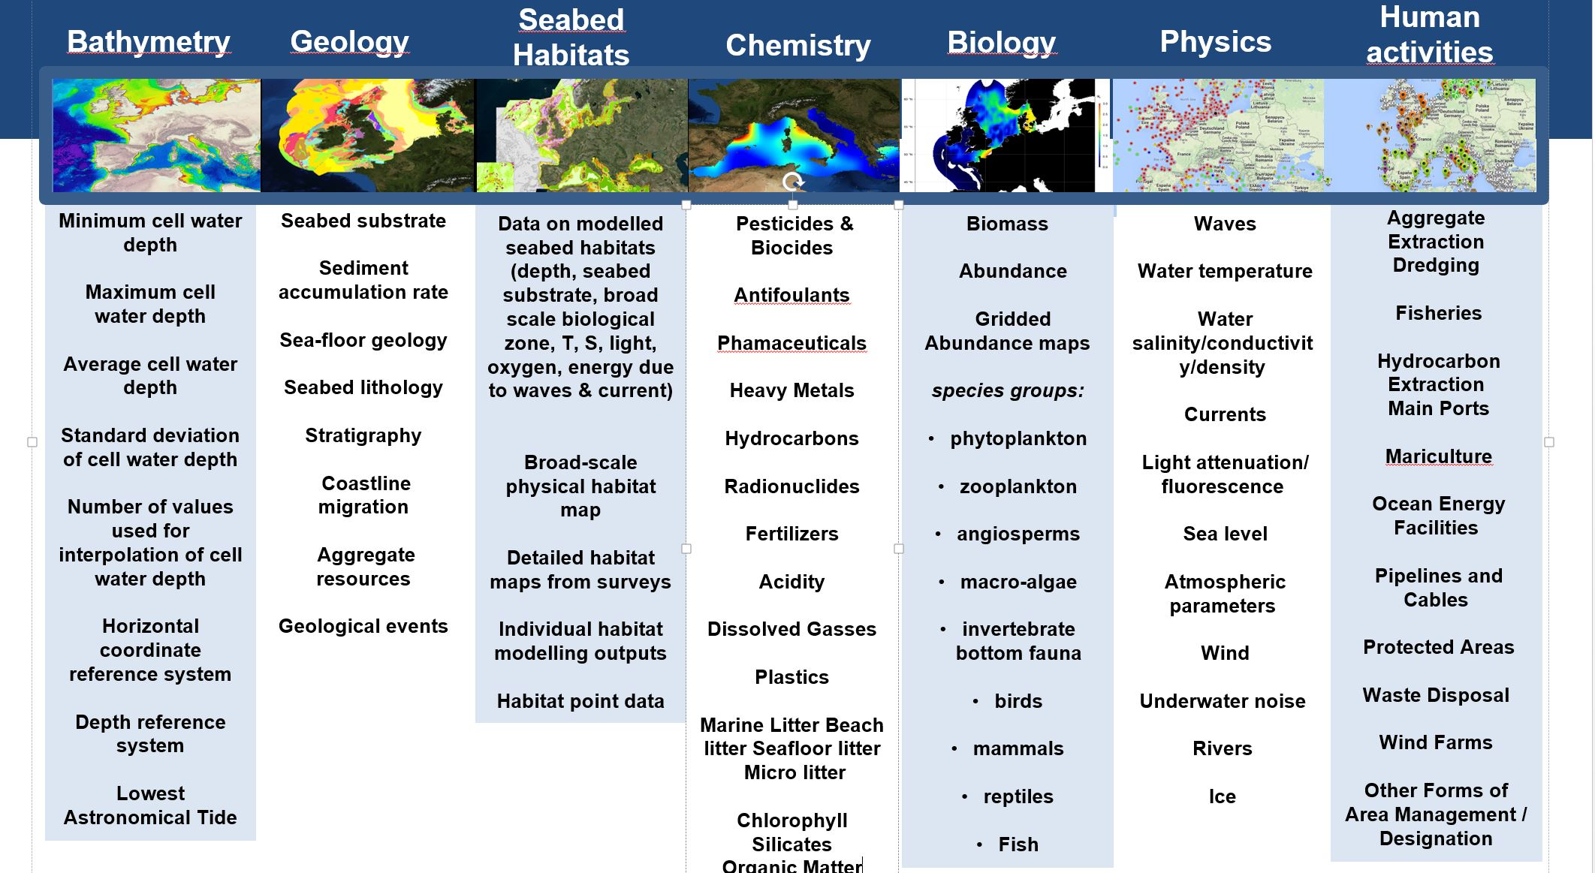
EMODnet thematic portals

Slide 5
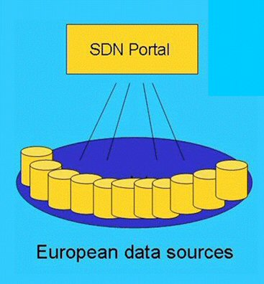
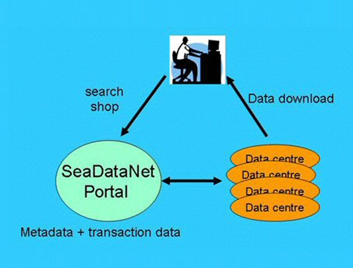
CDI Data Discovery and Access service
One of the core services of the SeaDataNet infrastructure
Providing a highly detailed insight and unified access to the large volumes of marine and oceanographic data sets managed by the distributed data centres
Fine-grained index (ISO 19115 – ISO 19139) to individual data measurements (such as a CTD cast or moored instrument record)
Supported by Controlled Vocabularies, and Directories (EDMO, EDMERP, CSR, EDMED)

Slide 6

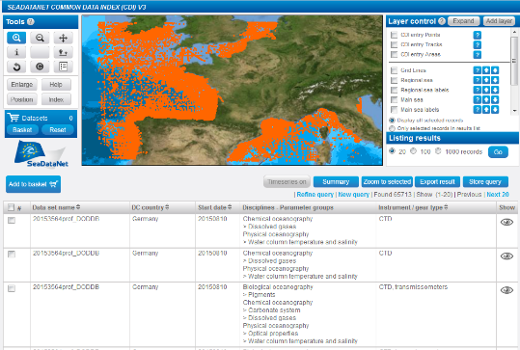

CDI service for discovery and unified data access
SeaDataNet portal
Search and Shop
Data download
Already 110 data centres connected and more underway
Data centres
Metadata
+ transaction data
European data sources
data centres > 650 originators

Slide 7
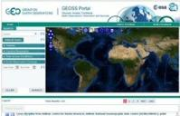
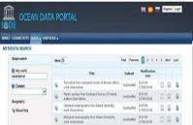







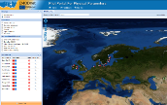
CDI service as driver
Total collection
GEOSS portal
IODE ODP portal
Aggregated collection
Data discovery
and access
Black Sea portal
Caspian portal
Geo-Seas portal
Regional subsets
> 110 data centres
Bathymetry
Thematic portals
NODCs; HOs; GEOs; BIOs; ICES; PANGAEA
Physics
Chemistry
≈ 650 European data originators
CDI Data Discovery and Access service
Geology
Biology

Slide 8
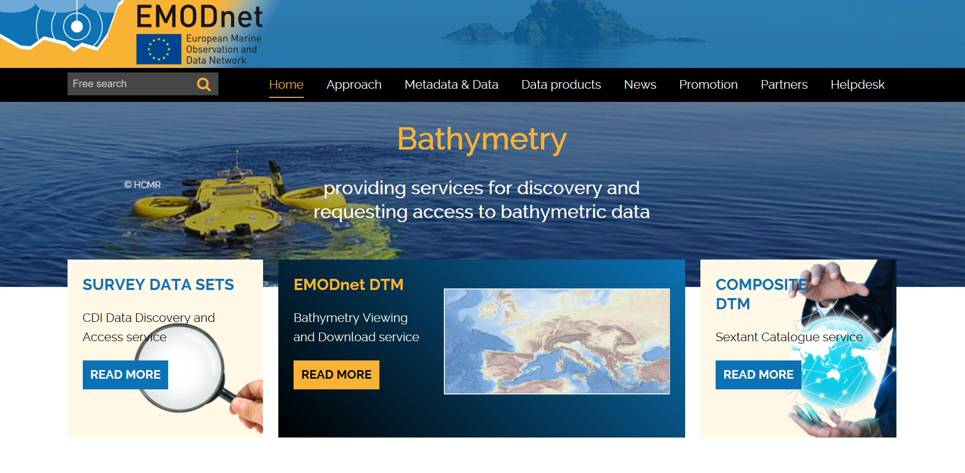
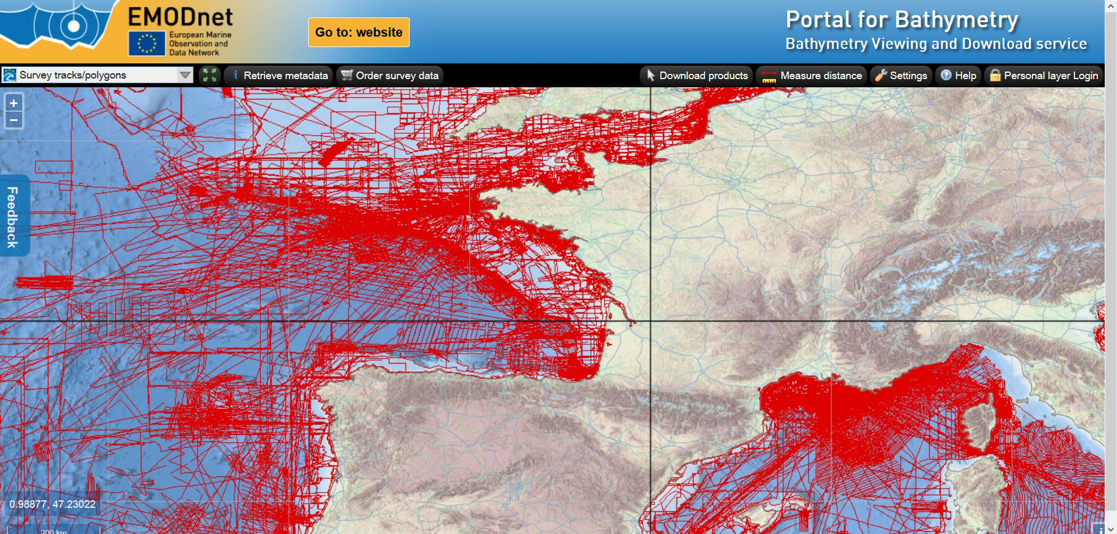
CDI service in EMODnet Bathymetry
Layer with CDI data references
Layer with CDI data references

Slide 9
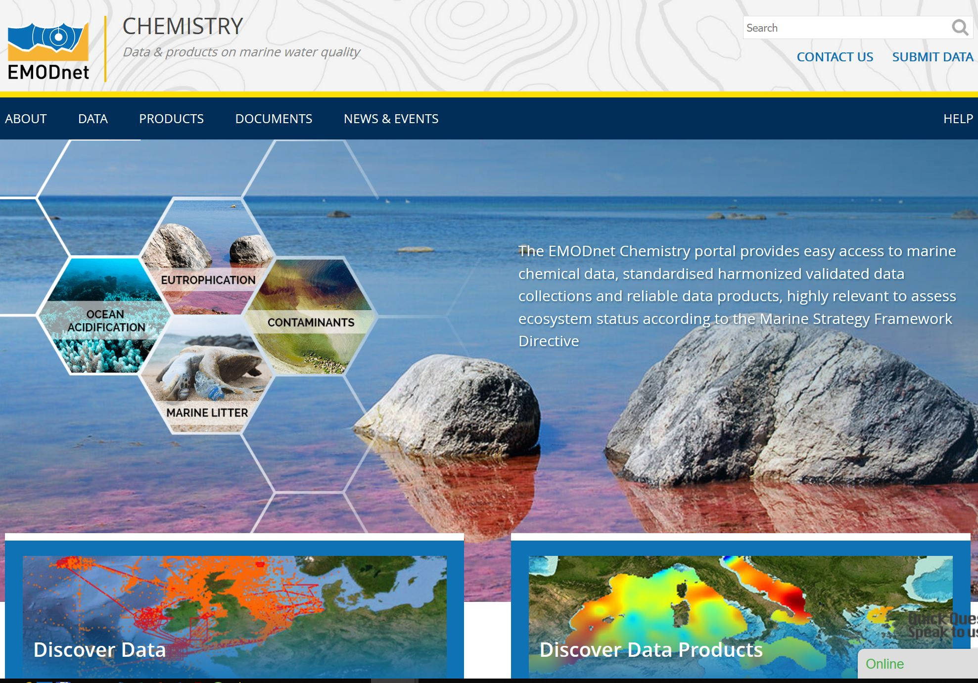
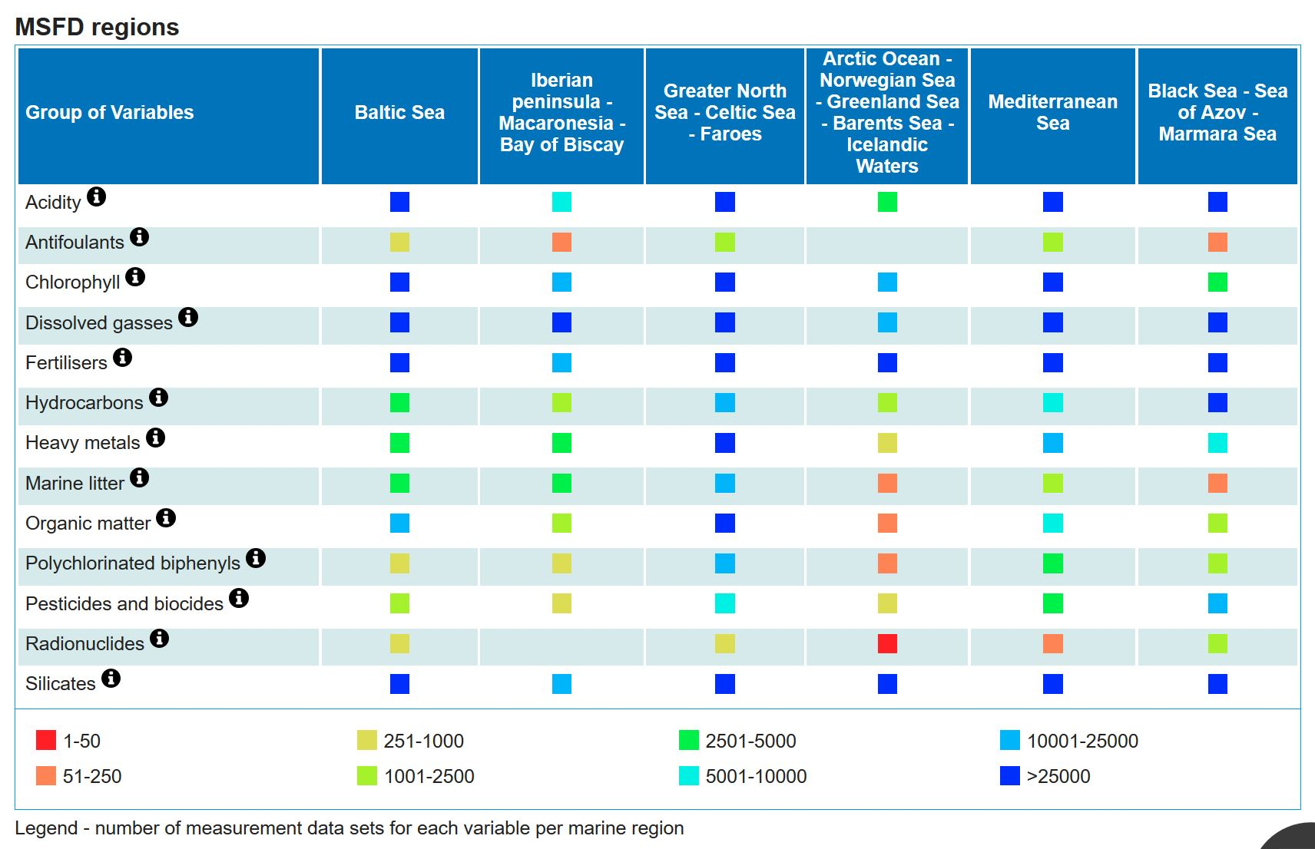
CDI service in EMODnet Chemistry

Slide 10
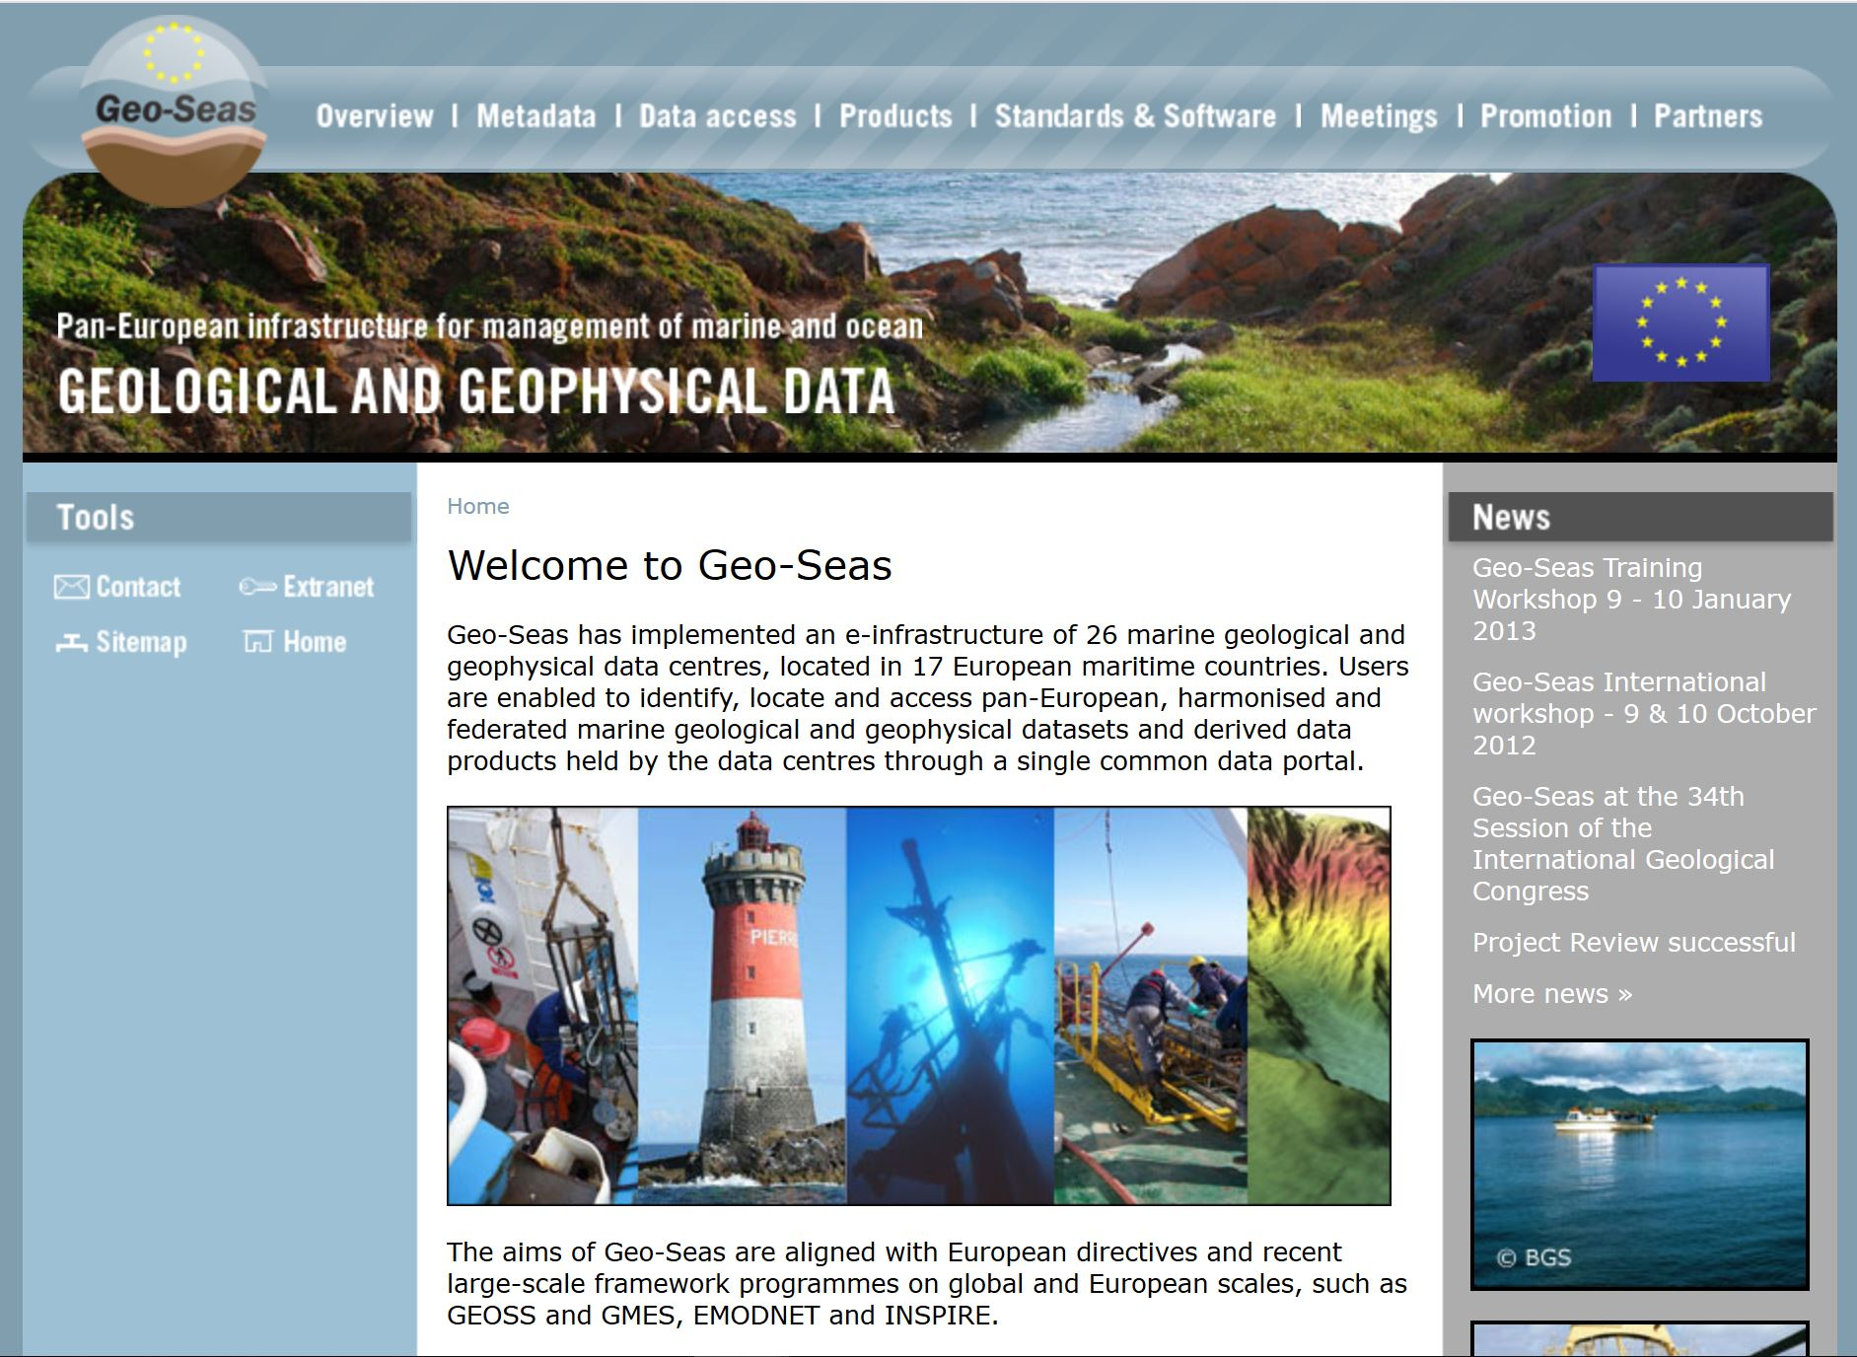
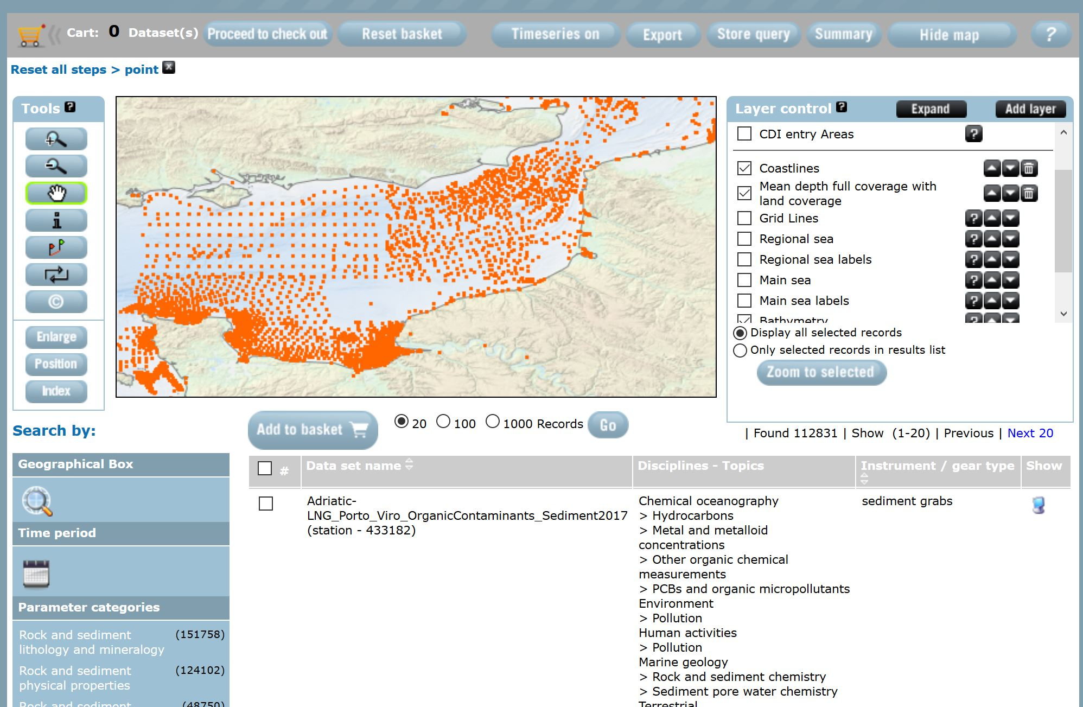
CDI service in Geo-Seas
Geological and geophysical data sets

Slide 11
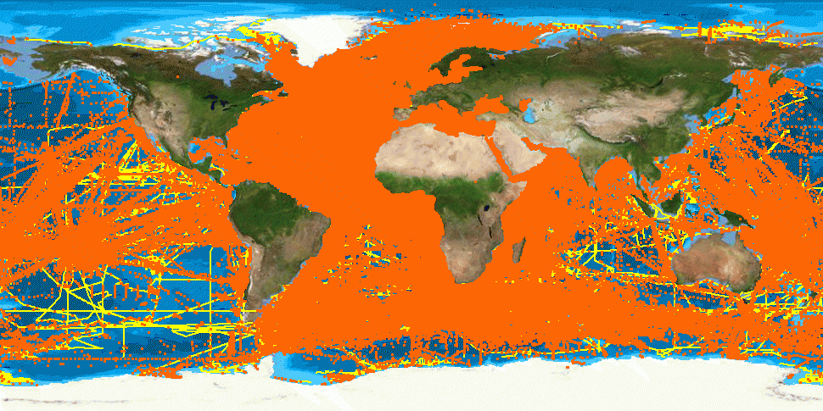
CDI data population
2.3 million CDI entries from 34 countries, 110 data centres and > 650 originators
physics, chemistry, geology, geophysics, bathymetry and biology;
from 1805 to 2018; 86% unrestricted or under SDN License

Slide 12
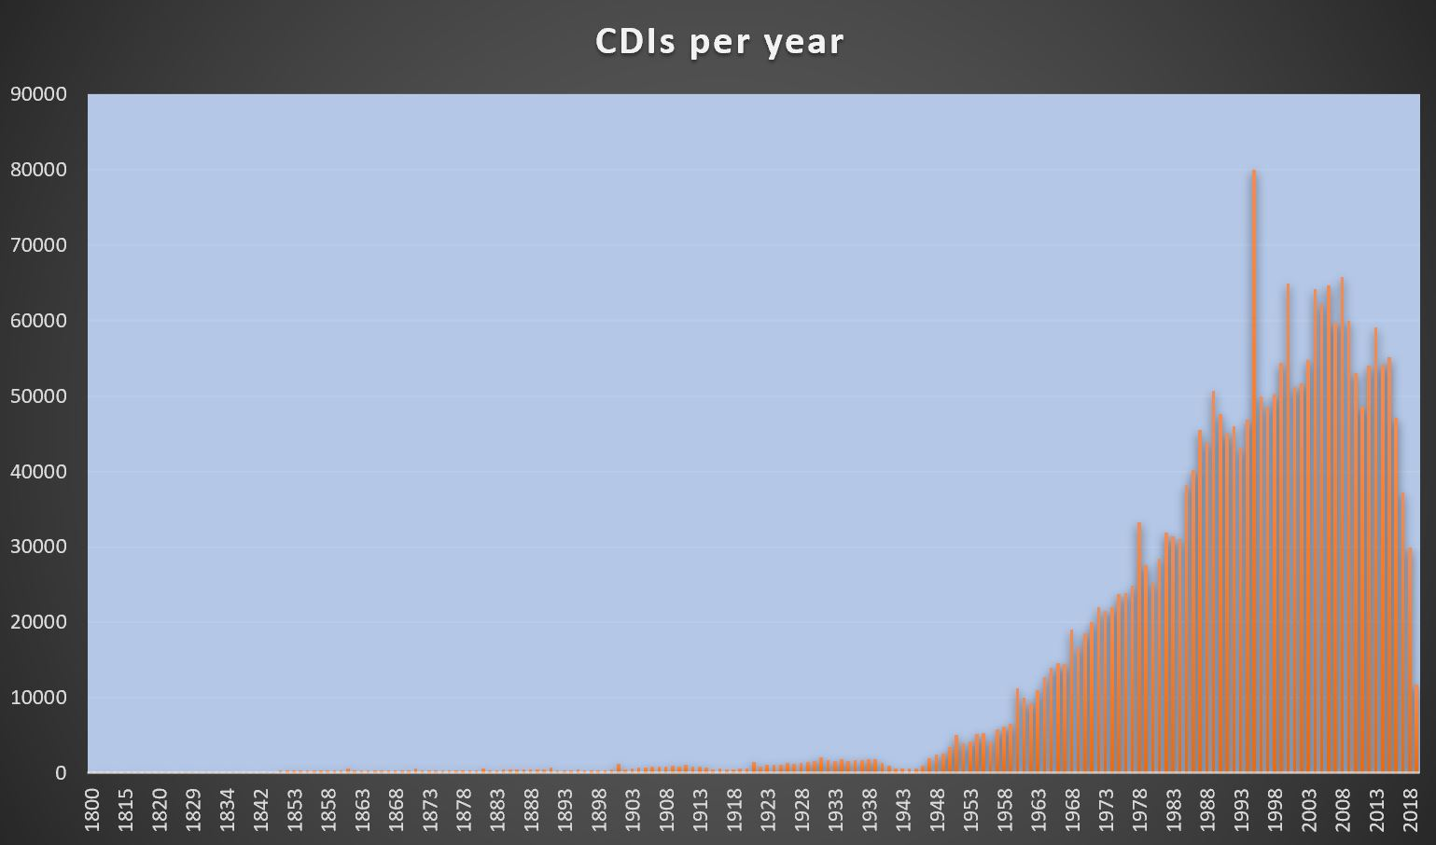
Year of measurements in CDIs

Slide 13
SeaDataCloud project
Standards and information technology are always evolving, there is a move towards cloud storage and cloud computing, and the SeaDataNet infrastructure must stay up-to-date to maintain and further expand its standards and services to its lead customers and major stakeholders
A strategic and operational cooperation between the SeaDataNet consortium of marine and ocean data centres and the EUDAT consortium of e-infrastructure service providers, also with a perspective to EOSC
SeaDataCloud project, started Nov 2016 with 4 year run

Slide 14
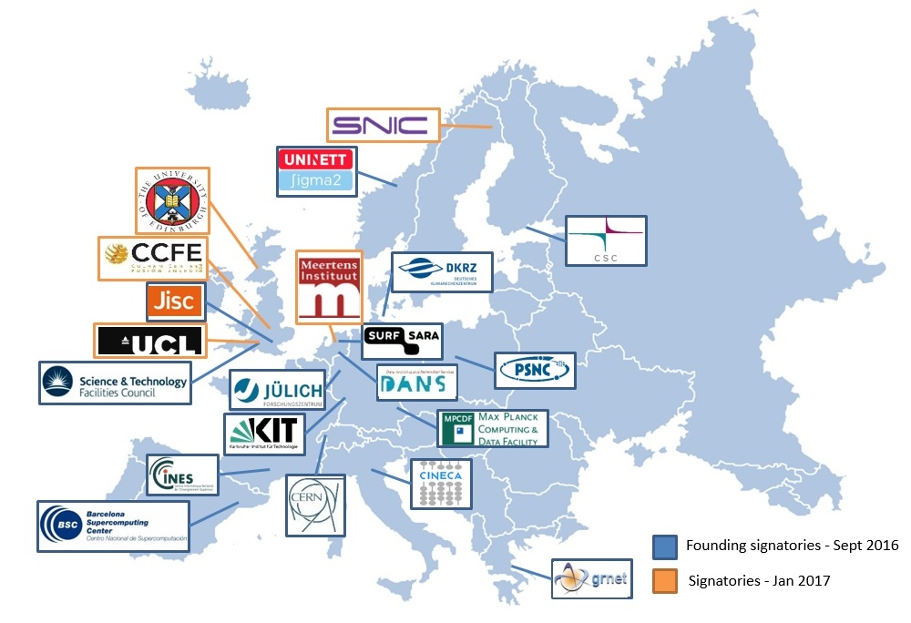
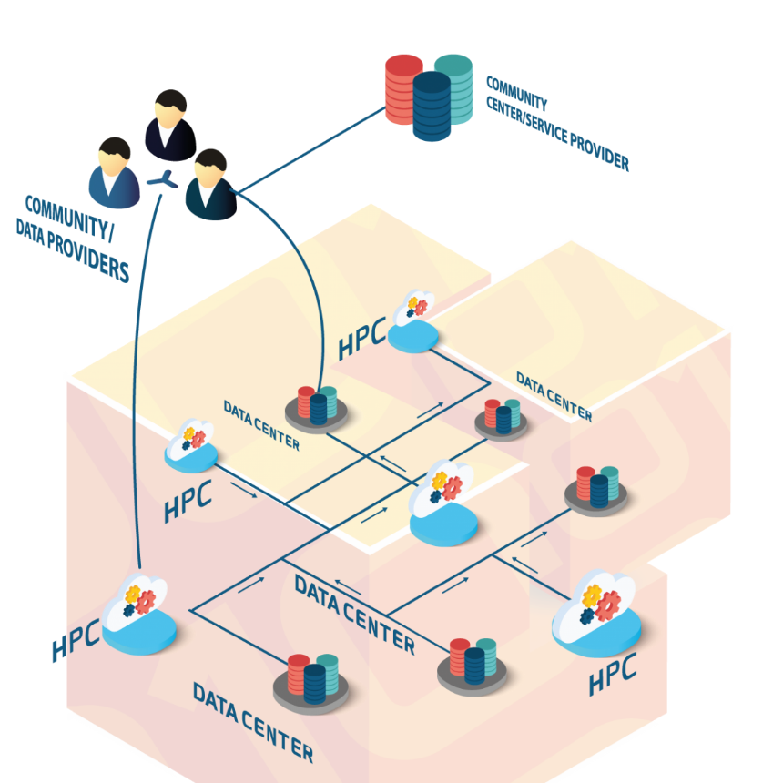
Cooperation with the EUDAT network of e-infrastructure providers
5 EUDAT members are partners of SeaDataCloud :
CINECA, CSC, DKRZ, GRNET and STFC

Slide 15
Issues with current CDI service
performance for users: CDI data access service interacts with the distributed data collections and databases at the connected data centres.
  user can submit a shopping basket with requests for data from multiple data centres.
  user must await the automatic data preparation by each of these data centres
  user must download resulting data sets through the RSM as packages directly from each data centre, which implicates multiple download transactions
performance for users: data centres are not always online, operational and have different machine capacities which might give extra delays
quality issues: concerning formats of data files (ODV + NetCDF) and their consistency with CDI metadata.
installation and configuration of the Download Manager software can be challenging due to different configurations, firewalls etc., which in practice results in having different versions installed

Slide 16
New CDI service architecture

Slide 17
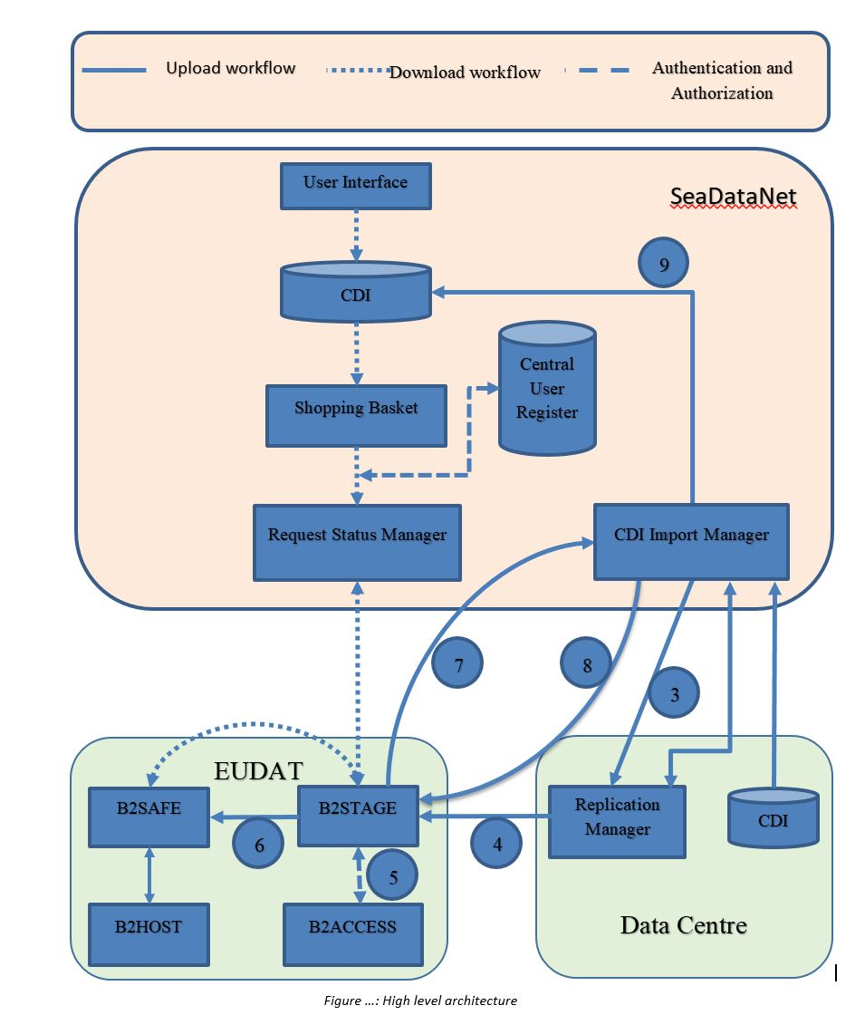
New CDI service components
Local software tools at data centres to prepare ingestions
Replication Manager (RM) at data centres for exchanging to Import Manager and EUDAT cloud
EUDAT cloud with adapted EUDAT services
Upgraded CDI User Interface, ordering and downloading facility

Slide 18
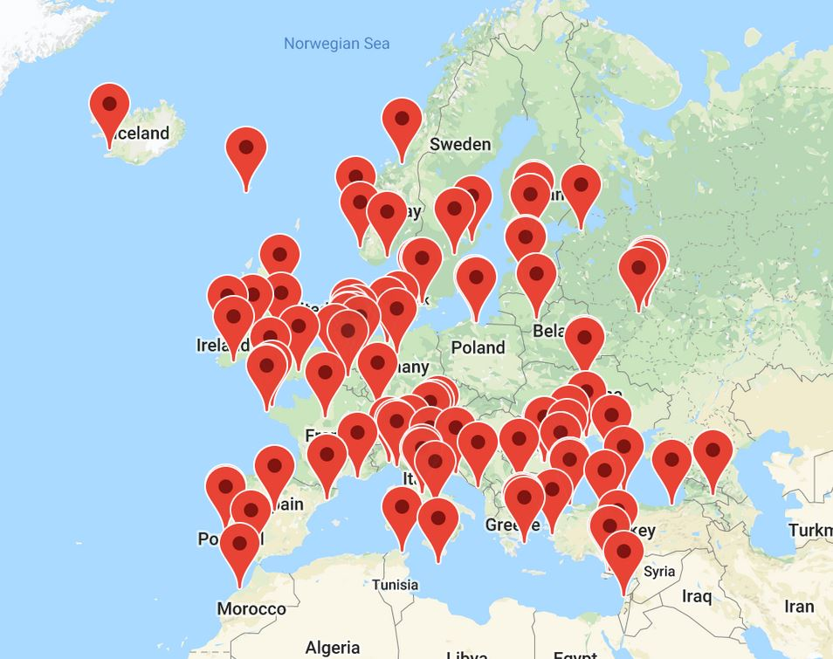
Installed base of CDI nodes

Slide 19
Migration to upgraded system
89 nodes with Download Manager => Replication Manager
24 nodes with Interim solution => Upgraded Interim Solution
The migration is well underway and groups of data centres have been or are being contacted with instructions; support by MARIS and IFREMER
We must assure that existing services continue to operate; only loading of new and updated CDIs is temporarily halted to allow for checking, validating and building the data cloud (> 2.3 million data files)
Cooperation and dedication of data centres is needed for installing and configuring the new set-up in time (May - July 2019)

Slide 20
New challenges
Users and applications of SeaDataNet are becoming more demanding:
  We have to guarantee data quality and long term stewardship
  We have to provide analytical frameworks and collaborative environments which support dealing with big data
  We have to make the overall infrastructure more ‘robust’ in performance, quality and content of services.
  We have to intensify the cooperation with other leading European initiatives, such as Copernicus (CMEMS, DIAS), EMODnet, and EOSC, resulting in synergies and integrations.
  We have to make the large resource of marine environmental data available in an interoperable or harmonized manner, following ‘FAIRness’ principles

Slide 21
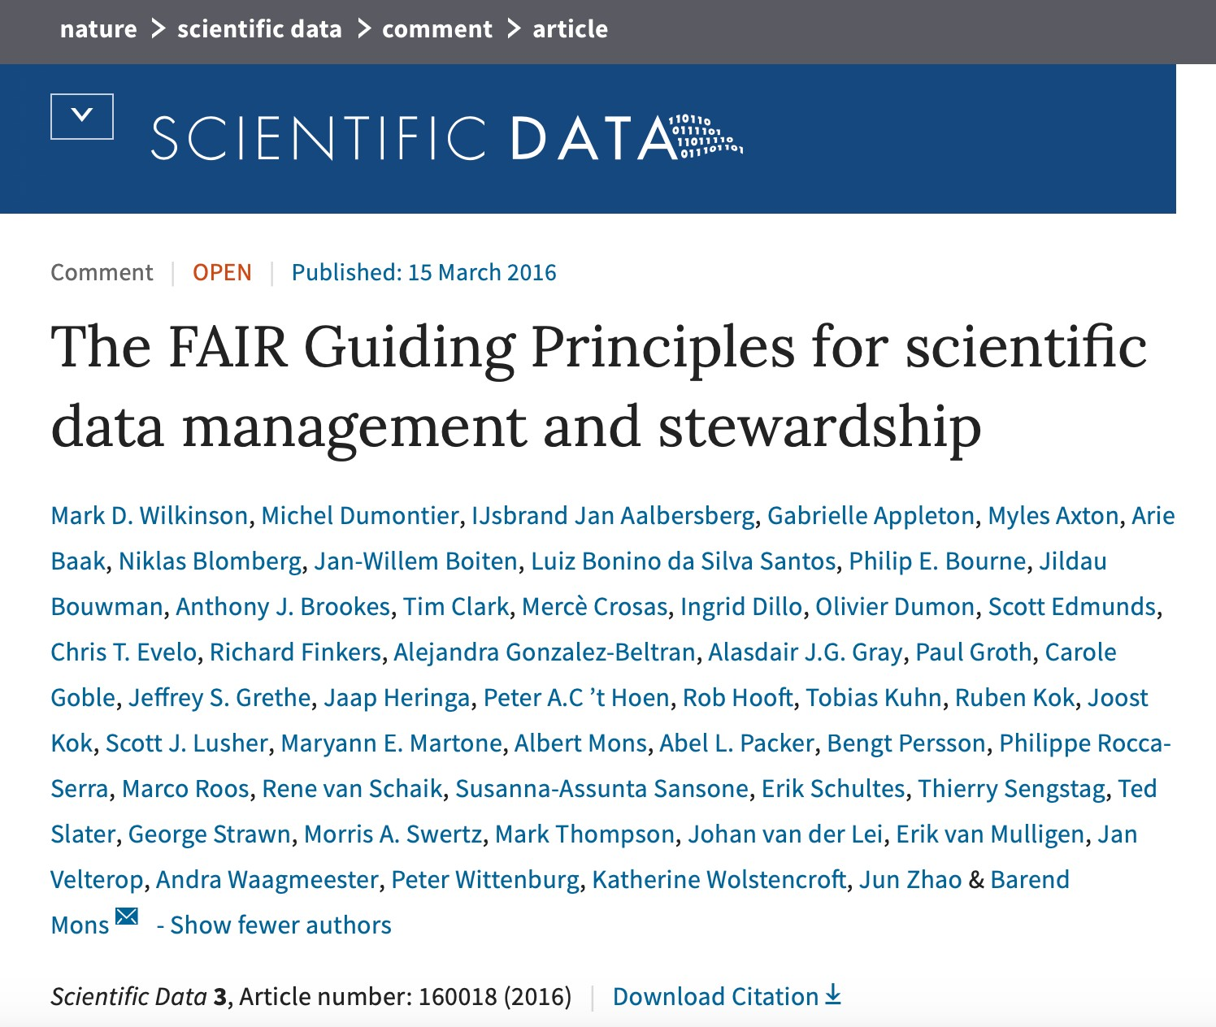


What is FAIR?
“Data and services that are
Findable, Accessible, Interoperable,
Re-usable
both for machines and for people.”
Article in 2016
Further work in:

Slide 22
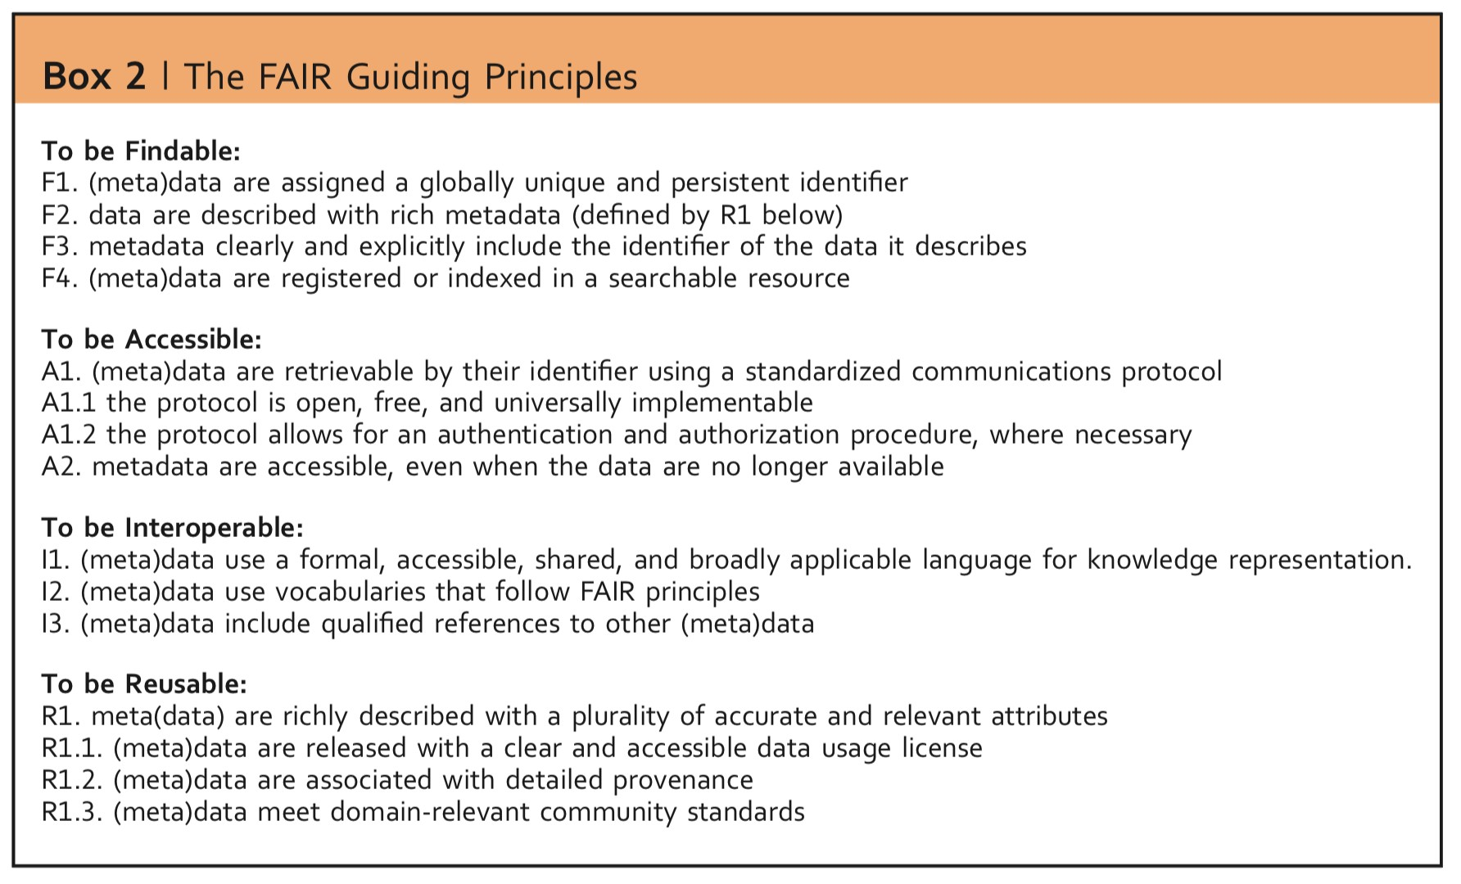
FAIR Guiding Principles

Slide 23
What FAIR is not
FAIR is not a standard
FAIR is not a semantic web / Linked Open Data
FAIR is not equal to ‘Open’ or ‘Free’
  Data are often Open (Access) but not FAIR
  Some data can never be Open, yet be perfectly FAIR
By design, FAIR is not explicit about data quality, trust worthiness, responsibility, ethics, etc

Slide 24
Making CDI service more FAIR
Enriching CDI metadata (actions Data Providers) :
  Adding more information on QA-QC activities, linking documentation, pref in a repository with citable DOIs
  Adding extra information about data collection, in particular instruments (L05 SDN Vocabulary) and, where possible, linking (Near) Real-Time data streams with Sensor Web Standards (SWE = SensorML - O&M)
  Include, where applicable, links to projects (EDMERP), cruises (CSR), data collections (EDMED)
  Include, where applicable, links to ‘standard data processing methods’ like laboratory tests, using the Ocean Best Practices repository of IODE (https://www.oceanbestpractices.net/)

Slide 25
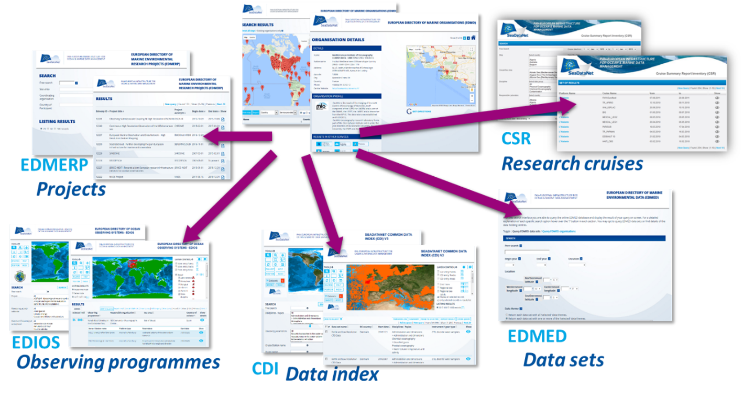
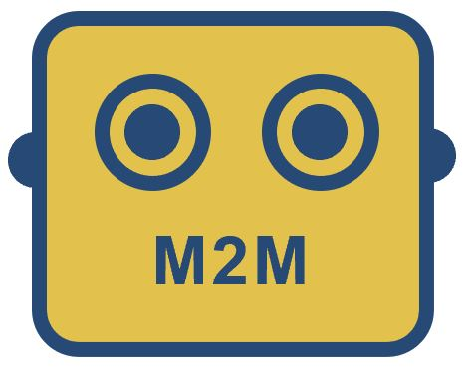
Making CDI service more FAIR
Applying Linked Data principles (= action SDN TTG)
  Publishing SDN directories as SPARQL services as RDF resources following existing models
  Enriching the CDI metadata by ‘exploiting’ the SPARQL services into an integrated model )
Use Schema.org
for Search Engines

Slide 26
Making CDI service more FAIR
Harmonising the URLs of the SDN services (= action SDN TTG)
  https://cdi.seadatanet.org/search (User Interface)
  https://edmed.seadatanet.org (User interface
  ….
  https://edmed.seadatanet.org/report/6585/ (detail page)
  https://edmo.seadatanet.org/report/43 (detail page)
  ….
  https://edmed.seadatanet.org/sparql/ (SPARQL endpoint)
  https://edmo.seadatanet.org/sparql/ (SPARQL endpoint)
  For CDI we will apply same URL conventions, but SPARQL for aggregated CDI collections

Slide 27
Making CDI service more FAIR
Ensuring data format conformance (actions Data Providers):
  Use SeaDataNet tools for preparing SeaDataNet data files (ODV, NetCDF (CF))
  Follow examples of SeaDataNet data files for specific data types
  Make sure that all declared parameters have one or more values
  Make sure that the correct primary variables in ODV are defined and filled with values considering the specific data types
  Check the syntax and semantics of ODV and NetCDF files, using SDN OCTOPUS software

Slide 28
Summarizing actions data providers
Give a direct follow-up to the CDI upgrading by installing and configuring the new set-up; maintain dialogue with CDI helpdesk for configuring and testing the new connection
Maintain and check the quality and format conformity of your data files as included in the CDI service
Enrich your CDI metadata with extra information
Populate entries into the related SDN directories (EDMED, CSR, EDMERP, EDMO) and OBP
Use the SeaDataNet tools and services for metadata and data preparation, population and checking

