Slide 1
Preparing CDI metadata and corresponding data files
Michèle Fichaut - Ifremer

Slide 2
Previous presentation
Last year, at the training course I presented how to Improve the workflow using the SeaDataNet tools NEMO, OCTOPUS, MIKADO
  Explaining the role of each tool
  Detailing a SDN ODV file
  Giving recommendations on the SDN ODV files
    List of current mistakes found in SDN ODV files
    How to avoid these errors
    Link to that presentation

Slide 3
This year presentation
Recall the role of the tools NEMO, OCTOPUS and MIKADO
Give some example of data flows using the tools
Give 6 key messages on
  The CDI granularity
  The coherency between metadata/data
  The metadata enrichment
  The data file enrichment
  The importance of data file format checking
  The advantage of using the tools

Slide 4

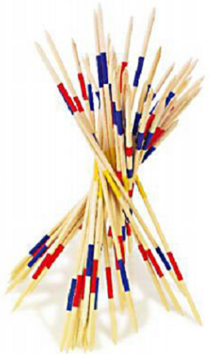
Challenge for a data infrastructure
Distribute homogeneous data and metadata files to data users in standardized formats that can be used in standard tools
  Available tools
    NEMO
    OCTOPUS
    MIKADO

Slide 5
The tools: NEMO (1)
  To convert ASCII files to SeaDataNet formats (ODV, MedAtlas, netCDF)
  To generate the corresponding coupling table
  To generate a CSV summary file file that can be used by MIKADO to create the correspponding metadata XML files

Slide 6
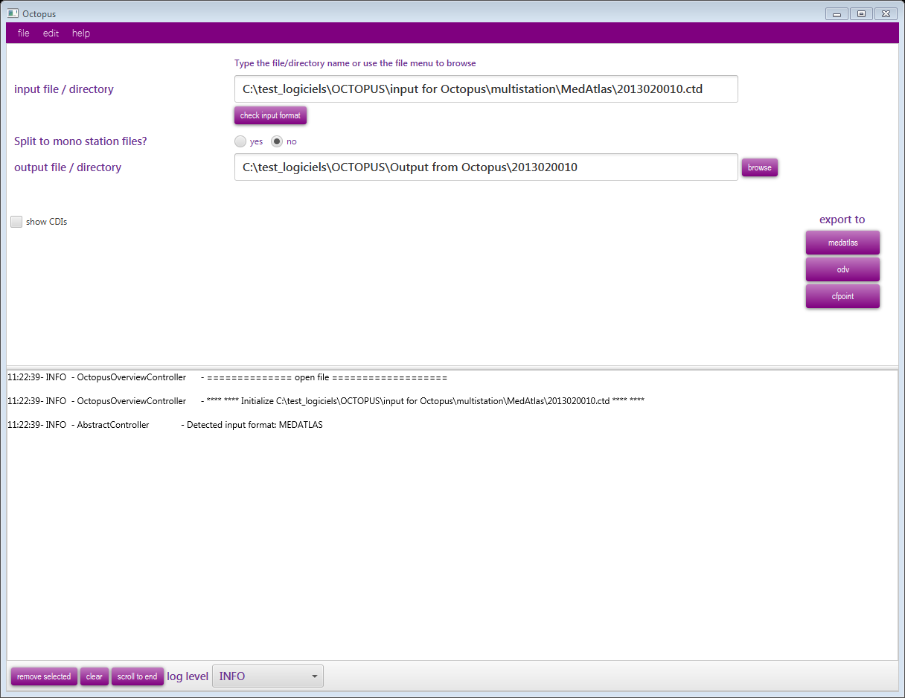
The tools: OCTOPUS (2)
To check SeaDataNet files
To split multistation SeaDataNet files
To convert from one SDN format to another one
  MedAtlas ➔ MedAtlas, ODV and NetcDF
  ODV ➔ ODV and NetCDF
  netCDF ➔ netCDF and ODV
  ODV variant ➔ ODV variant

Slide 7

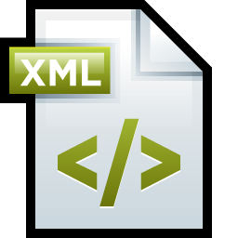

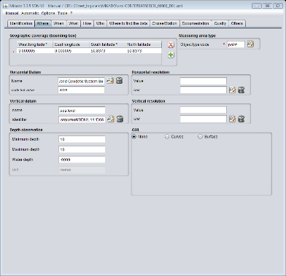
The tools : MIKADO (3)
Generation of standardised metadata XML descriptions for SeaDataNet catalogues
Metadata database
Automatic
ISO-19139 / ISO 19115
Metadata descriptions
Manual

Slide 8



Some examples of data flow in a data centre
Octopus
Example 1
Files
SDN format
No QC
Files
SDN format QC
Local
DB
QC
Files format X
Metadata
Coupling table
Mikado

Slide 9
Some examples of data flow in a data centre
Octopus
Example 1
Files
SDN format
No QC
Files
SDN format QC
Local
DB
QC
Files
format X
Metadata
Coupling table
Example 2
QC
Local DB
Mikado
Files format X
Metadata+ Data

Slide 10

Some examples of data flow in a data centre
Octopus
Example 1
Files
SDN format
No QC
QC
Files
SDN format QC
Local
DB
Files
format X
Metadata
Coupling table
Example 2
QC
Local DB
Mikado
Files format X
CDI-Summary
Metadata+ Data
Example 3
Files format X
QC
Files
SDN format QC
Octopus

Slide 11

Some examples of data flow in a data centre
Octopus
Example 1
Files
SDN format
No QC
QC
Files
SDN format QC
Local
DB
Files
SDN format QC
Files
format X
Metadata
Coupling table
Example 2
QC
Local DB
Mikado
Files format X
CDI-Summary
CDI central
Metadata+ Data
Example 3
RM
Files
SDN format QC
Files format X
QC
IM
EUDAT CLOUD
Octopus

Slide 12
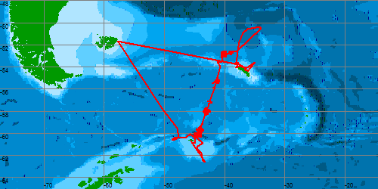
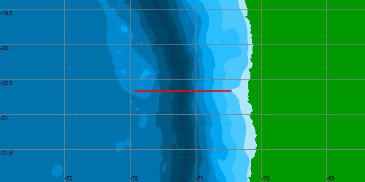
Key message 1: CDI granularity
Stations (vertical profiles), 1 CDI for
  1 CTD cast (with all measured parameters)
  1 Bottle cast (with all measured parameters)
  1 Sediment Core
  1 Sediment Grab
Trajectories (underway data) : 1 CDI for
  One ThermoSalinoGraph cruise (with T and S)
  1 seismic segment or seismic cruise
  1 bathymetric track or cruise

Slide 13
Key message 1: CDI granularity
Time series: 1 CDI for one location and one depth repeated in time (monitoring)
  1 current meter series
  1 wave series
  1 physical/chemical monitoring station
  1 biological monitoring station
  1 contaminant parameters in biota/sediment/water monitoring station
If new measurements for the same points: Update the CDIs and the files, do not create a new CDI

Slide 14
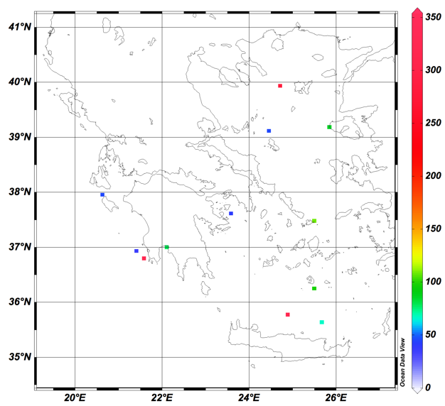
Granularity: Time-series management
  Large fragmentation of some time series (12 locations are fragmented in 1591 time series = CDI), in particular in three locations the number of stations is larger than 300.

Slide 15
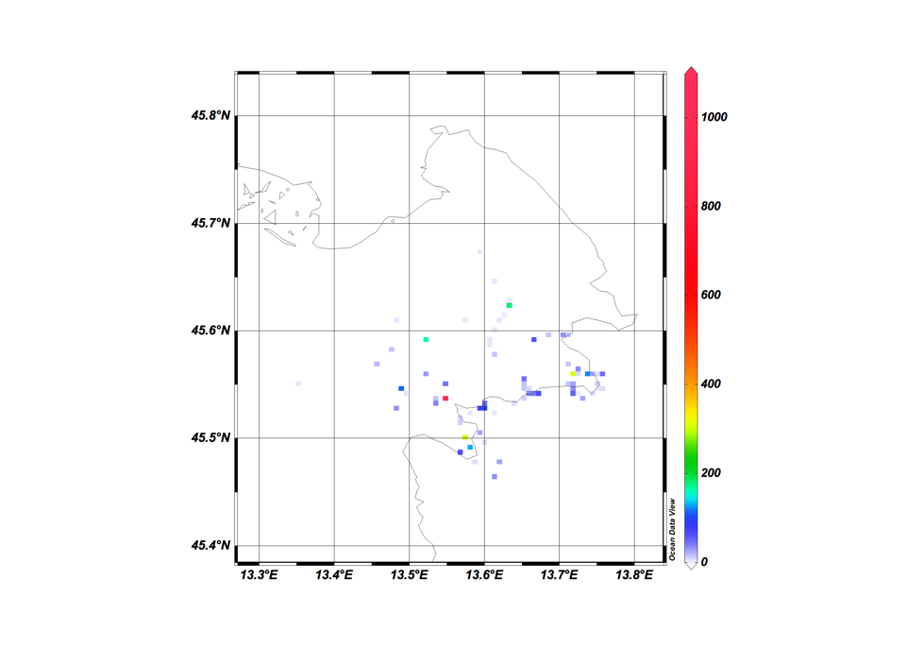
Granularity: Time-series management
  Here there is one point with more than 600 CDIs

Slide 16
Granularity: Time-series management
  Difficult to manage for both QC analysis and data products generation.
  WP11 wishes a reprocessing at the data centre level in order to aggregate the time series belonging to the same mooring station when possible

Slide 17
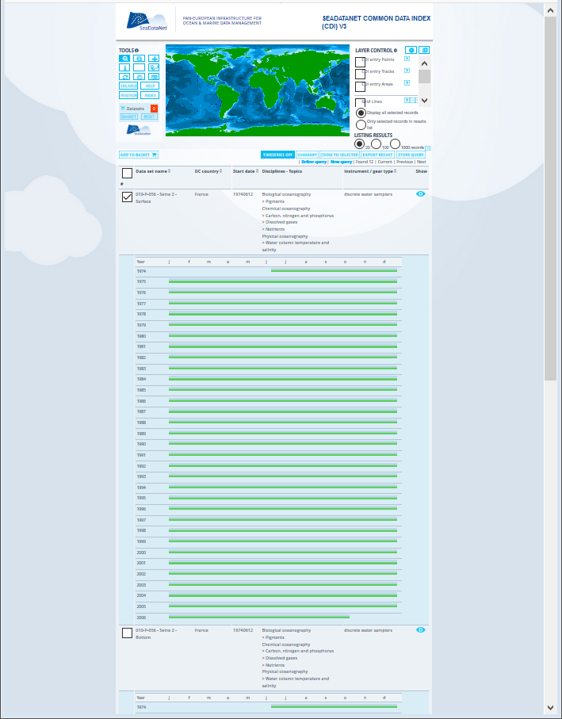
Granularity:
Long time-series
Example of one monitoring station:
From 1974 to 2006

Slide 18
Key message: 2 – Coherency metadata/data
Metadata and corresponding data files are sent separately
  Data files in the EUDAT cloud
  Metadata in the CDI catalogue at MARIS
It is very important that they are coherent
  What you describe in the metadata is what you have in the data files (one metadata per LOCAL_CDI_ID)
  The metadata description must be adapted to one LOCAL_CDI_ID and not to the cruise file: only the parameters measured in the corresponding station must be described in the metadata

Slide 19
Key message: 2 – Coherency metadata/data
Example one cruise file with several bottle stations
  Station 1: measurements of T, S, Nitrate + Nitrite and Oxygen
  Station 2: measurements of T, S and Oxygen
  Station 3: measurements of T, S, Nitrate + Nitrite and Oxygen
Corresponding CDIs
  Station 1: P02= TEMP, PSAL,NTRZ and DOXY
  Station 2: P02= TEMP, PSAL and DOXY
  Station 3: P02= TEMP, PSAL, NTRZ and DOXY

Slide 20
Key message: 3 – Metadata enrichment
Put as many metadata as possible in the CDI and not only the mandatory information
  Link to the EDMED, EDMERP and CSR catalogue using the EDMED, EDMERP and CSR references (see last year MIKADO presentation)
  GML tracks of the cruise (in case of trajectory) instead of an area
  Additional information such as documentation on the analysis methods used
  …

Slide 21
Key message: 4 – Data file enrichment
Give as many information as possible (using NEMO)
Use sdn_reference for external link to:
  CSR catalogue
  CDI catalogue
  The platform code (vocabulary list C17)
Keep sensor information as <instrument> tag in the SDN_MAPPING lines
Keep fall rate equation in case of XBT as a <fall_rate> tag in the SDN_MAPPING lines

Slide 22
Key message 5: Check your SDN files
Once you have generated your files
  Check them with OCTOPUS before sending them to the cloud
  OCTOPUS checks:
    The format structure
    The coherency of the files:
      if flag 9➔⬅ Then no measurements
      If one column empty of measurements ➔ deletion on conversion
    The vocabs :
      Detection of deprecated parameters and replacement on conversion
      Detection of wrong terms

Slide 23

Key message 6: Advantages of using the tools
Sure to be standard
Lots of errors avoided
Further standard and format evolutions are taken into account in the tools without any changes on your side
No incoherencies between
  Data file (ODV, NetCDF, MedAtlas)
  XML CDI description
  Coupling table

Slide 24
And do not forget that
There are a lot on information on-line
  Description of the data transport formats https://www.seadatanet.org/Standards/Data-Transport-Formats
  User manual for the CDI metadata https://www.seadatanet.org/Standards/Data-Transport-Formats
  How to include CSR reference in CDI description
There are responsive helpdesks
  sdn-userdesk@seadatanet.org and
  cdi-support@maris.nl

Slide 25

Any questions?

