Slide 1
OCTOPUS, SDN formats conversion software
Michèle Fichaut

Slide 2
Summary
Reminder on OCTOPUS, and all its functions
Releases of Octopus
New developments
Detailed presentations of the functions
Some news about NEMO
Hands-on session

Slide 3



OCTOPUS, main functions
for SeaDataNet data files: checker, converter
Converter
Checker
Data files at one SDN format
(multi and/or mono station)
Data files at one SDN format
(multi and/or mono station)

Slide 4
OCTOPUS, additional functions
Split multistation file in monostation ones
Splitter
Multistation data file at one SDN format
Monostation data files at one SDN format

Slide 5
OCTOPUS, additional functions
Selector of LOCAL_CDI_ID(s)
Selector
LOCAL_CDI_ID x
+
LOCAL_CDI_ID y
LOCAL_CDI_ID a
to
LOCAL_CDI_ID z
or
LOCAL_CDI_ID x
LOCAL_CDI_ID y
Multistation or Monostation data files at one SDN format with the selected LOCAL_CDI_IDs
Multistation data file at one SDN format

Slide 6
OCTOPUS, additional functions
Conversion of MGD files to SDN ODV format
  Magnetism, Gravity and Depth
ASCII MGD
V81 and V98
MGD file at SDN ODV format

Slide 7
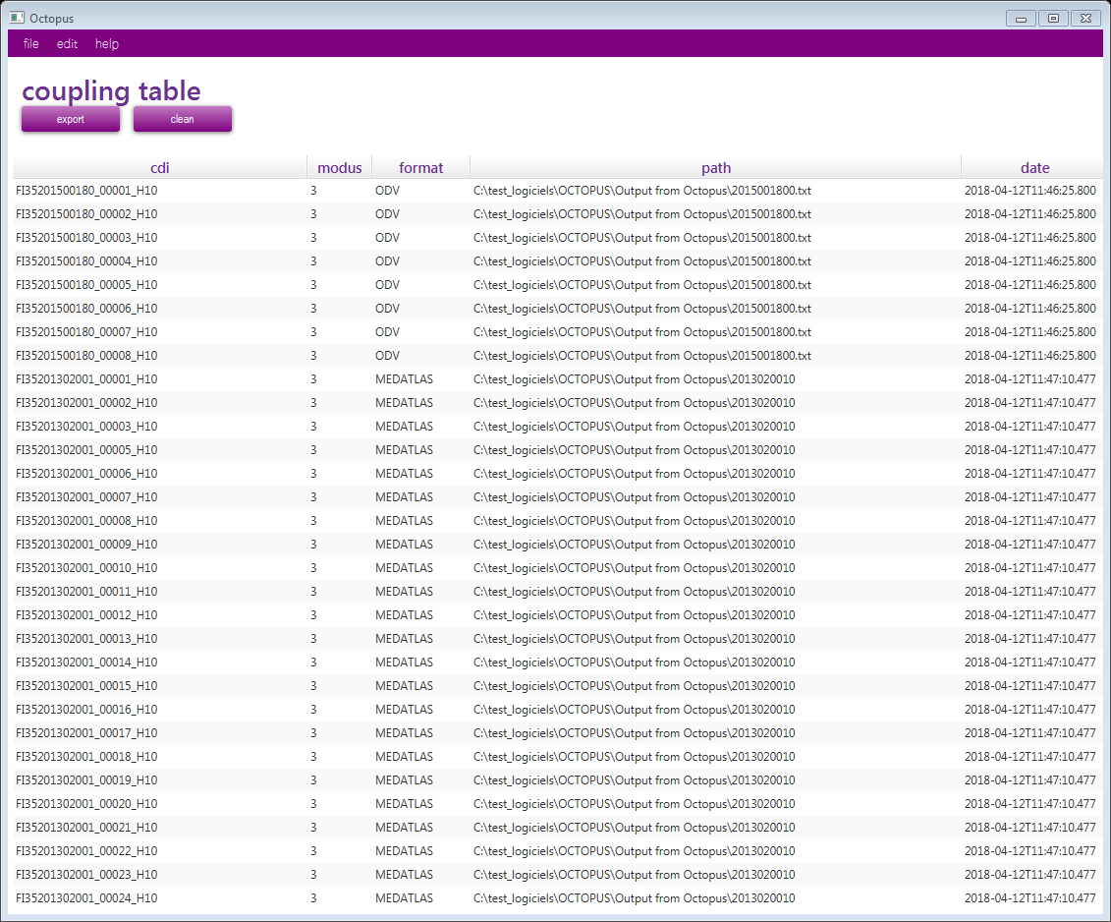
OCTOPUS, additional functions
While converting OCTOPUS can generate the the coupling table for SDN, on demand
Converter
Creation of corresponding records in the coupling table

Slide 8
OCTOPUS releases (1)
OCTOPUS 1.2 in January 2017
OCTOPUS 1.3.9 in July 2017
OCTOPUS 1.4.0 in March 2018, Major release, available for last training course
  New format conversion for : SDN netCDF to SDN ODV
  New SDN netCDF format checker
  Major improvement of SDN ODV format checker
  Batch mode available for format checkers

Slide 9
OCTOPUS releases (2)
OCTOPUS 1.4.1 in June 2018
  Be able to check and convert the ODV files generated from MGD77
  Detect extended SeaDataNet ODV formats: for biology, microlitter and flow cytometry : files are not rejected anymore, but not checked

Slide 10
OCTOPUS releases (3)
OCTOPUS 1.4.2 in March 2019
  Compliance with java 9 and 10
  Check consistency between values and quality flags
  Check considers as valid time series ODV files with a P02 ASLV parameter instead of AHGT (useful for sea level data)
  Homogenisation of the default value for measured parameters in netCDF SDN (-99999)
  Allow SDN CSR references using the central catalogue
  All conversions: non-mandatory variables are not kept if they are empty (with only default values)
  Conversion to ODV: an error is raised if one of the mandatory columns has missing value(s)
  Update SDN QC flags: add 'Q' flag
  JSON log: format added in logs in batch mode

Slide 11
OCTOPUS releases (4)
OCTOPUS 1.5.0 in June 2019, major release
  New checks and conversion for ODV variant formats for
    Biology
    Microlitter
    Flow cytometry
  Conversion only possible from ODV to ODV
    In order to add sdn_reference to the CDI if missing
    To check the standard vocabulary used
    To update the vocabulary in case of deprecated terms
    To delete the empty columns

Slide 12
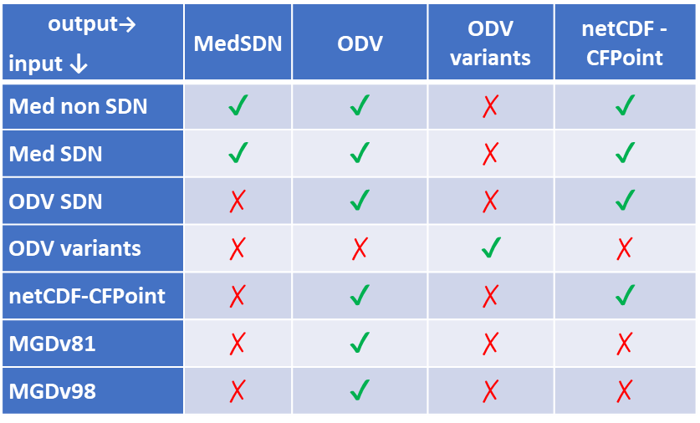
OCTOPUS possible conversions

Slide 13
OCTOPUS user manual
User manual is provided on line on SeaDataNet website and embedded in OCTOPUS software under the ‘help’ menu:
  https://www.seadatanet.org/Software/OCTOPUS
On this page also:
  FAQ
  a presentation of OCTOPUS and the corresponding video

Slide 14
New developments ➔ 1.5.0
Detection of Variant ODV formats
If this is not applied, the files can be valid SDN ODV but will not be detected as ODV variant
Variant ODV format | How to detect which type
For Biology | if MINWDIST and MAXWDIST present and SCNAME01 or SNANID01 present
For Flow Cytometry | If DTUT8601 and IDCLFL02 present if ADEPZZ01 is present then profile or trajectory, else time-series
For Microlitter | if MINWDIST and MAXWDIST present and MLITTYPW or MLITSIZW present

Slide 15
New developments ➔ 1.5.0
Checks implemented for Variant ODV formats
Variant ODV format | Additional tests
For Biology | 28 | Check the presence of the mandatory columns ➔ Error Check the label of the mandatory column ➔ Warning Check the unit of the mandatory column ➔ Warning Check The coherency between SDN_mapping units and the column header ➔ Error
For Flow cytometry | 17
For Microlitter | 28

Slide 16
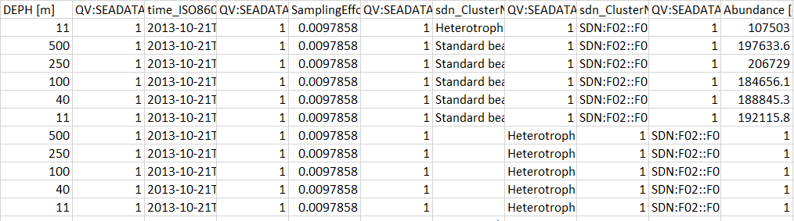
Check of flow cytometry data files
Out of 69 files downloaded from SDN
  9 are correct (EDMO 3078)
  60 have the same mistake: (EDMO 3078)
    extra tabulation ➔ shift in the columns

Slide 17
Check of microlitter data files
Out of 84 files downloaded from SDN
  20 are correct (EDMO 269)
Nb files | EDMO | Error
19 | 486 | SampleID mapped to EVNTID01 instead of SAMPID01
2 | 120 | Have a parameter mapped to H03 instead of P01 in the mapping lines
42 | 713 | Do not respect the Microlitter standard: First measured parameter = DEPTH instead of Minimal Observation Depth ➔ file not recognised as microlitter
42 | 713 | Net_Opening mapped to MTHAREA1 instead of MTHWDTH1

Slide 18
Check of biological data files
Out of 5260 files downloaded from SDN
  Only 1871 are detected without errors (35%)
Nb files | EDMO | Error
781 | 729 | Same P01 term used for 2 different parameters: MUM13209 used for WetWt_Lipid_BE006336_grams (Mass) and WetWt_Lipid_BE006336_perc (Concentration)
1 424 | 730 | ScientificNameID mapped to SNAMID01 instead of SNANID01
114 | 486 | Flag inconsistency: QC Flag = 9 with non empty columns
122 | 193 | Flag inconsistency: Empty columns with QC Flag != 9
890 | 193 | Unit Inconsistency between SDN mapping lines and column header for ABUNDANCE
205 | 193 | Unit Inconsistency between SDN mapping lines and column header for BIOMASS

Slide 19
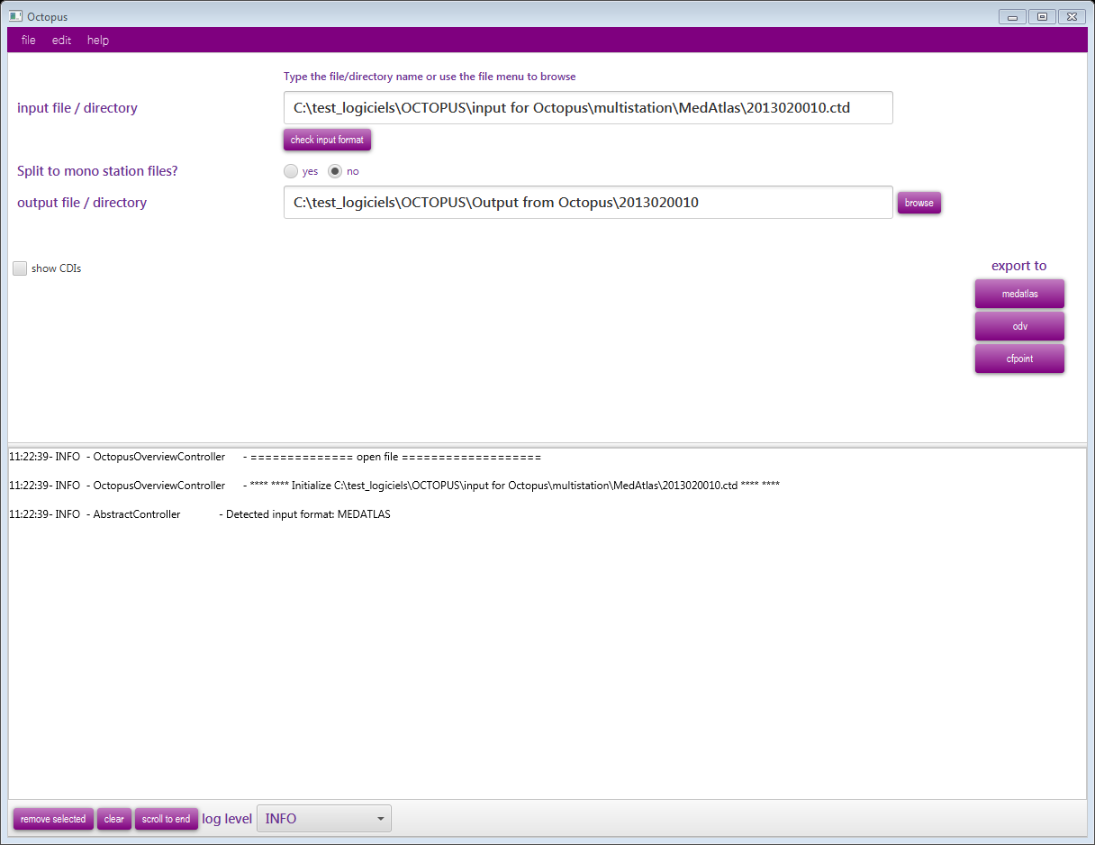
Can convert one file or one folder

Slide 20
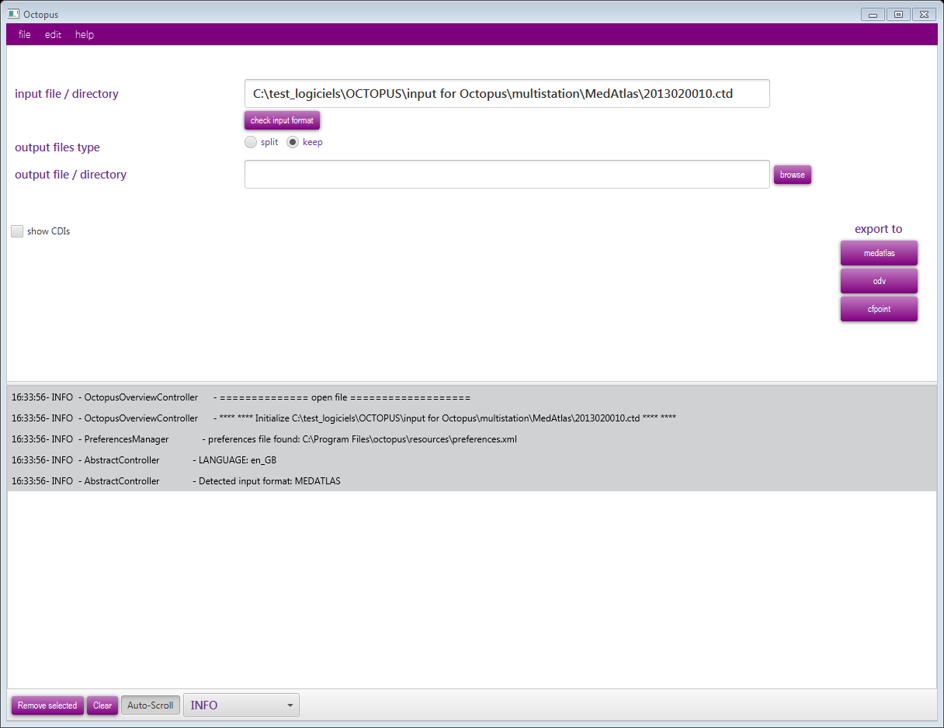
Check of the input format
The Input format automatically detected: MedAtlas, ODV, NetCDF or BIO variants

Slide 21
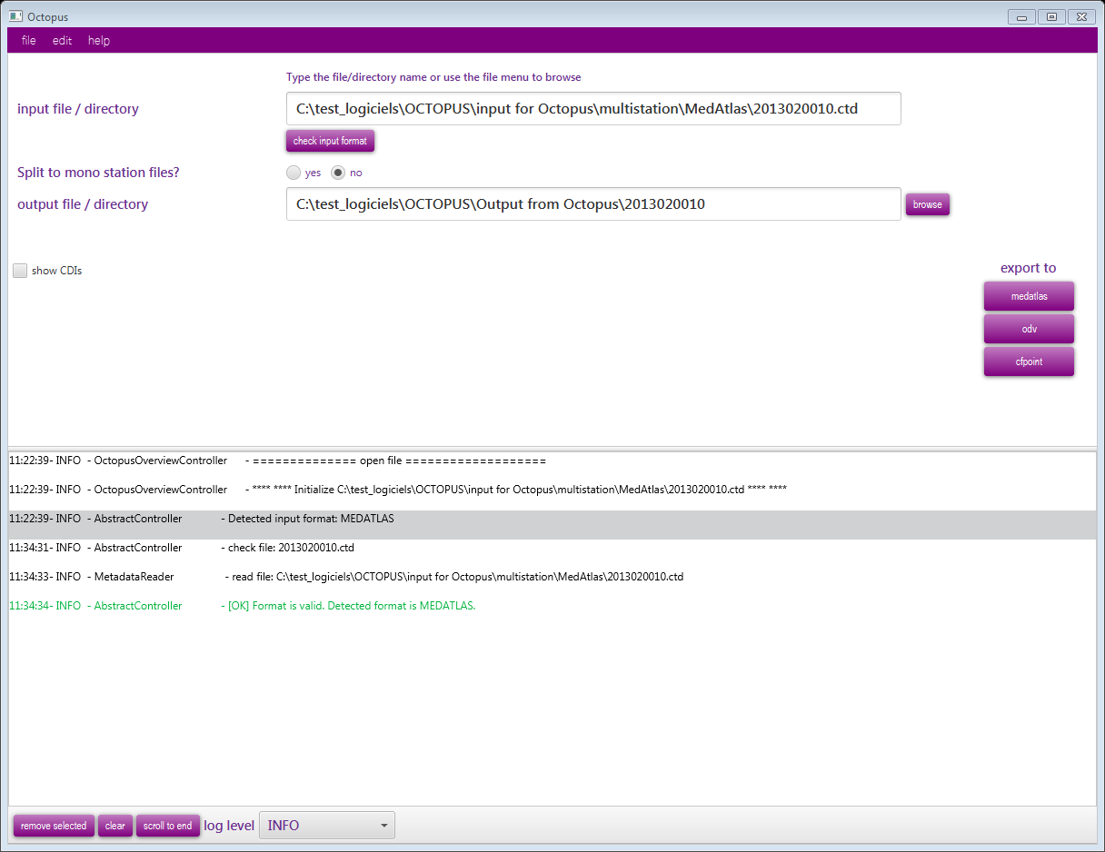
If format OK, green message

Slide 22
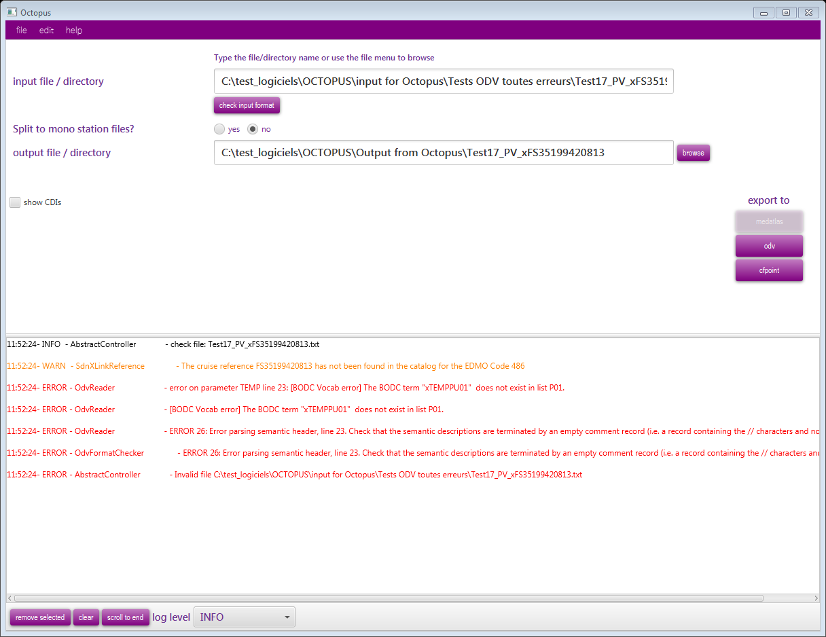
If format KO, red message and description of the error

Slide 23
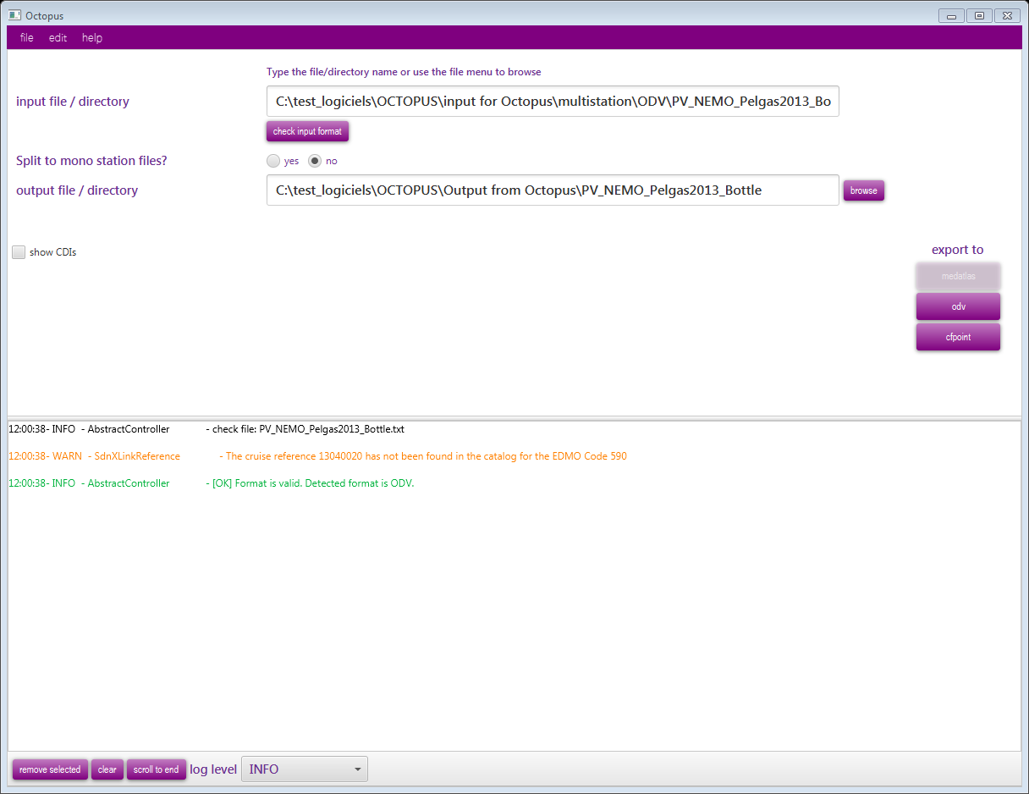
Choose to split Multistation file into Monostation files (no is the default value)

Slide 24
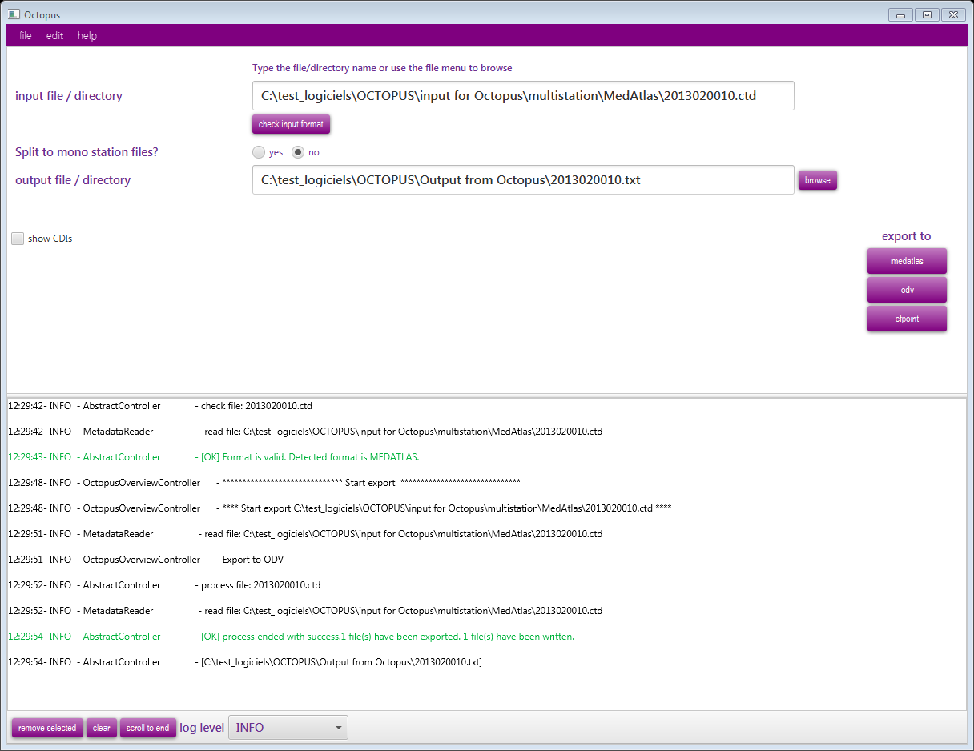

Slide 25
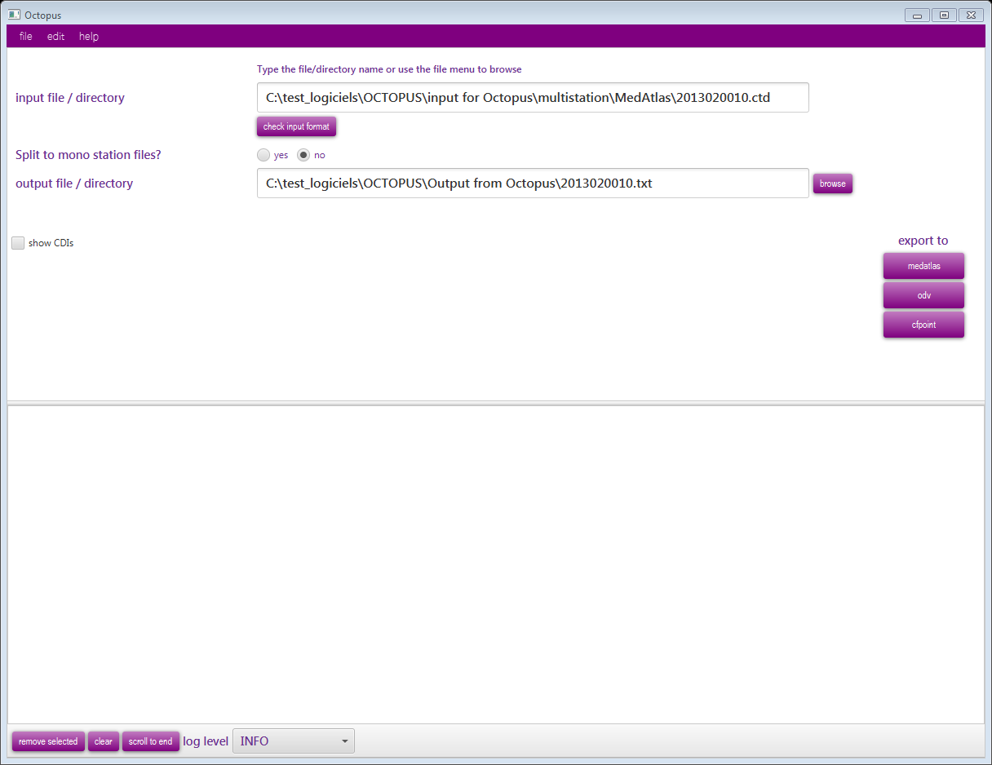
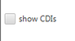
Extract CDIs from the input file

Slide 26
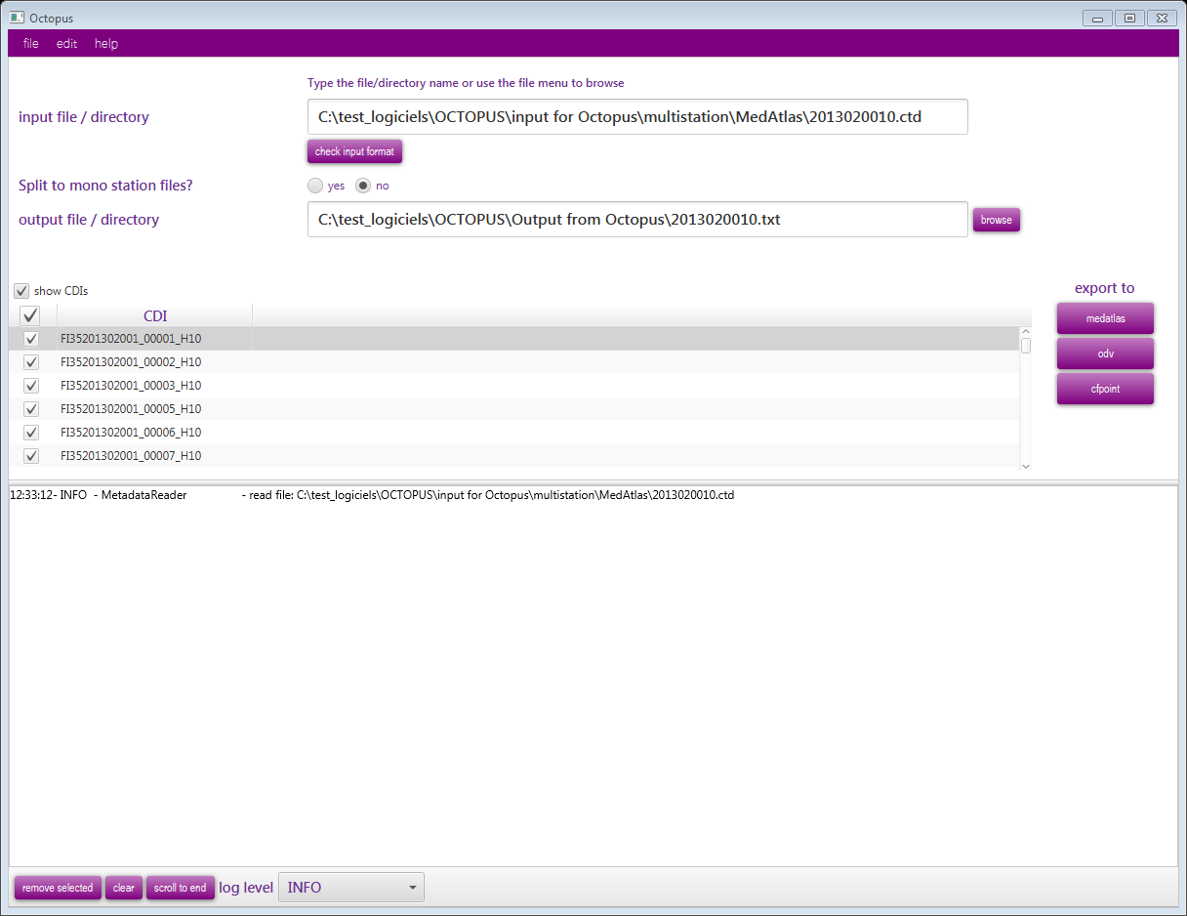
List all CDIs of the input file

Slide 27

Select the CDIs that you need to extract

Slide 28
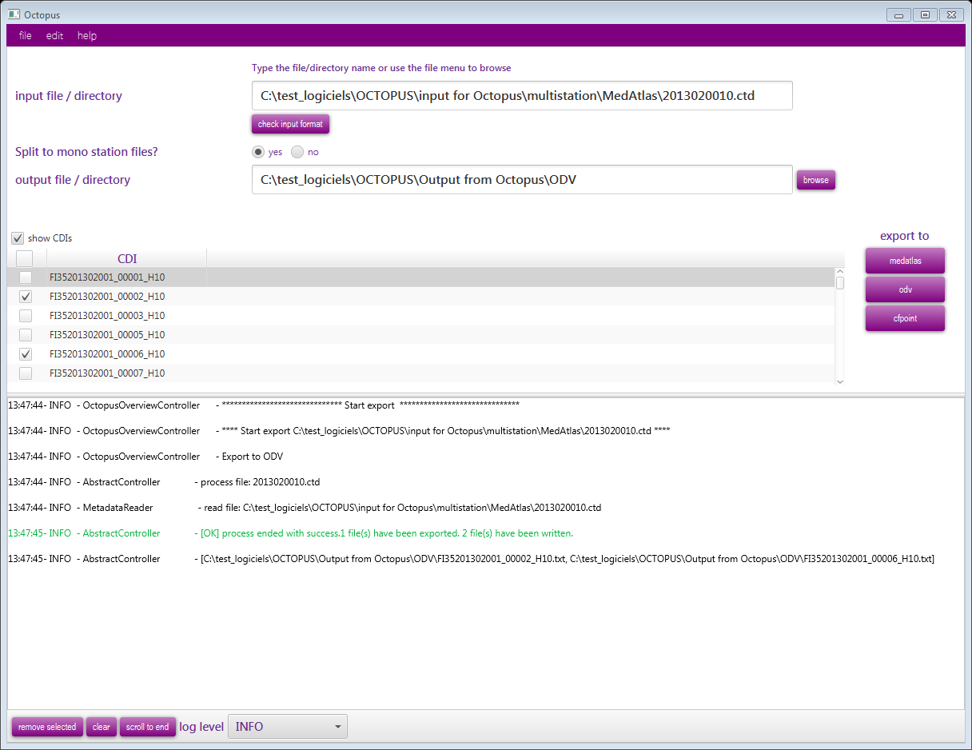
Only the 2 stations selected are extracted

Slide 29
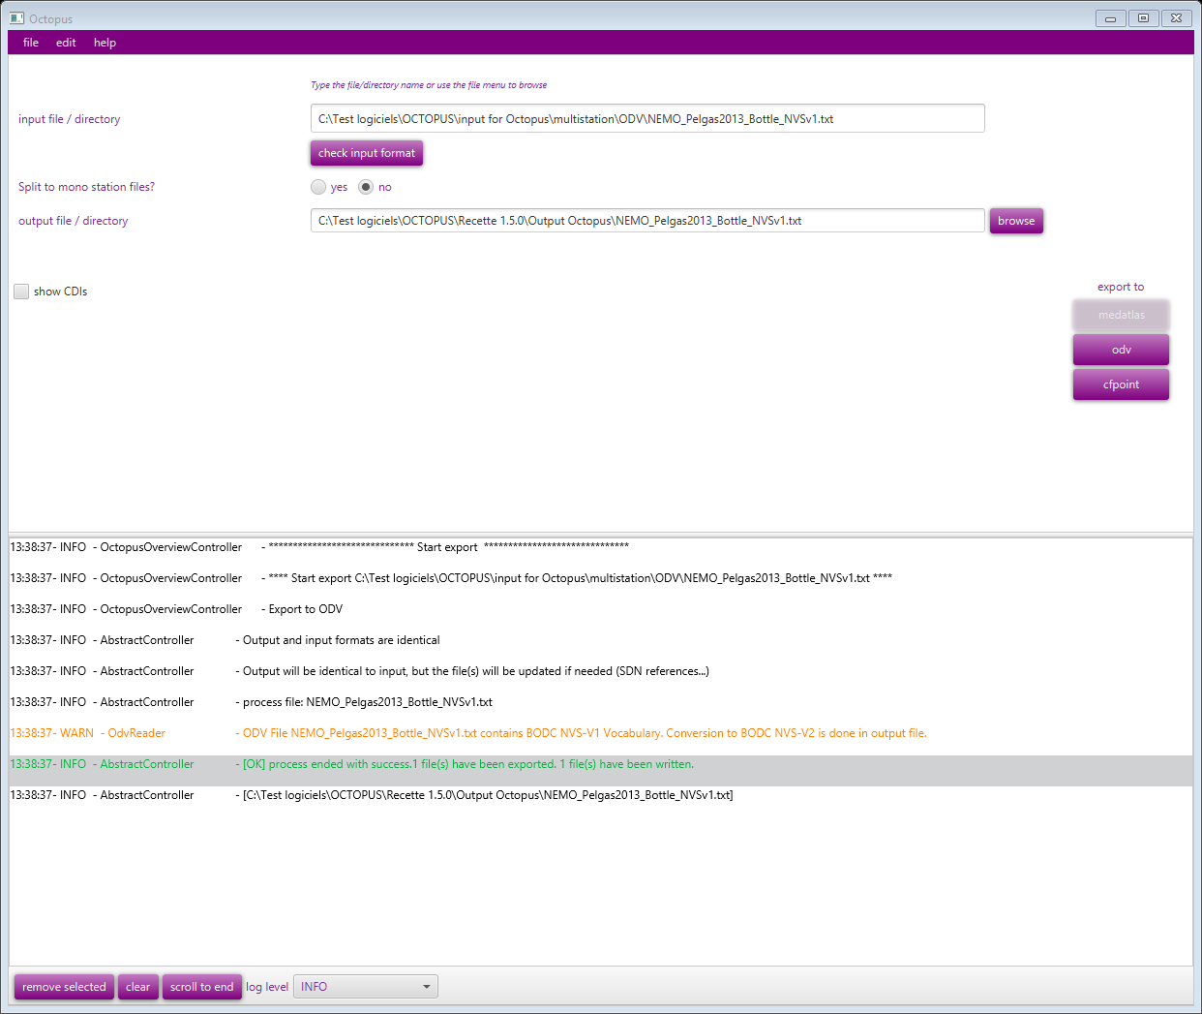
Input file with old version of vocabulary
  P011 and P061
Warning send to the user (orange)
Conversion to V2 vocabulary done : P01 and P06

Slide 30
OCTOPUS in batch mode for check
java -jar octopus.jar [-i <arg>] -check
-i <arg> | Mandatory | input path: </home/user/...>
-check | Optional | To check the files without conversion

Slide 31
OCTOPUS in batch mode for conversion
java -jar octopus.jar [-c <arg>] [-f <arg>] [-i <arg>] [-l <arg>] [-o <arg>] [-t <arg>]
-c <arg> | Optional | list of local_cdi_id, eg <FI35AAB, FI35AAC>, all cdi are exported if this argument is omitted
-f <arg> | Mandatory | output format: <medatlas>, <odv> or <cfpoint>
-i <arg> | Mandatory | input path: </home/user/...>
-l <arg> | Mandatory if input is MGD | local CDI Id value if input is a file, mapping file is input is a directory (see §5.5)
-o <arg> | Mandatory | output path (file or directory): </home/user/...>
-t <arg> | Mandatory except if input is MGD | output type: <split> or <keep>

Slide 32
NEMO delivery since last training
Actual version 1.6.7, delivered 21/01/2019
  Possibility to use a BSH CSR reference in a SDN reference:
  Improve flags scales window in Nemo settings
  New coordinates format in station folder: "decimal degrees for file with separators"
  Use -99999 as fill value in SDN NetCDF output files
  Add a new SDN QC flag: Q (value below limit of quantification)
  Update SeaDataNet CSR XML Schema (4.0.0)
  Java >= 9 compatibility

Slide 33
Planned extra functions for NEMO
NEMO 1.7.0 ➔ planned before next plenary
  Able to generate ODV variant formats for Biology, Microlitter and Flow cytometry
  Update the vocab lists in batch mode
  Able to read CSV metadata (not only measured parameters)
  Able to accept 2 identical P01 codes in the parameter list in the Data tab
  Provide a OS X version without installer

Slide 34
Hands-on session
Run OCTOPUS on your SeaDataNet files
… and see what happens!

Slide 35

Thank you for your attention

