Slide 1
Sub-setting Service using ERDDAP
Michèle Fichaut, Aurélie Briand, Léo Bruvry-Lagadec

Slide 2
Summary
General presentation of ERDDAP
Configuration for SDN in-situ files
Configuration for SDN products
ERDDAP Sub-setting
Restful output
JSON output and visualisation tools
Notes:
I’ll start with presentations of Oceanotron and Erddap
Then focus on sub-setting on SeaDataNet products
Then remind you the Grant Agreement content
And at the end we’ll discuss about how can Oceanotron or Erddap meet the needs

Slide 3
What is ERDDAP?
ERDDAP is developed by Bob Simons from NOAA
Reference: Simons, R.A. 2016. ERDDAP. https://coastwatch.pfeg.noaa.gov/erddap
Monterey, CA: NOAA/NMFS/SWFSC/ERD
Free & reusable software
ERDDAP handles gridded data and in-situ data
It allows temporal and spatial sub-setting
Users can download their data in many common files types and do not waste time in conversion
Designed for web applications & web services
Notes:
Erddap deals with gridded and in-situ data
It allows temporal and spatial sub-setting
Users can download their data in many formats
They don’t waste time in conversion
complements, if needed:
Erddap is free, reusable software
Erddap is designed to provide easier access to datasets for both people and machines
( = a web application (for humans with browsers) and a web service (with services for computer programs))
ERDDAP is “RESTful”, meaning the URL completely defines the data you want, in the format you want.

Slide 4
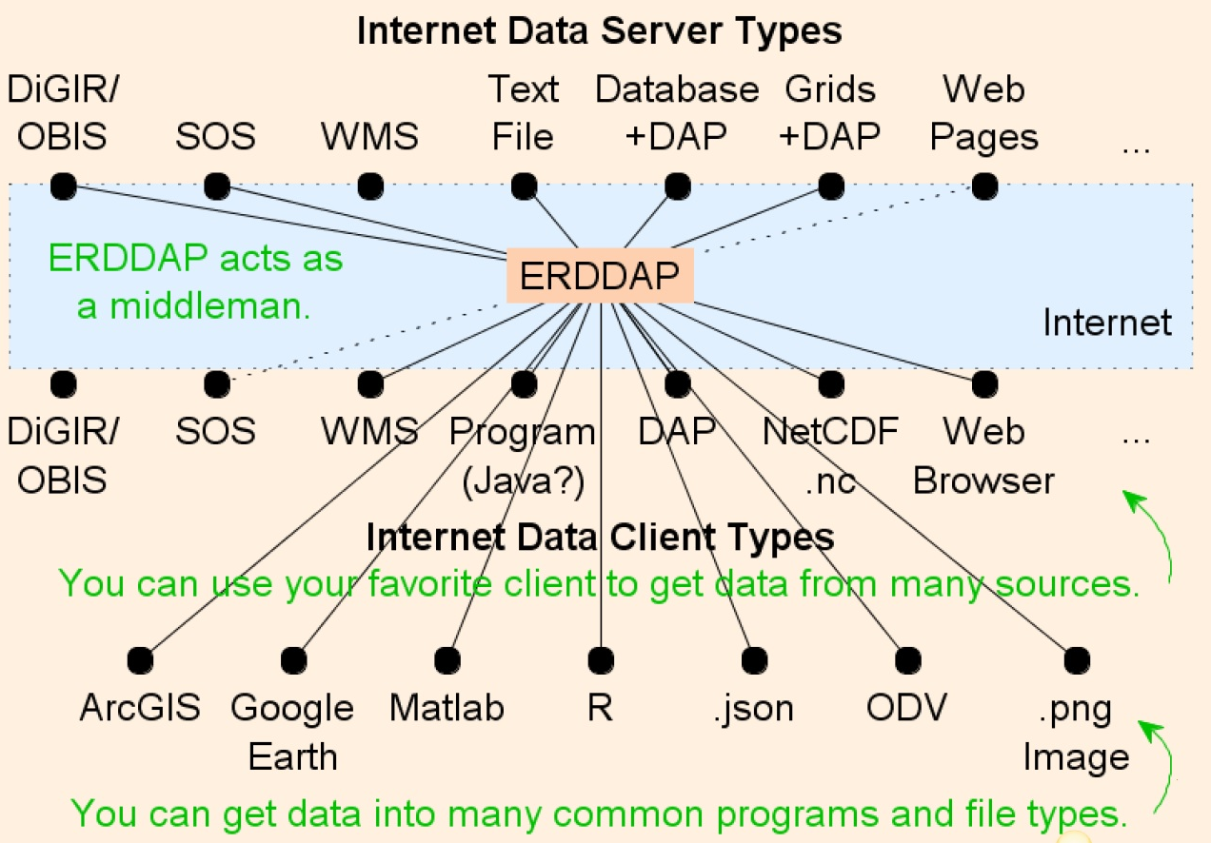
What is ERDDAP? (2)
Notes:
ERDDAP is like a middleman
Users can use their favorite client to get data from many sources
They can get data into many commons programs and file types

Slide 5
ERDDAP Sub-setting
The data access functions
  Discovery
  sub-setting
  Visualisation
  download
download data in many common files types
  data formats (netCDF, grib, csv, ESRicsv, JSON, ODVtxt, mat, R, etc…)
  image files formats (png, pdf, kml, etc…)

Slide 6
Configuration for SDN in-situ files
ERDDAP is used as a sub-setting service on the VRE data pools to support VRE users
OCTOPUS has been improved to manage the FillValue in the same way in the different conversion flows (ODV to NetCDF, …) so that ERDDAP can gather all the files in one dataset
Notes:
Correction fillValue done
netcdf files need P02 enrichment

Slide 7
Subsetting SDN in-situ files in VRE
ERDDAP will be provided in a Docker container for an easy deployment in the VRE cloud environment
  with pre-installed instance of ERDDAP software
  preconfigured on the SeaDataCloud inSitu data whole data set
  The user will work on his/her selection from the whole SDN dataset in his/her workspace
Notes:
accessible through marine-ID credentials and ERDDAP instance
will be protected by a semi-static token or X.509 certificate(s) to validate the client-server connection

Slide 8
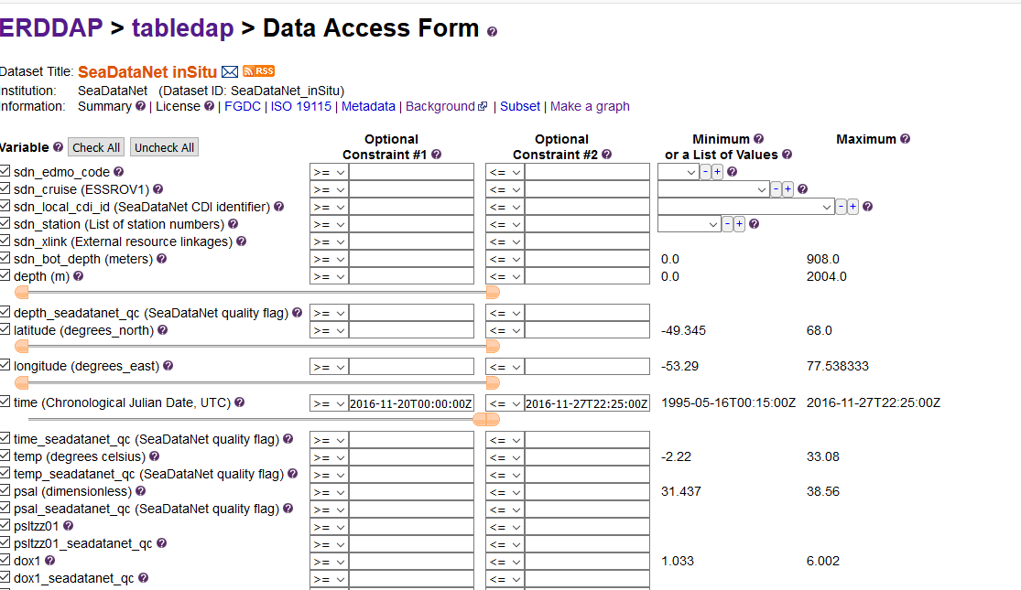
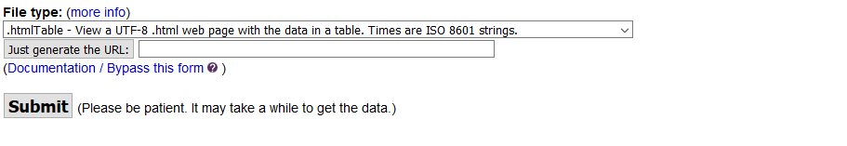
ERDDAP Sub-setting : data access form
…
Notes:
Example Dataset with 509 CDIs

Slide 9
ERDDAP Sub-setting : data access form (2)
P02 search : Improvement of ERDDAP will be done in order to be able to make a request on a dataset and have the response including all variables that have certain PO2 values ➔ for example : select all temperature P01 codes in one request
This development is not yet available

Slide 10
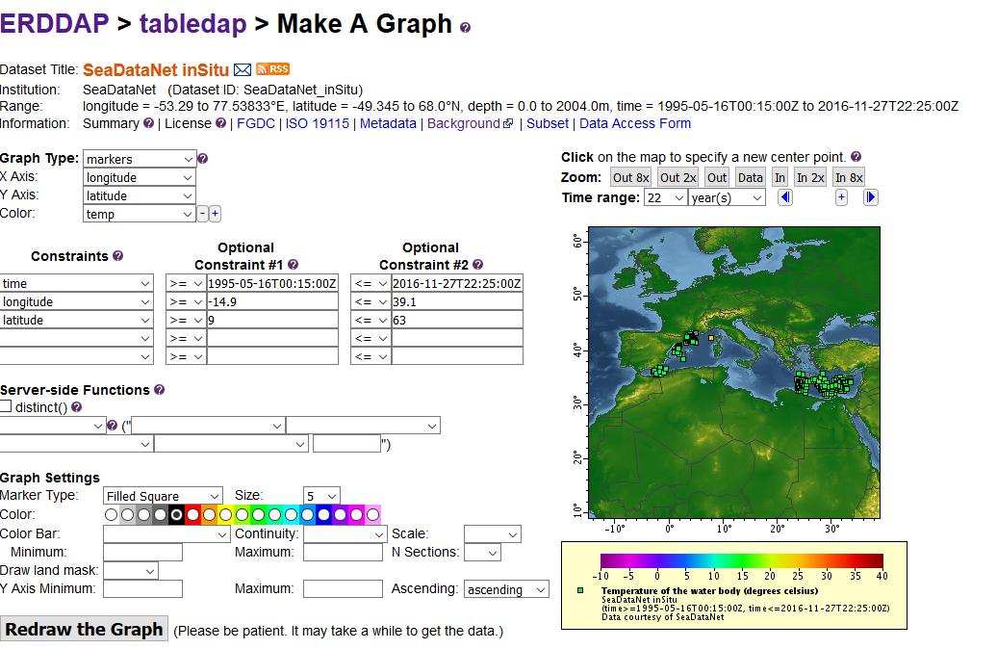
ERDDAP Sub-setting : graph view

Slide 11
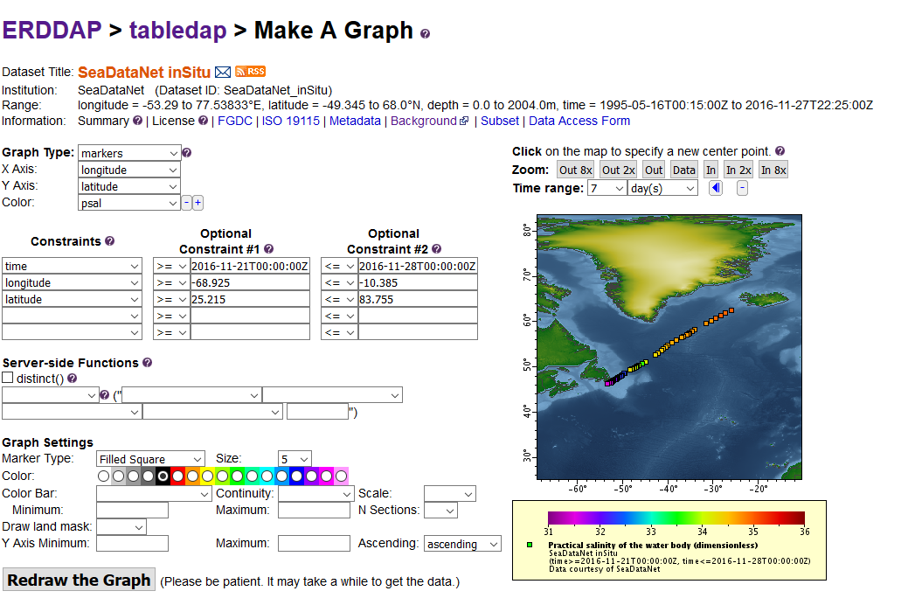
ERDDAP Sub-setting : graph view (2)

Slide 12
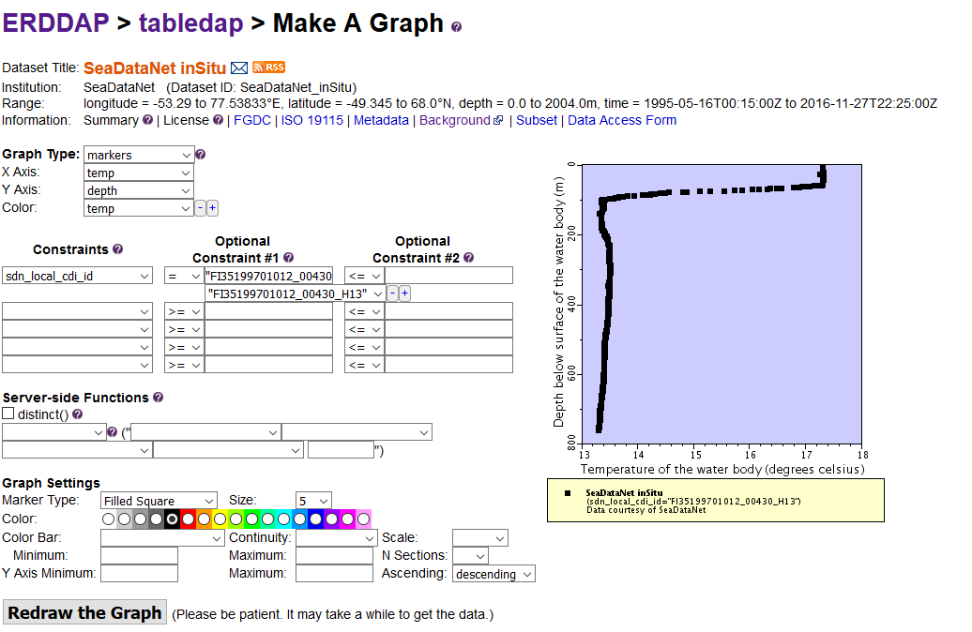
ERDDAP Sub-setting : graph view (3)

Slide 13
Configuration for SDN products
ERDDAP can also be used to give users access and visualisations of SeaDataNet products
  Climatologies (netcdf DIVA files)
  Aggregated data collections
    products will have to be splitted because of volume issue
    NetCDF export functionality offered by ODV software will have to be improved on variables names

Slide 14
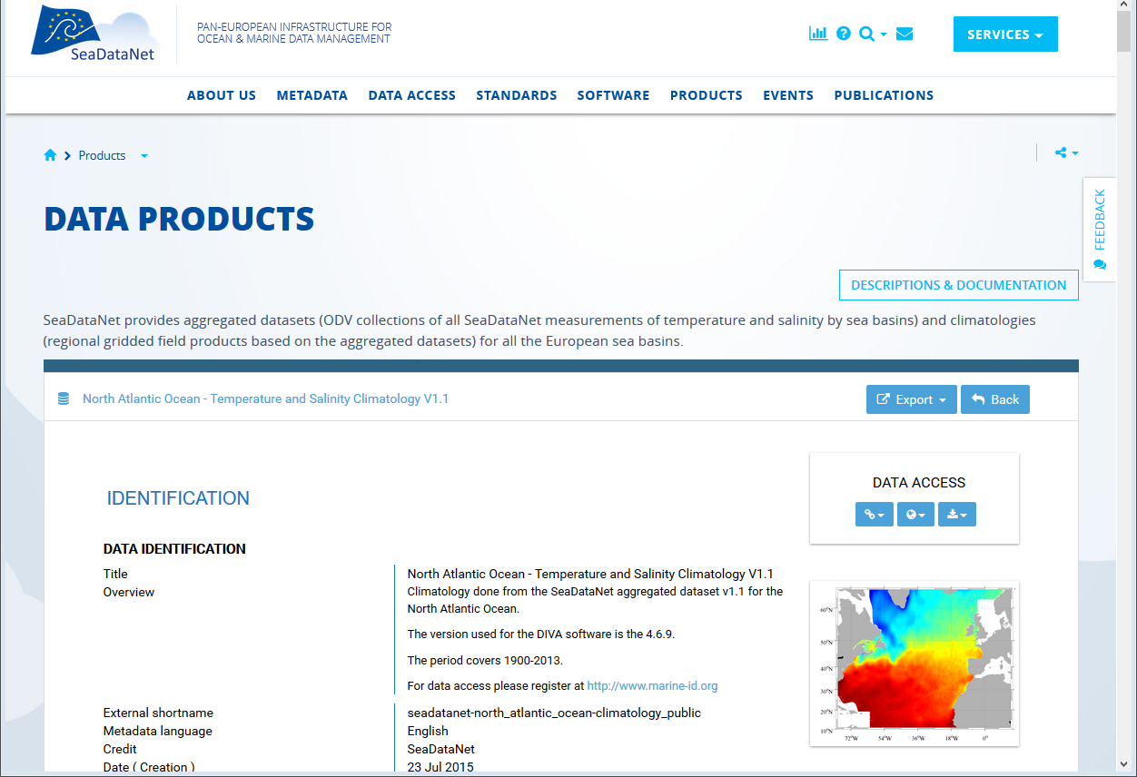
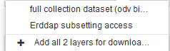

Slide 15
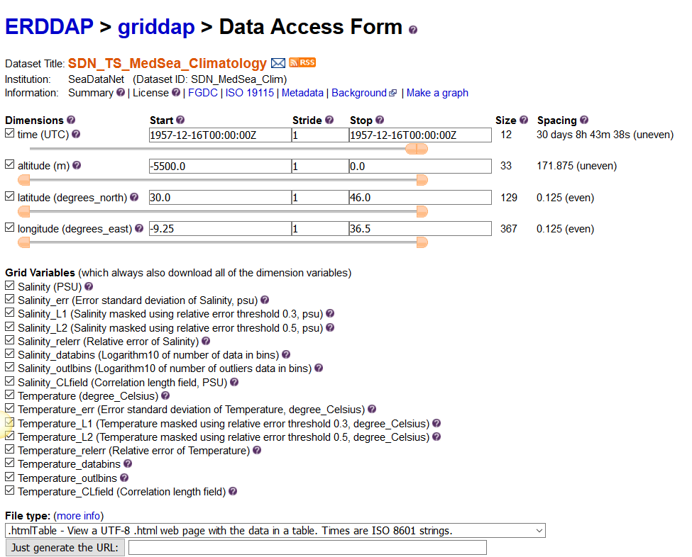

Slide 16
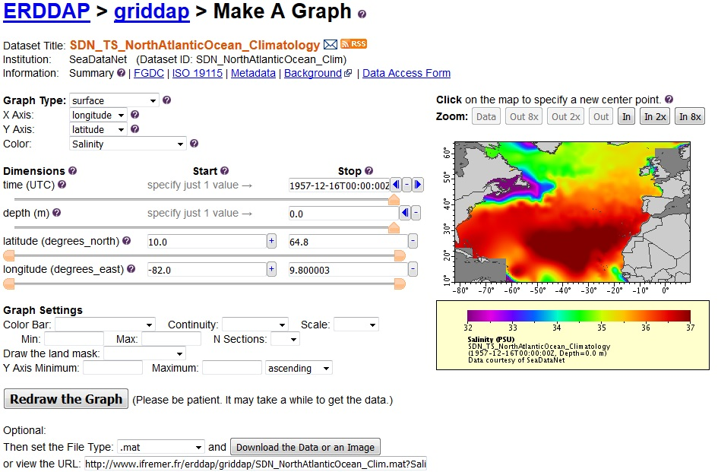
Notes:
Here is the Erddap interface for sub-setting by making graphs

Slide 17
Configuration for SDN products
Marine-ID authentication : A special instance of ERDDAP protected by Marine-ID authentication will be set up as soon as possible

Slide 18
RESTful services and JSON output
ERDDAP provides data access RESTful services: meaning the URL completely defines the data you want, in the format you want
And GeoJSON output: used for visualisation
➔ To quickly plug the provided data sources in a web portal implementing OpenLayers, leaflet or google map GIS layers…
Notes:
ERDDAP is designed to provide easier access to datasets for web services by using RESTful services and JSON output

Slide 19
Visualisation tool prototype
Example of a web application
using ERDDAP RESTful services based on JavaScript mapping library Leafletjs
and Highcharts to draw graphs with data from ERDDAP GeoJSON output

Slide 20
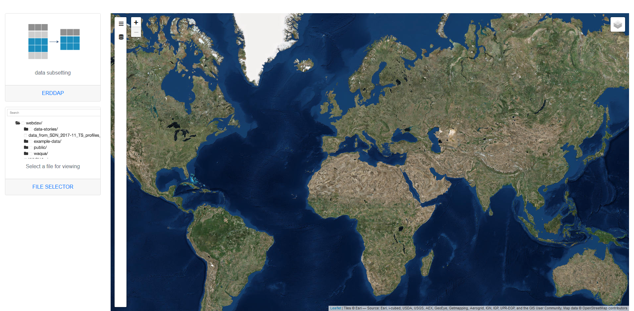
Visualisation tool linked to ERDDAP
Notes:
https://www.ifremer.fr/isi/sdc-subset-ifr/

Slide 21
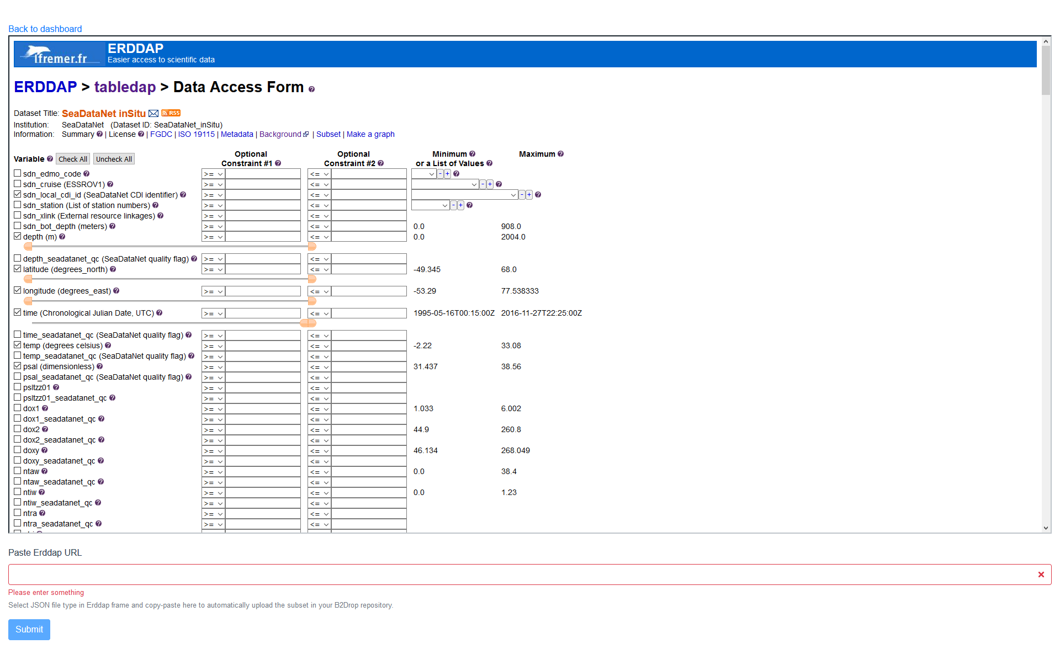
1 - Select the options of your sub-setting
Metadata:
LOCAL_CDI_ID
DEPTH or PRES
Latitude
Longitude
Time
are mandatory

Slide 22
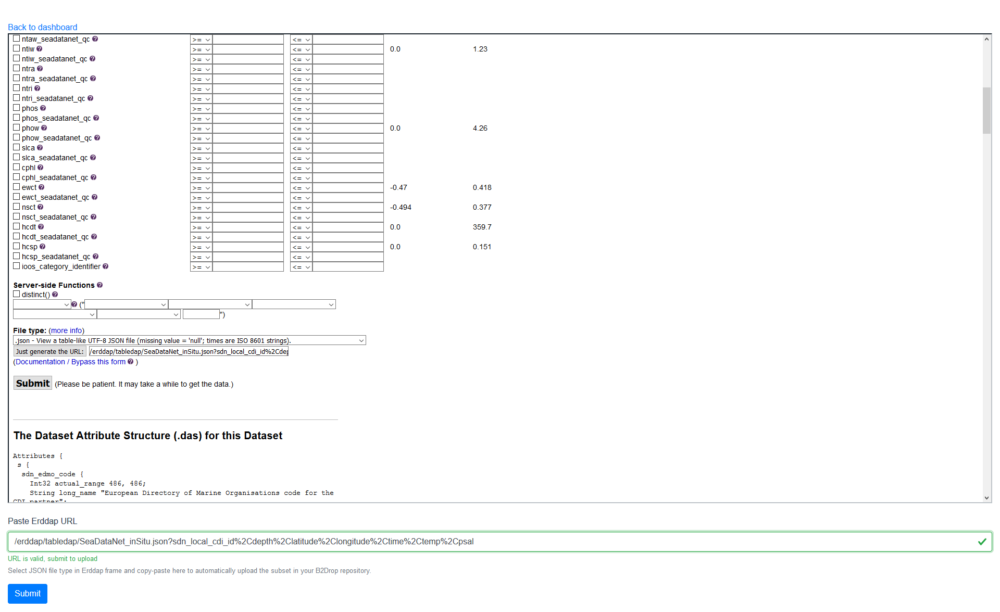
2 – Select the JSON output format and generate the ERDDAP URL corresponding to your sub-setting
3 – copy the URL in the field
4 – Submit it to the visualisation tool

Slide 23
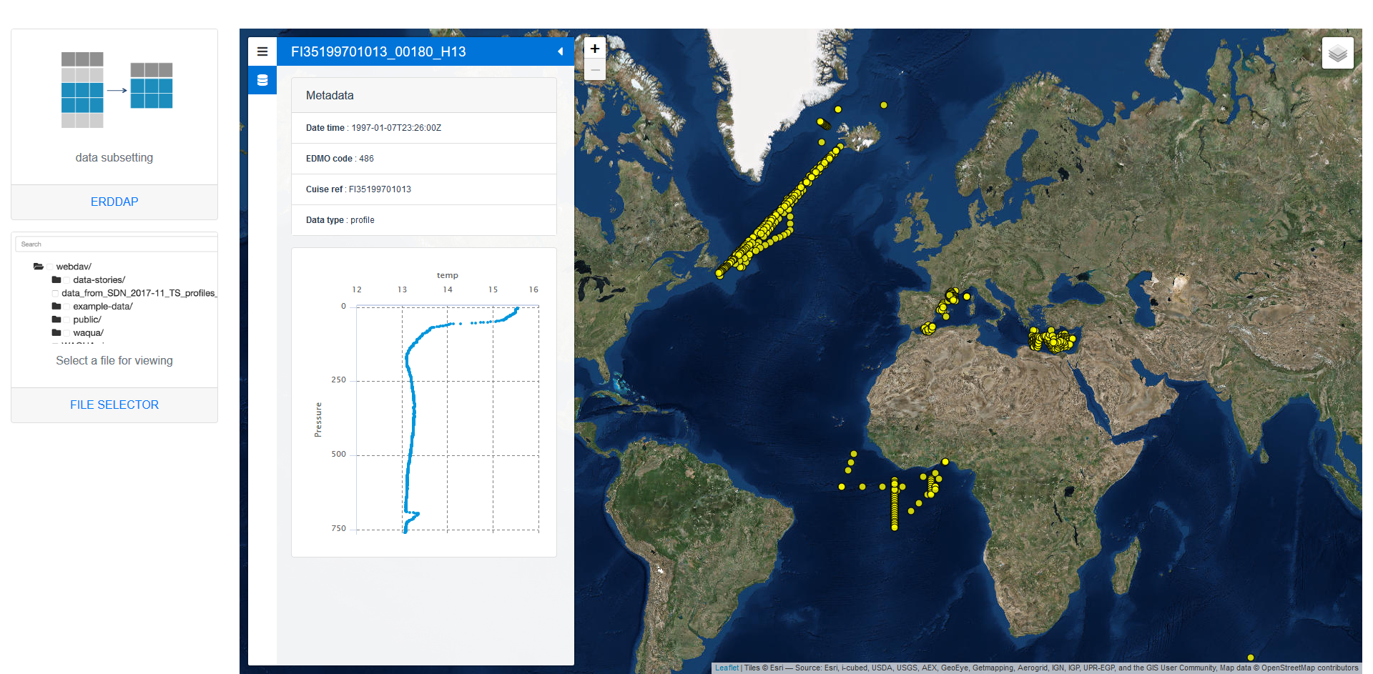
Sub-setting plotted in the visualisation tool
Visualisation of the profiles of one LOCAL-CDI-ID

Slide 24
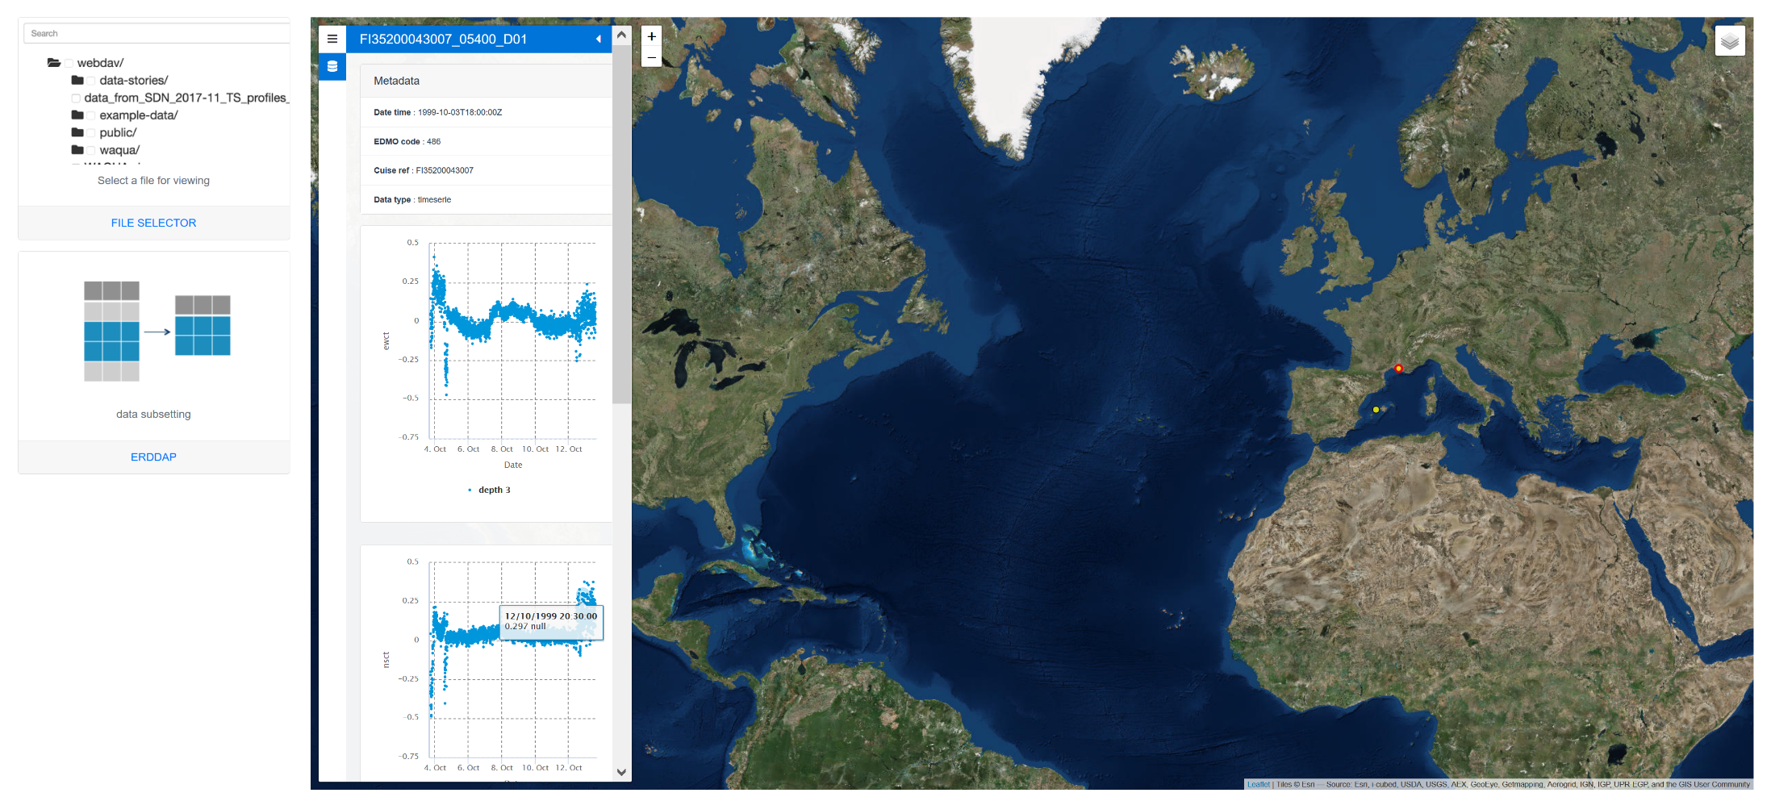
Sub-setting plotted in the visualisation tool
Visualisation of the timeseries of one LOCAL-CDI-ID

Slide 25
To come: the possibility to plug ERDDAP on a SDN dataset saved in the VRE workspace of the user and make a corresponding configuration file for ERDDAP

Slide 26
Hands-on in the VRE
Test some ERDDAP functions on the example dataset of NetCDF SeaDataNet files
  508 LOCAL_CDI_ID
    Tide Gauge
    Current meters
    XBTs
    Thermosalinograph
    Bottle
Click on ERDDAP in the VRE

Slide 27
Thank you for your attention

