Slide 1


CDI HTTP-API environments at EUDAT

Slide 2

EUDAT CDI
SeaDataCloud HTTP APIs are part of the EUDAT Collaborative Data Infrastructure (CDI)
EUDAT CDI is a network of nodes that provide a range of services for data upload, retrieval, identification, replication. The nodes are essentially data centers

Slide 3
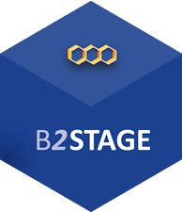
B2STAGE
One of the core services of the EUDAT Data Infrastructure
Offers functionalities for eary data transfer
  between EUDAT resources and external facilities
Built to extend iRODS, the core data technology of the EUDAT infrastructure
Implements an extensible RESTful HTTP interface

Slide 4


EUDAT Services
Data identification
(PIDs)
SDC HTTP APIs
Data transfer
Data storage

Slide 5
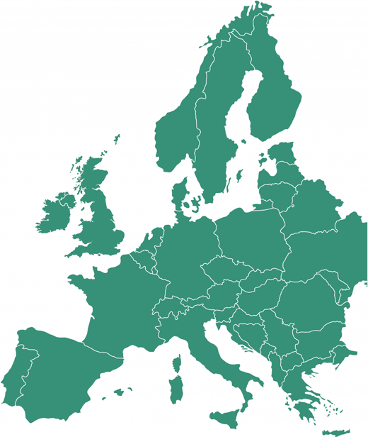





The EUDAT Team

Slide 6
Service infrastructure based on several components
  HTTP APIs (B2STAGE + custom SDC functionalities)
          Data transfer functionalities and interface of all other services
  iRODS (B2SAFE)
          Data storage (replicated among all involved centers)
  Persistent Identifiers (PIDs, B2HANDLE)
          Data identification
  Celery
          Asynchronous operations (e.g. data ingestion and data harvesting)
  Rancher & Docker
          Execution of quality checks
  RabbitMQ
          Centralized logging archive

Slide 7



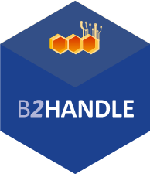
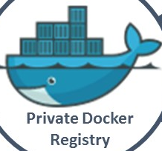
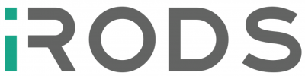
SDC HTTP API Architecture
NGINX PROXY
HTTP APIs
Quality checks
Sessions DB
Shared Filesystem
NFS
CELERY
PIDs Cache
RabbitMQ + MongoDB

Slide 8

Three different environments
  Development (DEV) environment
  Test environment
  Production (PROD) environment

Slide 9
DEVELOPMENT environment
  Deployment of latest development version
  Potentially untested/untrusted functiontalities
  Only accessible to other developers (EUDAT, MARIS, IFREMER)
  Temporary data
  Currently installed at CINECA

Slide 10
TEST environment
  Deployment of latest stable version
  Working functionalities
  Accessible to all SDC partners
  Temporary data
  Currently installed at CSC

Slide 11
PRODUCTION environment
  Deployment of latest stable version
  Fully working functiontalities
  Accessible to all SDC partners
  Production data
  Currently installed at CSC

Slide 12
CSC TEST
CSC PROD
NGINX PROXY
LOGS
NGINX PROXY
HTTP APIs
HTTP APIs
Session DB
Session DB
Quality checks
Quality checks
Shared Filesystem
Shared Filesystem
PID Cache
PID Cache
CELERY
CELERY
RabbitMQ + MongoDB
RabbitMQ + MongoDB
TEST
PARTITION
PROD
PARTITION

Slide 13
Next step – deployment on all 5 centers
PROD
TEST
PROD
TEST
DEV
PROD
TEST
PROD
TEST
PROD
TEST

Slide 14
Extended data ingestion workflow: data replication
Data Replication

Slide 15

Extended data harvesting workflow
Proxy

Slide 16
Monitoring

Slide 17

Monitoring SDC
Users / Researchers all around the world have access to SDC services.

Slide 18
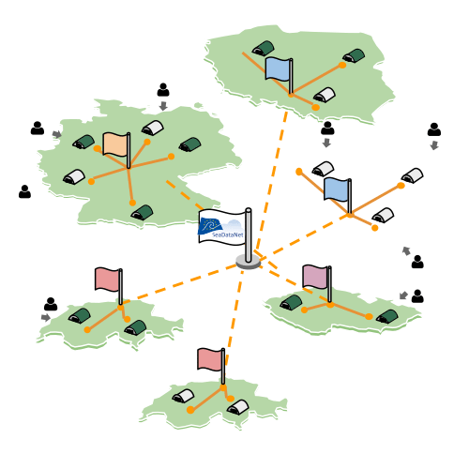
Monitoring SDC
Users / Researchers all around the world have access to SDC services.
Most of the services are up but..

Slide 19
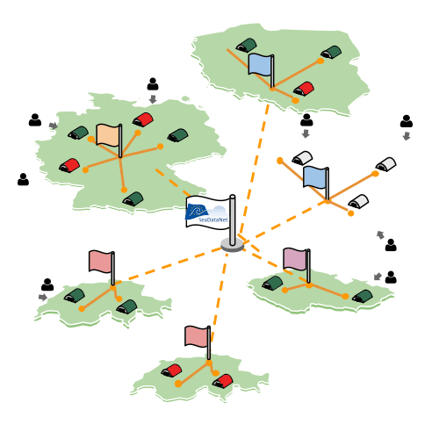



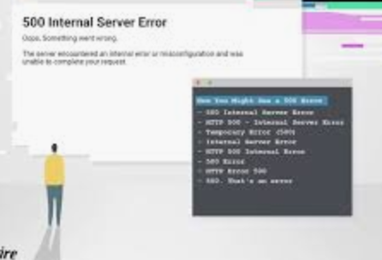

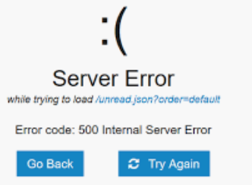

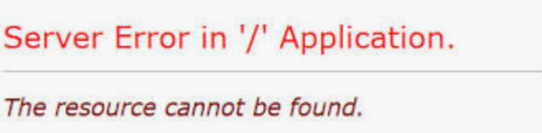
Monitoring SDC
Users / Researchers all around the world have access to SDC services.
Most of the services are up but..
Sometimes everything looks OK until the user starts complaining.

Slide 20
Monitoring SDC
Users / Researchers all around the world have access to SDC services.
Most of the services are up but..
Sometimes everything looks OK until the user starts complaining.
The problem
Service remains unavailable longer than expected.

Slide 21
Monitoring SDC
Users / Researchers all around the world have access to SDC services.
Most of the services are up but..
Sometimes everything looks OK until the user starts complaining.
Solution
Monitor
Analyse
Report
Alert

Slide 22
Monitoring SDC
Monitor
Analyse
Alert
Report
What ARGO is trying to do is to emulate the user behaviour and constantly monitor the Services to provide:
  - Real time status reports
  - Availability and reliability reports
  - Real time alerts

Slide 23
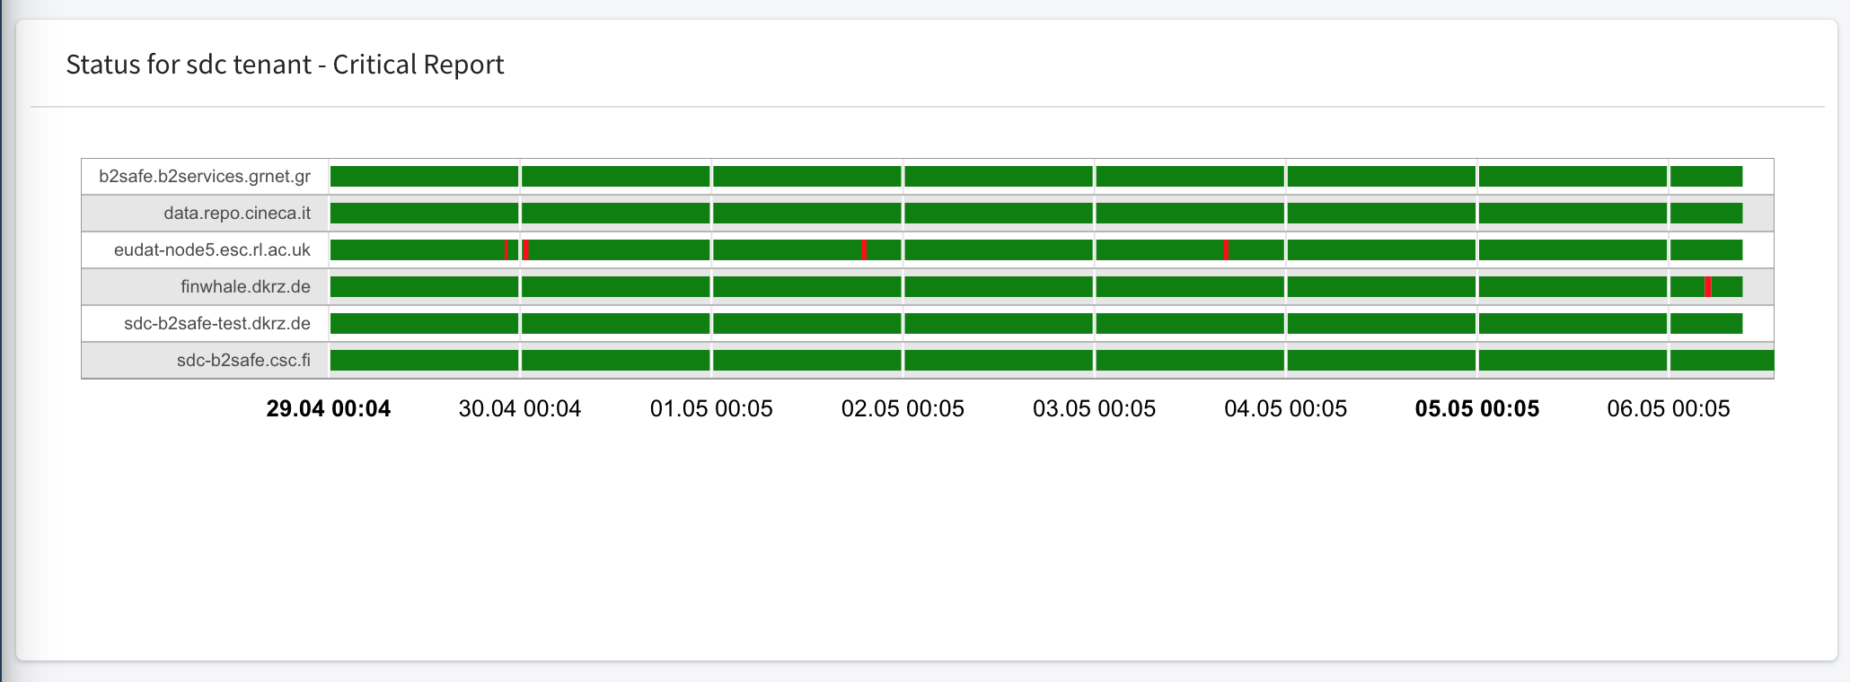
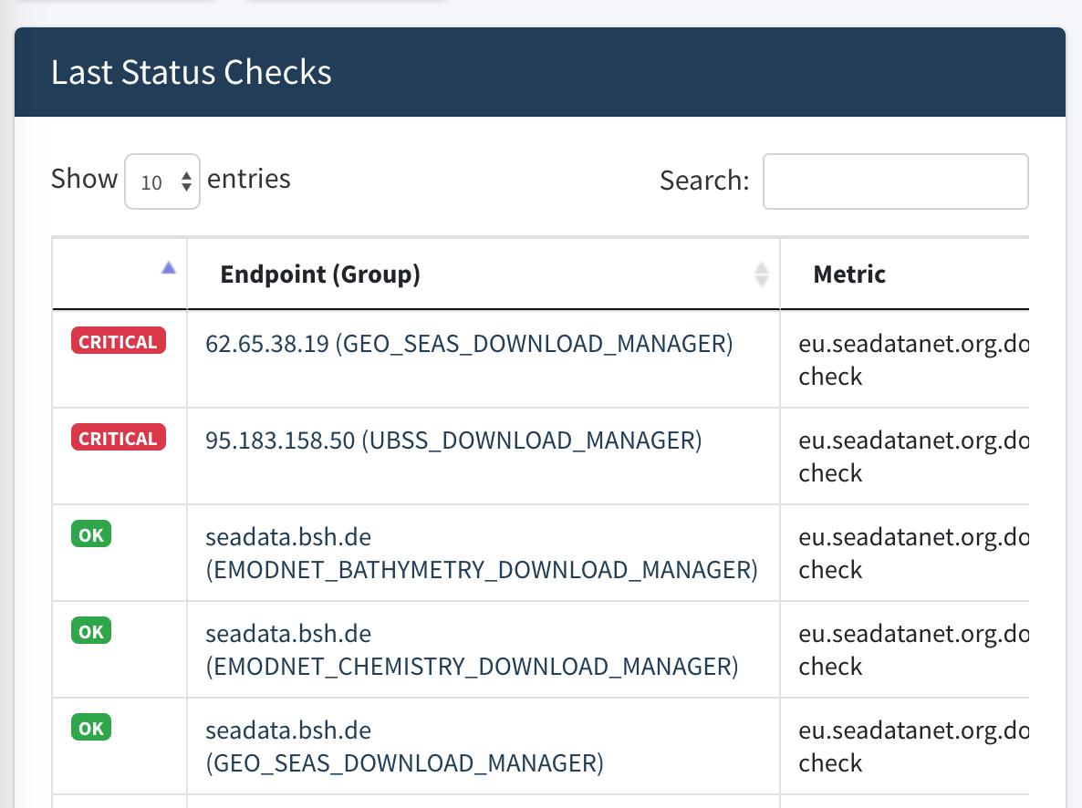
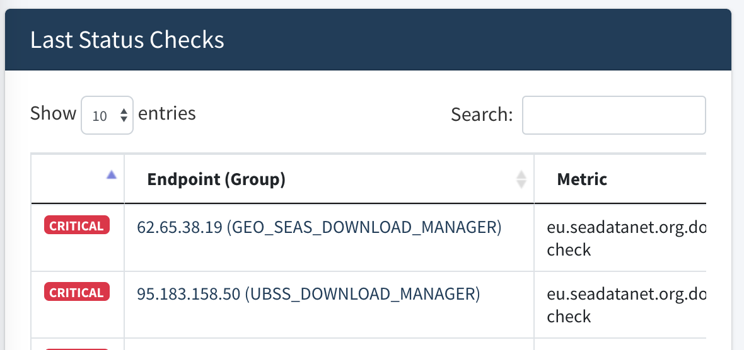
Real Time Status Report

Slide 24
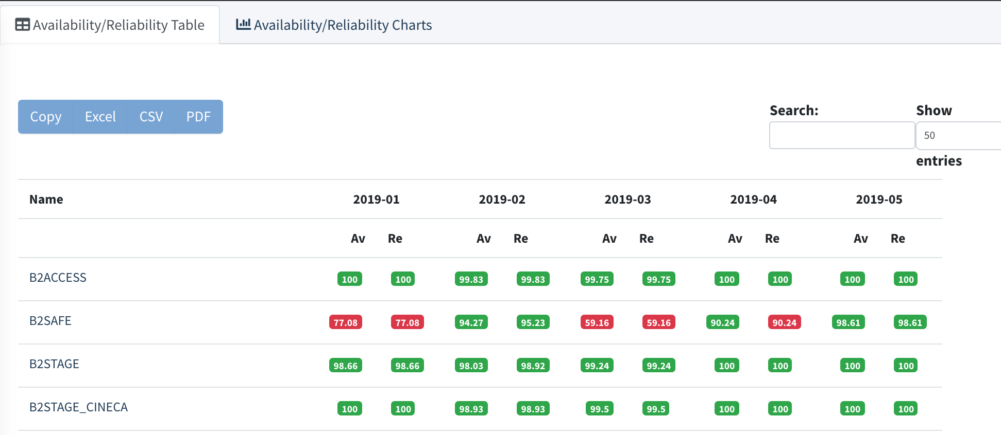
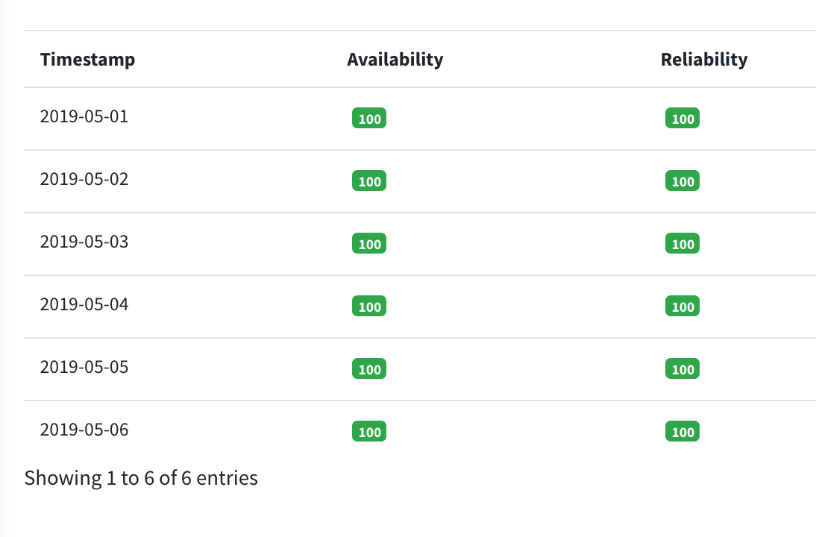
Availability / Reliability Report

Slide 25
Availability / Reliability Report

Slide 26
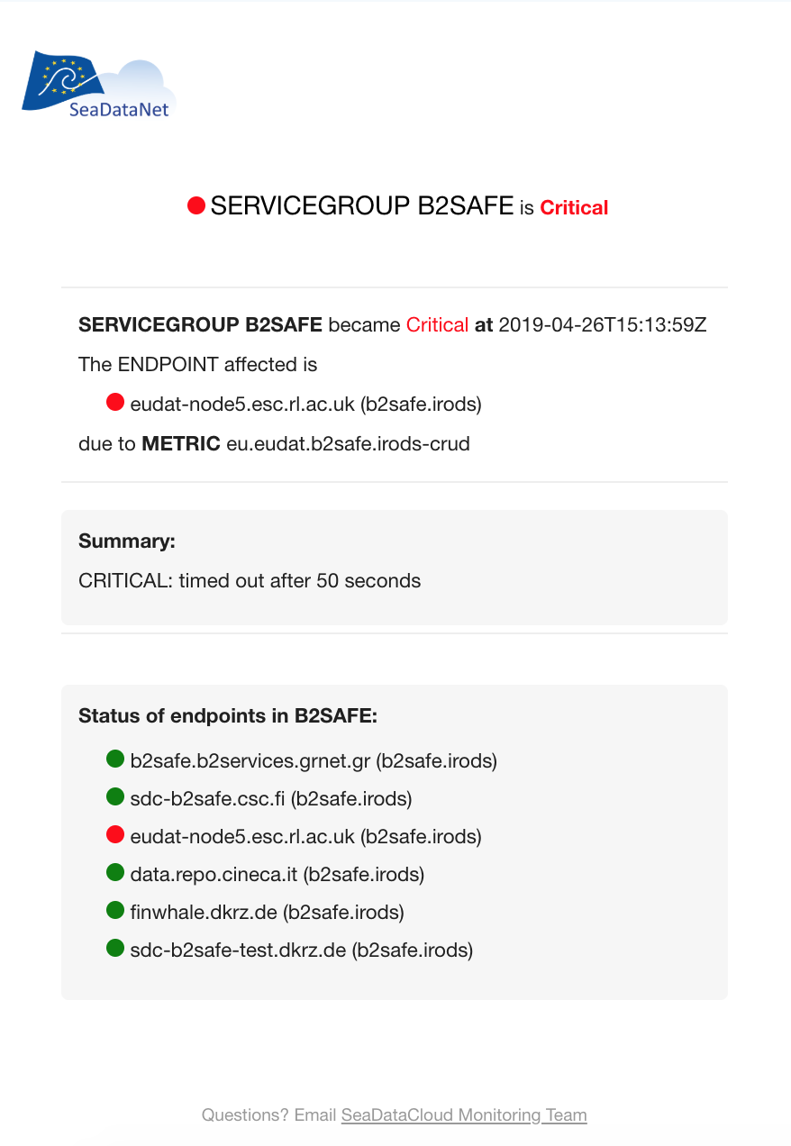
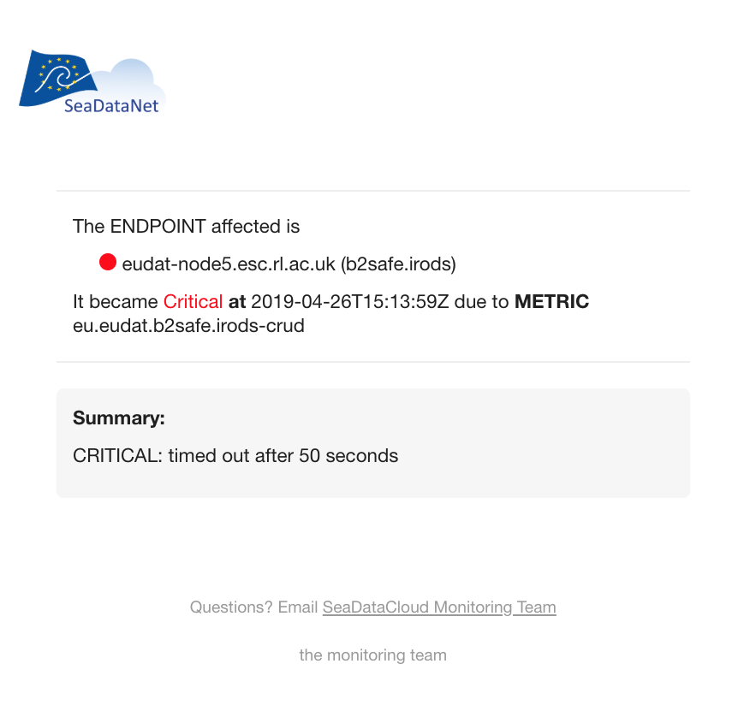
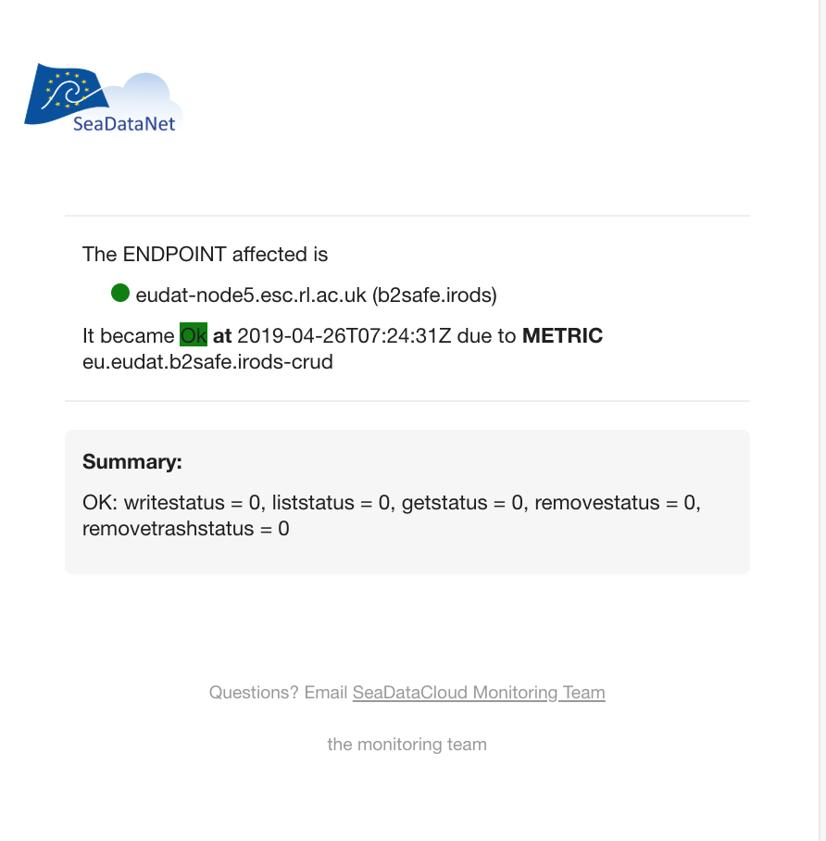
Alerts

Slide 27
Thank you for your attention!

