Slide 1
CDI DEMO user interface: Test version of the new CDI service
Peter Thijsse (MARIS), on behalf of WP9 team

Slide 2
A new GUI on top of a new system
Faster => Elastic search, and quicker delivery
Easier => faster to data
Inviting => Catchy design with large map
And more added value for users: MySeaDataCloud

Slide 3
Part 1: Demonstration

Slide 4
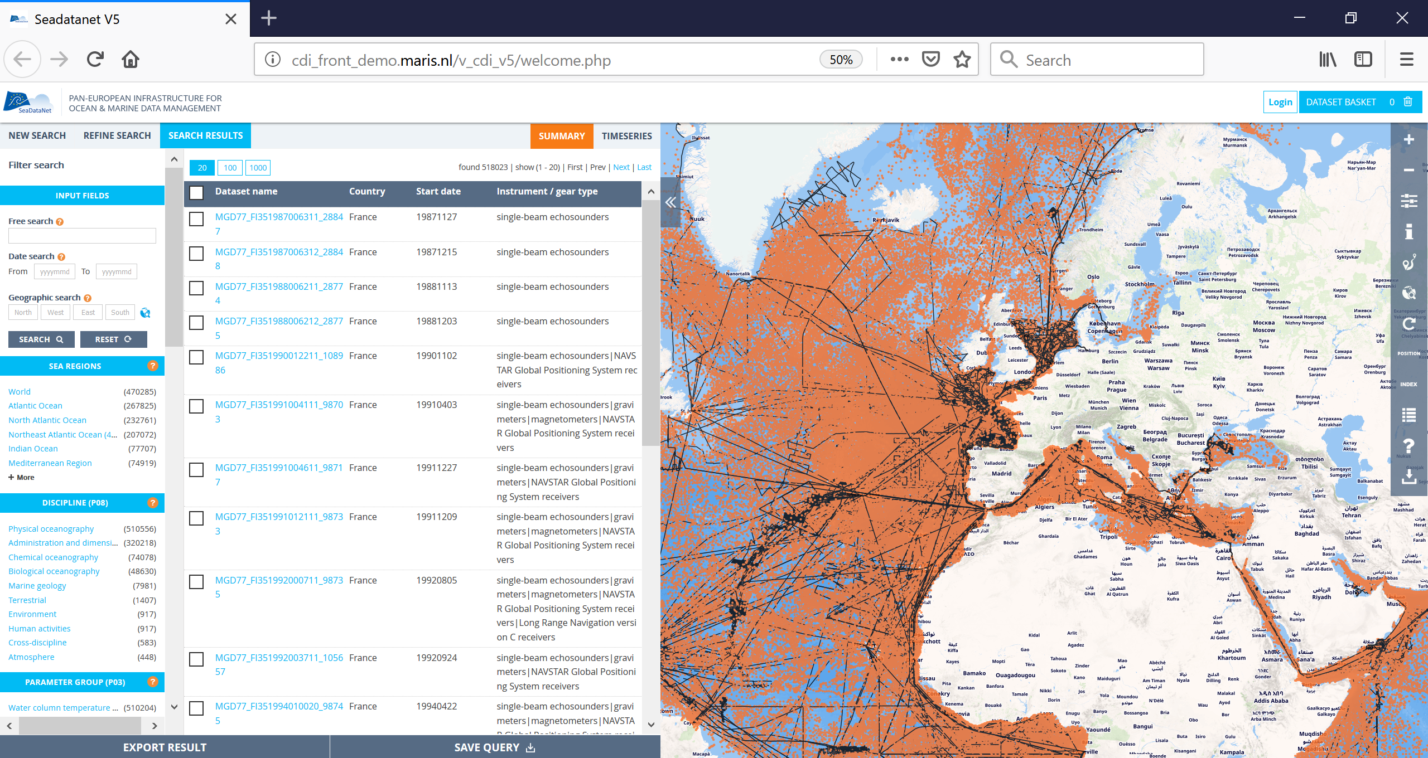
Demo of the new interface

Slide 5
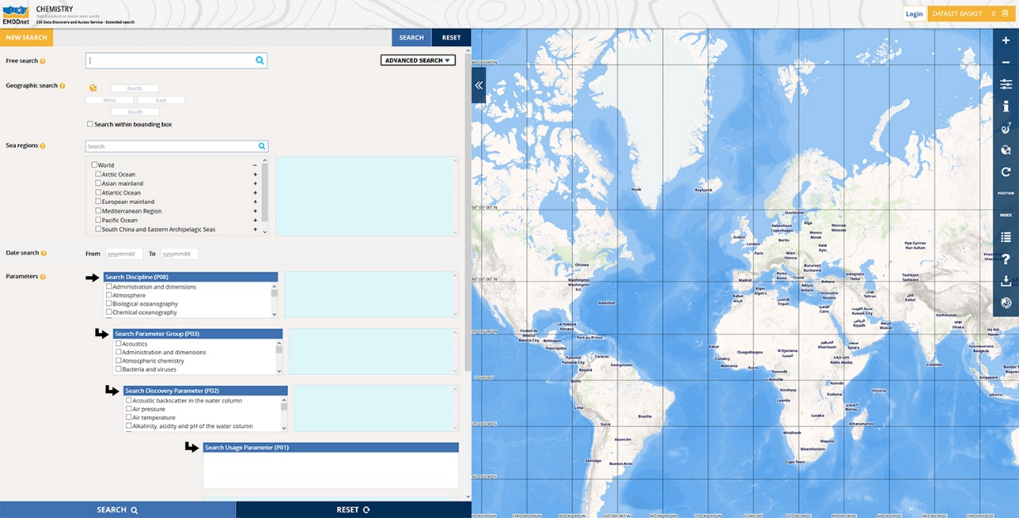
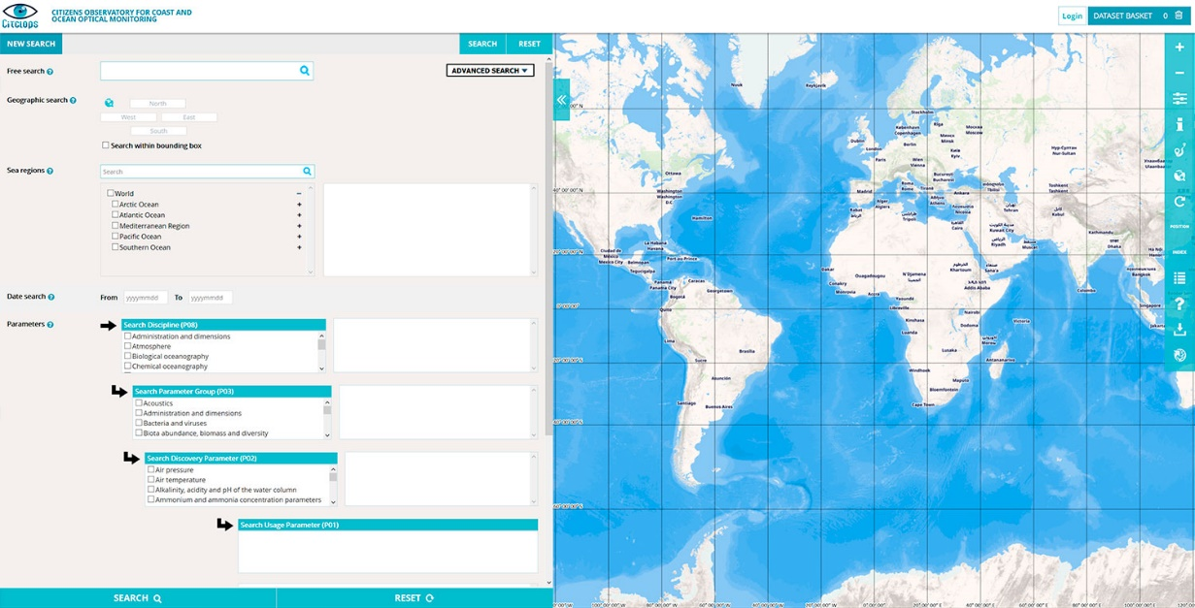
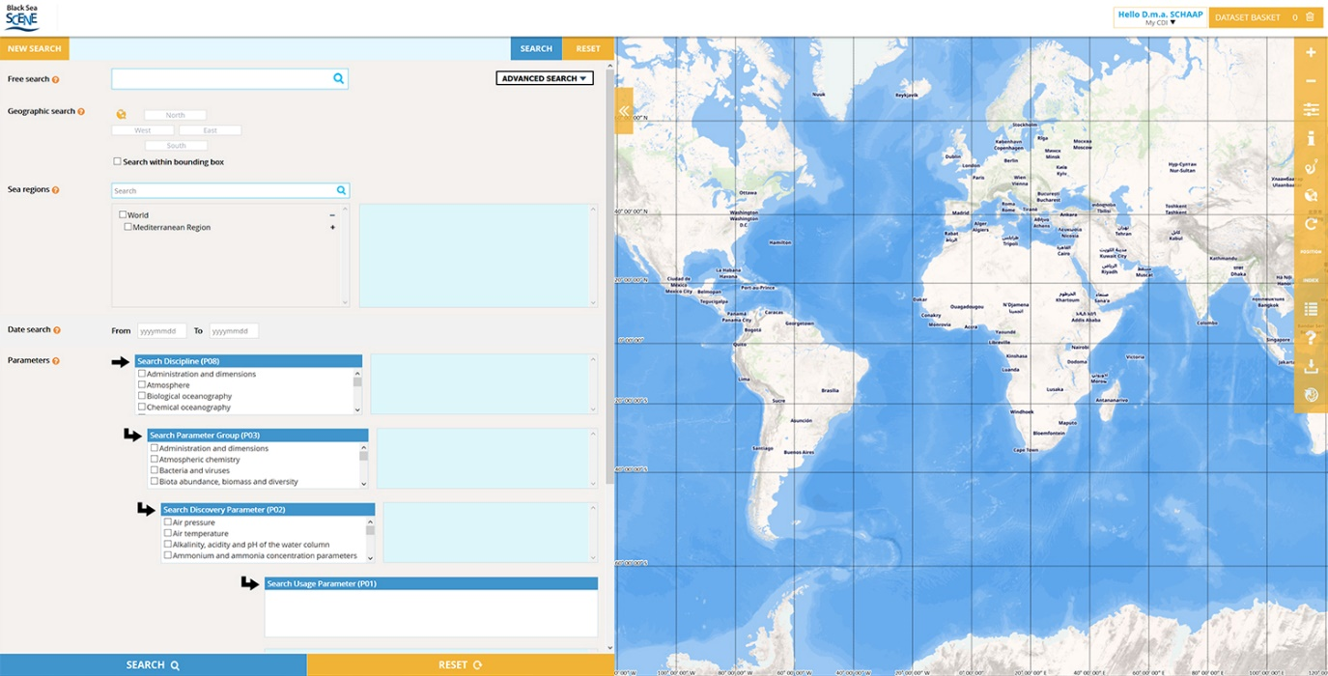
Different flavours

Slide 6
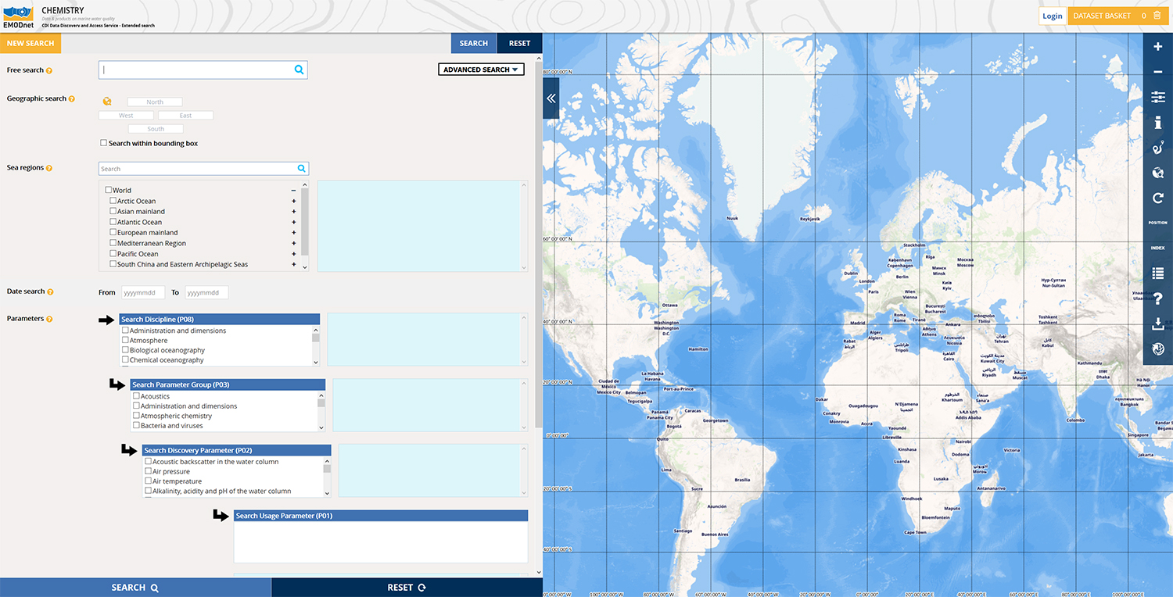
Search

Slide 7
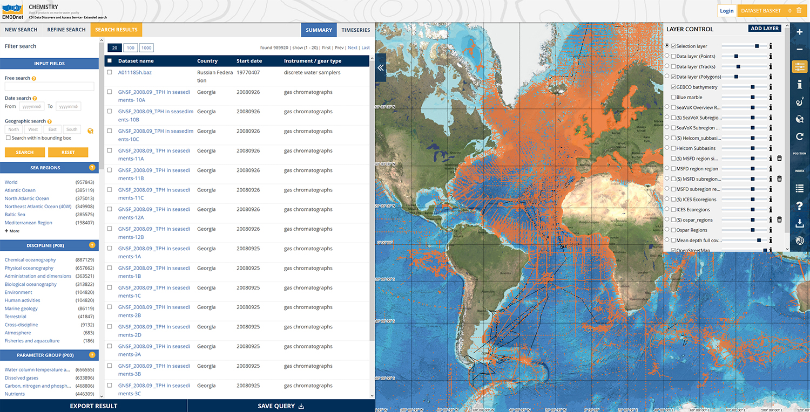
Browse

Slide 8
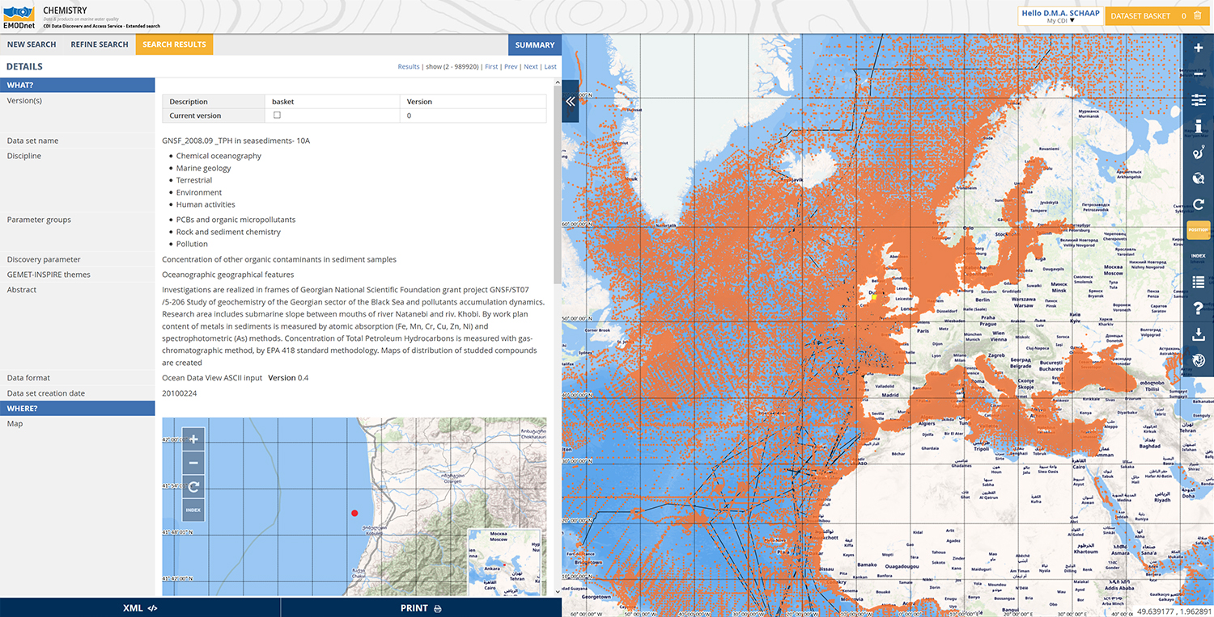
Details

Slide 9
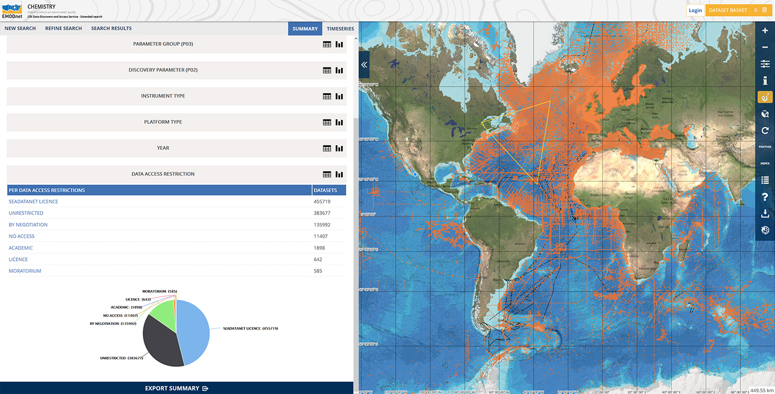
View summary of results

Slide 10
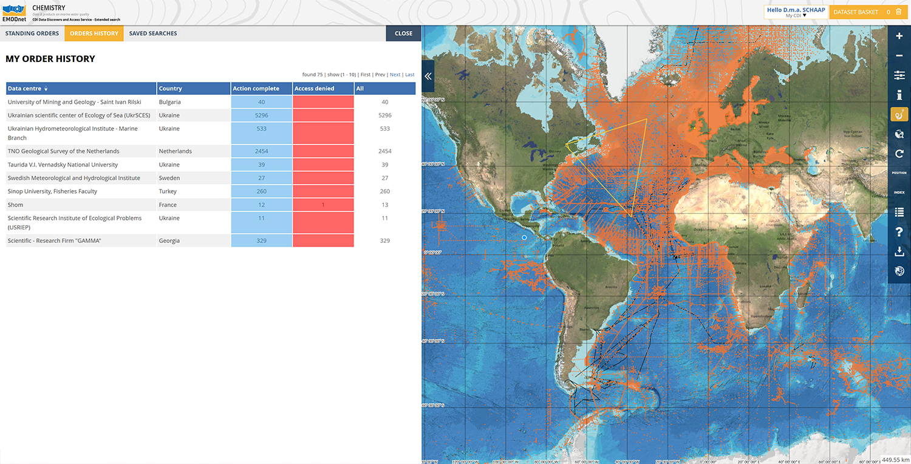
Order

Slide 11
Part 2: Usability testing

Slide 12
Please go to:
Updated version after last years feedback, great!
Go to: http://sdc.maris.nl – click first link
We look forward to your feedback (again)

Slide 13
Some example how to search
Login (or create Marine-ID first)
Free search: nitrate
Use a facet: e.g. Select an area
Set the results to 20/100/1000
Order
Go to the basket and follow the steps
Submit
Go to your orders to download (takes some mins)

Slide 14
Part 3: Provide us your feedback

Slide 15
Use our online from
Go to: http://sdc.maris.nl
Follow link on the right
Provide us any bugs, suggestions, and wishes

