Slide 1
CDI Replication: The new ingestion process
Peter Thijsse, Bert Broeren, Dick Schaap, Mattia D’Antonio, Merret Buurman, Jani Heikkinen, and others

Slide 2
The data ingestion (to the cloud)
Demonstration of process, live and via screens

Slide 3
Main components
Replication manager
Import manager
EUDATs HTTP API
B2SAFE (Cloud storage)

Slide 4
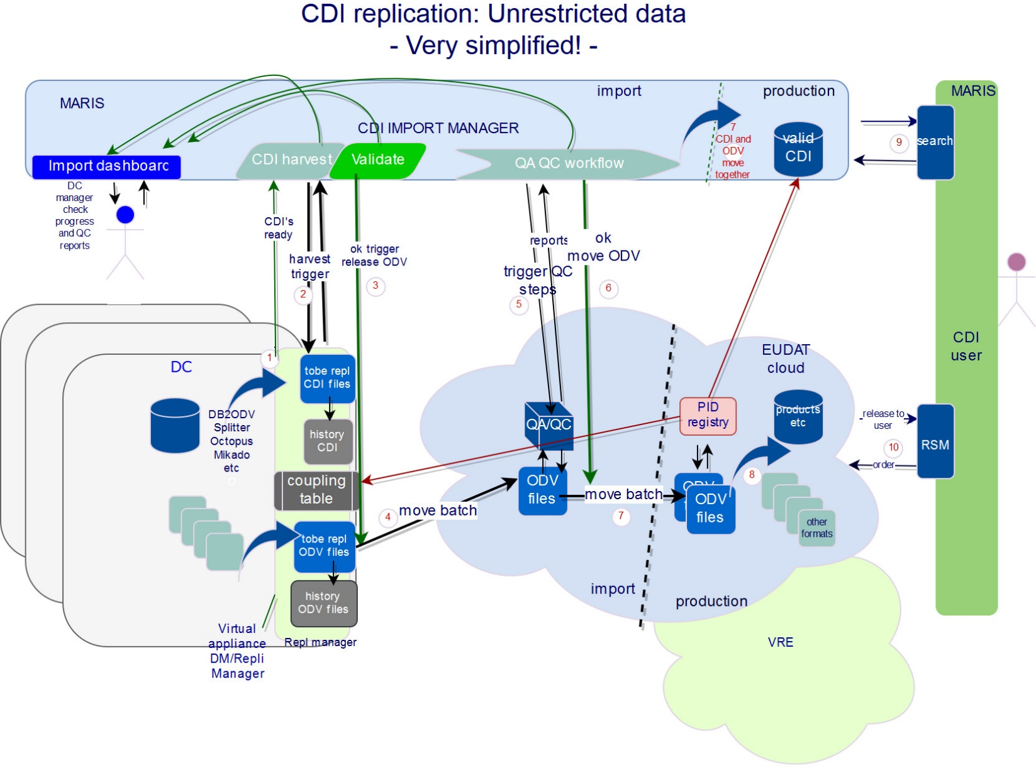
Overview unrestricted dataflow

Slide 5
Remarks unrestricted
The main solution is designed for Unrestricted (UN/LS) data where the process of QA/QC and file format conversions in the cloud are involved.
Important steps:
The CDI import manager is guiding the process of CDI and ODV release and QA/QC towards production.
At data center there is production of CDI and ODV (or one other accepted exchange data format) using the stack of tools produced at IFREMER: DB2ODV, Splitter, Mikado, Octopus etc.
Replication Manager at the Data Center is triggered by import manager to:
  Move a batch of CDI files to CDI central server
  Follow up requests to move a batch of ODV files triggered by import manager. One batch at a time handled by the system.
After moving a batch it is archived by the RM (history of full situation).
The EUDAT cloud consists of a area for Import and an area of Production. During import QA/QC processes will be triggered by the CDI import manager after which reports flow back. After an ok the datasets will be made available in production. Again moved after a trigger from the import manager.
When a dataset moves to production the PID is reported back to import manager and DC (coupling table)
The DC data manager (and masters) can follow progress and if necessary take actions to get to a next stage, or e.g. discard the set and release a new updated batch.

Slide 6
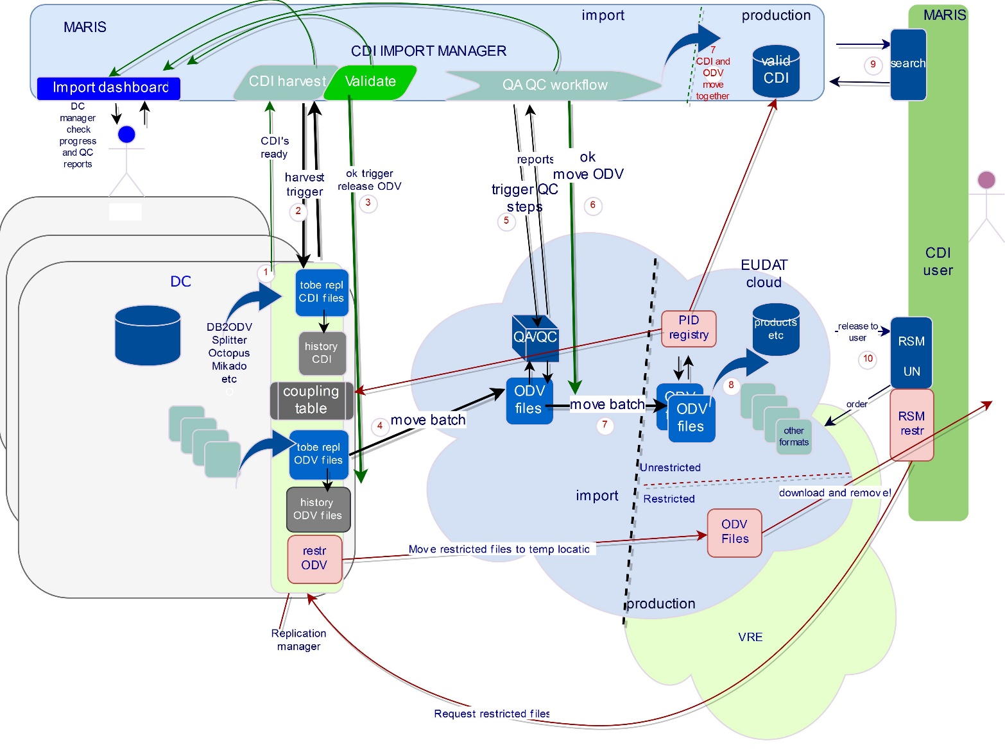
Overview restricted dataflow

Slide 7
Remarks restricted
Replication Manager at the Data Center is for restricted data triggered by RSM to:
  Follow up requests for releasing and moving a set of restricted data
    Only when allowed by the DC via confirmation in the RSM
    Directly to a “user section” in a restricted part of the cloud where it will be available to the user to download it for limited time.
    After download it will be removed.
Replication of RS data is a sensitive step:
  Trust is needed from the DC in the secure part of the cloud to temporarily store the data
  But, working with the same “trigger and move” process/protocols for each release of data makes it simpler
  The set will be removed in the cloud once downloaded, so it is ready for the next batch.

Slide 8
Main steps in the unrestricted data ingestion process
Publishing metadata
Checking metadata
Publishing databatch (download by cloud)
Unzip and run data checks
Move validated metadata and data in production

Slide 9
Step 1: Publishing the CDI metadata
The problem
  RM needs to notify the Import Manager a new batch is ready (RM)
  IM will download when ready
The solution
DC manager puts one or more batches in publish-directory
RM triggers
IM downloads the CDI metadata batch
One batch at a time in the process

Slide 10
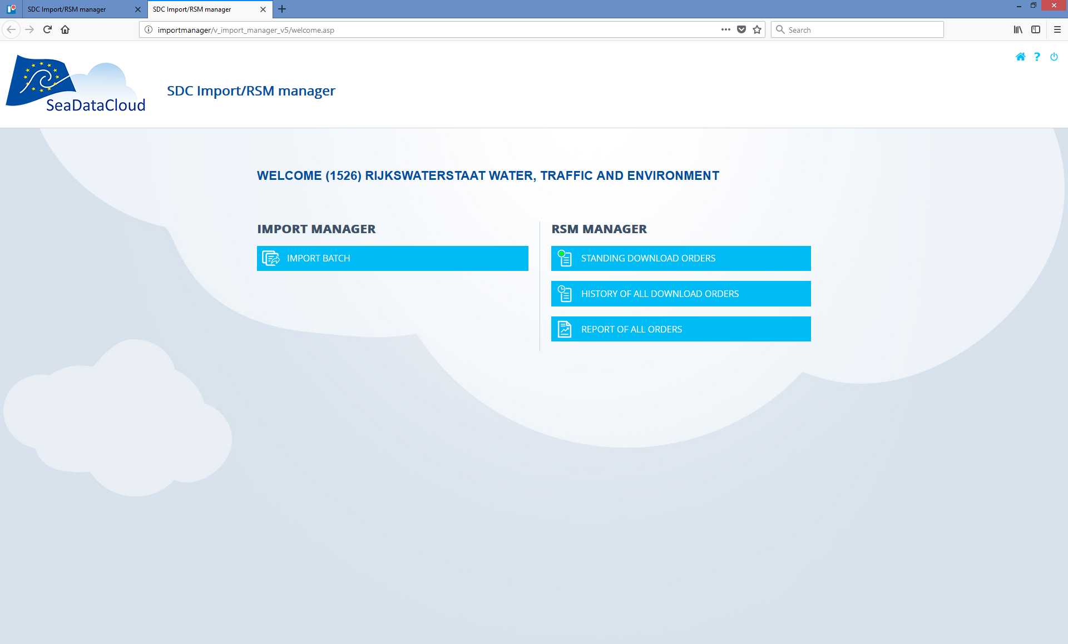
Login to the Import Manager for process overview
Notes:
IM: http://importmanager.seadatanet.org/v_import_manager_v5_test/welcome.asp
RM MARIS: http://83.163.127.252:8080/ReplicationManager-rws-test/

Slide 11
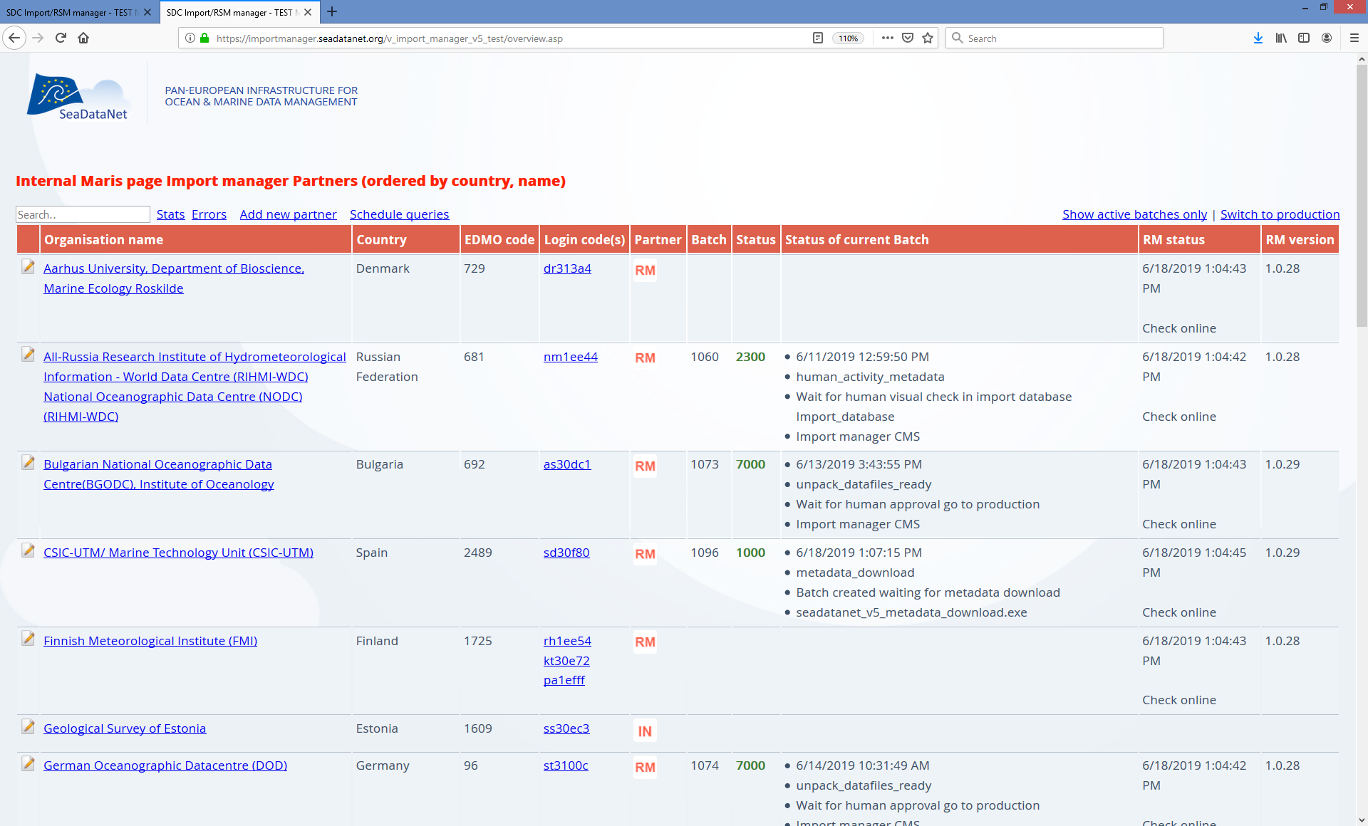
MARIS master overview of all RM’s

Slide 12
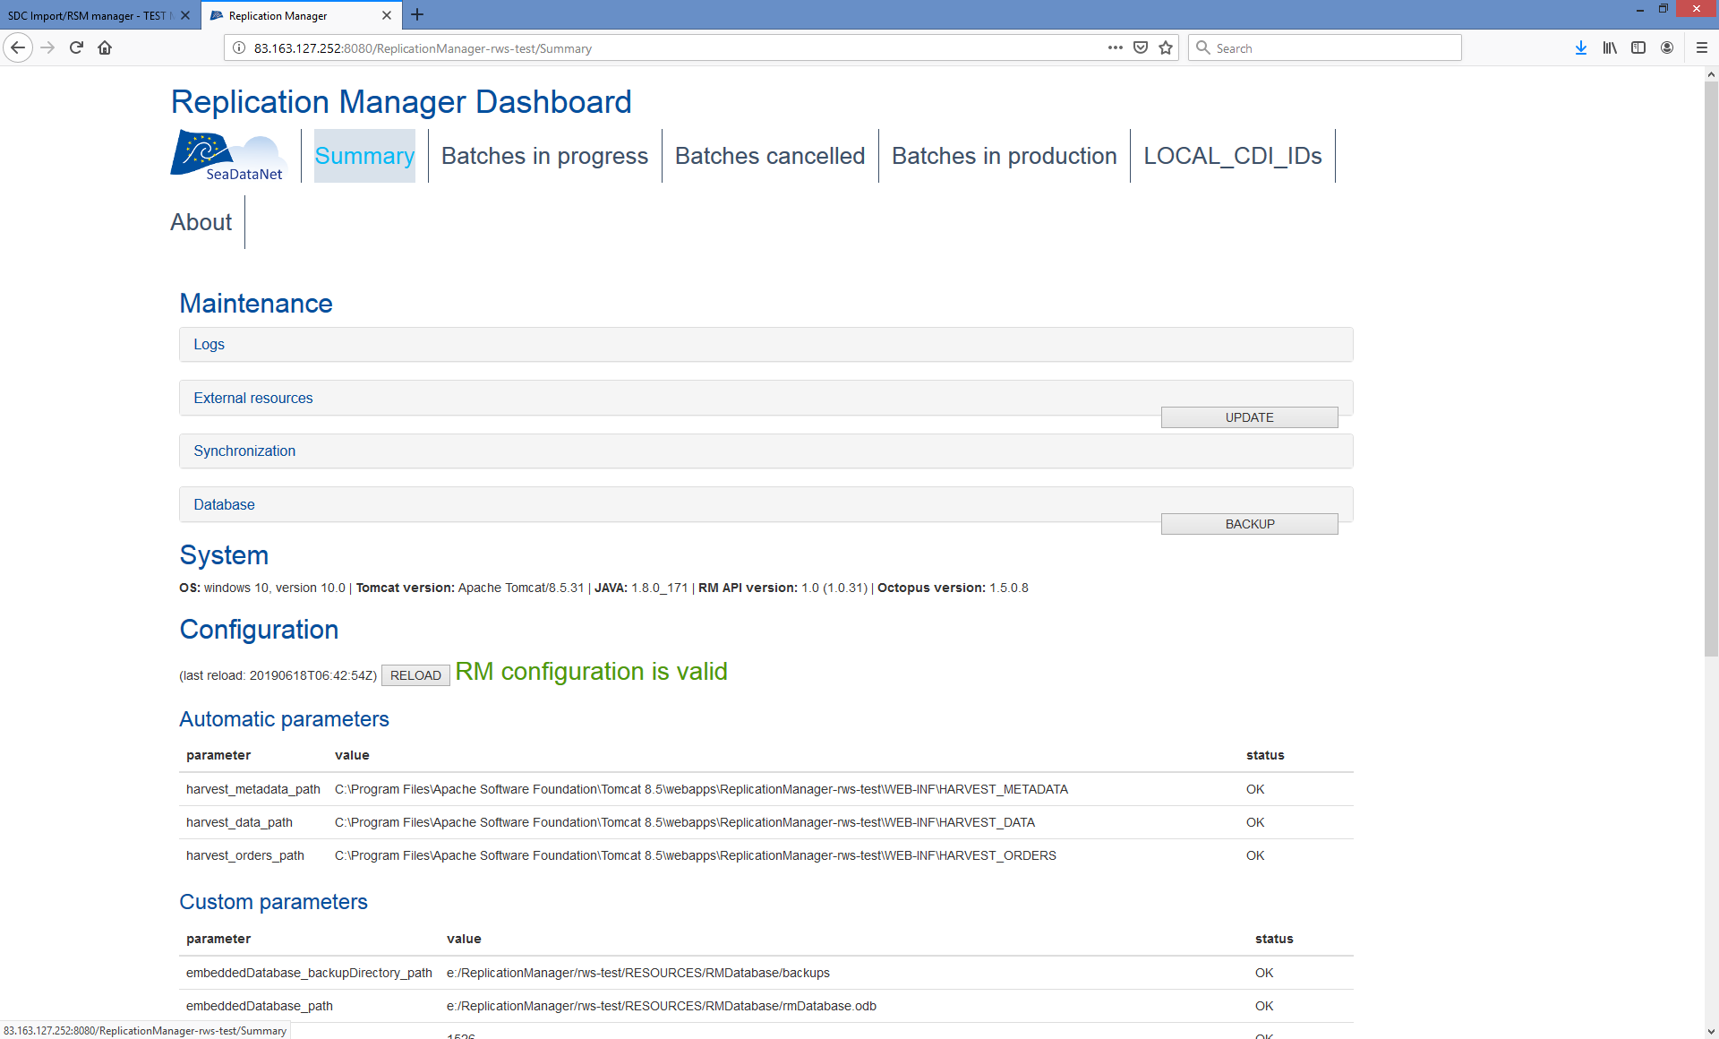
View of RM dashboard in Test

Slide 13
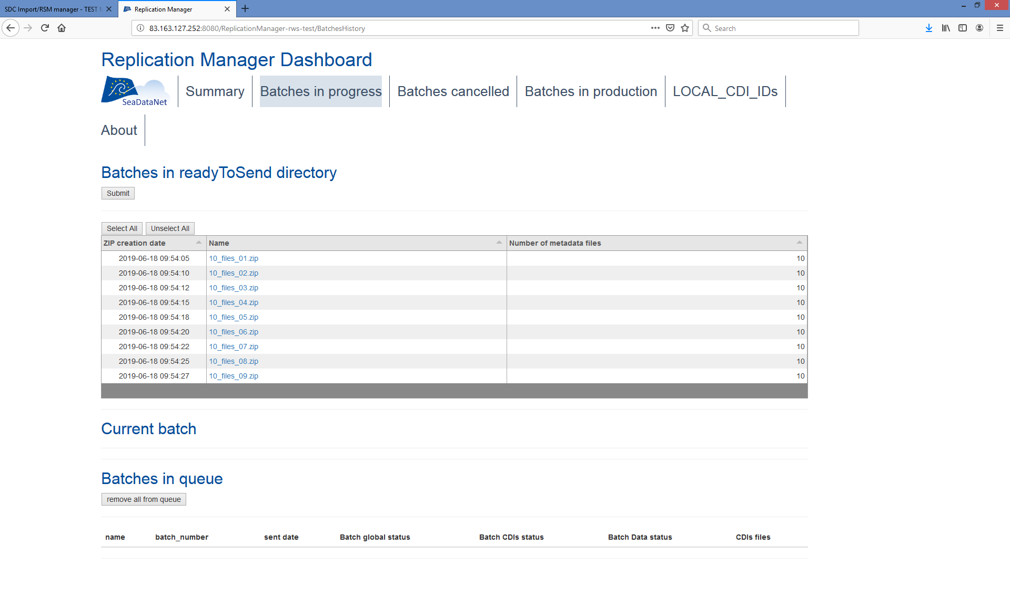
RM: Go to “batches in progress” to select batch
If you place batch in queue the CDI’s, and ODV’s are checked

Slide 14
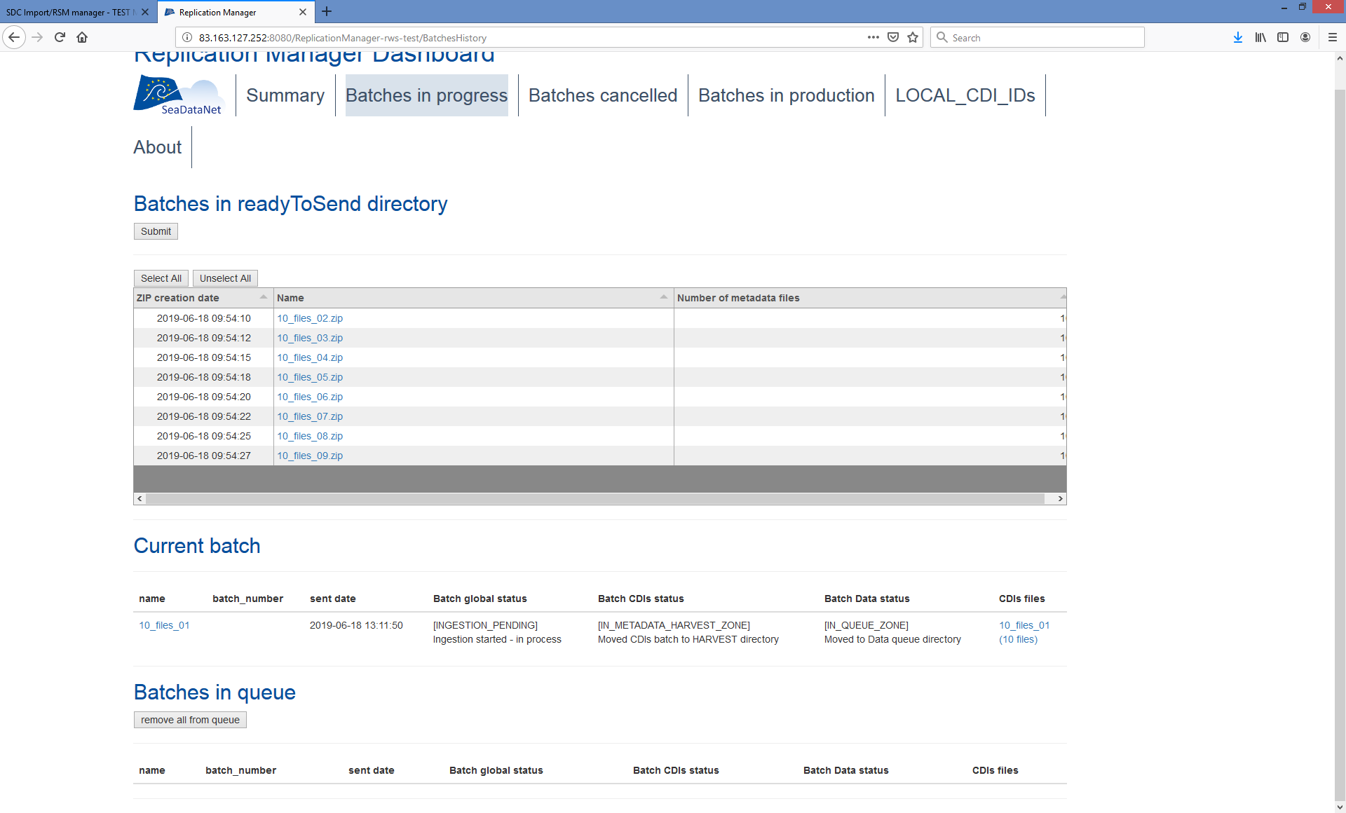
RM dashboard: CDI Batch ready notification submitted
Screenshots and specific remarks

Slide 15
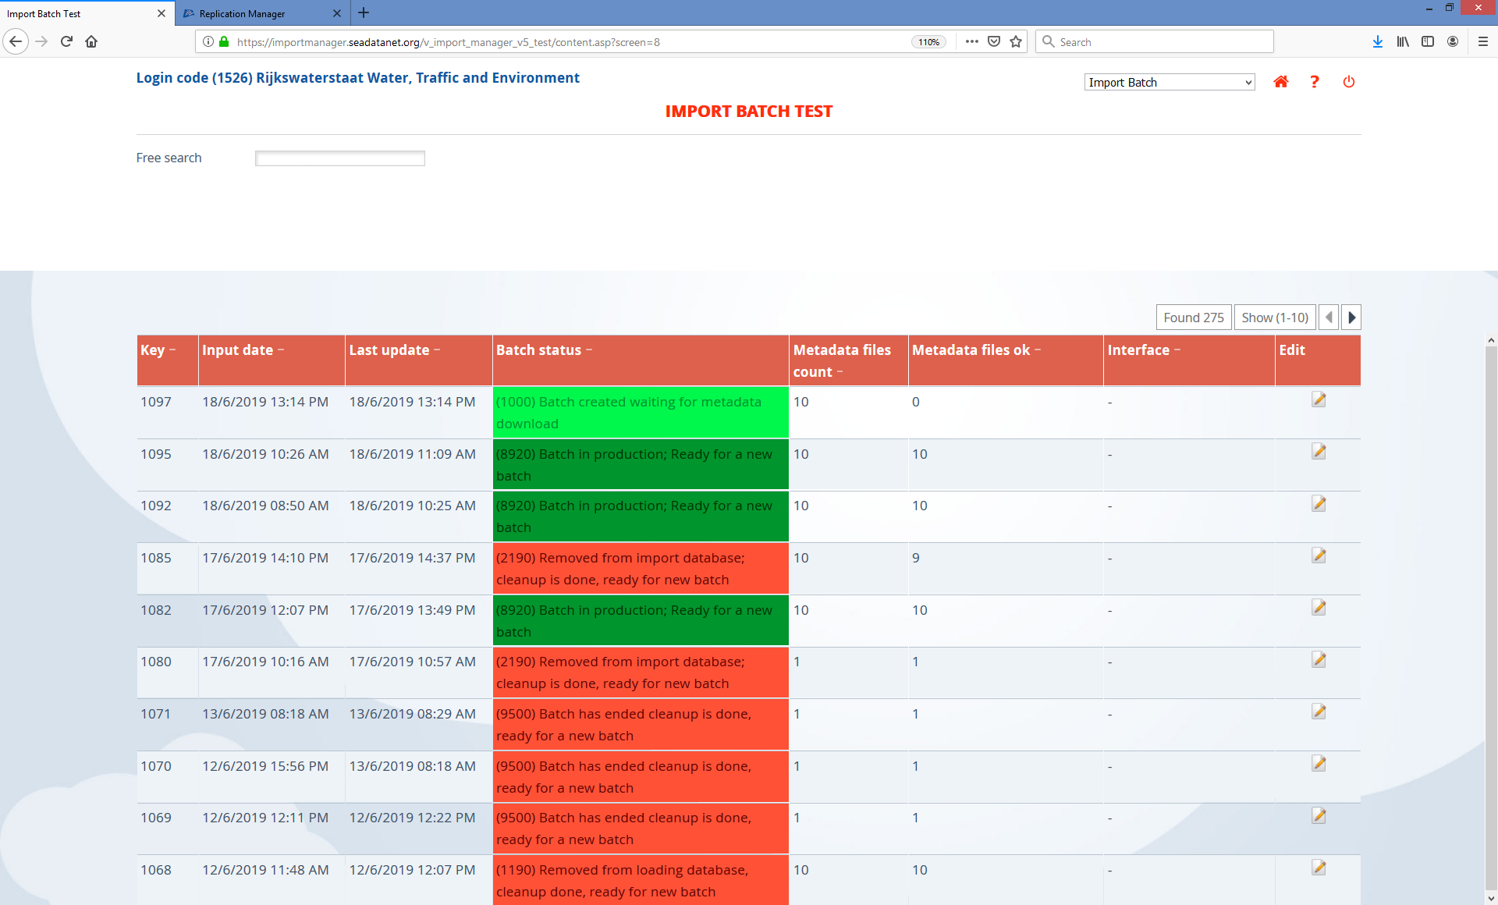
IM: Notification of CDI batch received, waiting for download

Slide 16
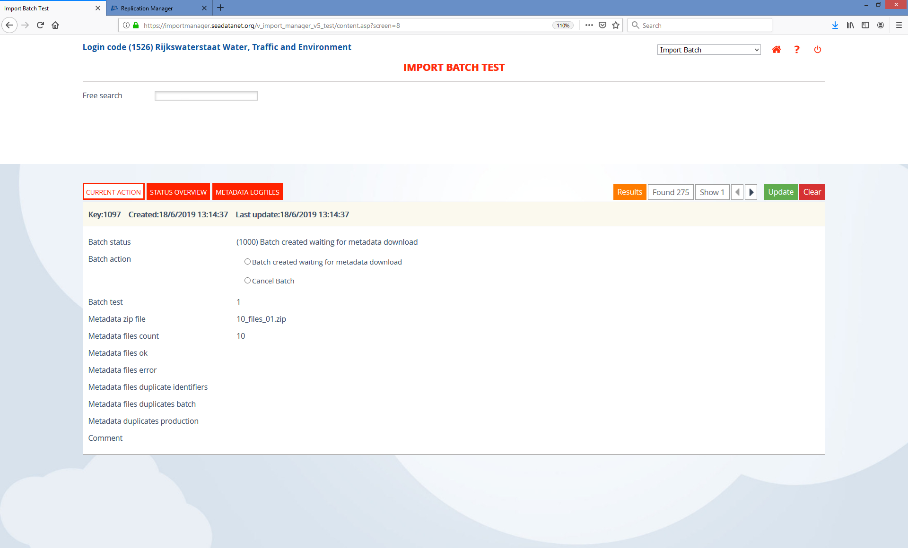
IM: View into the batch specs

Slide 17
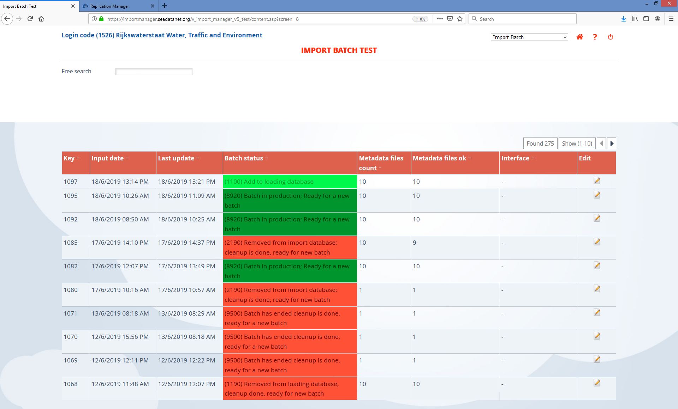
IM: Batch now received (downloaded by MARIS from RM), ready to load

Slide 18

RM: Batch received by IM - Now indicates batchnumber

Slide 19
Step 2: Checking the CDI metadata
The system will now:
Unzip the batch
Run sequence of checks (same as current)
All logs added to IM CMS
Metadata loaded to import database
RM notified visual check in import is needed
RM manager decides which files continue to next steps

Slide 20

IM: All ok, ready to load to webinterface (build up tables, elastic search, etc)

Slide 21
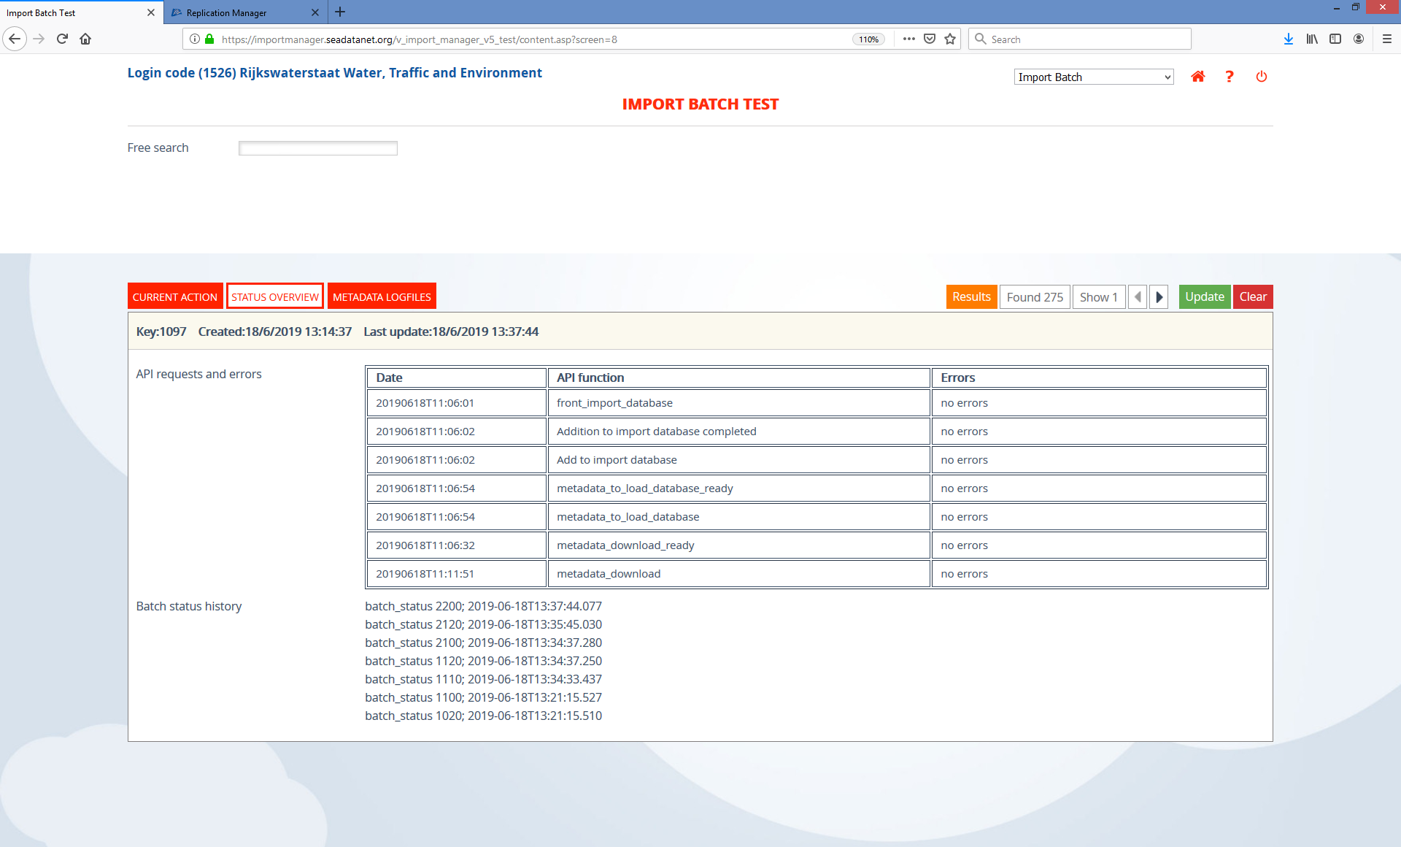
IM: History of steps in process passed

Slide 22
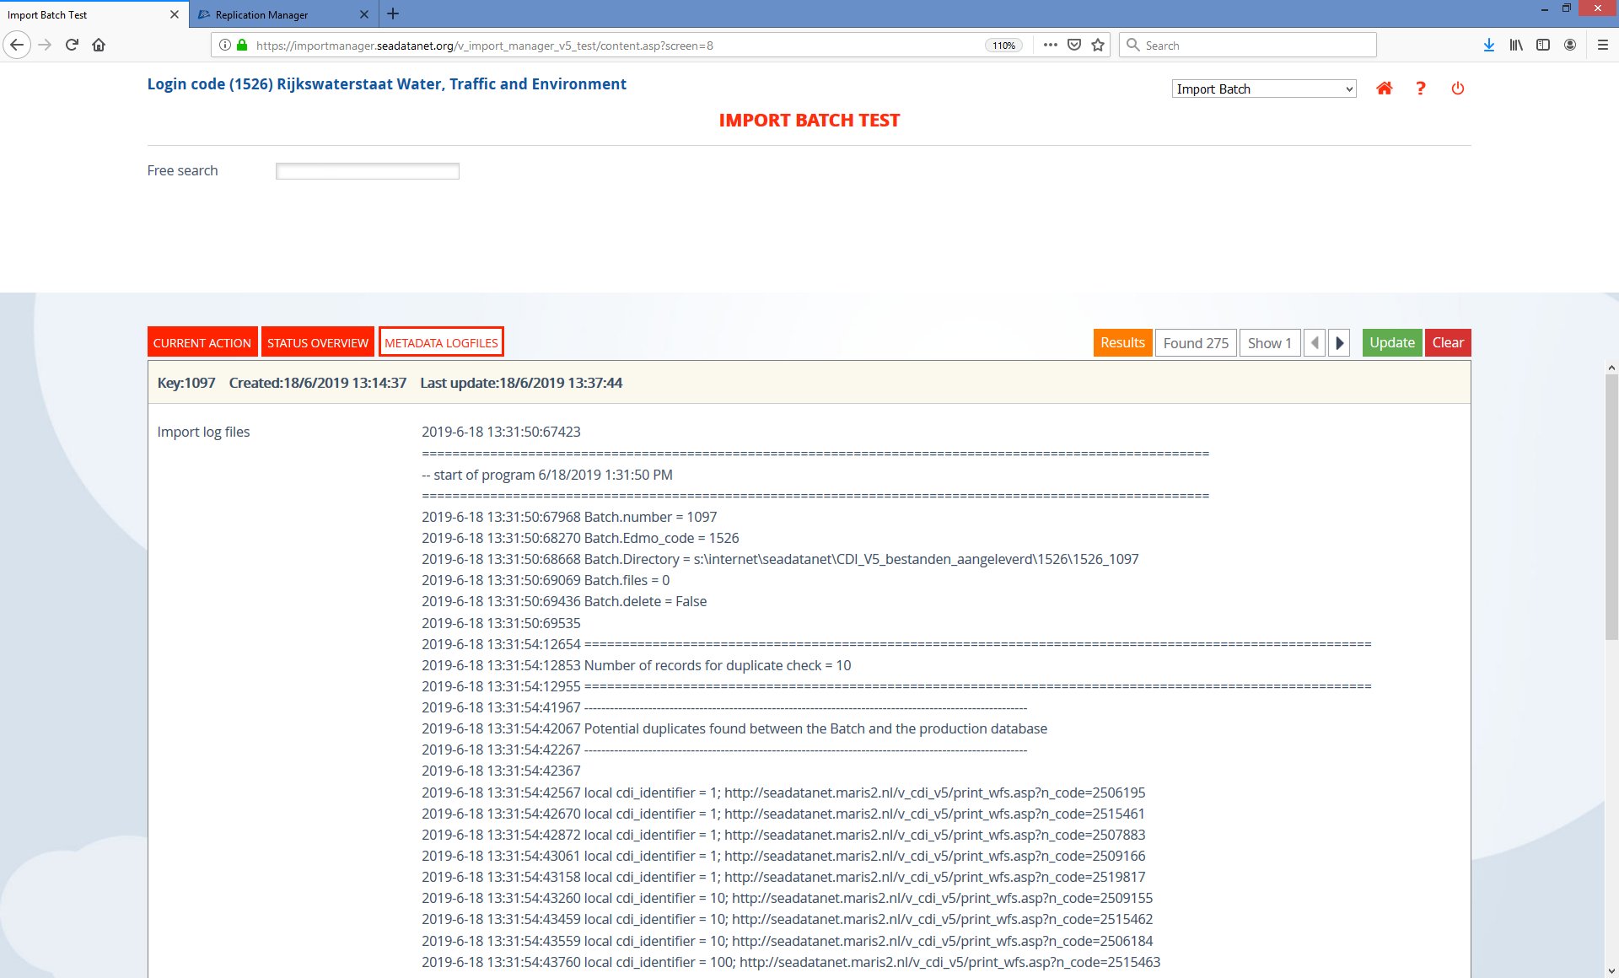
IM: Status progress and logs XML validation available

Slide 23

IM: Ready to visually check logs and interface (only human action)

Slide 24
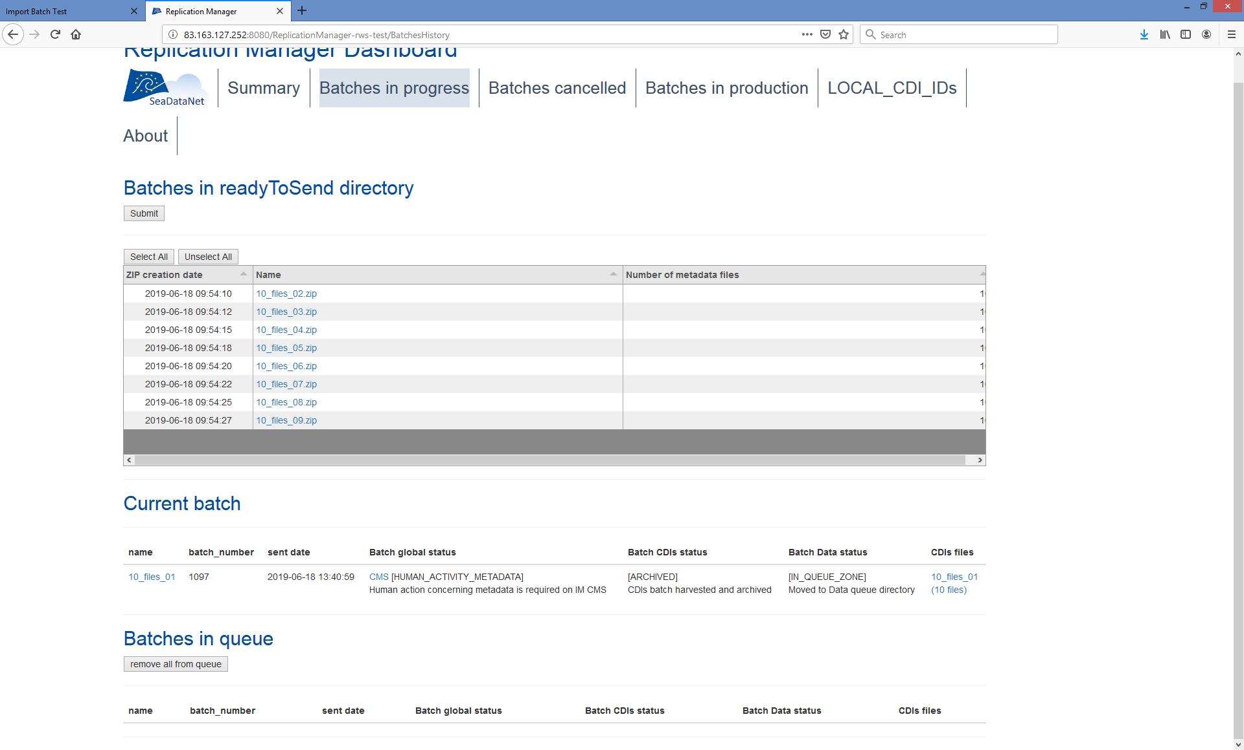
RM: Notification calls datamanager to action

Slide 25
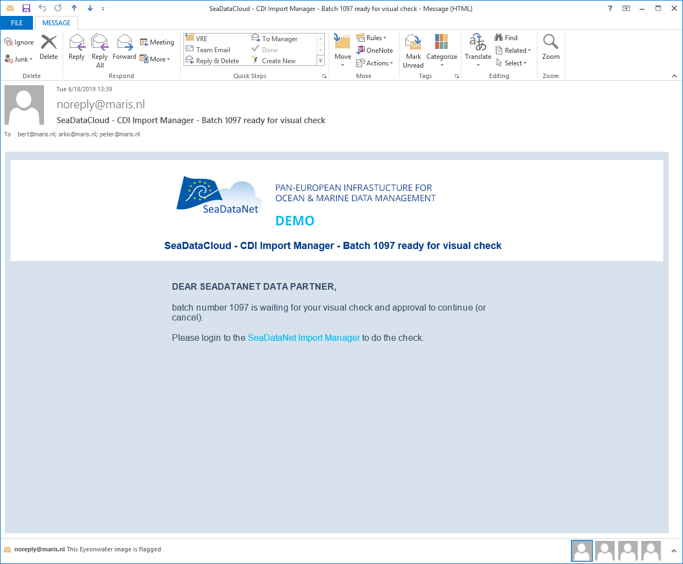
And an email to datamanager

Slide 26
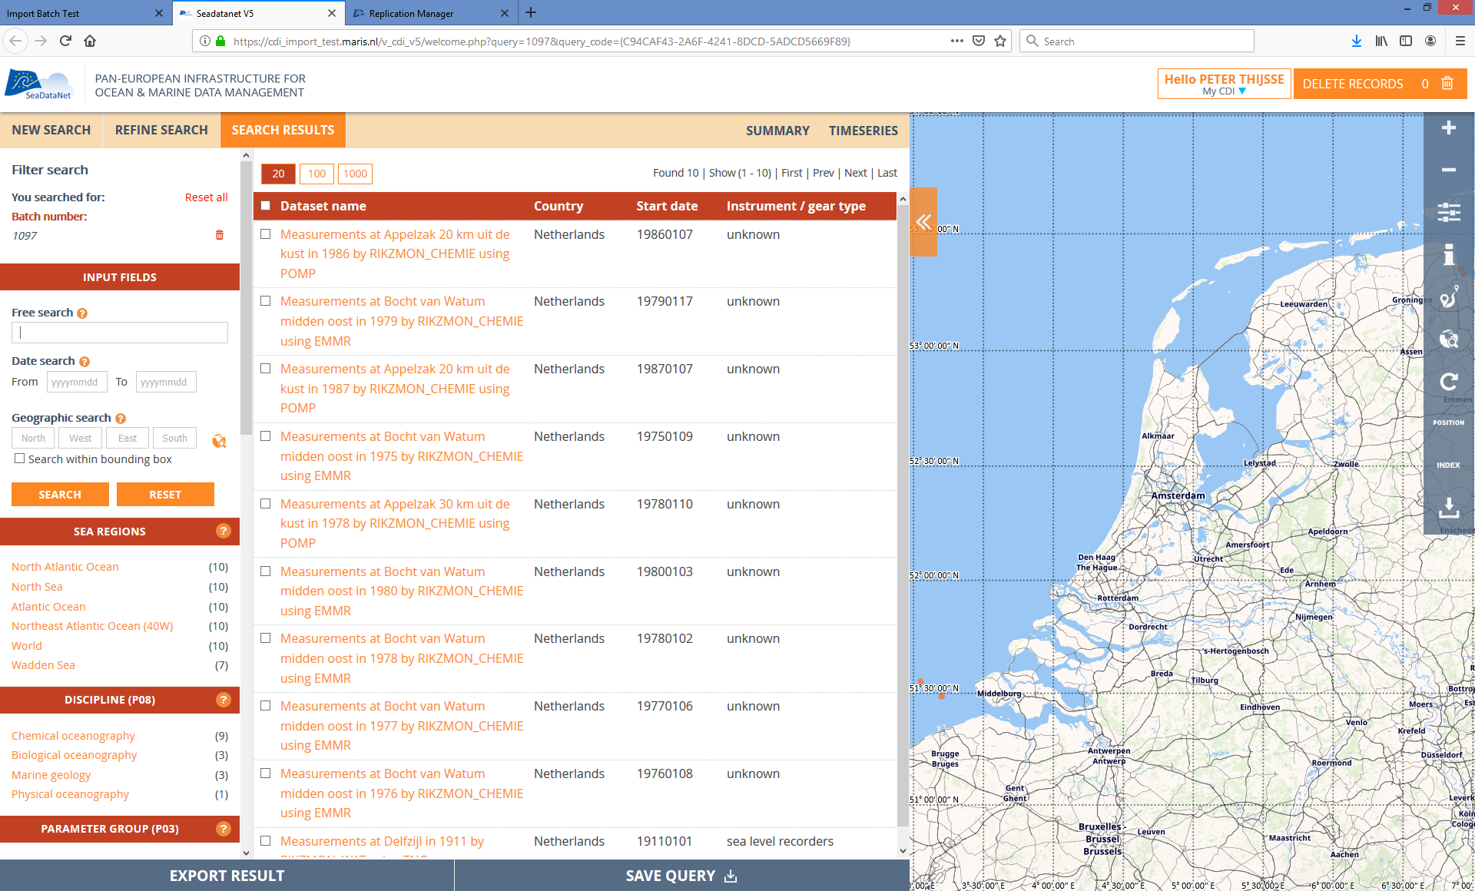
IM: Visual check - Individual records can be removed (check live!)

Slide 27
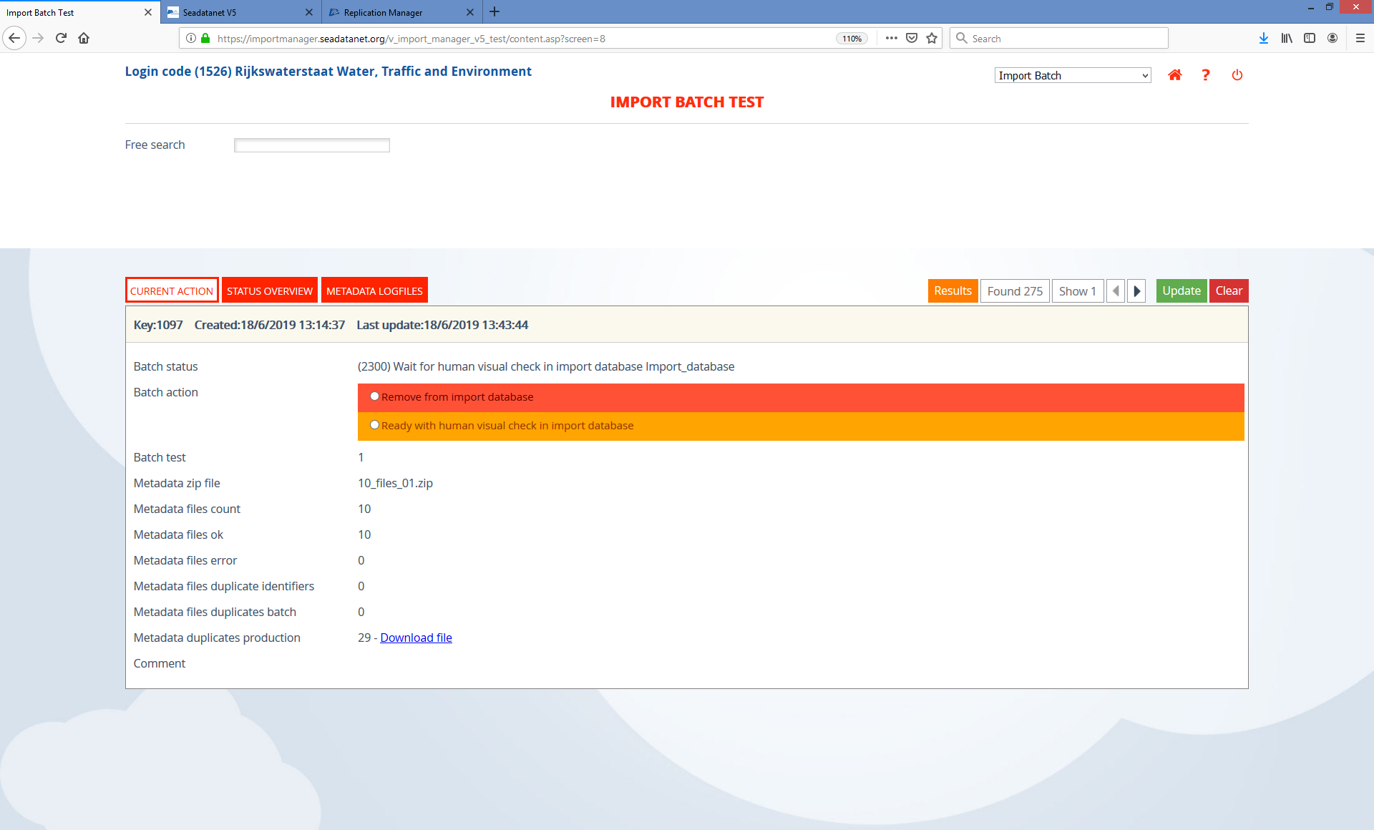
IM: RM manager indicates check is done (go on or cancel batch)

Slide 28

IM: Confirmed and programmes take over again

Slide 29
Step 3: Publishing the databatch
The datasets (unrestricted) belonging to the CDI metadata are now releases:
RM holds files in a folder, created at the same time as the CDI files!
IM triggers cloud (HTTP-API) to download the zip file to the folder in cloud
HTTP API confirms upload completed to RM
Cloud notifies Import Manager that upload is ready.

Slide 30

IM: Import manager triggers Cloud to download data
Screenshots and specific remarks

Slide 31
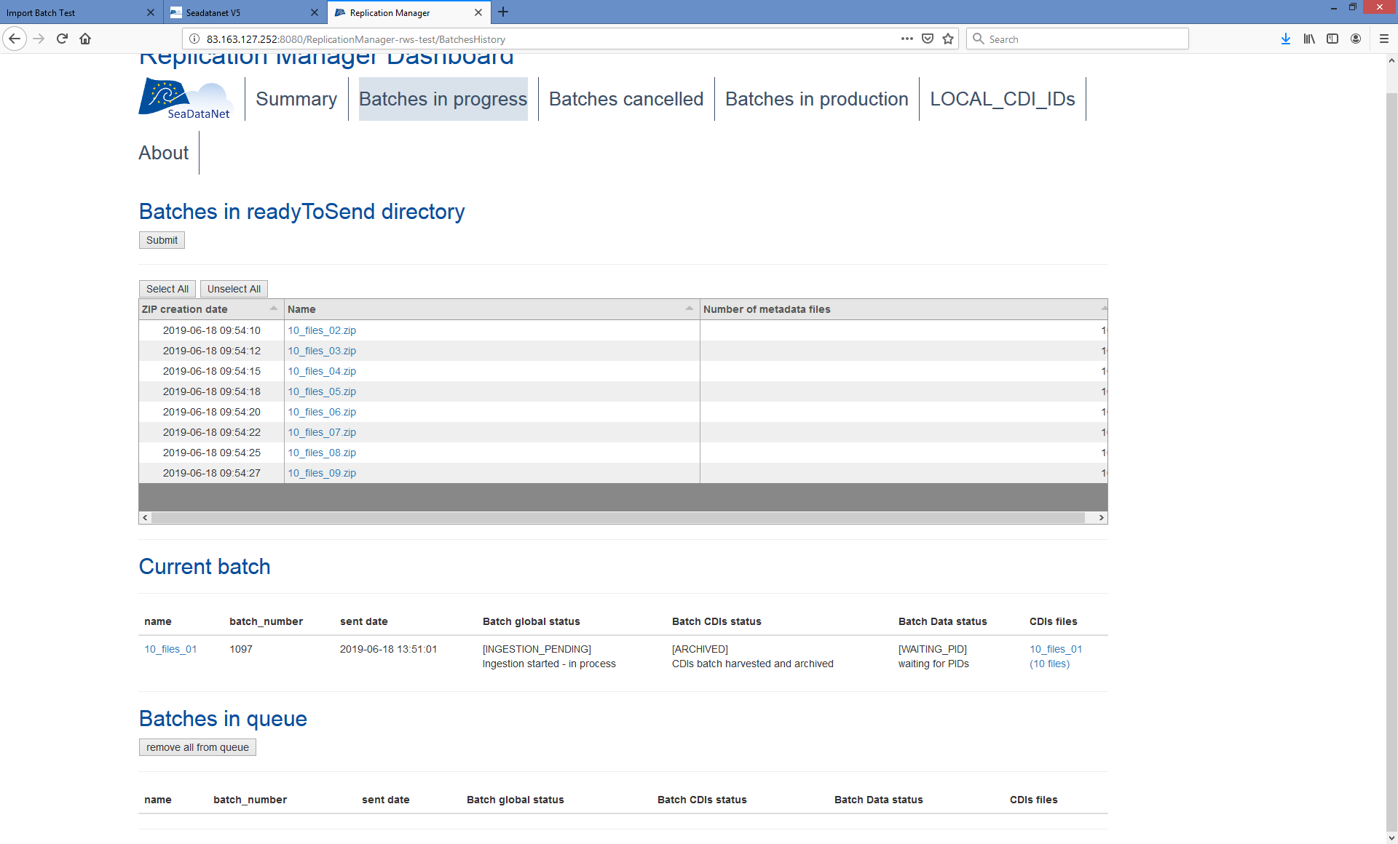
RM: Datafiles downloaded by cloud

Slide 32
Step 4: Unzip and run datachecks
Every uploaded batch is unzipped and checked:
Programme runs in Docker Container triggered by IM
The JSON output submitted to IM
Next action

Slide 33
Technical QC implementation status
Checks implemented:
  Compare checksum of file
  Compare length of file
  Unzip file
  Compare nr of files
  Check length of files > 0
  Check for each CDI_identifier if requested files and formats exist
All errors reported back to IM, logs are user and shown in CMS.
Erroneous records removed from batch, but batch moves forward as long as ok records exist.
No more records, or batch cancelled by data manager, start again.

Slide 34
Now additional QC checks may run
ODV quality checks, conversion to other formats (if not already present)
Validation
Etc.
Facilitated by Octopus, plus additional programmes

Slide 35

IM: Unzip and checks are done, left-over files ready to be moved. RM manager should check logs and confirm (Live!)

Slide 36
Step 5: Move validated data in production
Import manager has a matrix of Quality checks for the batch. All batch records that passed all quality checks move to production.
Human approval to continue for all valid files.
IM calls HTTP API with the filename for each approved file
HTTP API asynchronously triggers the ingestion process of IRODS
iRODS moves the collection to Production
Automatic irules are triggered for each file to generate the PID (B2Handle)
HTTP API supplies IM a JSON with filenames and their PIDs (per format)
PID’s and version shared by IM with RM
IM triggers system to update database, create tables, update Elastic index, etc.
Ready

Slide 37

IM: Human approval to move to production

Slide 38

IM: Ready to go for final steps

Slide 39

IM: Extract metadata from ODV for CDI search

Slide 40
Some steps behind the screen to retrieve PID’s..

Slide 41
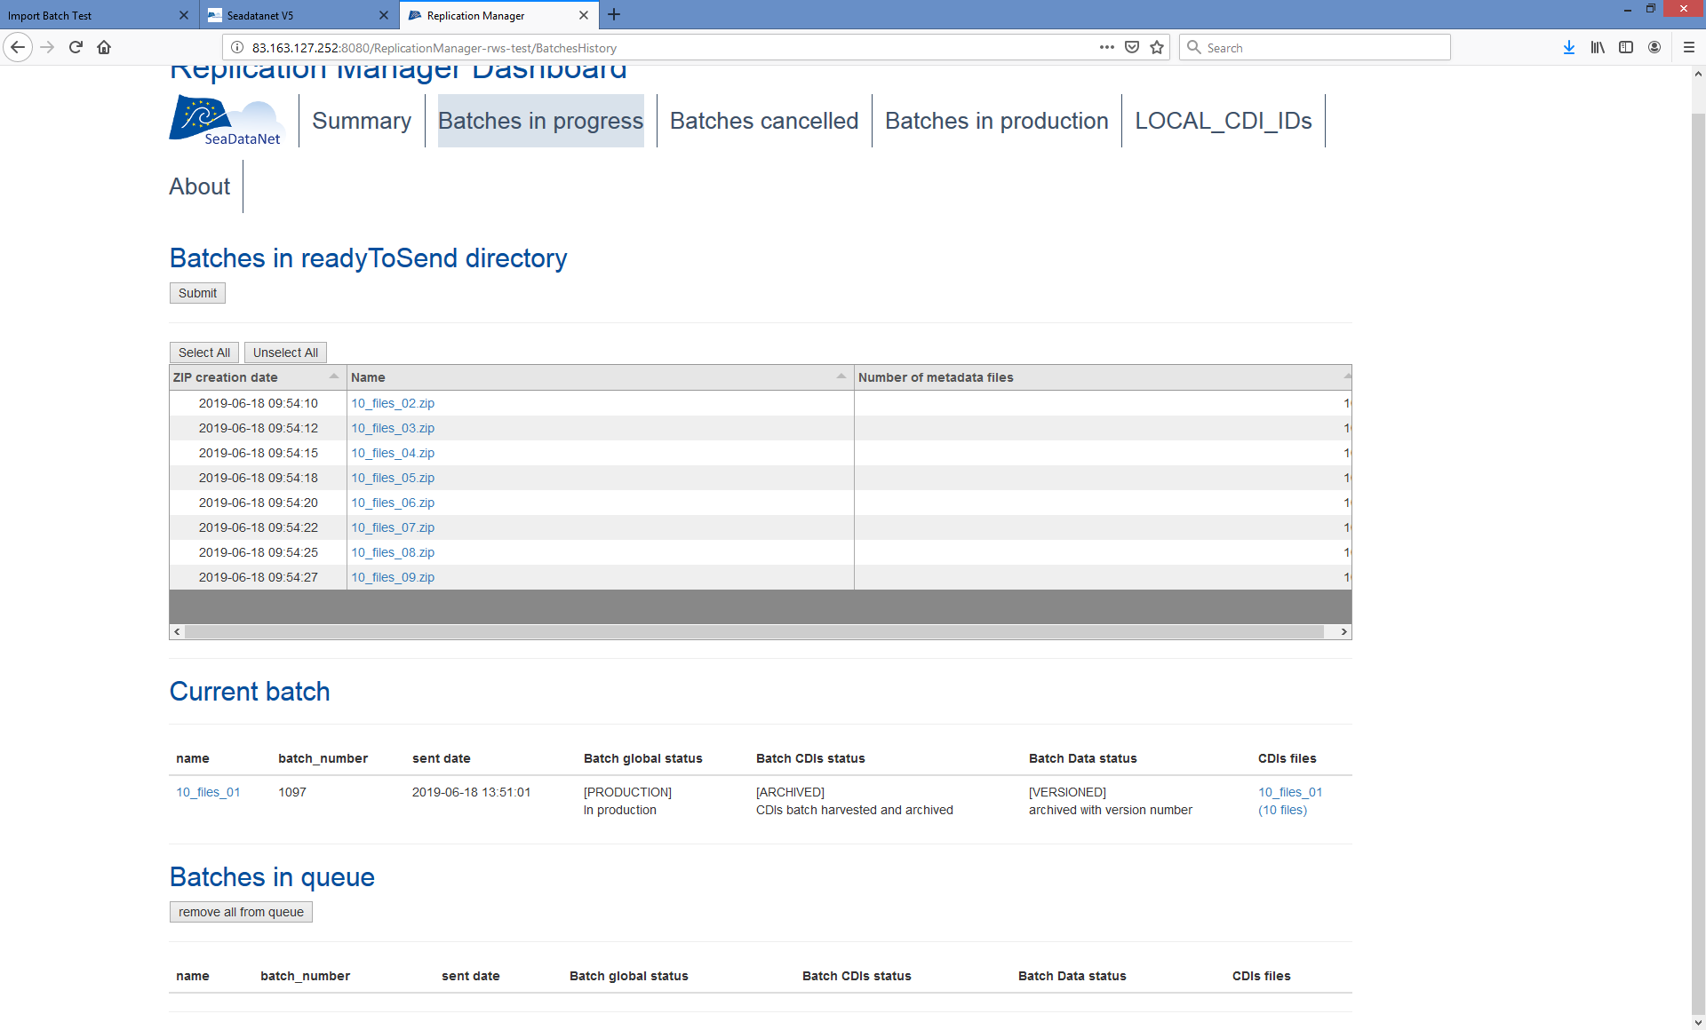
RM: PID’s sent to RM, version assigned, archived

Slide 42
More steps behind the screen… but then..

Slide 43
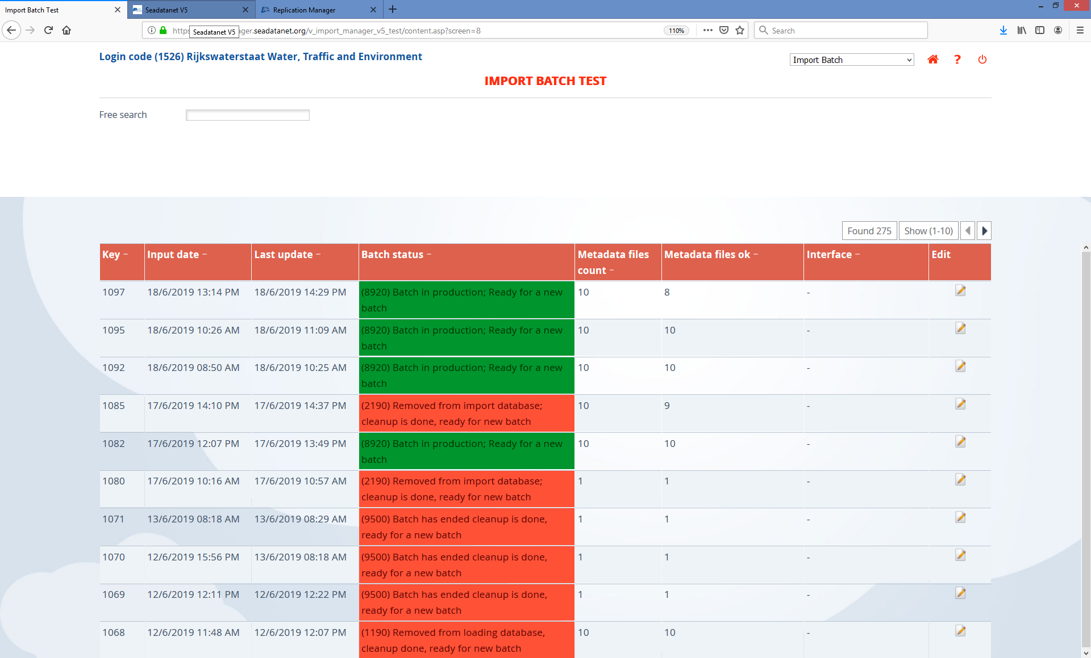
IM: Success! Ready for a new batch! (if next one in queue it automatically continues)

Slide 44
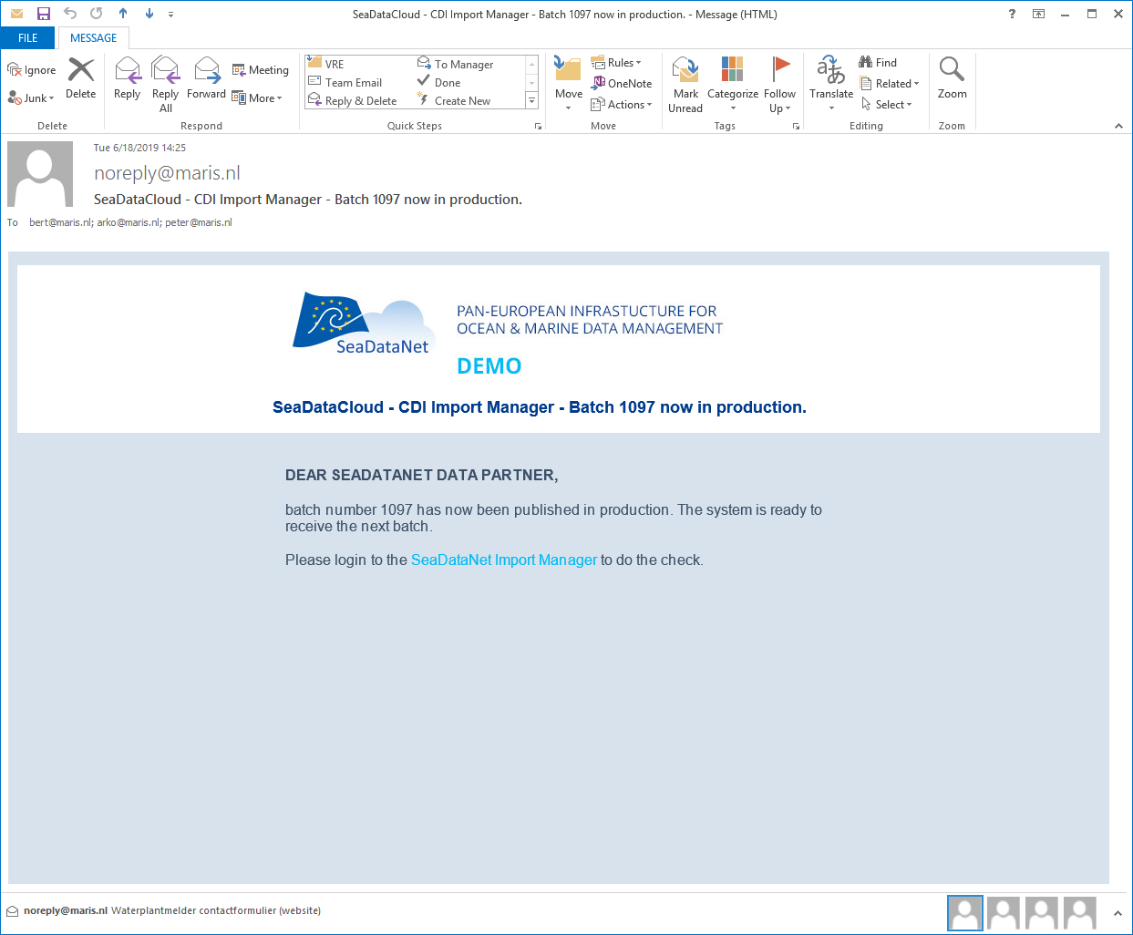
Confirmation per email

Slide 45
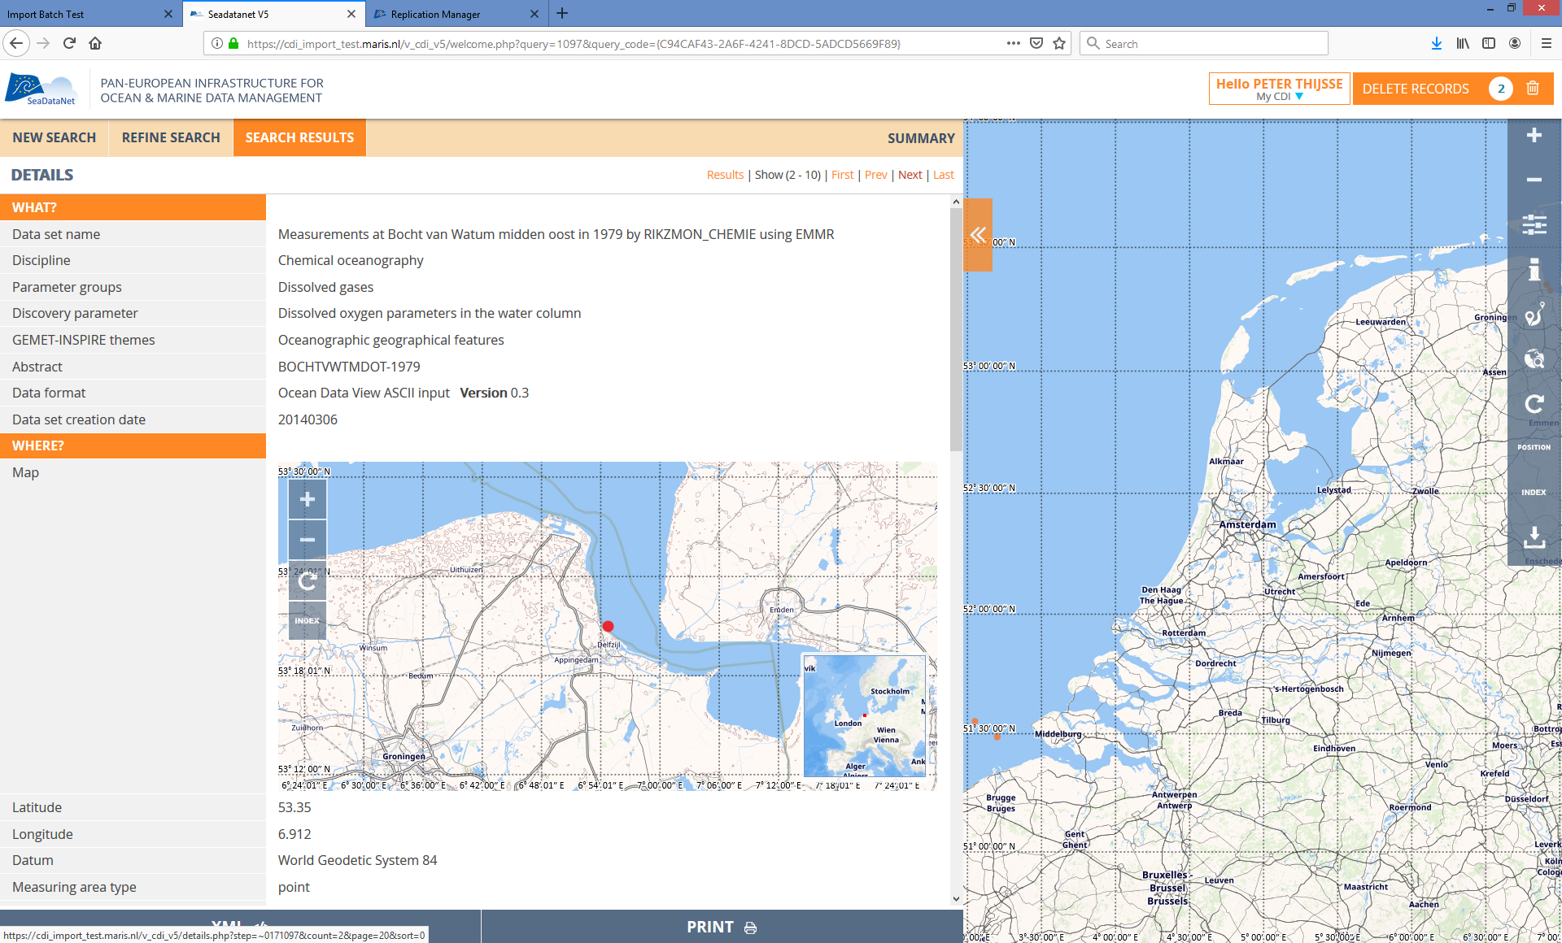
Batch active in interface (example record – in test)

Slide 46
Restricted data – much shorter!
CDI metadata same flow
After check immediately ready for publication
Data files extracted at same time as metadata. Copy stored (for each version)
Files will be temporarily released to cloud directory of user upon request RSM

Slide 47
Next steps
Replication manager being rolled-out now
Support from MARIS CDI support and SDN user desk
New system live => July 2019
More in implementation plan

Slide 48
- END -

