Slide 1
Replication Manager – Functionalities and configuration of Replication Manager
Sophie Brégent, altran

Slide 2
Summary
introduction
roles / functionalities
setup
usage

Slide 3
Introduction
The Replication Manager (RM) :
a new software that will replace the Download Manager
will be installed in each Data Centre as a part of the SeaDataNet infrastructure
handles all communications between the Data Centres and the MARIS CDI Import Manager (IM) and the EUDAT Data Cloud

Slide 4
SeaDataNet infrastructure
cloud
IM
submission
download
RM
RM
RM
RM

Slide 5
Replication Manager roles
submission of metadata and unrestricted data to the Import Manager
provision of restricted data
dashboard with submission history

Slide 6
Replication Manager roles: workflow
Data are generated before metadata are submitted to the IM
Nothing is submitted if errors are found during generation or check with Octopus
Metadata and unrestricted data are archived locally in an ARCHIVE directory
Restricted data are stored locally in a PRODUCTION directory

Slide 7
Replication Manager roles: data storage
cloud
IM
metadata
unrestricted data
RM
RM
RM
RM
restricted data

Slide 8
Replication Manager setup
data preparation
installation
configuration

Slide 9
Preparation: where are the data
As the DM, the RM will use
  a coupling table
  data files
    stored in directories or in web services
    containing one (modus 1) or several local_cdi_ids (modus 3)
  data in database (modus 2)

Slide 10
Preparation: coupling and modus 2
No change for the coupling table, can be:
  a file
  a database table
No change for modus 2:
  data in database + mapping files

Slide 11
Preparation : modus 1 and 3
Modus 1 is for files « on the shelf »:
  The file is only copied
Modus 3 is (historically) for multistations files
  The RM uses Octopus to extract one station
  Octopus also updates the file (BODC deprecated vocabularies…)
  ⇨ We strongly recommend to use modus 3 for SDN files, even if they contain only one station.

Slide 12
Preparation: where to store the RM resources
The RM will store
ARCHIVES: submitted metadata and datafiles
  can be purged regularly
PRODUCTION data : restricted data, in each version
  must be always available
⇨ These directories can become large

Slide 13
Installation
The RM is a web application
Uses an embedded database
  submissions history
  restricted data management

Slide 14




Installation: requirements
OS: windows or linux
Tomcat server >= 8.5 , <9
Java Oracle >= 8 , <9

Slide 15
Installation: deployment
First installation:
just put the ReplicationManager.war file into the webapps tomcat directory
You can see the About page in a web browser:
http://localhost:<port>/ReplicationManager

Slide 16
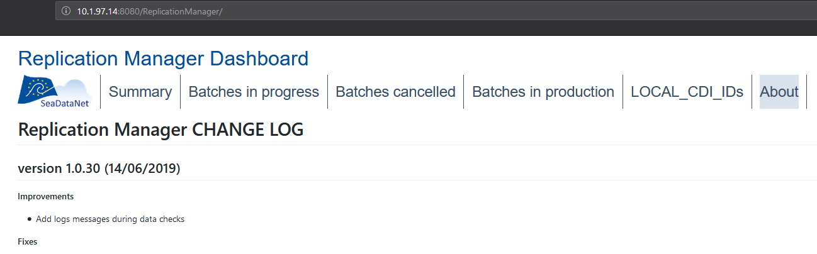
Installation: deployment

Slide 17
Configuration
The configuration is set in two distinct files:
RMConfiguration.properties
  data, workflow…
web.xml file
  security

Slide 18
Configuration : RM properties
# TEST MODE : 0 is production, 1 is test
test_mode=1
# EDMO CODE
edmo_code=486

Slide 19
Configuration: workflow directories (new!)
readyToSendCDIs_path
tmpDirectory_path
queueDirectory_path
archive_path
production_path
embeddedDatabase_path
embeddedDatabase_backupDirectory_path

Slide 20
Configuration: data directories
data_path
mapping_files_path
coupling_table_type
coupling_table_file_path
externalResources_path
unitsTranslationFile_path (optional)

Slide 21
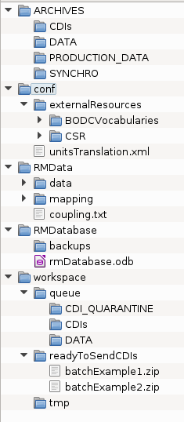
Configuration: tree example
archive_path
production_path
externalResources_path
unitsTranslationFile_path
data_path
mapping_files_path
coupling_table_file_path
embeddedDatabase_backupDirectory_path
embeddedDatabase_path
queueDirectory_path
readyToSendCDIs_path
tmpDirectory_path
Notes:
Here are the directories used by RM.
Some of them already exists for DM.

Slide 22
Configuration: network configuration
PROXY: uncomment and set values if your server is behind a proxy
#proxy_host=10.1.96.214
#proxy_port=3128

Slide 23
Configuration: network connections (new)
⇨ DO NOT MODIFY
maris_api_url_test=https://importmanager.seadatanet.org/api_v1
maris_api_url_production=https://importmanager.seadatanet.org/api_v1
maris_cms_url_test=https://importmanager.seadatanet.org/v_import_manager_v5_test/content.asp?screen=4
maris_cms_url_production=https://importmanager.seadatanet.org/v_import_manager_v5/content.asp?screen=4

Slide 24
Configuration: security
RM uses the default tomcat application configuration file web.xml.
It defines
  which filters are applied to URLs
  who has access
  ⇨ Add the IP addresses/masks you want to allow

Slide 25
Configuration: summary page 1/2
Once the configuration is done, you can check the results in the Summary page:
http://10.1.97.14:8080/ReplicationManager/Summary

Slide 26
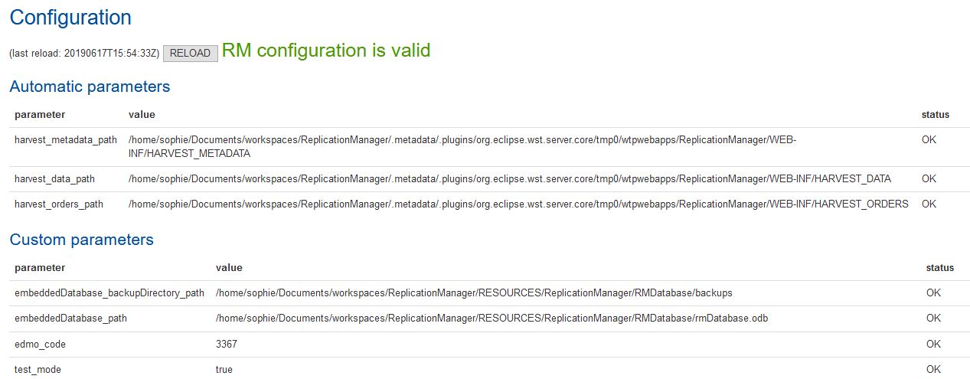
Configuration: summary page 2/2

Slide 27
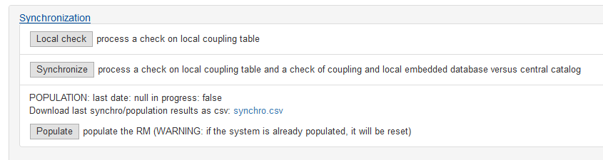
Configuration: check
process a local check

Slide 28
Usage: initial population
After the first installation, the system has to be « populated » with existing metadata and data.
metadata are already present in the IM (Maris)
unrestricted data are harvested by Maris
⇨ RM job is to
  get the full CDIs catalog from Maris
  generate and store restricted data
  populate the RM embedded database

Slide 29
Usage: synchronization
1 / populate
2 / synchronize

Slide 30
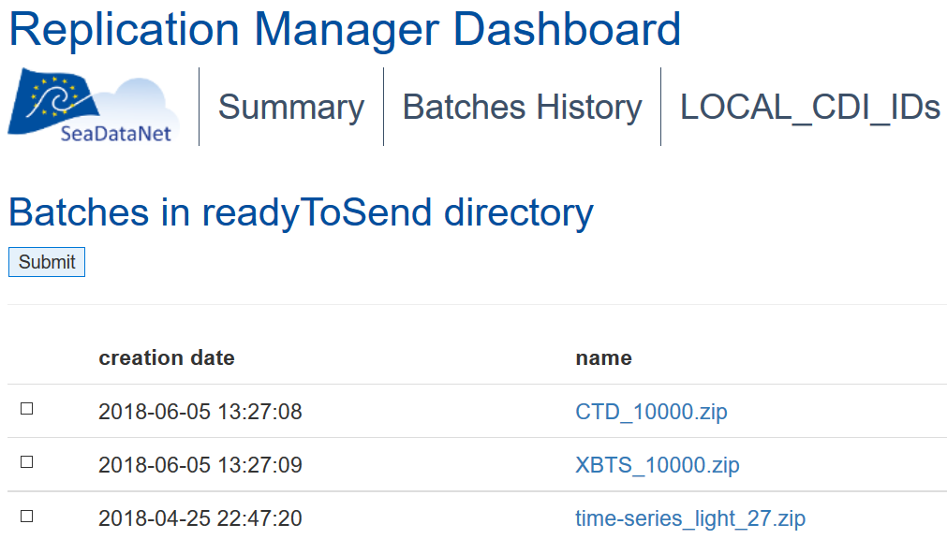
Usage: batch submission

Slide 31
Any questions?

