Slide 1
The contribution of the SeaDataNet infrastructure in the Arctic studies
Leda Pecci – ENEA (Italy)
EGU Conference, Vienna, Austria, 8 April 2019
Notes:
<numero>
EGU Conference, Vienna, Austria, 8-13April 2018

Slide 2
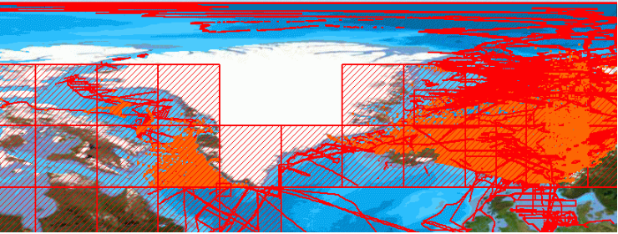
EGU Conference, Vienna, Austria, 8 April 2018
SeaDataNet is a comprehensive Pan-European semi-distributed marine data infrastructure, providing access to multidisciplinary, integrated marine and ocean data and products of standardised quality, services, as well as an overview of marine organisations, research and monitoring activities related to the sea.
Physical oceanography
Chemistry
Geophysics
Marine Geology
Biology
Bathymetry
Data in the Arctic region
Meteorology
Notes:
<numero>
EGU Conference, Vienna, Austria, 8-13April 2018

Slide 3
EGU Conference, Vienna, Austria, 8 April 2019
Origin
Architecture
Data services
Metadata services
Data products
Vocabulary services
Software tools
On going activities
Challenges in the Arctic Ocean
How SeaDataNet supports Arctic studies
The highlights
SeaDataNet standards and tools in other EU projects
User workshop at EGU 2019
Notes:
3
EGU Conference, Vienna, Austria, 8-13April 2018

Slide 4
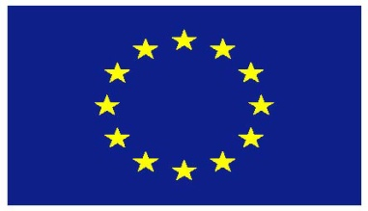
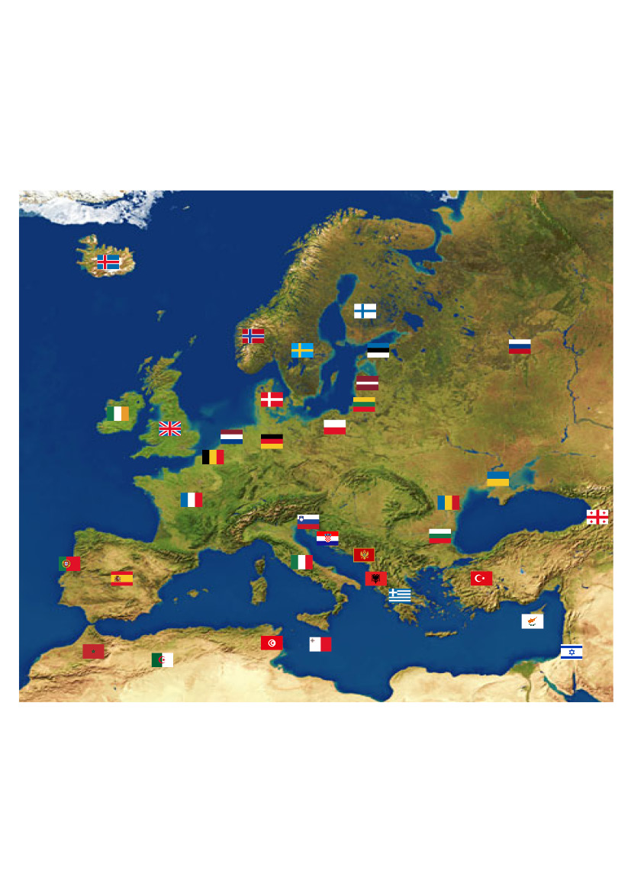
Origins
EGU Conference, Vienna, Austria, 8 April 2019
SeaDataNet started in the 90s and has been developing over the years. Thanks to EU funded projects:
90 | Metadata directories Medar/MedAtlas
2002-2005 | Sea-Search (FP5)
2006-2011 | SeaDataNet (FP6)
2011-2015 | SeaDataNet II (FP7)
2016-2020 | SeaDataCloud (H2020)
Notes:
SeaDataNet was a EU project funded by FP7 (seventh Programme for Research) started in his first phase in 2006 to 2011.
SeaDataNet is the result of the joint efforts of several marine institutes around the European and the Mediterranean seas.
4
EGU Conference, Vienna, Austria, 8-13April 2018

Slide 5
Architecture
EGU Conference, Vienna, Austria, 8 April 2019
→ a single access for a wide range of data of different types
Data centre
NODC
Data centre
User
Data centre
Central Portal
Data
Request
Data centre
Data
Downloading
NODC
NODC
NODC (National Oceanographic Data Centre)
Notes:
The infrastructure provides a unique point of access to discover and download data residing in remote data centres (or repositories). The CDI service (Common Data Index service) provides a catalogue of global data availability.
1. The user connects to the portal and sends a data request to the central portal.
2. The portal first checks if the data is available and whether the user has the necessary permissions.
3. If so, the portal forwards the request to the data centre(s) that own the data.
4. The user will then receive the data directly from each data centre.
5
EGU Conference, Vienna, Austria, 8-13April 2018

Slide 6
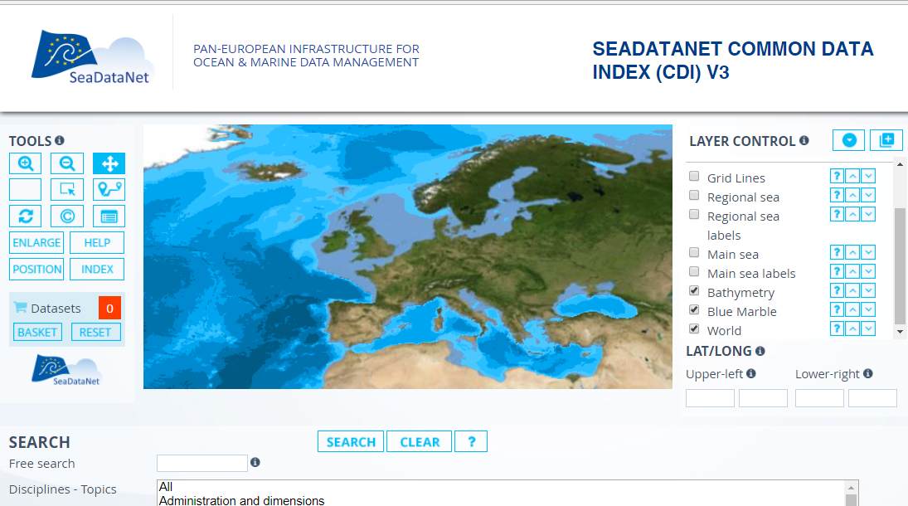
Data services
EGU Conference, Vienna, Austria, 8 April 2019
Discovery, visualization, access and download
http://www.seadatanet.org
Notes:
The SeaDataNet portal offers different services: discovery, visualisation, access and data downloading. The data discovery is freely available, without registration and allows to access metadata. The discovery interface allows searching for data and visualising the results through an interactive map and/or by searching for specific properties.
How to download the data: Data discovery, data selection, Add to the shopping basket and user registration
Data policy: All metadata services are public domain. User registration is required to download data, in order to accept the SeaDataNet license.
The major part of data is freely available (85%). The remaining data have access estrictions and the user has to make arrengements with the data producers to negotiate access for downloading.
6
EGU Conference, Vienna, Austria, 8-13April 2018

Slide 7
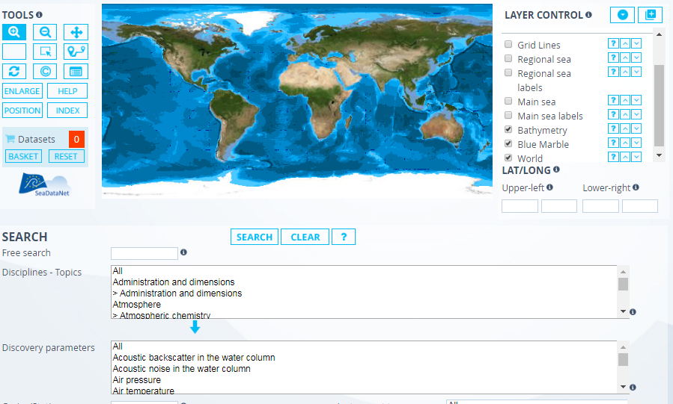

Data Services
EGU Conference, Vienna, Austria, 8 April 2019
Map tools
Data discovery interface
Discipline
Cruise
Parameter
Country
Instrument
Platform
………..
Notes:
The discovery interface allows searching for data and visualising the results through an interactive map and/or by searching for specific properties.
How to download the data: Data discovery, data selection, Add to the shopping basket and user registration
Data policy: All metadata services are public domain. User registration is required to download data, in order to accept the SeaDataNet license.
The major part of data is freely available (85%). The remaining data have access estrictions and the user has to make arrengements with the data producers to negotiate access for downloading.
7
EGU Conference, Vienna, Austria, 8-13April 2018

Slide 8
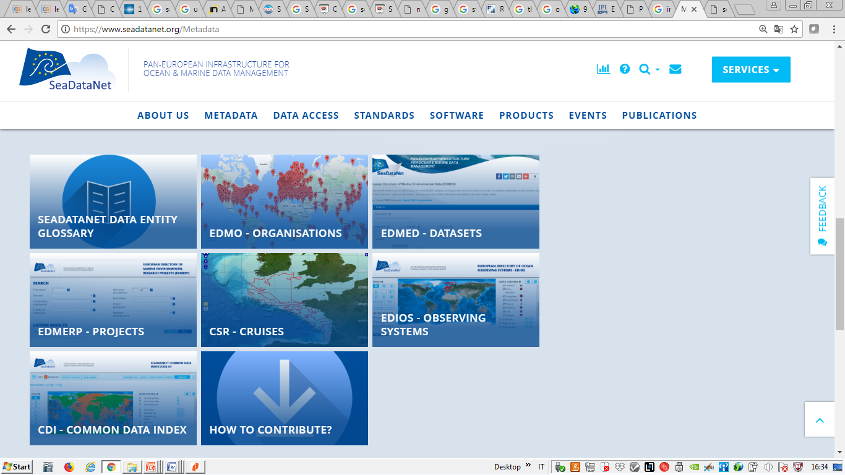
EGU Conference, Vienna, Austria, 8 April 2019
Metadata Services
SDN provides useful information to know the organisations that operate in marine environment, what they do and where → chances for future collaborations in research or in the private sector
Notes:
8
EGU Conference, Vienna, Austria, 8-13April 2018

Slide 9
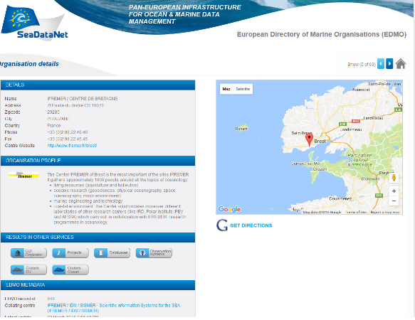
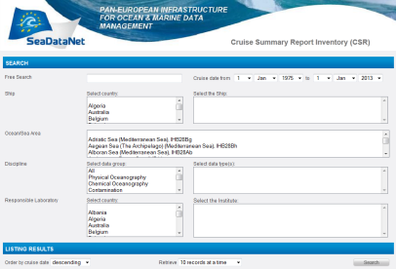


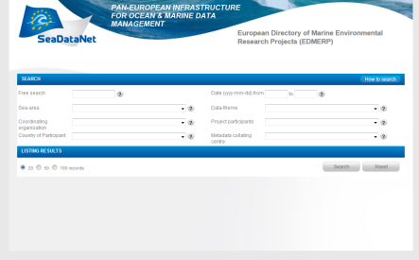
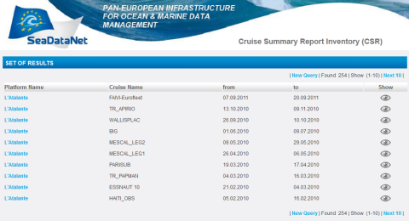
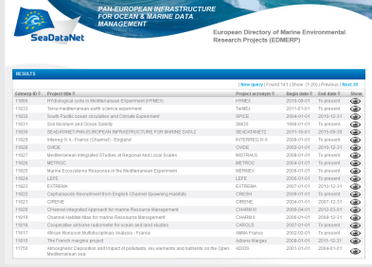
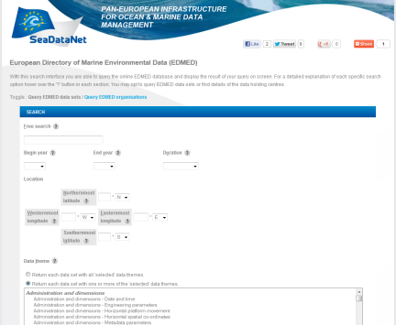
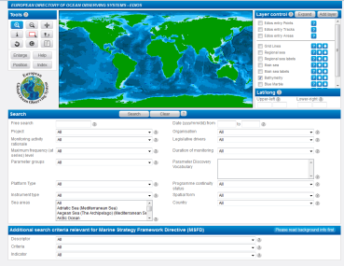
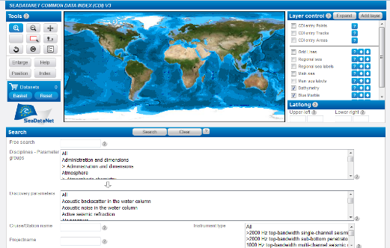
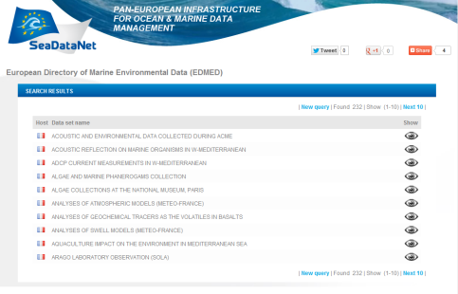
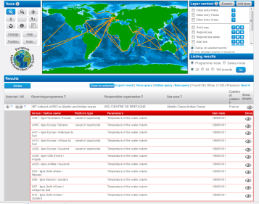
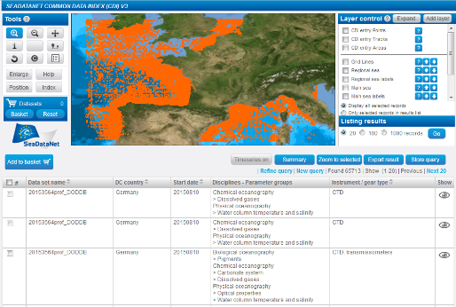
EGU Conference, Vienna, Austria, 8 April 2019
Metadata Services
EDMO
Organisations
COMPLIANT
CSR
EDMERP
Research cruises
Projects
COMPLIANT
EDIOS
EDMED
Observing programmes
CDI
Data sets
Data index
Notes:
SeaDataNet portal provides an overview of the Marine organisations in Europe and their involvement in scientific cruises, data collection, marine projects
EDMO : European Directory of Marine Organisations (
CSR : Cruise Summary Reports (
EDMED : European Directory of Marine Environmental Datasets (
EDMERP : European Directory of Marine Environmental Research projects
EDIOS : European Directory of Ocean Observing Systems ()
CDI : Common Data Index () All SeaDataNet catalogues have been harmonised and tuned in format, syntax and semantics (common vocabularies).
They have a common editor (MIKADO) and online CMS and online query interfaces
9
EGU Conference, Vienna, Austria, 8-13April 2018

Slide 10
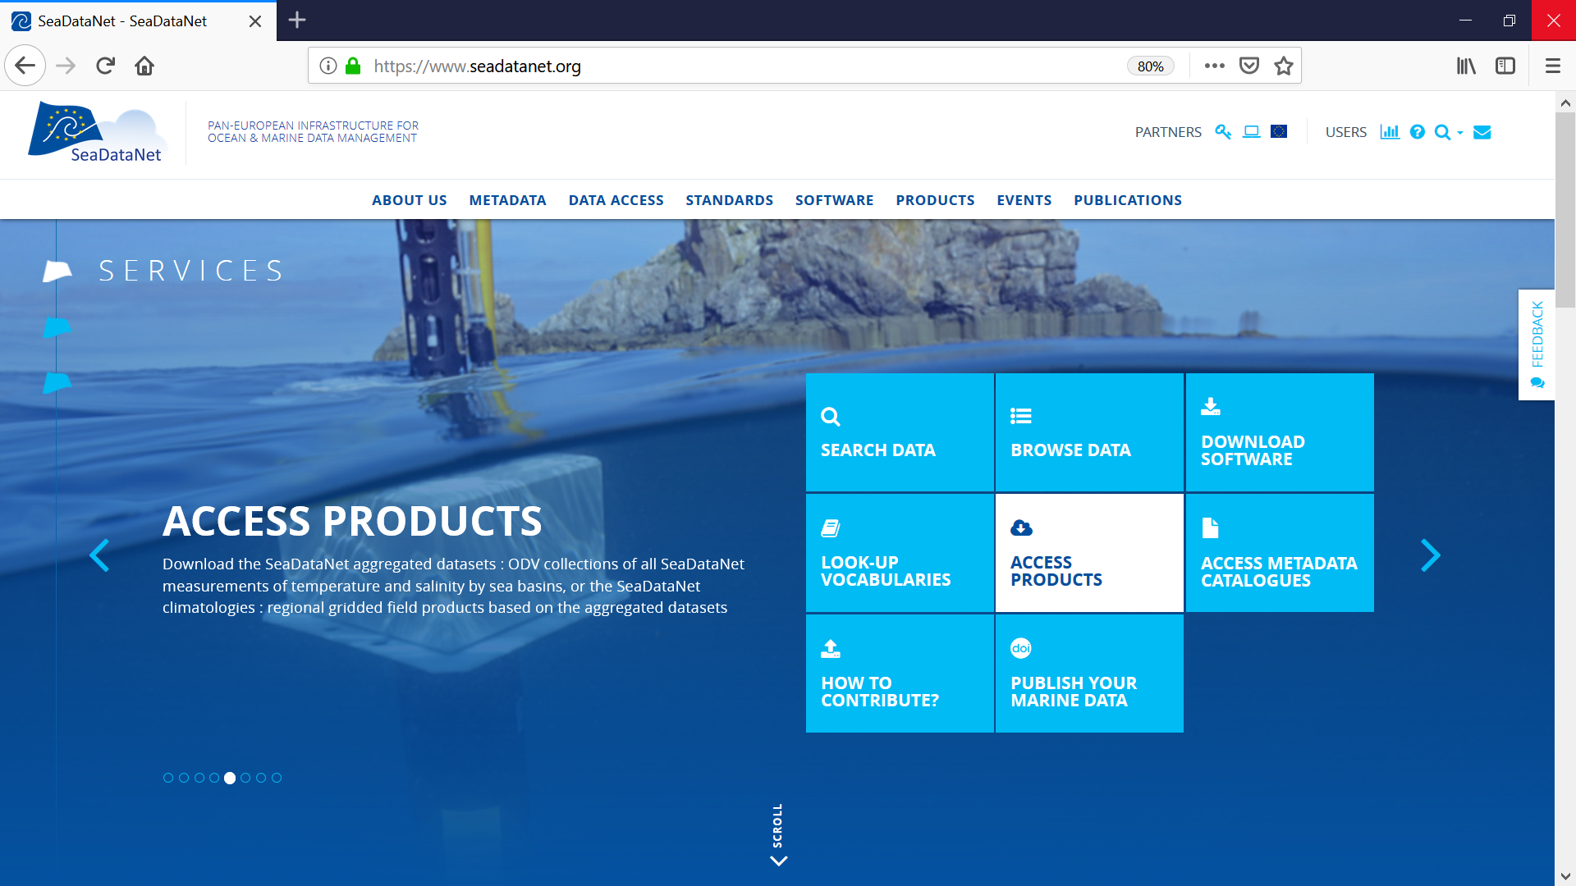
Data Products
EGU Conference, Vienna, Austria, 8 April 2019
Notes:
10
EGU Conference, Vienna, Austria, 8-13April 2018

Slide 11
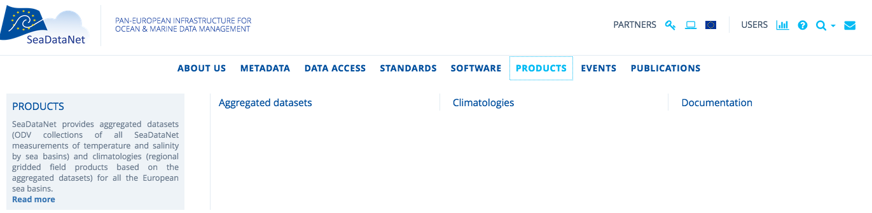
Data Products
EGU Conference, Vienna, Austria, 8 April 2019
gridded climatologies (DOI)
reports describing products’ characteristics and quality (DOI)
Historical data collections of all T and S measurements within SeaDataNet covering all EU sea basins (DOI)
Catalogue
Notes:
11
EGU Conference, Vienna, Austria, 8-13April 2018

Slide 12
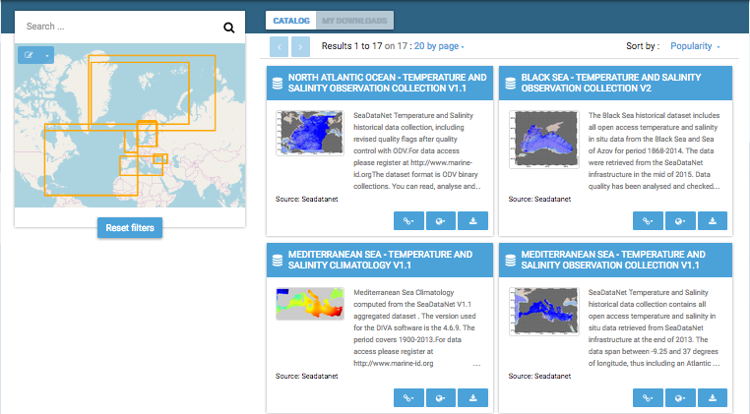
EGU Conference, Vienna, Austria, 8 April 2019
Product Catalogue
<numero>
Notes:
12
EGU Conference, Vienna, Austria, 8-13April 2018

Slide 13
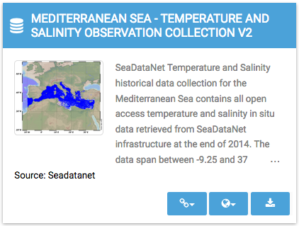
EGU Conference, Vienna, Austria, 8 April 2019
Product Catalogue
Download
Viewing tools Ocean Browser
and Oceanotron
Metadata record (DOI)
<numero>
<numero>
Notes:
13
EGU Conference, Vienna, Austria, 8-13April 2018

Slide 14
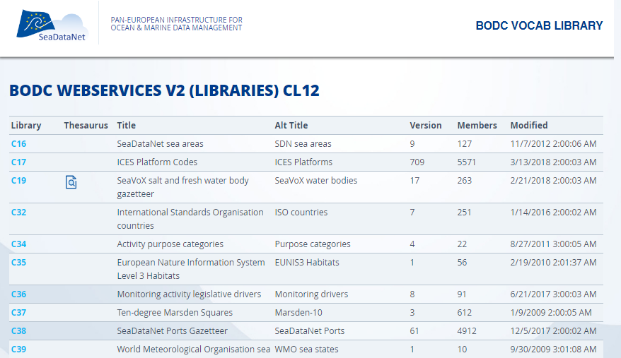
EGU Conference, Vienna, Austria, 8 April 2019
Vocabulary services
Controlled vocabularies used in all metadatabases and data formats (interoperability) organised with international governance, user interfaces and web services
Notes:
14
EGU Conference, Vienna, Austria, 8-13April 2018

Slide 15
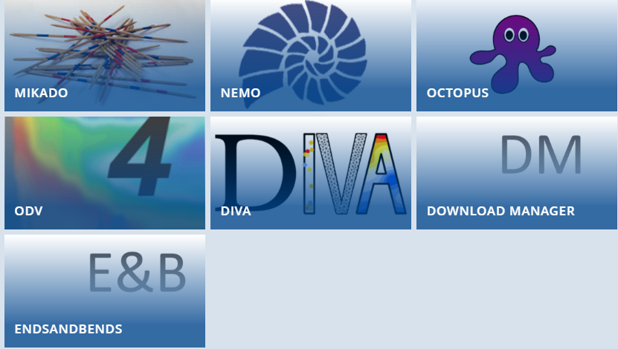
Software Tools
EGU Conference, Vienna, Austria, 8 April 2019
To create metadata CDI, CSR, EDMO, EDIOS, EDMERP
To convert data file
To convert to the internal formats
To present and analyse data
To make available data in data centres
To generate the spatial objects for CDI files
Notes:
NEMO reformat ASCII file of vertical profiles, time series and trajectories to SDN formats file.
NEMO generates the coupling table and a CSV file that is a summary of the data that can be used by Mikado to produce a CDI file for metadata.
The ODV software is also being used in SeaDataNet for producing generic data products for each of the regional seas for various variables. The DIVA software tool ( Data-Interpolating Variational Analysis ) allows to spatially interpolate (or analyse) those observations on a regular grid in an optimal way. As a part of SeaDataNet, the DIVA method has been integrated into ODV, and the integration greatly facilitates the usage of DIVA.
MIKADO: generator of XML descriptions of SeaDataNet catalogues
NEMO: reformatting software to SeaDataNet formats
Download Manager: downloading software
ODV: Ocean data view adapted to SeaDataNet needs
DIVA: for product generation adapted to SeaDataNet needs
15
EGU Conference, Vienna, Austria, 8-13April 2018

Slide 16
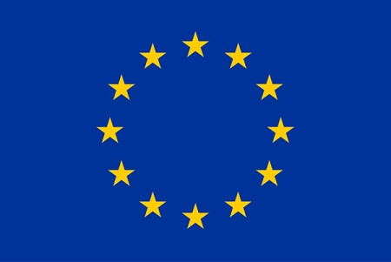


SeaDataCloud project activities
This project has received funding from the European Union’s Horizon 2020 Research Infrastructures programme,
under the grant agreement No 730960”.
Upgrading and innovating existing services for users and data providers:
Advancing the CDI service by adopting cloud
Introducing 'Linked Data principle' to catalogues for
semantic web
Adding transformation facility to INSPIRE compliance
Developing new services for users and data providers:
consortium of e-infrastructure service providers
SWE Ingestion service for Real Time data streams
Brokerage service for mutual exchange with international data networks
Virtual Research Environment (VRE) with advanced services: subsetting, online ODV, DIVA, and visualisation
Notes:
Innovation: The infrastructure is going to offer a virtual research environment that includes on line services for analysis, quality control, data sub-setting, visualisation of retrieved datasets, generation and publication of data products.
16
EGU Conference, Vienna, Austria, 8-13April 2018

Slide 17
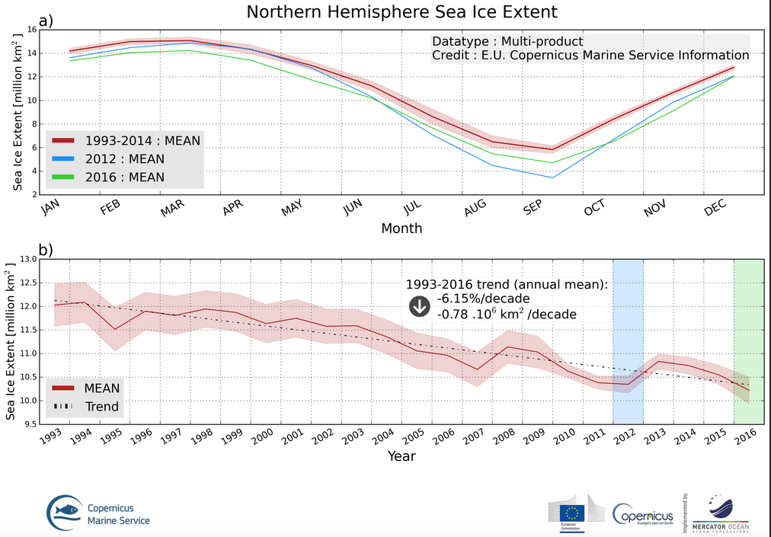
Challenges for the Arctic regions
Climate Change
T increase and SI extent reduction
Notes:
17
EGU Conference, Vienna, Austria, 8-13April 2018

Slide 18
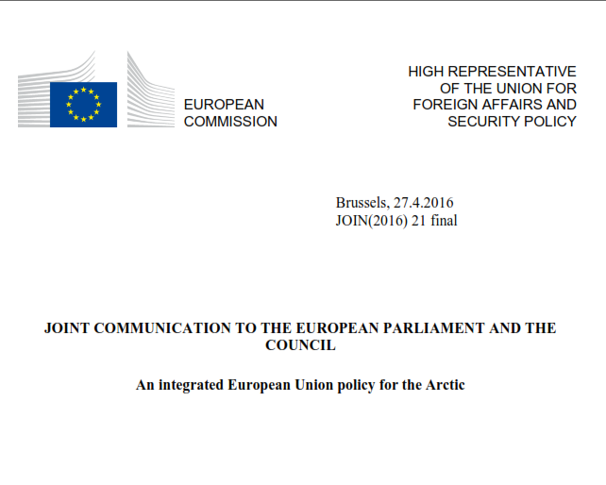
EGU Conference, Vienna, Austria, 8 April 2019
Challenges for the Arctic regions
In 2016, the Commission and the High Representative for Foreign Affairs and Security Policy of the EU have updated the policy on Arctic, defining the following “priority areas”:
Climate change and safeguarding the Arctic environment
Sustainable development in and around the Arctic
International cooperation on Arctic issues
Notes:
the Commission and the High Representative for Foreign Affairs and Security Policy to develop an integrated policy on Arctic matters, and to develop a more coherent framework for EU action and funding programmes. In response, an integrated EU Arctic policy is therefore proposed in three priority areas. Basically, defining the aspects of EU presence in the Arctic:
18
EGU Conference, Vienna, Austria, 8-13April 2018

Slide 19
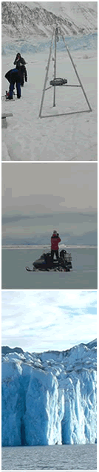
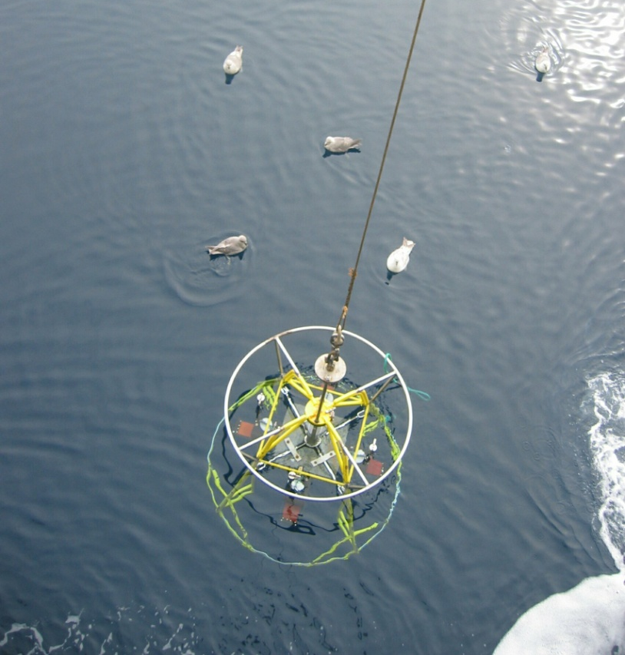
How SeaDataNet supports arctic studies
EGU Conference, Vienna, Austria, 8 April 2019
Arctic → "engine" of the planet's climate and crucial for understanding the climate evolution and its impact on the planet and the global economy.
To get data in the Arctic’s extreme conditions it is really challenging.
Credit: ENEA
SeaDataNet contribution:
data, metadata, T/S climatologies
information about projects and institutions involved in those regions
High quality data is available because of contributors specialised in monitoring the Arctic regions
Credit: ENEA
Notes:
19
EGU Conference, Vienna, Austria, 8-13April 2018

Slide 20
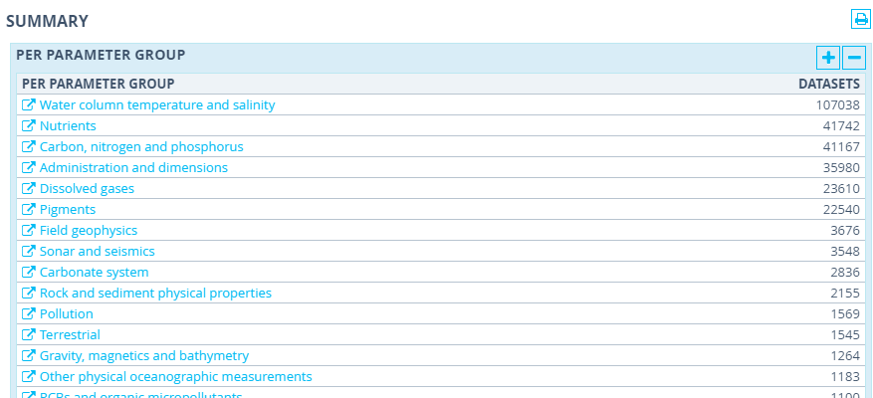
Data Summary in the Arctic by instruments
143,680 data sets taken in the Arctic over 1851-now
Data is mainly distributed in the following fields:
EGU Conference, Vienna, Austria, 8 April 2019
Physical oceanography
Geophysics
Marine Geology
Notes:
20
EGU Conference, Vienna, Austria, 8-13April 2018

Slide 21
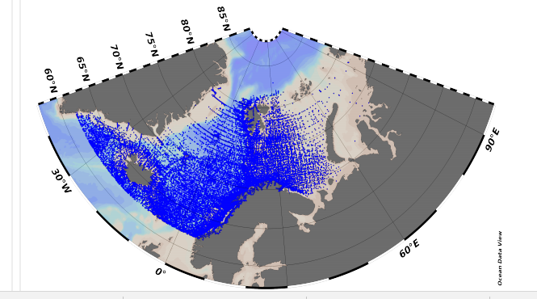
EGU Conference, Vienna, Austria, 8 April 2019
Arctic aggregated dataset 1900-2014
Notes:
21
EGU Conference, Vienna, Austria, 8-13April 2018

Slide 22
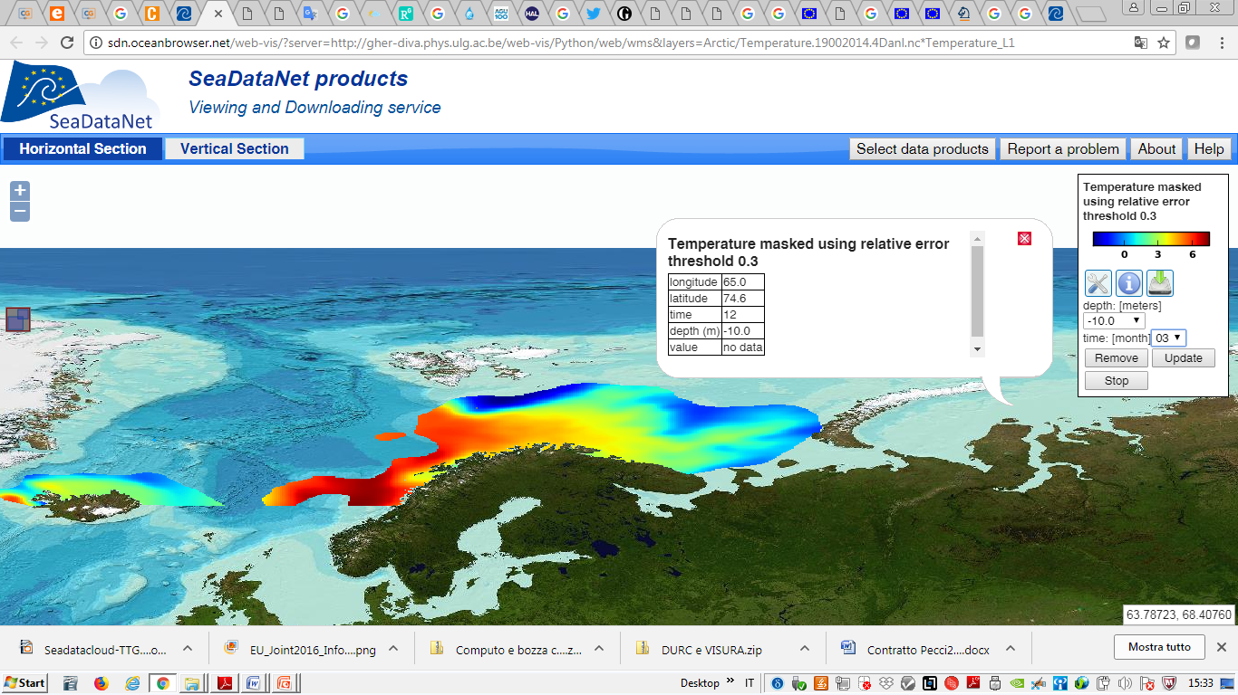
EGU Conference, Vienna, Austria, 8 April 2019
Arctic Climatology
OceanBrowser
Notes:
22
EGU Conference, Vienna, Austria, 8-13April 2018

Slide 23

EGU Conference, Vienna, Austria, 8 April 2019
The highlights
  Easy to use for end-users and data providers
  110 Data centres providing data and metadata
  More than 2,100,000 ocean data sets available
  Vocabulary governance and services
  Standard QA-QC procedures, method for checking possible duplicates
  Standards and interoperability solutions widely recognized by the international community, beyond European borders.
SeaDataNet has participated in the ODIP I and II projects and it collaborates with the existing global infrastructures such as the IOC-IODE – Ocean Data Portal (ODP), GEOSS and the International Council for Science World Data System (ICSUWDS).
Notes:
These strategic collaborations to work towards the common goal of a better interoperability Best practices in data management in collaboration with international infrastructures of U.S., Australia and Canada.
23
EGU Conference, Vienna, Austria, 8-13April 2018

Slide 24
EGU Conference, Vienna, Austria, 8 April 2019
Cooperation and involvement
Copernicus Marine Environmental Monitoring Services (CMEMS): providing long-term archives and standards
Marine Strategy Framework Directive (MSFD): providing infrastructure, standards and data collections for several indicators
Large ocean monitoring systems (EuroGOOS, AtlantOS, Euro-ARGO, JERICO-Next, EuroFleets, ..): providing standards and validation + long-term archiving services
Ocean Data Interoperability Platform (ODIP): exploring and demonstrating common standards and interoperability with leading data management infrastructures in USA and Australia
GEOSS - EuroGEOSS: feeding GEOSS portal with SeaDataNet in-situ data collections from large community of European data holders (> 100 data centres; >600 data originators)
European Open Science Cloud (EOSC): shaping the pilot Blue Cloud
European Marine Observation and Data Network (EMODnet): driving and serving many EMODnet thematic portals
Notes:
Black Sea SCENE involving 6 NODCs and many other data holding institutes from the 6 Black Sea countries, to provide metadata and data access and to strengthen their national NODC networks. EU-funding 3.4 MEuro.
Caspinfo involving 12 institutes and private industry from the Caspian Sea region, to provide metadata and data access and to build their capacity for data management and user services. EU-funding 0.8 Meuro
Geoo seas involving 24 geological and geophysical data centres from 16 European countries (EuroGeoSurveys), to provide metadata and data access. EU-funding 4.9 MEuro.
EuroFleets involving 24 research institutes and data centres from 17 European countries, to optimise the management of research vessels and to streamline the flow of data from the research cruises to the data centre infrastructure. EU-funding 7.2 MEuro.
Jerico involving 27 institutes from 17 European countries, to develop better coordination between the coastal observatories responsible for physical and bio-chemistry parameters as well as to develop improved procedures for streamlining the flow of data from the monitoring stations to the data centre infrastructure. EU-funding 6.5 MEuro.
Emodnet Chemistry chemistry, hydrography, physics lots. SeaDataNet has qualified itself as leading infrastructure for the EMODNet data management component and is leading several preparatory EMODNet projects
24
EGU Conference, Vienna, Austria, 8-13April 2018

Slide 25
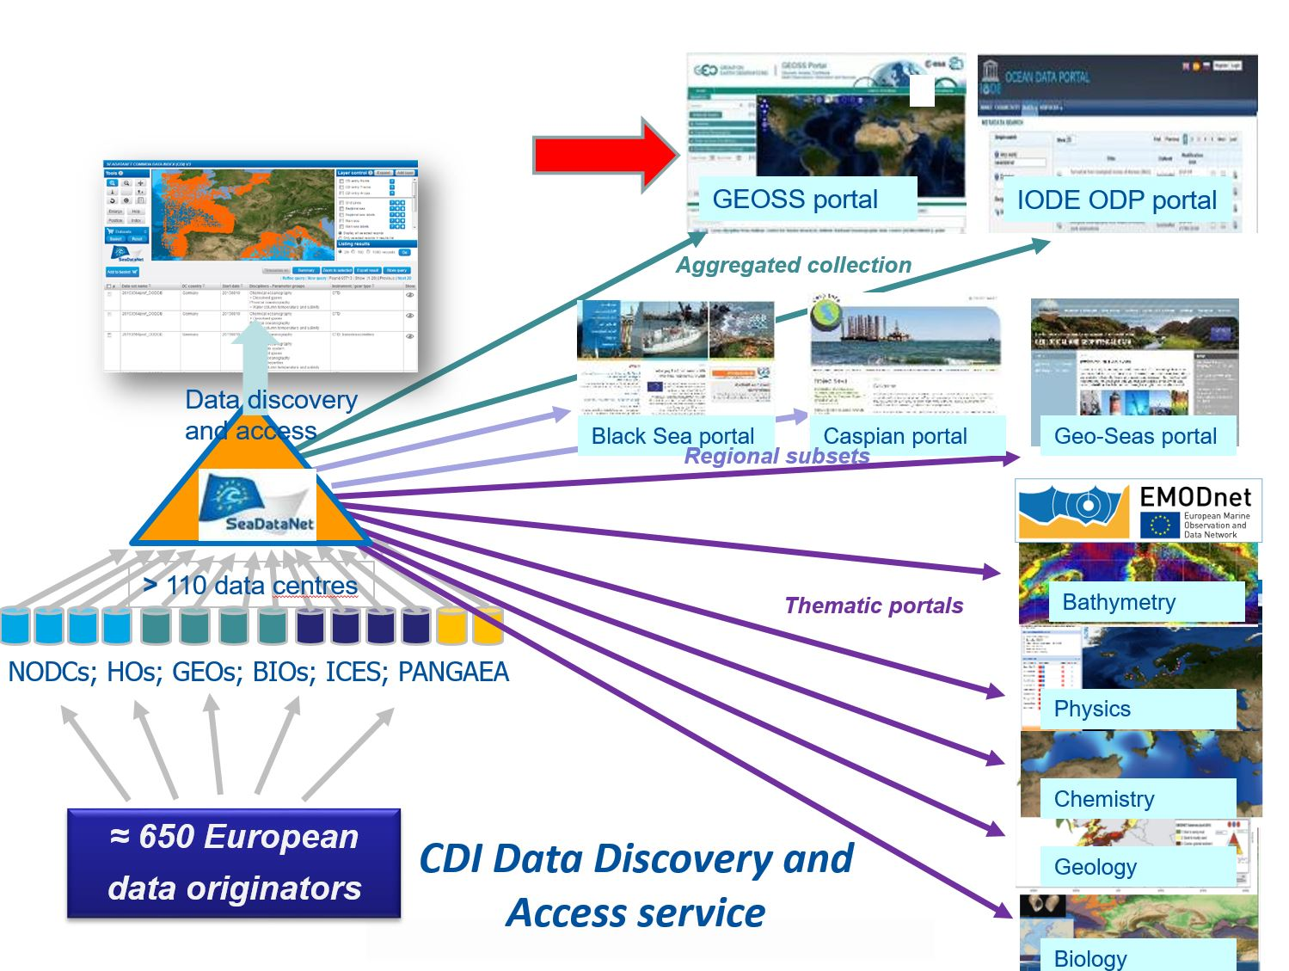
EGU Conference, Vienna, Austria, 8 April 2019
CDI service driving and serving many portals and communities
Notes:
Black Sea SCENE involving 6 NODCs and many other data holding institutes from the 6 Black Sea countries, to provide metadata and data access and to strengthen their national NODC networks. EU-funding 3.4 MEuro.
Caspinfo involving 12 institutes and private industry from the Caspian Sea region, to provide metadata and data access and to build their capacity for data management and user services. EU-funding 0.8 Meuro
Geoo seas involving 24 geological and geophysical data centres from 16 European countries (EuroGeoSurveys), to provide metadata and data access. EU-funding 4.9 MEuro.
EuroFleets involving 24 research institutes and data centres from 17 European countries, to optimise the management of research vessels and to streamline the flow of data from the research cruises to the data centre infrastructure. EU-funding 7.2 MEuro.
Jerico involving 27 institutes from 17 European countries, to develop better coordination between the coastal observatories responsible for physical and bio-chemistry parameters as well as to develop improved procedures for streamlining the flow of data from the monitoring stations to the data centre infrastructure. EU-funding 6.5 MEuro.
Emodnet Chemistry chemistry, hydrography, physics lots. SeaDataNet has qualified itself as leading infrastructure for the EMODNet data management component and is leading several preparatory EMODNet projects
25
EGU Conference, Vienna, Austria, 8-13April 2018

Slide 26
EGU Conference, Vienna, Austria, 8 April 2019
User workshop at EGU 2019
SeaDataNet user workshop will be held at
EGU Conference in Vienna
(Thursday 11 April 2019 - Splinter meeting 10:45 - 12:30 – SMP28 - Room 0.16)
https://meetingorganizer.copernicus.org/EGU2019/session/3370
Notes:
Black Sea SCENE involving 6 NODCs and many other data holding institutes from the 6 Black Sea countries, to provide metadata and data access and to strengthen their national NODC networks. EU-funding 3.4 MEuro.
Caspinfo involving 12 institutes and private industry from the Caspian Sea region, to provide metadata and data access and to build their capacity for data management and user services. EU-funding 0.8 Meuro
Geoo seas involving 24 geological and geophysical data centres from 16 European countries (EuroGeoSurveys), to provide metadata and data access. EU-funding 4.9 MEuro.
EuroFleets involving 24 research institutes and data centres from 17 European countries, to optimise the management of research vessels and to streamline the flow of data from the research cruises to the data centre infrastructure. EU-funding 7.2 MEuro.
Jerico involving 27 institutes from 17 European countries, to develop better coordination between the coastal observatories responsible for physical and bio-chemistry parameters as well as to develop improved procedures for streamlining the flow of data from the monitoring stations to the data centre infrastructure. EU-funding 6.5 MEuro.
Emodnet Chemistry chemistry, hydrography, physics lots. SeaDataNet has qualified itself as leading infrastructure for the EMODNet data management component and is leading several preparatory EMODNet projects
26
EGU Conference, Vienna, Austria, 8-13April 2018

