Slide 1
The contribution of the SeaDataNet infrastructure in the extreme weather events study
Leda Pecci – ENEA (Italy)

Slide 2
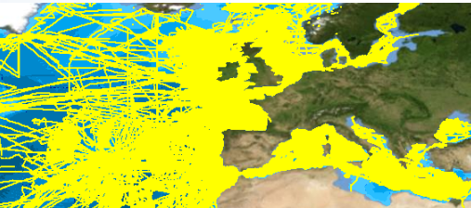
SeaDataNet is a comprehensive Pan-European semi-distributed marine data infrastructure, providing access to multidisciplinary, integrated marine and ocean data and products of standardised quality, services, as well as an overview of marine organisations, research and monitoring activities related to the sea.
Physical oceanography
Chemistry
Geophysics
Marine Geology
Biology
Bathymetry
Selection of data along tracks
Meteorology

Slide 3
Origin
Architecture
Data services (visualisation, quality check)
Metadata services
Data products
Vocabulary services
Software tools
SeaDataNet project activities
Challenges for extreme weather events
How SeaDataNet supports extreme weather events study
The highlights
SeaDataNet standards and tools in other EU projects

Slide 4
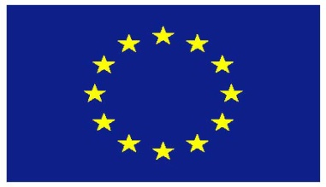
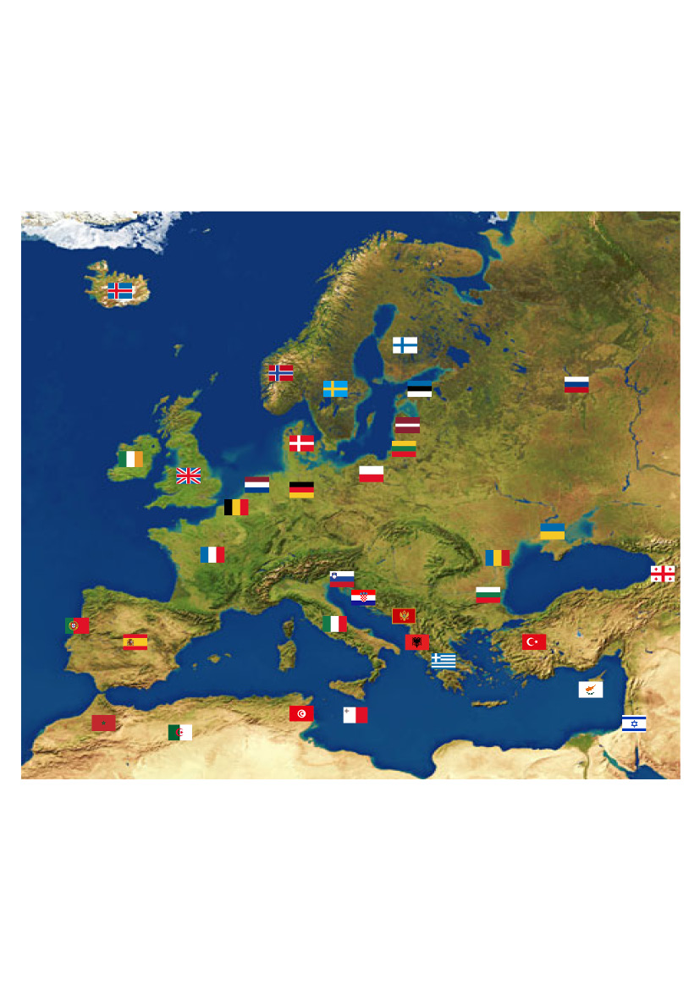
Origin
SeaDataNet started in 1990s and has been developing over the years thanks to EU funded projects:
90 | Metadata directories Medar/MedAtlas
2002-2005 | Sea-Search (FP5)
2006-2011 | SeaDataNet (FP6)
2011-2015 | SeaDataNet II (FP7)
2016-2020 | SeaDataCloud (H2020)
Notes:
SeaDataNet was a EU project funded by FP7 (seventh Programme for Research) started in his first phase in 2006 to 2011.
SeaDataNet is the result of the joint efforts of several marine institutes around the European and the Mediterranean seas.

Slide 5
Architecture
→ a single access for a wide range of data of different types
Central Portal
Data centre
Data centre
NODC
NODC
Data centre
Data centre
NODC
User
Data
Request
Data
Downloading
NODC (National Oceanographic Data Centre)
Notes:
The infrastructure provides a unique point of access to discover and download data residing in remote data centres (or repositories). The CDI service (Common Data Index service) provides a catalogue of global data availability.
1. The user connects to the portal and sends a data request to the central portal.
2. The portal first checks if the data is available and whether the user has the necessary permissions.
3. If so, the portal forwards the request to the data centre(s) that own the data.
4. The user will then receive the data directly from each data centre.

Slide 6
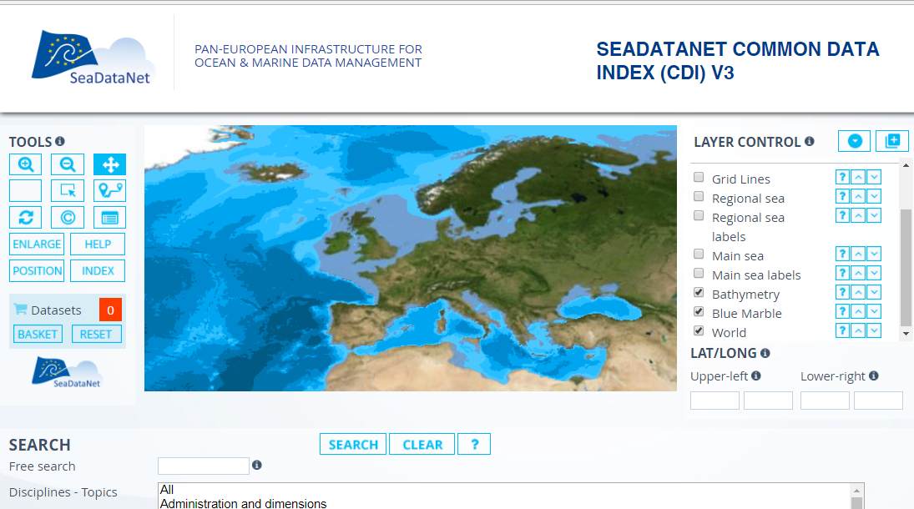
Data services
Discovery, visualization, access and download
http://www.seadatanet.org
Notes:
The SeaDataNet portal offers different services: discovery, visualisation, access and data downloading. The data discovery is freely available, without registration and allows to access metadata. The discovery interface allows searching for data and visualising the results through an interactive map and/or by searching for specific properties.
How to download the data: Data discovery, data selection, Add to the shopping basket and user registration
Data policy: All metadata services are public domain. User registration is required to download data, in order to accept the SeaDataNet license.
The major part of data is freely available (85%). The remaining data have access estrictions and the user has to make arrengements with the data producers to negotiate access for downloading.

Slide 7
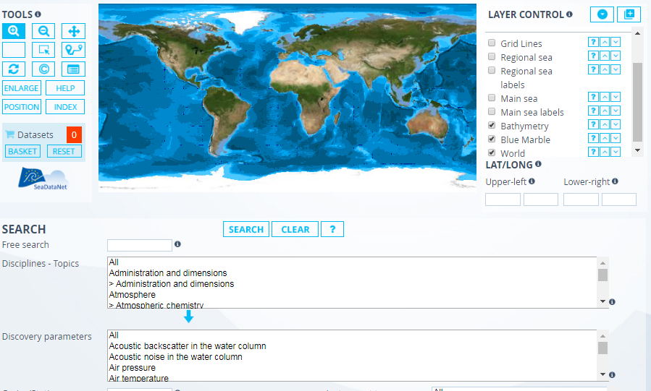

Data Services
Map tools
Data discovery interface
Discipline
Cruise
Parameter
Country
Instrument
Platform
………..
Notes:
The discovery interface allows searching for data and visualising the results through an interactive map and/or by searching for specific properties.
How to download the data: Data discovery, data selection, Add to the shopping basket and user registration
Data policy: All metadata services are public domain. User registration is required to download data, in order to accept the SeaDataNet license.
The major part of data is freely available (85%). The remaining data have access restrictions and the user has to make arrengements with the data producers to negotiate access for downloading.

Slide 8
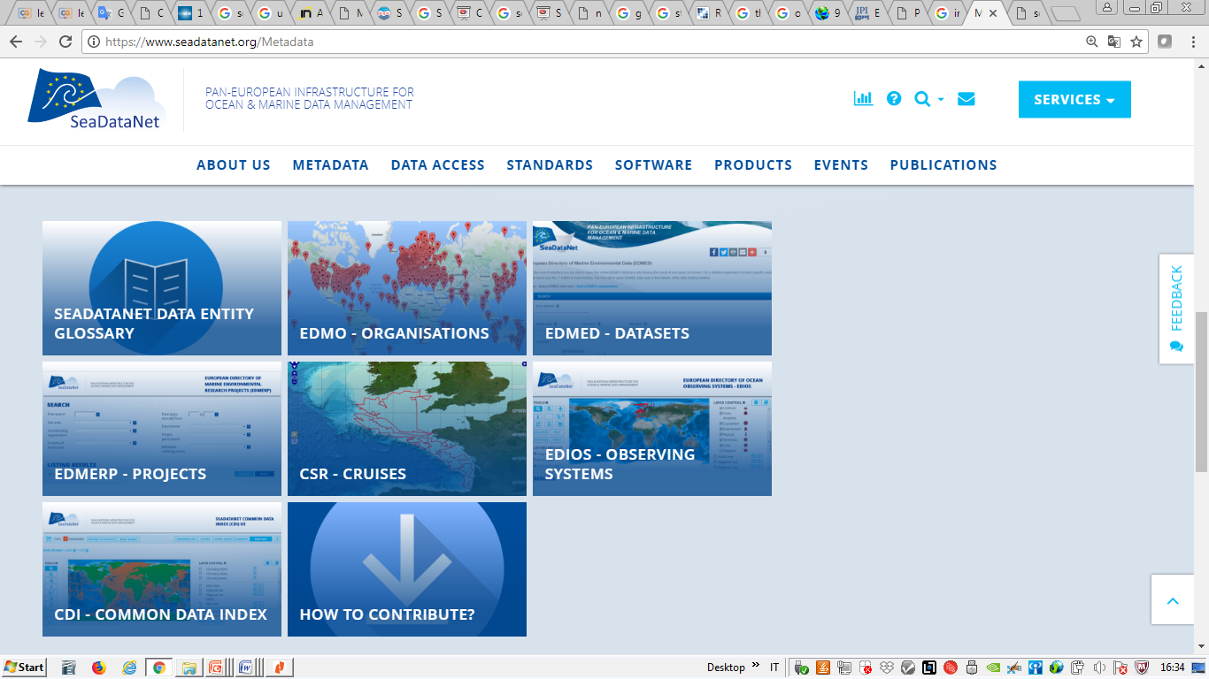
Metadata Services
SDN provides useful information to know which organisations operate in marine environment, what they do and where → chances for future collaborations in research or in the private sector

Slide 9
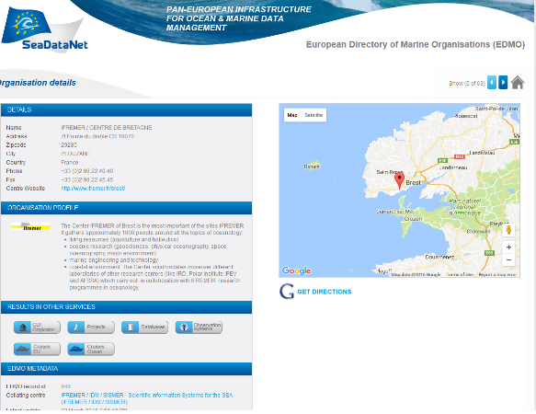
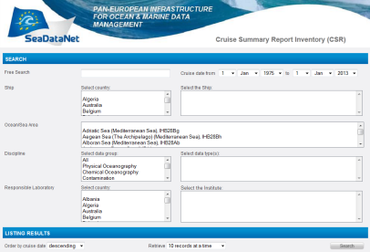


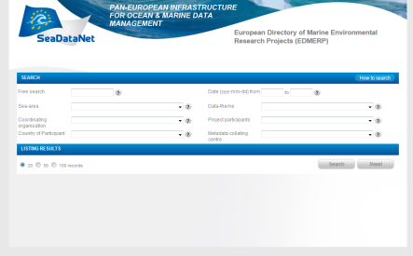
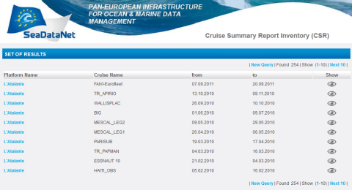
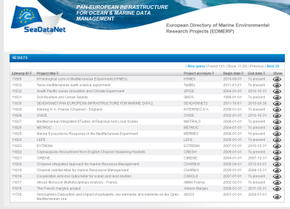
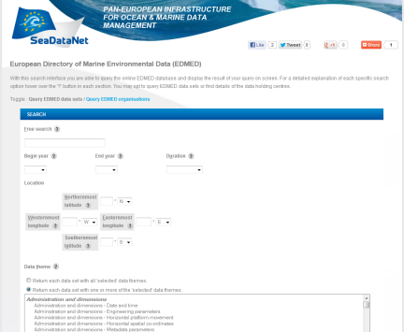
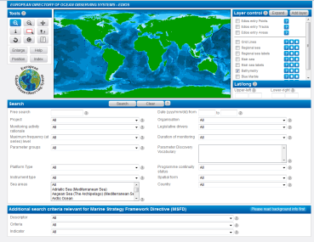
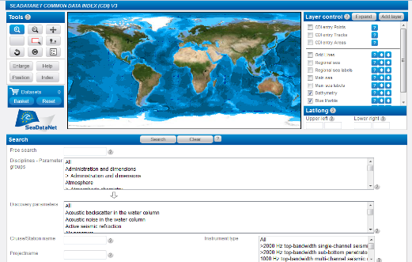
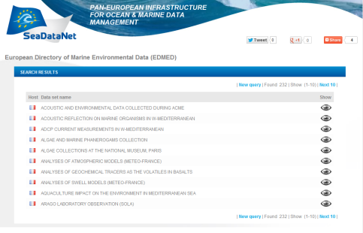
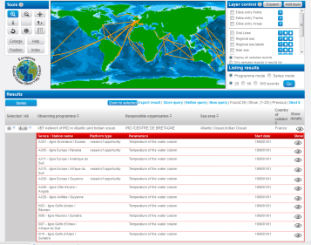
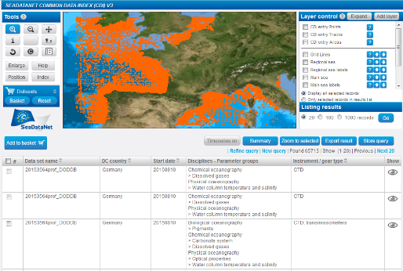
Metadata Services
EDMO
Organisations
COMPLIANT
CSR
EDMERP
Research cruises
Projects
COMPLIANT
EDIOS
EDMED
Observing programmes
CDI
Data sets
Data index
Notes:
SeaDataNet portal provides an overview of the Marine organisations in Europe and their involvement in scientific cruises, data collection, marine projects
EDMO : European Directory of Marine Organisations (
CSR : Cruise Summary Reports (
EDMED : European Directory of Marine Environmental Datasets (
EDMERP : European Directory of Marine Environmental Research projects
EDIOS : European Directory of Ocean Observing Systems ()
CDI : Common Data Index () All SeaDataNet catalogues have been harmonised and tuned in format, syntax and semantics (common vocabularies).
They have a common editor (MIKADO) and online CMS and online query interfaces

Slide 10
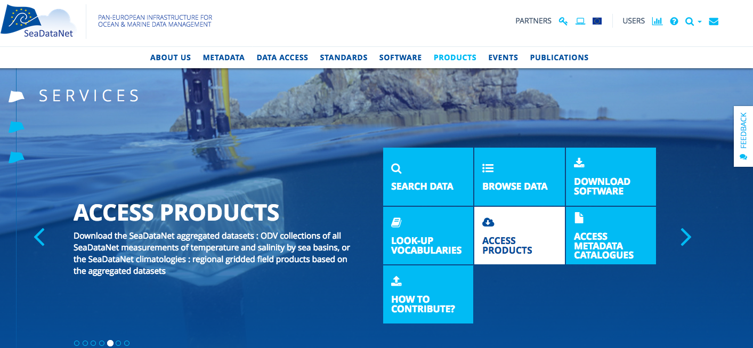
Data Products

Slide 11
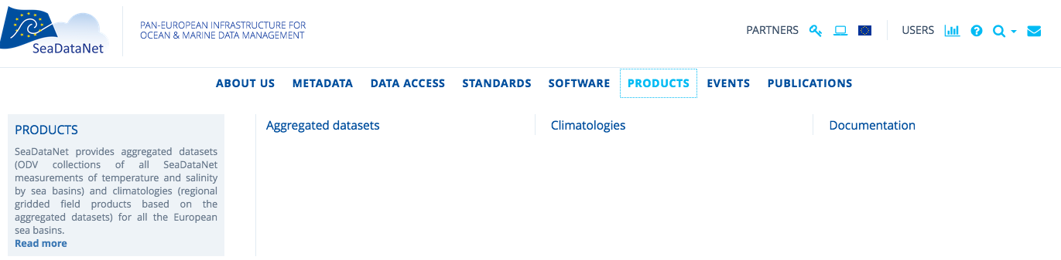
Data Products
gridded climatologies (DOI)
reports describing products’ characteristics and quality (DOI)
Historical data collections of all T and S measurements within SeaDataNet covering all EU sea basins (DOI)
Catalogue

Slide 12
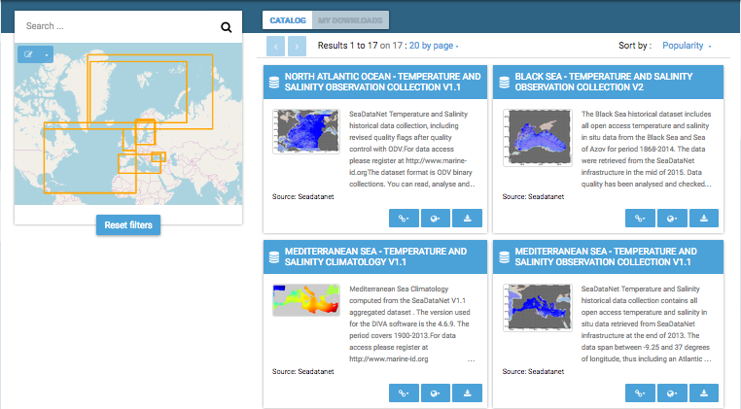
Product Catalogue
12

Slide 13
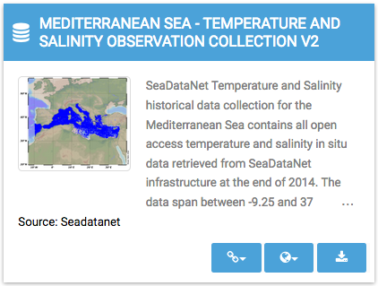
Product Catalogue
Download
Viewing tools Ocean Browser
and Oceanotron
Metadata record (DOI)
13
13

Slide 14
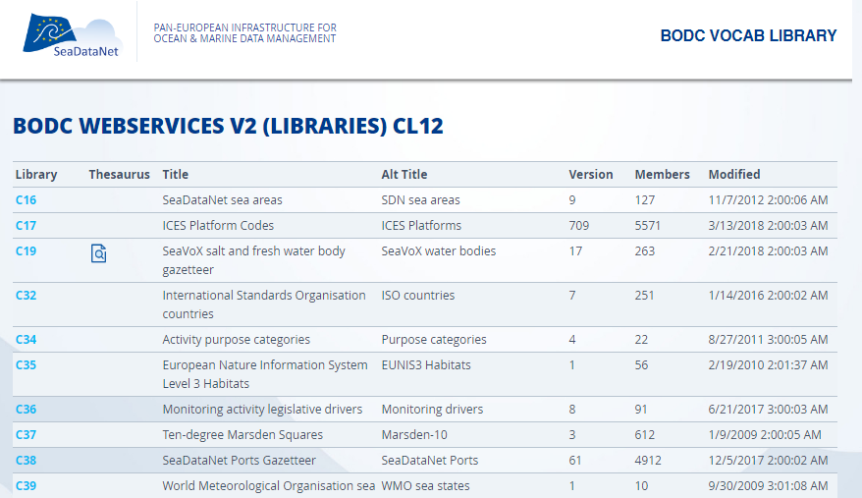
Vocabulary services
Controlled vocabularies used in all metadatabases and data formats (interoperability) organised with international governance, user interfaces and web services

Slide 15
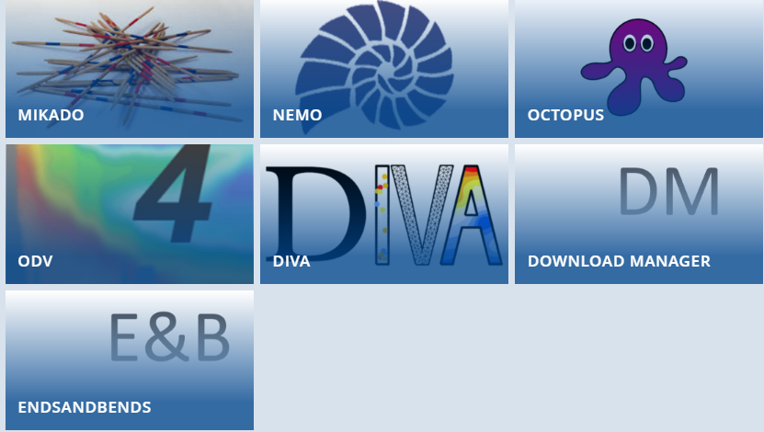
Software Tools
To create metadata CDI, CSR, EDMO, EDIOS, EDMERP
To convert data file
To convert to the internal formats
To present and analyse data
To make available data in data centres
To generate the spatial objects for CDI files
Notes:
NEMO reformat ASCII file of vertical profiles, time series and trajectories to SDN formats file.
NEMO generates the coupling table and a CSV file that is a summary of the data that can be used by Mikado to produce a CDI file for metadata.
The ODV software is also being used in SeaDataNet for producing generic data products for each of the regional seas for various variables. The DIVA software tool ( Data-Interpolating Variational Analysis ) allows to spatially interpolate (or analyse) those observations on a regular grid in an optimal way. As a part of SeaDataNet, the DIVA method has been integrated into ODV, and the integration greatly facilitates the usage of DIVA.
MIKADO: generator of XML descriptions of SeaDataNet catalogues
NEMO: reformatting software to SeaDataNet formats
Download Manager: downloading software
ODV: Ocean data view adapted to SeaDataNet needs
DIVA: for product generation adapted to SeaDataNet needs

Slide 16
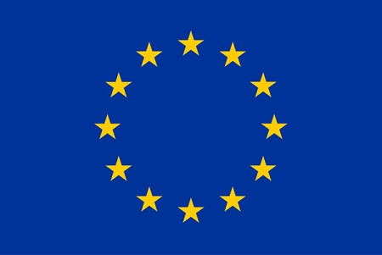
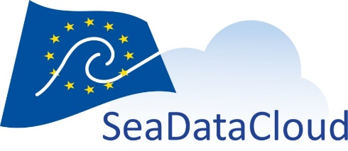

SeaDataCloud project activities
This project has received funding from the European Union’s Horizon 2020 Research Infrastructures programme,
under the grant agreement No 730960”.
Upgrading and innovating existing services for users and data providers:
Advancing the CDI service by adopting cloud
Introducing 'Linked Data principle' to catalogues for
semantic web
Adding transformation facility for INSPIRE compliance
Developing new services for users and data providers:
consortium of e-infrastructure service providers
SWE Ingestion service for Real Time data streams
Brokerage service for mutual exchange with international data networks
Virtual Research Environment (VRE) with advanced services: subsetting, online ODV, DIVA, and visualisation
Notes:
Innovation: The infrastructure is going to offer a virtual research environment that includes on line services for analysis, quality control, data sub-setting, visualisation of retrieved datasets, generation and publication of data products.

Slide 17
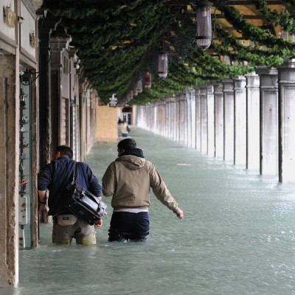
Challenges for extreme weather events
How do oceans drive extreme weather events?
To improve the understanding of variability and climate change and the link between the latter and extreme events
To improve the knowledge of global climate pattern
To predict human influence on climate change
Carrying out research in this field of sea sciences can help the humanity. The availability of great amount of high quality ocean data allows hazard vulnerability assessment and gives the possibility to plan the risk mitigation strategies and the adaptation measures.
High tide in Venice (01dic2008)
Credit: Consorzio Venezia Nuova

Slide 18
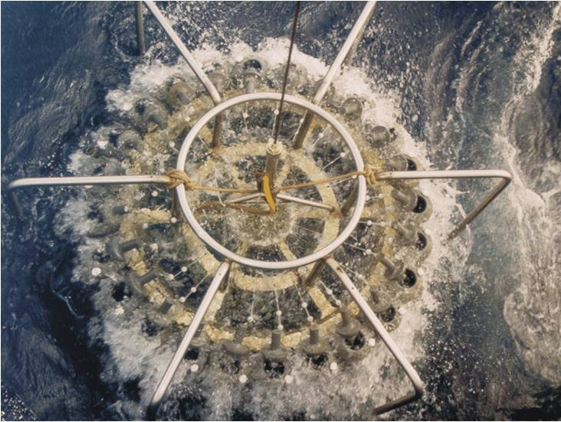
How SeaDataNet supports extreme weather events study
In the SeaDataNet infrastructure are available more than 2 M of data sets comprising bathymetry data as well as temperature, salinity, currents, etc. In situ data is used mainly for validation activity of climate-hazard modelling data and satellite data.
Improved models are used to better forecast and to predict areas that are likely to be very high exposure to climate hazards.
SDN released qualified temperature and salinity historical data collections in the European regional seas as well as climatological maps.
Credit: C. Papucci
Rosette sampler

Slide 19
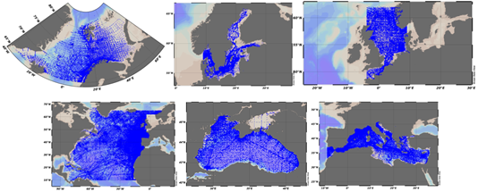
Availability of aggregated dataset 1900-2014

Slide 20
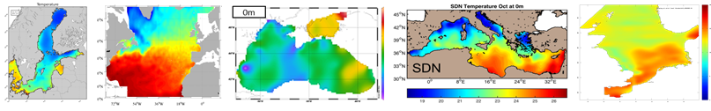
Climatology
OceanBrowser
SDN provides temperature and salinity climatologies, based on the aggregated datasets, for all the European sea basins produced using DIVA software

Slide 21
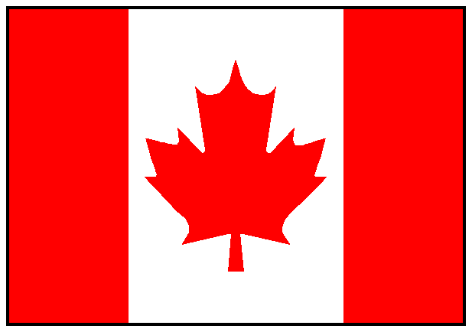
The highlights
  Easy to use for end-users and data providers
  110 Data centres providing data and metadata
  More than 2,100,000 ocean data sets available
  Vocabulary governance and services
  Standard QA-QC procedures, method for checking possible duplicates
  Standards and interoperability solutions widely recognized by the international community, beyond European borders.
  SeaDataNet has participated in the ODIP I and II projects and it collaborates with the existing global infrastructures such as the IOC-IODE – Ocean Data Portal (ODP), GEOSS and the International Council for Science World Data System (ICSUWDS).
Notes:
These strategic collaborations to work towards the common goal of a better interoperability Best practices in data management in collaboration with international infrastructures of U.S., Australia and Canada.

Slide 22
Cooperation and involvement
Copernicus Marine Environmental Monitoring Services (CMEMS): providing long-term archives and standards
Marine Strategy Framework Directive (MSFD): providing infrastructure, standards and data collections for several indicators
Large ocean monitoring systems (EuroGOOS, AtlantOS, Euro-ARGO, JERICO-Next, EuroFleets, ..): providing standards and validation + long-term archiving services
Ocean Data Interoperability Platform (ODIP): exploring and demonstrating common standards and interoperability with leading data management infrastructures in USA and Australia
GEOSS - EuroGEOSS: feeding GEOSS portal with SeaDataNet in-situ data collections from large community of European data holders (> 100 data centres; >600 data originators)
European Open Science Cloud (EOSC): shaping the pilot Blue Cloud
European Marine Observation and Data Network (EMODnet): driving and serving many EMODnet thematic portals
Notes:
Black Sea SCENE involving 6 NODCs and many other data holding institutes from the 6 Black Sea countries, to provide metadata and data access and to strengthen their national NODC networks. EU-funding 3.4 MEuro.
Caspinfo involving 12 institutes and private industry from the Caspian Sea region, to provide metadata and data access and to build their capacity for data management and user services. EU-funding 0.8 Meuro
Geoo seas involving 24 geological and geophysical data centres from 16 European countries (EuroGeoSurveys), to provide metadata and data access. EU-funding 4.9 MEuro.
EuroFleets involving 24 research institutes and data centres from 17 European countries, to optimise the management of research vessels and to streamline the flow of data from the research cruises to the data centre infrastructure. EU-funding 7.2 MEuro.
Jerico involving 27 institutes from 17 European countries, to develop better coordination between the coastal observatories responsible for physical and bio-chemistry parameters as well as to develop improved procedures for streamlining the flow of data from the monitoring stations to the data centre infrastructure. EU-funding 6.5 MEuro.
Emodnet Chemistry chemistry, hydrography, physics lots. SeaDataNet has qualified itself as leading infrastructure for the EMODNet data management component and is leading several preparatory EMODNet projects

Slide 23
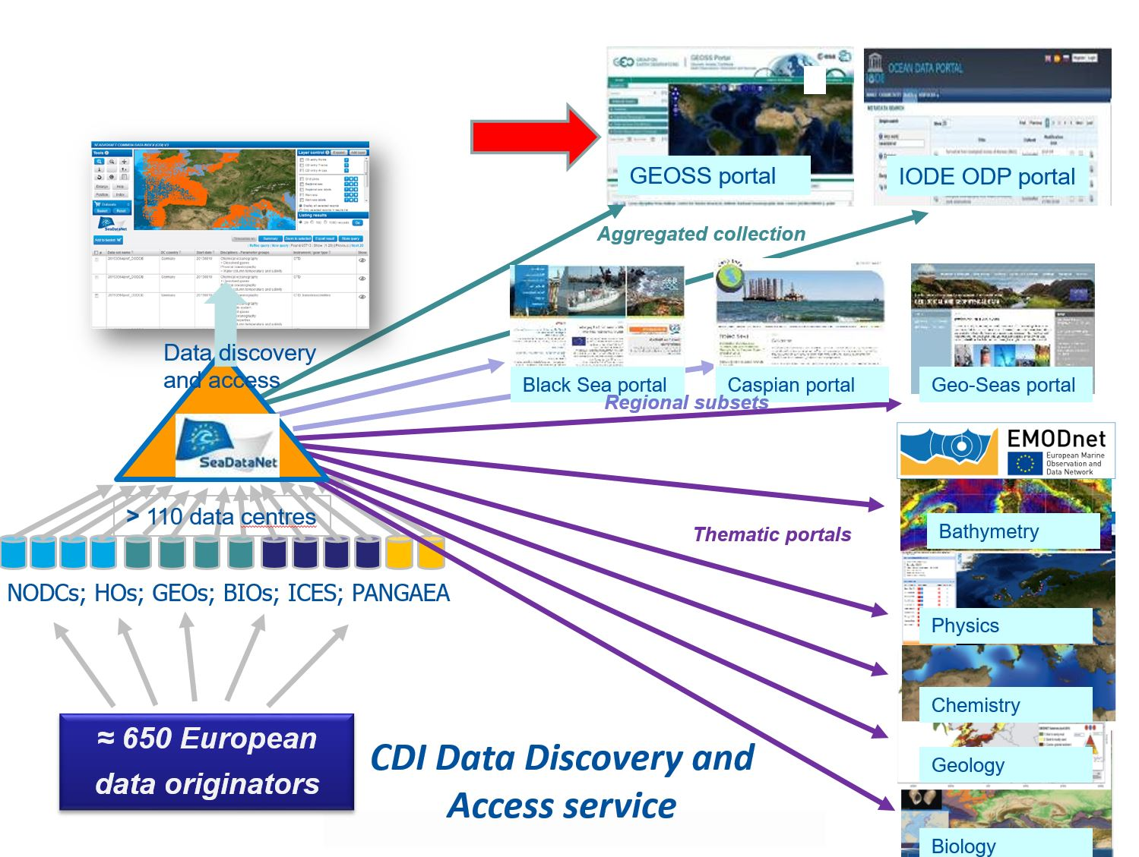
CDI service driving and serving many portals and communities
Notes:
Black Sea SCENE involving 6 NODCs and many other data holding institutes from the 6 Black Sea countries, to provide metadata and data access and to strengthen their national NODC networks. EU-funding 3.4 MEuro.
Caspinfo involving 12 institutes and private industry from the Caspian Sea region, to provide metadata and data access and to build their capacity for data management and user services. EU-funding 0.8 Meuro
Geoo seas involving 24 geological and geophysical data centres from 16 European countries (EuroGeoSurveys), to provide metadata and data access. EU-funding 4.9 MEuro.
EuroFleets involving 24 research institutes and data centres from 17 European countries, to optimise the management of research vessels and to streamline the flow of data from the research cruises to the data centre infrastructure. EU-funding 7.2 MEuro.
Jerico involving 27 institutes from 17 European countries, to develop better coordination between the coastal observatories responsible for physical and bio-chemistry parameters as well as to develop improved procedures for streamlining the flow of data from the monitoring stations to the data centre infrastructure. EU-funding 6.5 MEuro.
Emodnet Chemistry chemistry, hydrography, physics lots. SeaDataNet has qualified itself as leading infrastructure for the EMODNet data management component and is leading several preparatory EMODNet projects

