Slide 1
SeaDataNet-II Training Course
European Directory of the Ocean-observing System (EDIOS)
Oostende, 2 July 2012

Slide 2
Aim:
Understanding of what EDIOS is
Understanding of content required for EDIOS entries

Slide 3
European Directory of the Ocean-observing System (EDIOS)
EDIOS is an information system for marine observing stations (including moored buoys, coastal installations, seabed stations, drifting buoys, repeated sections and sampling stations, airborne repeated tracks, etc) where there are routine, repeated, and consistent long-term observations of the marine environmental conditions.

Slide 4
Examples of observing programmes
Swedish Real Time Oceanographic Monitoring Network - Moored Buoys (SMHI)
Bathing waters monitoring programme
CSEMP Shellfish Contaminants Programme
RECOPESCA - Network of fishing effort and environment parameters
XBT network of IRD in Atlantic and Indian Ocean
Norwegian Sea Monitoring Programme Fixed Oceanographic Sections
Norwegian Coast Monitoring Programme Fixed Stations and Ferry Box
Mackerel Egg Survey
Irish Groundfish Survey (International Bottom Trawl Survey)
NIEA Cetacean Monitoring Northern Ireland
Marine Turtle Entanglement Surveys
Marine Environmental Monitoring Network in the North Sea and Baltic Sea

Slide 5
EDIOS Version 0
Original EDIOS project ran from 2001 – 2004
Initiative of the European Global Ocean Observing System (EuroGOOS)
Input was via a mixture of Metadata Input Forms (MIFs), spreadsheets and database export files
Five regional coordinators collected and collated input and passed to BODC
Input supplied by 30 countries
Front-end query and map interface designed by MARIS

Slide 6
EDIOS – Current status – July 2012
EDIOS is hierarchical and has been complex to implement using ISO19115
Mikado software tool includes EDIOS
3 schemas for: observing programmes, series and platforms
User Manual explains in some detail how to produce XML files in manual or automatic mode
Old (V0) EDIOS entries will not be upgraded
Can be retrieved as examples for producing new entries

Slide 7
Information Required for EDIOS
EDIOS has 3 levels:
  Programmes
  Series
  Platforms

Slide 8
Relationships within EDIOS (1)
Observing programme
Series 1 Series 2 Series 3 Series4 etc...
Platform 1 Platform 2 Platform 3 Platform 4 etc....

Slide 9
Relationships within EDIOS (2)
Observing programme
Series 1 Series 2 Series 3 Series4 etc...
Platform

Slide 10
Relationships within EDIOS (3)
Observing programme
Series 1 Series 2 Series 3 Series4 etc...
Platform 1 Platform 2

Slide 11
Relationships within EDIOS (4)
Observing programme
Series 1
Platform 1

Slide 12
Prepare your XML files via the MIKADO tool in manual or automatic mode
First create the programmes
Then the series
And finally the platforms
An EDIOS programme can relate to multiple series
Therefore an EDIOS Programme identifier is used in the EDIOS series form as the EDIOS programme reference
The EDIOS series identifier(s) is used in the EDIOS platforms form as the EDIOS series reference.
NOTE: Do not use ‘unusual’ characters in filenames (e.g. ž, ð, ö, å, ê). Do not leave blank spaces in filenames – use underscore (‘_’) instead.
Notes:
Re

Slide 13
Use of vocabularies in EDIOS
Metadata needs to be mapped with the following vocabularies which are used by MIKADO for the construction of the EDIOS XML format:
  EDMO
  EDMERP
  C16 (Sea Areas)
  P021 (Parameters Discovery Vocabulary)
  L121 (Parameter quality control procedures)
  L061 (SeaVoX Platform Classes)
  L081 (Data Access Restriction Policies)

Slide 14
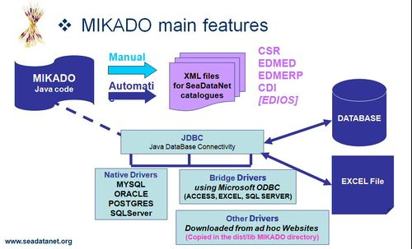
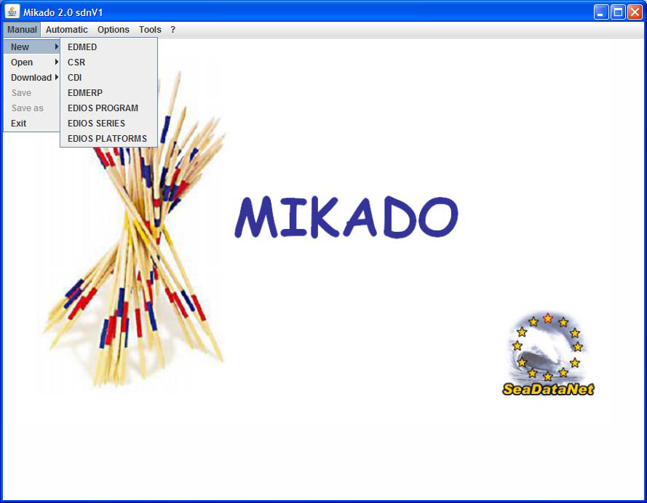
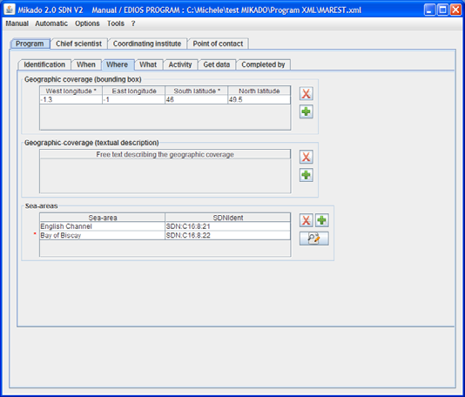
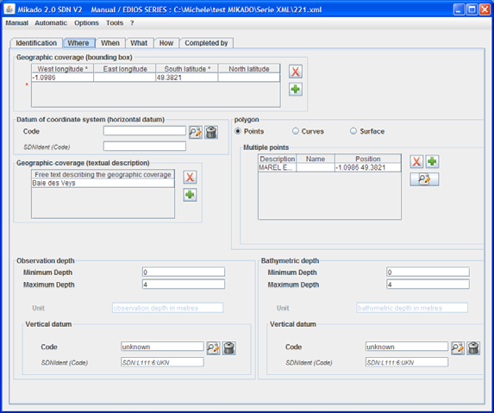
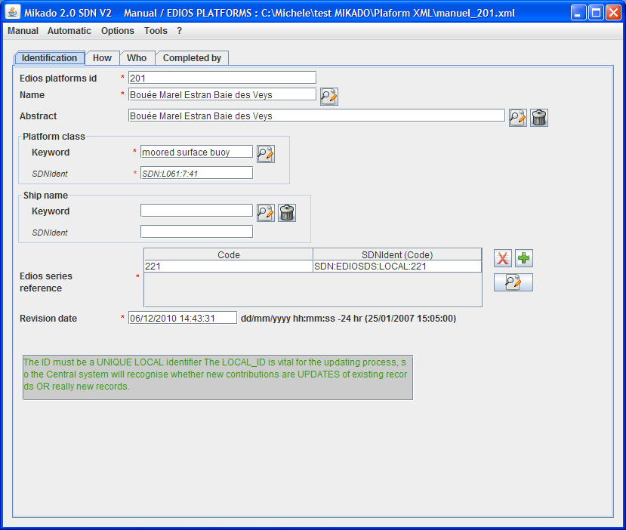
Mikado Software Tool
Tallinn, 16-17 June 2011

Slide 15
Mandatory Programme Information
EDIOS program identifier (local identifier)
Program acronym
Program Name
Start date
Sea-areas
Abstract
Data Access Restriction
Collate Centre (EDMO reference)
Principal investigator/laboratory
Coordinating institute (EDMO reference)

Slide 16
EDIOS Program information window 'Identification'
Program Id (Mandatory)
Must be UNIQUE. It is used to recognise updated records.
Program Acronym (Mandatory)
Shortened version of the observing program name. [up to 50 characters]
Program Name (Mandatory)
It should be unique, and describe the observing program. [up to 200 characters]

Slide 17
Programme information
EDIOS programme identifier (local identifier) examples:
  MON_BH, MON_NH, MON_NH, MON_NS, …
  SMHI MOORED BUOY, SMHI TIDE GAUGE, …
  GR1, GR2, GR3, GR4, …
  RADIALES_PROGRAM, …
  UA_MedGLOSS_BS, …

Slide 18
Programme identification information
EDIOS programme name examples:
Barents Sea Monitoring Programme Fixed Oceanographic Sections
Swedish Real Time Oceanographic Monitoring Network - Moored Buoys (SMHI)
POSEIDON Monitoring System
Series temporales de Oceanografía en el Norte de España
Marine Environmental Monitoring Network in the North Sea and Baltic Sea
PErmanent environmental RAdioactivity Observatories (OPERA)
Mackerel Egg Survey

Slide 19
Programme identification information tips
The programme must have a name, e.g. ‘Not available’ or ‘Unknown’ are NOT acceptable names
Programme names should be unique, e.g. NO duplicate programme names from an organisation
Programme name should NOT be all UPPER CASE
The programme acronym must NOT be ‘Not available’ or ‘Unknown’
Programme description should NOT be all UPPER CASE
There should NOT be identical programme descriptions from the same originator

Slide 20
EDIOS Program information window 'When'
Start date (date in iso8601, format YYYY or YYYY/MM/DD) (Mandatory) the earliest year when observations began for the program. This does not mean when real time measurements began, but when any form of observations started.
End date (date in iso8601, format YYYY or YYYY/MM/DD): this is almost always left empty, as EDIOS is a directory of on-going observing programs (i.e. it is expected that the observations are continuing). It is NOT the latest date for which measurements have been received. The end date cannot be in the future.

Slide 21
EDIOS Program information window 'Where'
Select the appropriate Sea-areas Only include an entire ocean if the data set has ocean wide coverage. Mandatory
Geographic coverage (bounding box): limits of dataset in degrees latitude and longitude. If included, it must cover all the positions in the series records

Slide 22
EDIOS Program information window 'What'
Projects: Used to Link to the European Directory of Marine Environmental Research Projects (EDMERP).
Data set: can be linked to EDMED record
Abstract: Mandatory. A concise description containing brief statements for describing the programme. Should NOT be all upper case. Check spelling. Should be unique.

Slide 23
Example EDIOS abstracts (1)
POSEIDON is a comprehensive marine monitoring and forecasting system, that aims to improve environmental surveillance and facilitate sea transport, rescue and safety of life at sea, fishing and aquaculture, protection of the marine ecosystem, etc. POSEIDON enhanced considerably the capabilities to manage, protect and develop the marine resources of the Greek Seas and to promote Greek Operational Oceanography

Slide 24
Example EDIOS abstracts (2)
The Environment Agency monitors 497 marine bathing waters and 5 inland waters. Sampling is conducted 20 during May to September only.
There are two main sets of standards for measuring bathing water quality: the minimum standard and the stricter guideline standard. All bathing waters must meet the minimum standard, the stricter guideline standard is used by the European Bathing Waters directive to assess bathing waters across all member states.
Data held in Defra's Bathing Water Database and Environment Agency archive.
Further information at: http://www.environment-agency.gov.uk/yourenv/eff/1190084/water/213925/bathing/?lang=_e

Slide 25
Example EDIOS abstracts (3)
Time series of physical and chemical data are generated by the BSH observational network MARNET. Here, the instrument chains are connected to special surface buoys, unmanned light vessels or fixed platforms. In contrast to moorings the data are not stored internally but transmitted directly to a land station. In general the data are received every hour by the land station and allow an up-to-date description of the state of the ocean.

Slide 26
Series information
EDIOS series identifier (local identifier)
Series acronym
Series Name
Geographic coverage (bounding box)
Start date
Abstract
Parameters
Quality control procedures
Collate Centre (EDMO reference)

Slide 27
EDIOS Series information window 'Identification'
Series Id (Mandatory)
Must be UNIQUE. It is used to recognise updated records.
Series Acronym (Mandatory)
Shortened version of the series name.
Series Name (Mandatory)
It should be unique within the programme and describe the series. It is NOT the same as the programme name.
EDIOS Programme Reference (Mandatory) Link back to programme record previously defined (local id).

Slide 28
EDIOS Series information window ‘Where'
Geographic coverage (Mandatory). This refers to the individual series.
If it is a point, then enter the latitude into the ‘South latitude’ box and longitude into the ‘West longitude’ box.
If the series is a cruise track, then waypoints (latitude/longitude pairs) should be added under ‘Polygon’ and ‘Curves’. They should be entered from west to east.
For a surface (area), enter waypoints anticlockwise and repeat the first waypoint as last waypoint.

Slide 29
EDIOS Series information window ‘When’
Start date dd/mm/yyyy (Mandatory) This is the start date of the individual series, and should be day, month, year.
End date: This will usually be left empty as measurements are continuing.
Sampling interval (Mandatory) Unit of measurement is selected from a list. Note this refers to time intervals only.

Slide 30
EDIOS Series information window ‘What’
Parameters measured (Mandatory) Selected from vocabulary P021. Each parameter only needs to be included once – e.g. if there are 3 temperature sensors on the same mooring, only include ‘TEMP’ once.
Abstract (Mandatory) is for the series NOT the same one as used at the programme level.

Slide 31
Platform information
EDIOS platform identifier (local identifier)
Platform Name
Platform class
Platform Owner (EDMO reference)
Collate Centre (EDMO reference)

Slide 32
EDIOS Platform information window 'Identification'
Platform Id (Mandatory)
Must be UNIQUE. It is used to recognise updated records.
Platform Name (Mandatory)
It should be unique within the programme and describe the platform. ‘Not available’ or ‘not known’ are NOT acceptable.
Platform class (Mandatory)
Selected from vocabulary L061 (e.g. Research vessel, coastal structure)
EDIOS Series Reference (Mandatory) Link back to series record previously defined. Can link to more than one series.

Slide 33
Updating and maintaining EDIOS entries
Why do we need to do this?
Incorrect information supplied
Information changes with time
For those with their own databases of EDIOS information, revised EDIOS program, series and platform XML files must be supplied.
For those without their own databases:
  Revised XML files can be sent as above
  Or for small amendments, these can be sent to BODC, who will edit the records in the master database
Where incorrect information is discovered by BODC in checking and loading information to the database, this will be fed back to the information supplier. Revised information may be suggested.
BODC is developing software to compare the new records with existing records at BODC, this allows a level of checking before replacing old values with revised ones.

Slide 34
To look at existing EDIOS entries, visit:
http://seadatanet.maris2.nl/v_edios_v2/search.asp
To look at EDIOS entries in the test database, visit:
http://edios-test.maris2.nl/v_edios_v2/search.asp
Coming soon: EDIOS Content Guidance Note
Send completed EDIOS files to BODC:
Lesley Rickards (ljr@bodc.ac.uk)
Maureen Pagnani (mred@bodc.ac.uk)

