Slide 1
Cruise Summary Report Content Management
02.07.2012 SDN2 1. Training Workshop - Ostend, Belgium

Slide 2
CSR Content Management
Table of contents
Metadata Catalogues & Common Vocabularies
How to submit Cruise Summary Report
Online Content Management System
CMS via Mikado
SeaDataNet 2 Look and Feel
Practical Session with Online CMS

Slide 3
CSR Content Management
Metadata catalogues & common vocabularies
Use of Metadata Catalogues:
EDMO Metadata for organisations
EDMERP Metadata for projects
be sure that all required organisations and projects are already entered into EDMO and EDMERP respectively
Use of common vocabularies:
Ship / Platform C174 SeaDataNet CSR ship metadata
Port of departure / return C381 Ports Gazetteer
Access restriction L081 SDN Data Access Restriction Policies
Parameters measured P02 SeaDataNet Parameter Discovery Vocabulary
Device used L05 SeaDataNet device categories
ROSCOP data type C77 SeaDataNet CSR data categories
Quantification unit L181 SeaDataNet CSR quantification units
General Ocean Area C16 SeaDataNet Sea Areas
Marsden Square C371 Ten-degree Marsden Squares
be sure that all required ships are already added to C174 (obtain ship code from ICES)

Slide 4
CSR Content Management
How to submit Cruise Summary Report
1) via Online Content Management System
entry and modification / updates directly into CSR entry database
up-to-date EDMO, EDMERP and common vocabularies
automatically loaded into CSR database once completed and checked
master record at BSH
2) creation of XML records via Mikado
offline possible, independent of network
online update of EDMO, EDMERP and vocabularies possible
master record at your data centre
submission currently via email or ftp
modification/updates via download function and BSH CSR web service
3) self generated XML records
using own software
master record at your data centre
submission currently via email or ftp

Slide 5
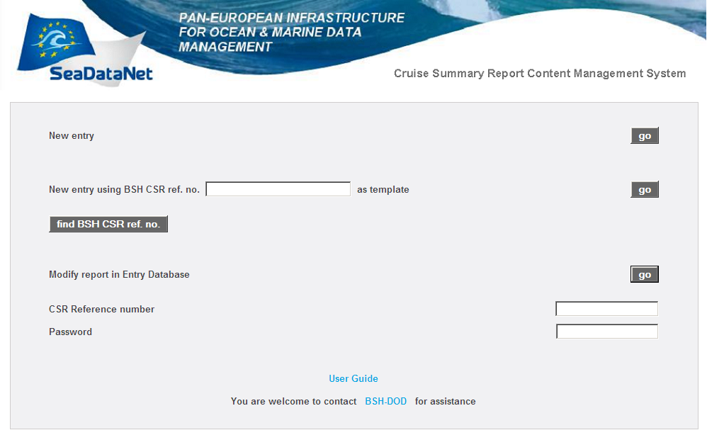
Online Content Management System
CSR Content Management
Using a blank form
Using a template from former records

Slide 6
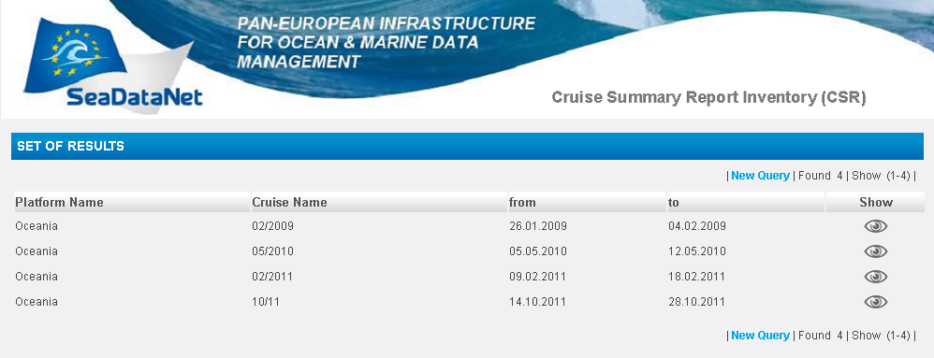
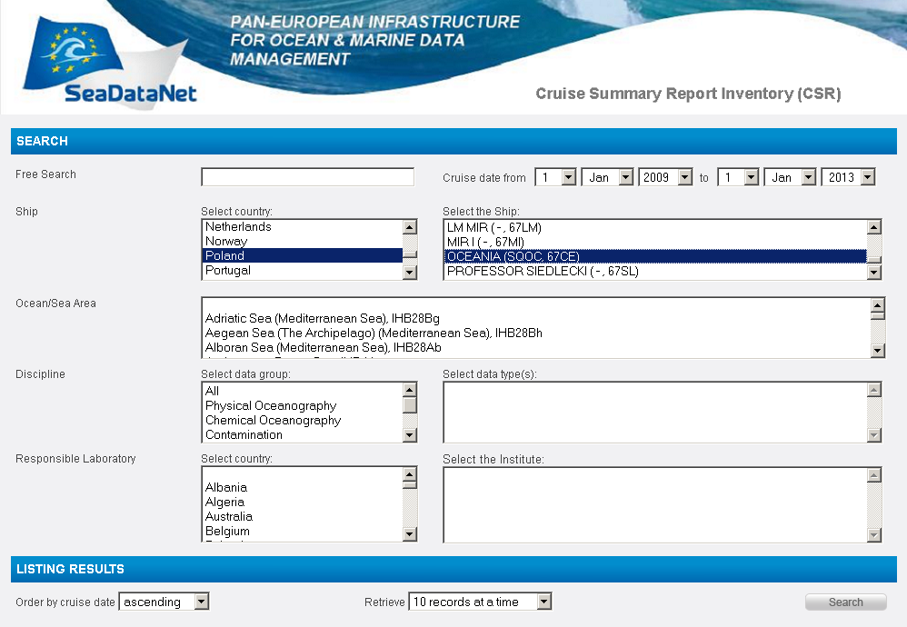
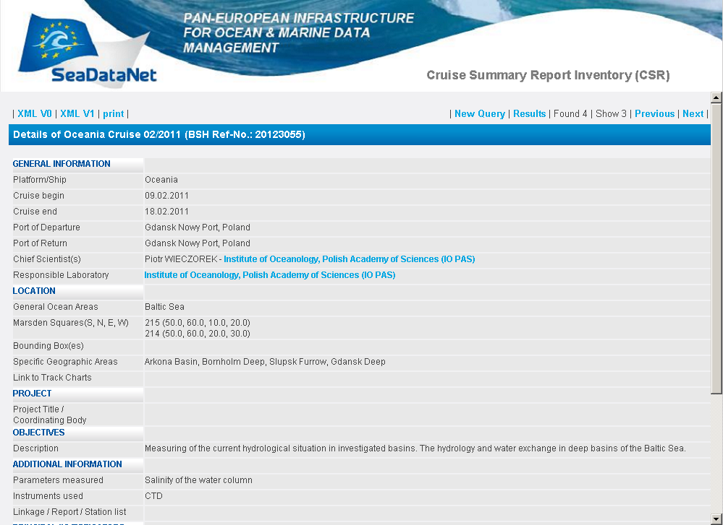
Online CMS - search User Interface for CSR ref.
CSR Content Management

Slide 7
Online Content Management System
CSR Content Management
Using a blank form
Using a template from former records
Modify a record in entry database:
CSR ref. number & password required

Slide 8
Online Content Management System
CSR Content Management
Similar to the former ROSCOP forms the Cruise Summary Report has 4 basic sections:
General cruise information (Part A)
Mooring description (Part B)
Sampling/Measurement description (Part B)
Information on geographical coverage (Part B)

Slide 9
Online Content Management System
CSR Content Management
Mandatory fields in Part A:
Contact E-Mail address (important for control mails)
Ship
Begin & end of cruise
Cruise name
Cruise ID (given by data centre, default BSH ref. No.)
Responsible laboratory
Chief scientist
Access restriction
Objectives
Mandatory fields in Part B:
Ocean area
Bounding box / Marsden square

Slide 10
Online Content Management System
CSR Content Management
The major differences to previous version are
viewing of report during input (after saving Part A)
scientists list in alphabetical order of surnames with specification of
organisation in brackets
input of cruise ID given by data centre
moorings Latitude and Longitude as degrees (decimal)
handling of selection lists will be continuously improved
to come: upload of track charts also in GML-format

Slide 11
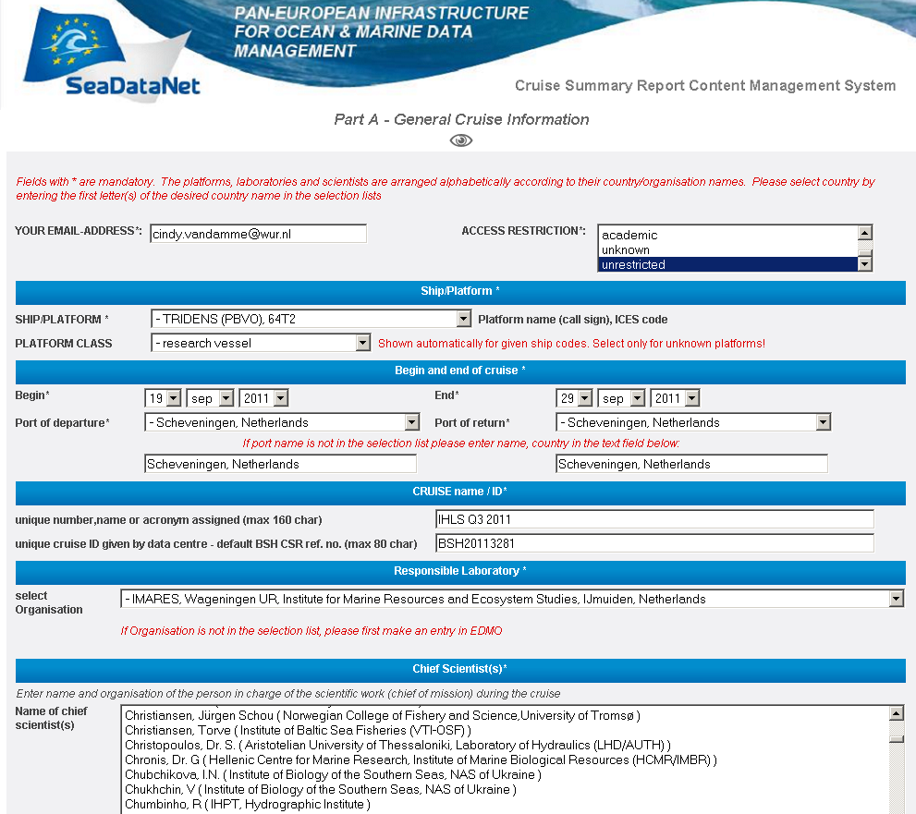
Online Content Management System
CSR Content Management
Mandatory fields marked
with asterisk *
Data centre cruise ID
Scientist in alphabetical order of surnames

Slide 12
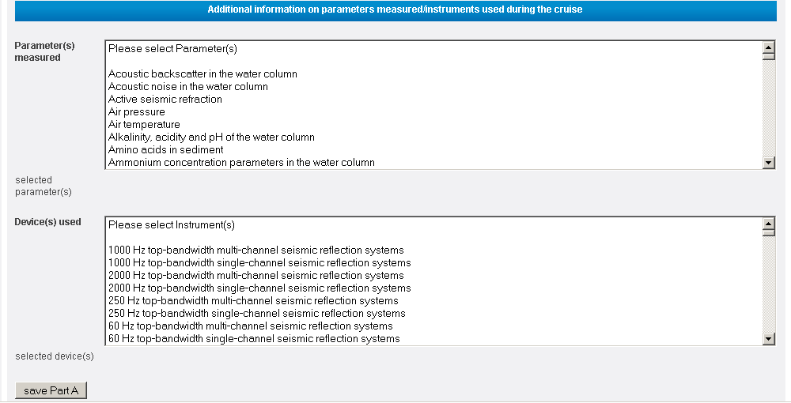
Online Content Management System
CSR Content Management
Save Part A after filling in the mandatory fields

Slide 13
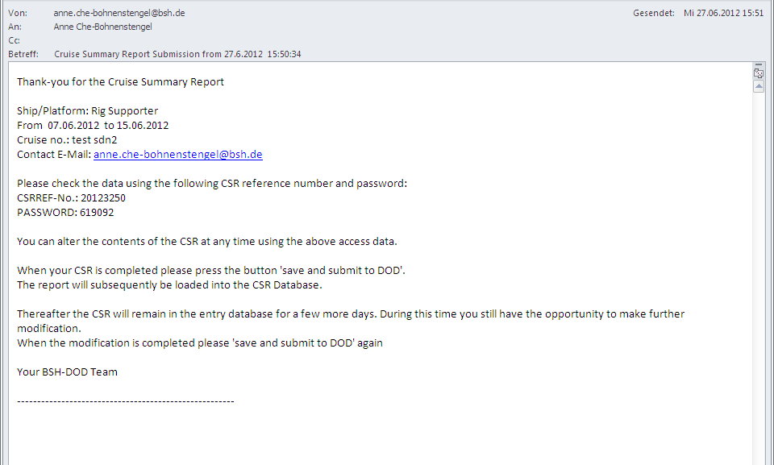
Online Content Management System
Automatic control email received after saving Part A
Access information for later modification of this CSR record
in the entry database

Slide 14
Online Content Management System
CSR Content Management
View report after saving into entry database

Slide 15
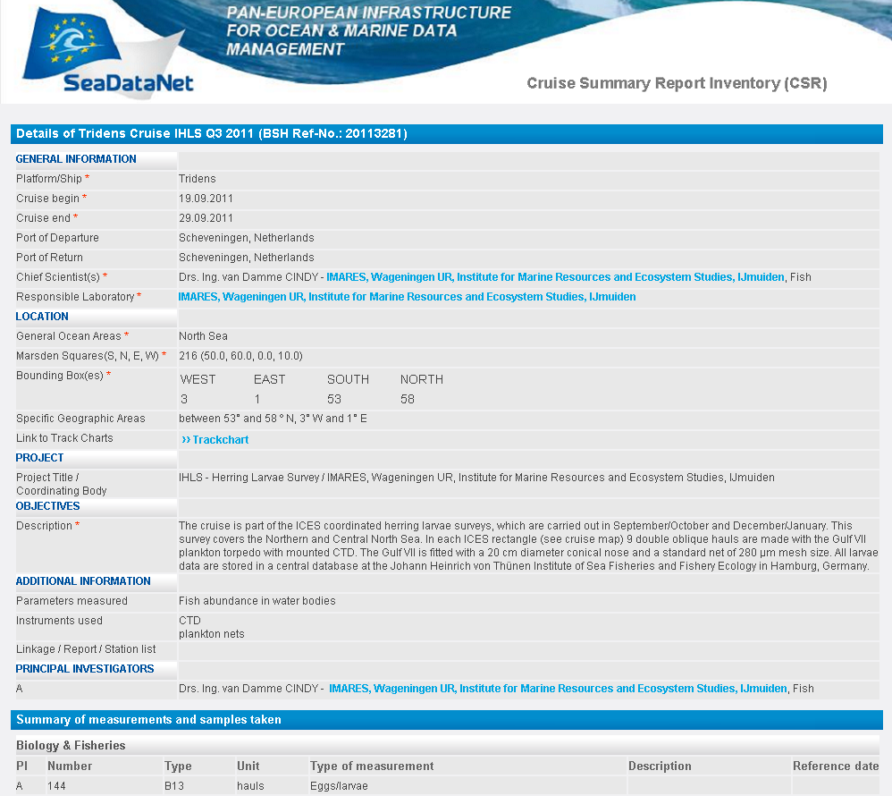
Online Content Management System
CSR Content Management
Mandatory fields with *

Slide 16
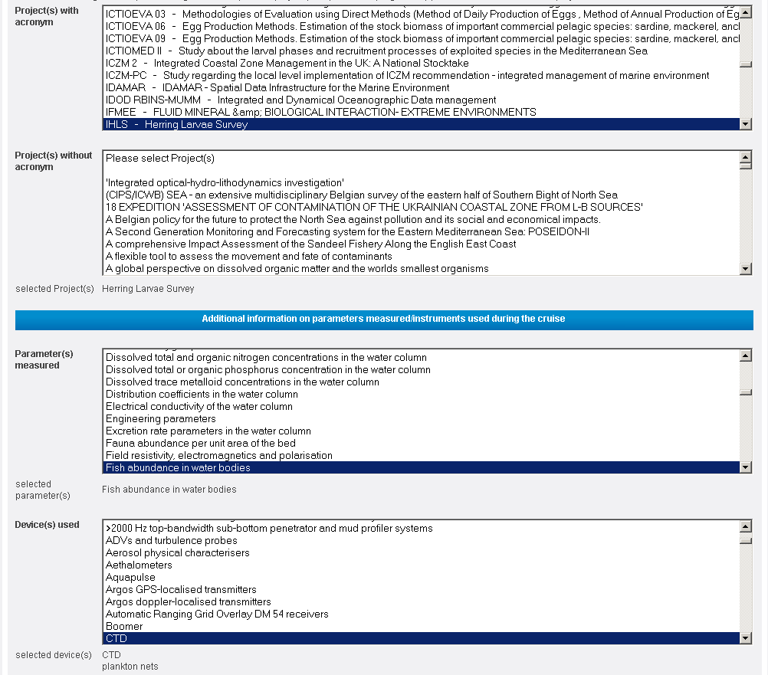
Online Content Management System
CSR Content Management
Additional information
select projects
select parameters
select devices

Slide 17
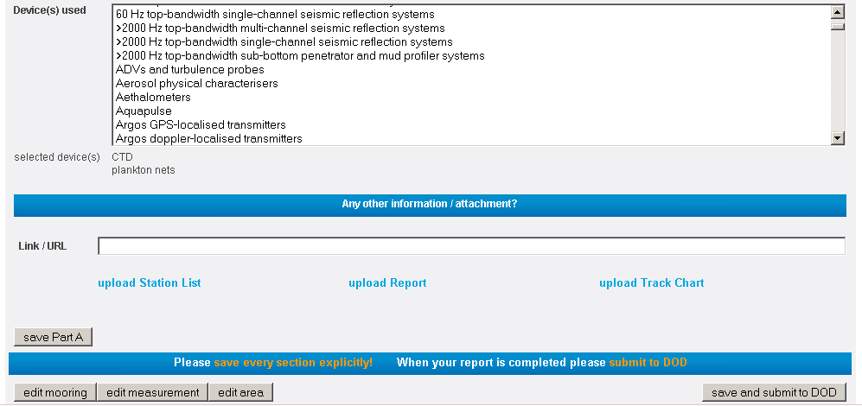
Online Content Management System
More additional information
Link to other relevant website
Track charts, additional reports or station lists

Slide 18
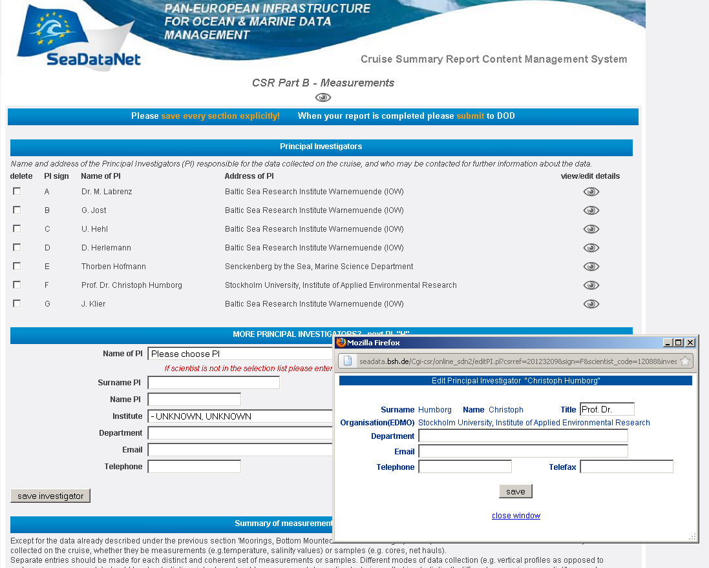
Online Content Management System
Part B - Principal investigators
Adding PIs by selection from list or adding new scientists

Slide 19
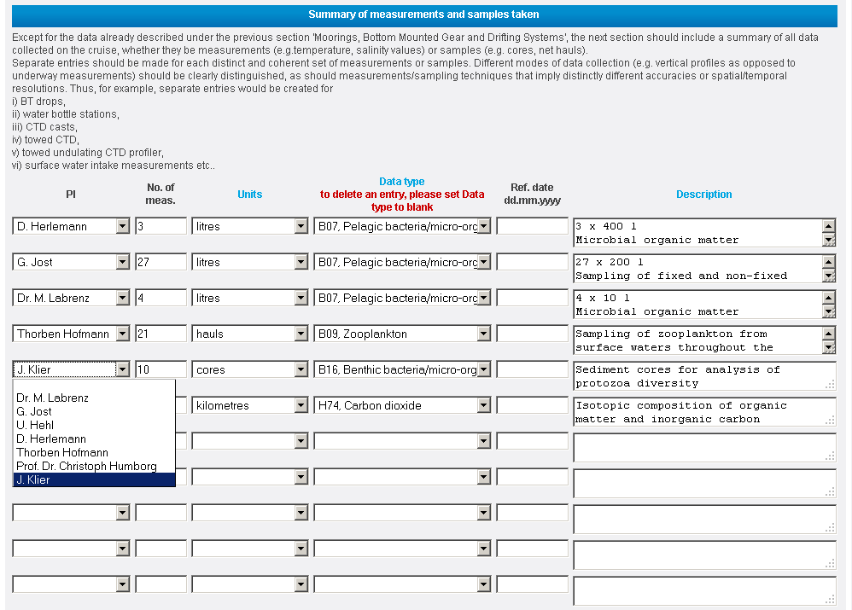
Online Content Management System
Part B - Summary of measurements
select PI from list

Slide 20
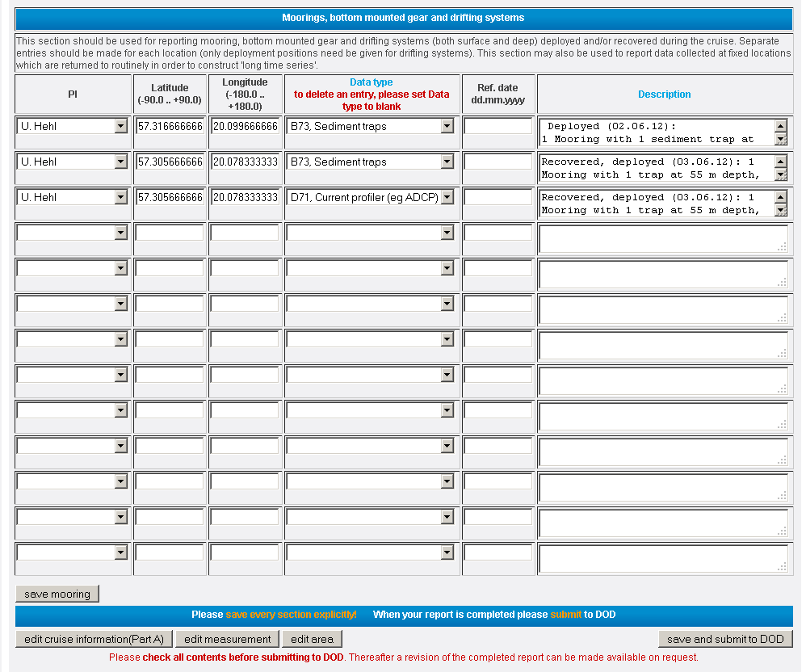
Online Content Management System
Part B - Moorings information
latitude and longitude in decimal degrees

Slide 21
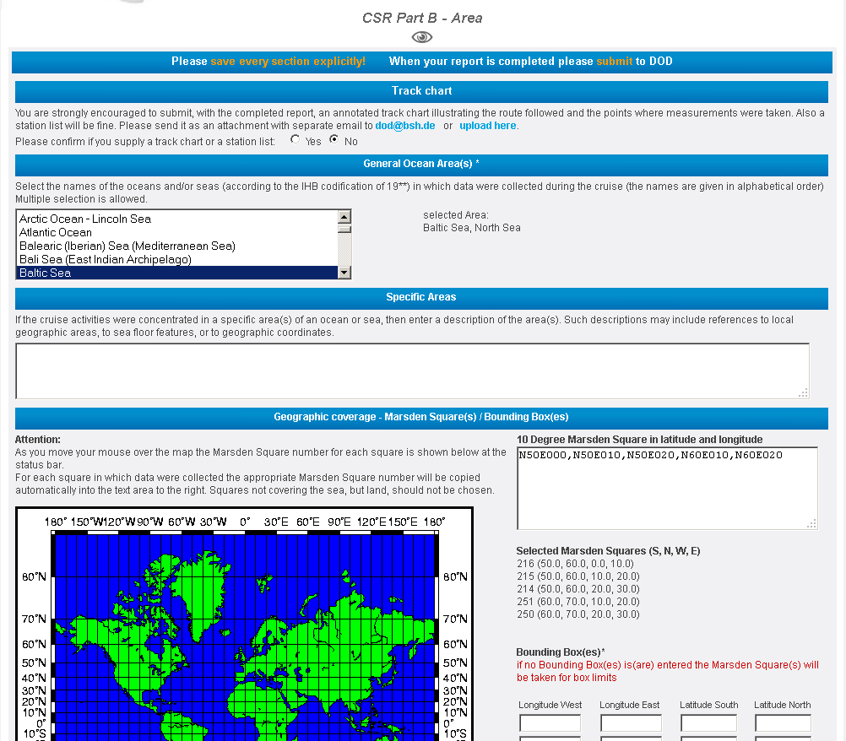
Online Content Management System
Part B - Geographical coverage
multiple selection of IHB area
free text area for specific description
Marsden square and / or bounding box

Slide 22
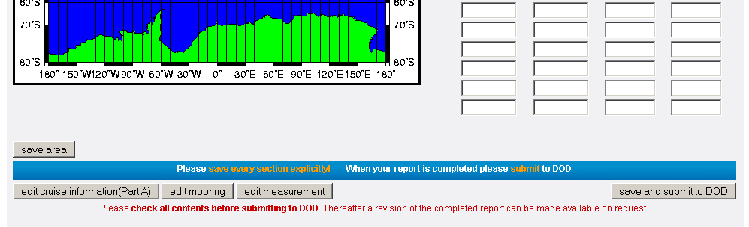
Online Content Management System
Save and submit to BSH-DOD
do not forget to save every section
save and submit when completed

Slide 23
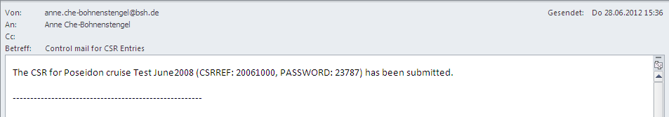
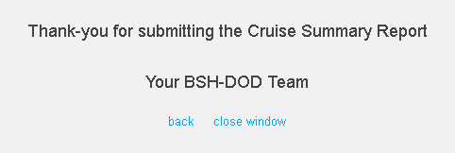
Online Content Management System
on the screen after successful submission
E-mail confirmation after successful submission

Slide 24
Online Content Management System
… or with warning after mandatory fields check
Thank you for submitting the Cruise Summary Report
Please complete the following mandatory field(s):
Cruise Name, Responsible Laboratory, General Ocean Area
Your BSH-DOD Team
Similar warning in the e-mail after submission

Slide 25
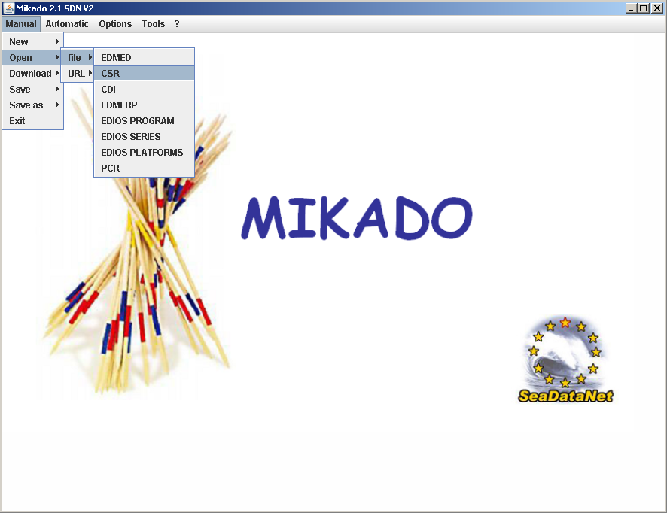
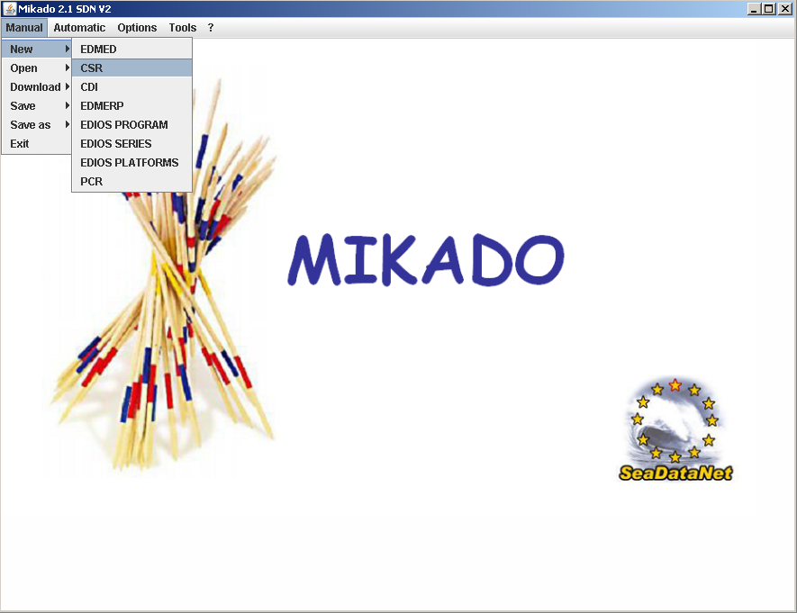
CSR management via Mikado
Manual processing of CSR - create new record or modify existing record

Slide 26
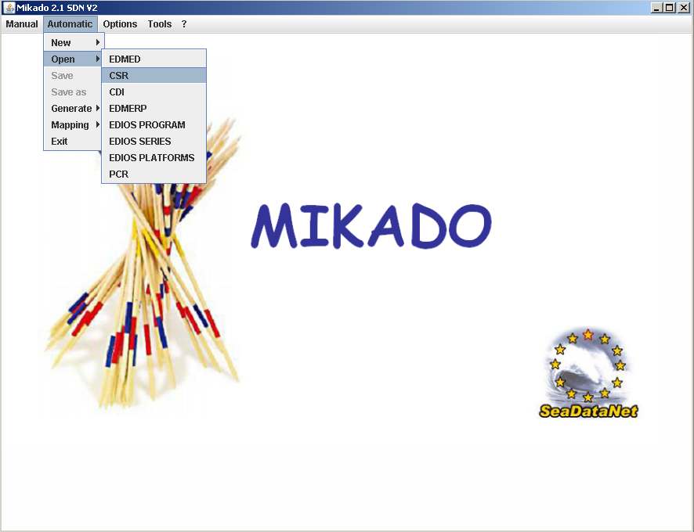
CSR management via Mikado
Automatically generated CSR from e.g. database

Slide 27
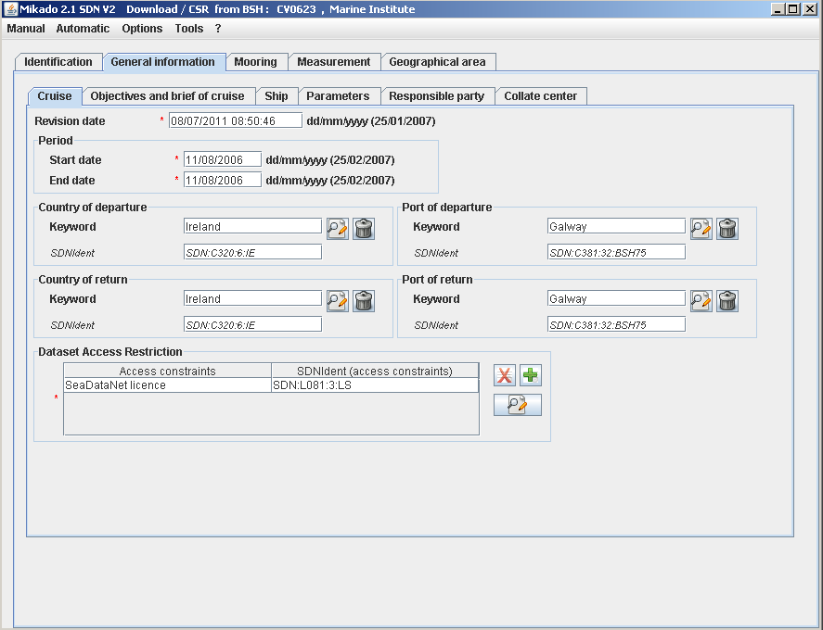
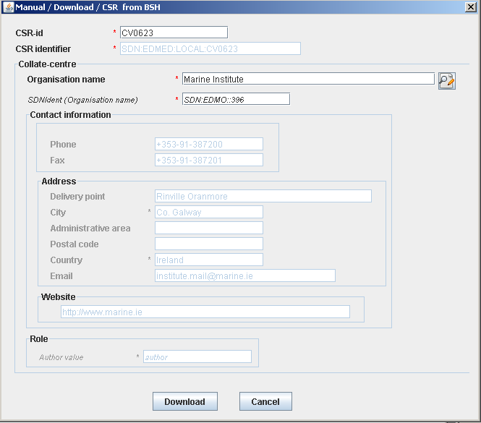
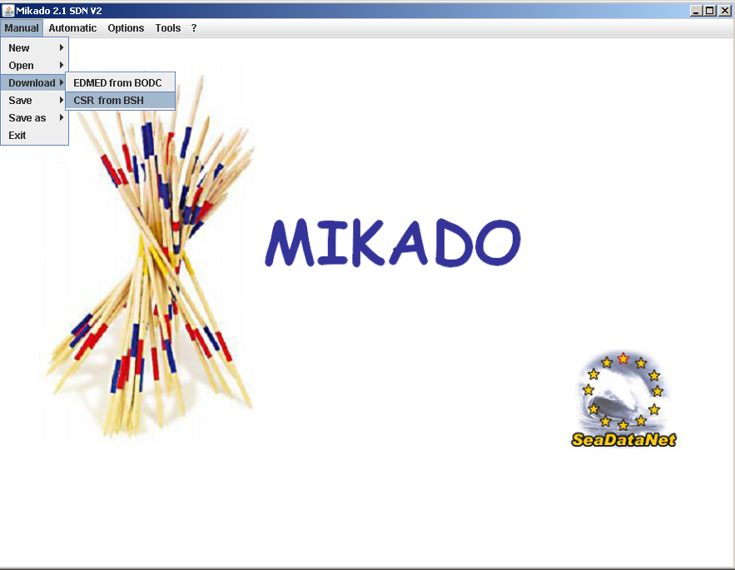
CSR management via Mikado
Update V1 record by fetching contents from BSH via CSR web service

Slide 28
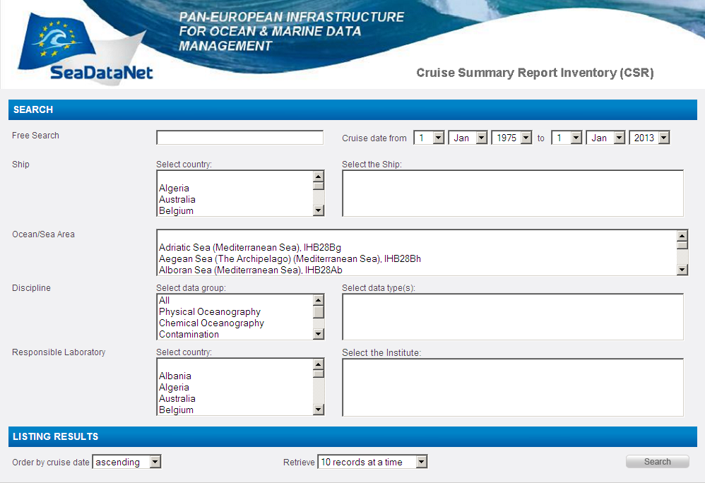
SDN II Look and Feel - CSR User Interface
CSR Content Management

Slide 29
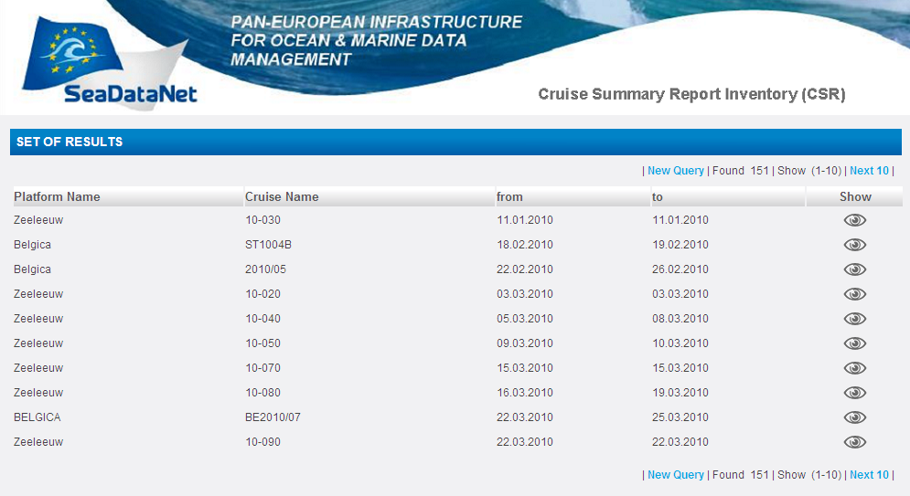
SDN II Look and Feel - CSR Set of Results
CSR Content Management

Slide 30
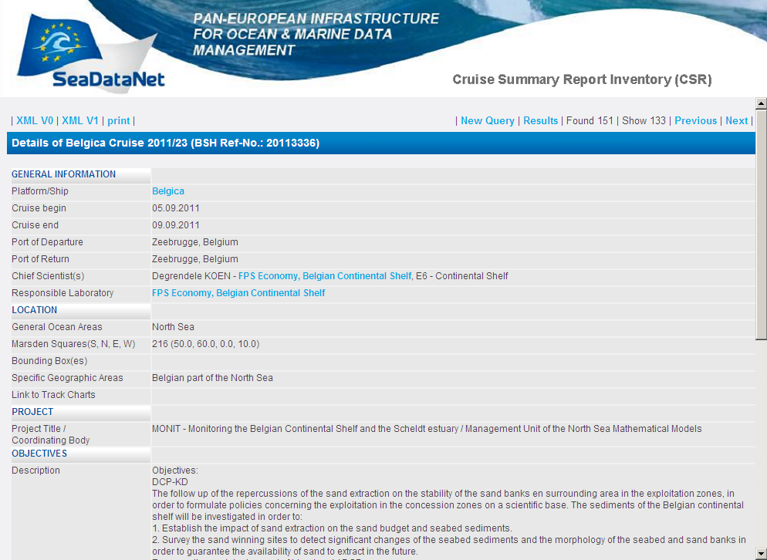
SDN II Look and Feel - Cruise Summary Report
CSR Content Management

Slide 31
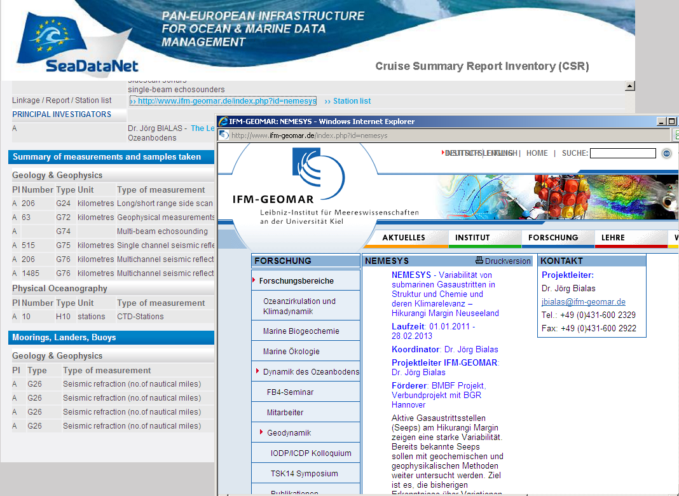
SDN II Look and Feel - Cruise Summary Report
CSR Content Management

Slide 32
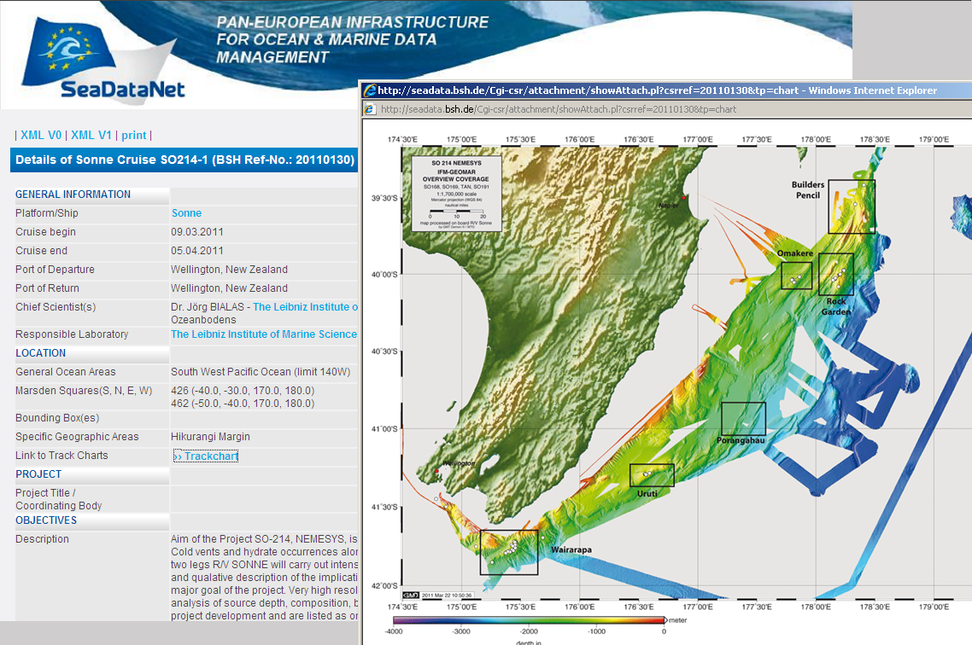
SDN II Look and Feel - Cruise Summary Report
CSR Content Management

Slide 33
CSR Content Management
CSR Online Practical Session
website: http://seadata.bsh.de/csr/online/sdn2_index.html
user: csronline
password: jellyfish
IMPORTANT!
Use a correct e-mail address so that the control mail can be delivered to you
If the entry is just a test report please enter something like “test***” as cruise name or into objectives

Slide 34
CSR Content Management
CSR Online Practical Session
3 Exercises:
create a CSR from a blank form
create a CSR from a previous record
modify a record using the CSR reference number and given password from control e-mail

