Slide 1
SeaDataNet Services monitoring
Angelos Lykiardopoulos
SeaDataNet-2 Training Course
2 - 6 July 2012, Oostende, Belgium

Slide 2
Introduction to Network Monitoring
What is Network Monitoring ?
The term network monitoring describes the use of a system that constantly monitors a computer network for slow or failing components and that notifies the network administrator (via email, SMS or other alarms) in case of outages. It is a subset of the functions involved in network management.

Slide 3
Introduction to Network Monitoring
Advantages of a Network Monitoring System (NMS)
Automatic vs human effort
Real time (near) discovery of malfunctions
Real time (near) notification of responsible persons (admins)
Estimation of frequently appearing problems (from statistics)
Clear picture of the total availabillity of a monitored system (from statistics)

Slide 4
Introduction to Network Monitoring
Main components of a monitoring system
The monitoring software
The monitored devices (hosts)
The monitored services (each host can hold more than one)
The notification (messaging system)
The administrators of hosts and services

Slide 5
Introduction to Network Monitoring
Commonly measured metrics are:
  response time
  availability
  uptime

Slide 6
The SDN case
NMS system selected:
Nagios (http://www.nagios.org)
Objects to be monitored:
SDN services (Central and Download Manager)
Monitoring is based on:
Availability (performance is not measured)

Slide 7
SDN monitoring
It will be monitored indicators, such as:
  Operational availability of data centre sites and portals.
  Around-the-clock system communication between the portal and data centers.
The metrics reports will be published at the extranet and discussed at the Project Coordination Group meetings. Bilateral intervention from the Technical coordinator to individual data centers, requesting for repair / modification, will be triggered by repeated or long-term failure of system nodes.
Also, an overall availability indicator will be calculated for SeaDataNet infrastructure

Slide 8
Network Monitoring Plan
Preparation of the detailed list of monitored services
Fine tuning nagios system to reduce system load
Definition of a SeaDataNet global availability indicator (weights and formula).
HNODC will propose a formula.
Development of the appropriate module to monitor the availability of the Download Manager at Data Centers

Slide 9
Network Monitoring Plan
Extend monitoring to web services and web forms
Development of messaging system to notify the administrators in case of SERVICE DOWN events
Development of “Monitoring Portal”. This will provide information collected from monitoring systems. It will be accessible to SEADATANET services’ administrators.

Slide 10
Description Of Work (DONE)
PHASE I: Monitoring services inventory, existing monitoring services upgrade.
Task a : Development and distribution of the online survey
http://sdnsurvey.ath.hcmr.gr/index.php?sid=72744&newtest=Y&lang=en
Task b : Update of Nagios software, plug-ins and other tools to the latest versions.
PHASE II: Starting up monitoring services with pilot partners
Task a: Testing the monitoring system using pilot services from specific partners.
Task b: Examination and analysis of the first monitoring data
Task c: Extension of monitoring service to all partners
Task d: Compilation of monitoring data to regular reports

Slide 11
A brief tour to monitoring sites
The nagios site:
http://netmon4.ath.hcmr.gr/nagios
The nagvis site:
http://netmon4.ath.hcmr.gr/nagvis

Slide 12
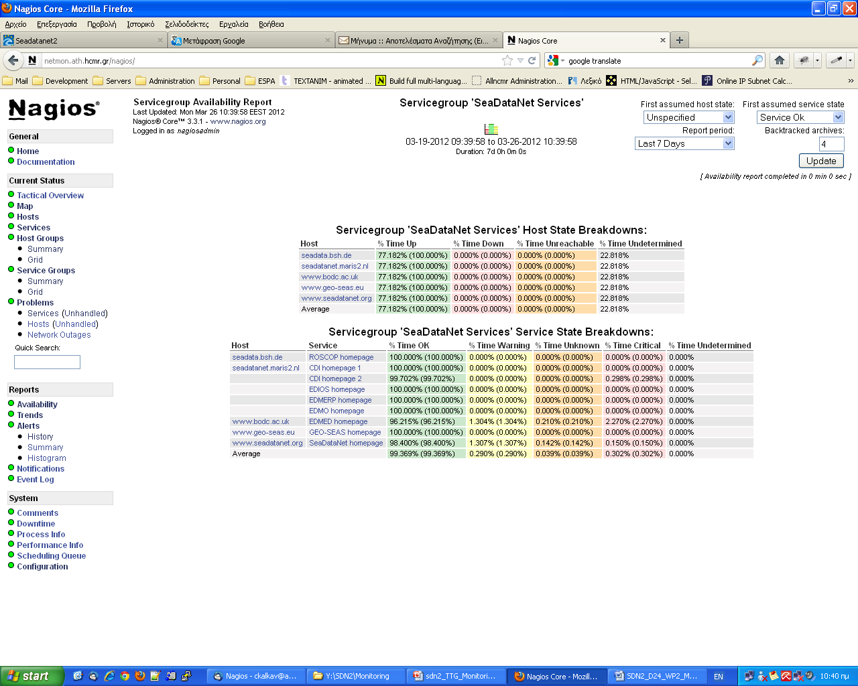
SeaDataNet Services Availability

Slide 13
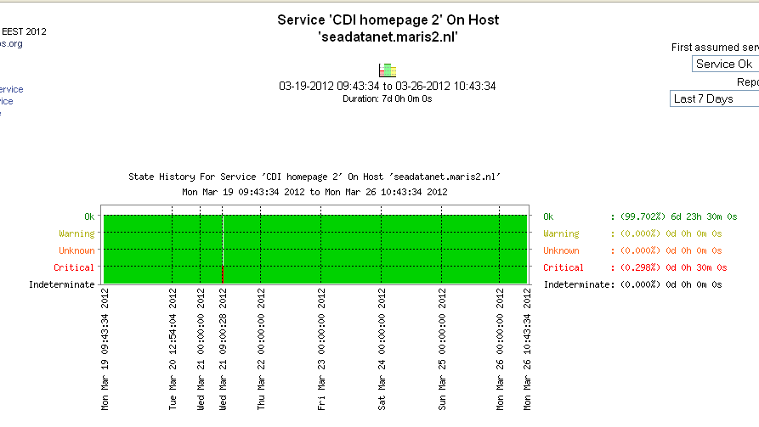
Trend about CDI (Extended Search)

Slide 14
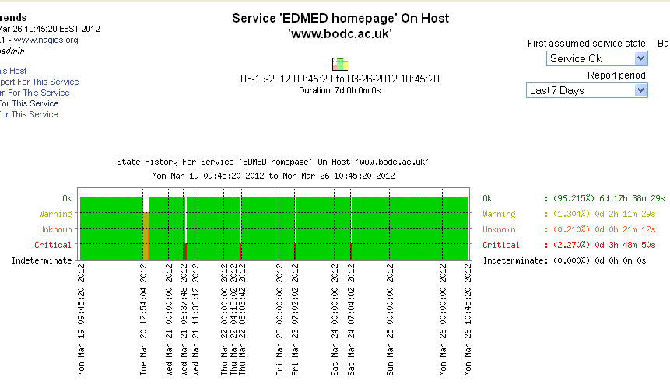
Trend about EDMED

Slide 15

Thank you!

